Slide 1
Architecture
Mira Balaban and Arnon Sturm
Object-Oriented Analysis and Design

Slide 2
5. Packages
Mira Balaban and Arnon Sturm
Object-Oriented Analysis and Design

Slide 3
Packages
A package is a group of elements – classes, associations, generalizations, aggregations, packages – with a common theme.
  Unique name restrictions – only within a package.
  Low coupling criterion suggests minimization of associations across package boundaries.
  A class is defined in a single package.
  A package can contain model elements of different kinds.
  In particular, there can be a containment hierarchy of nested packages.
  A package defines a namespace for its contents.
Mira Balaban and Arnon Sturm
Object-Oriented Analysis and Design

Slide 4
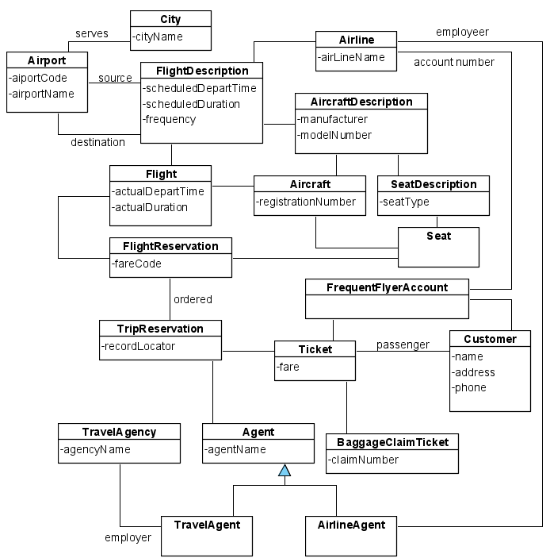
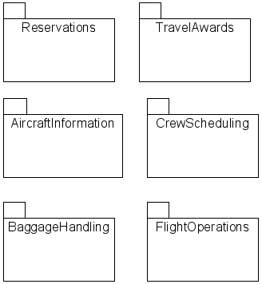
Packages
Possible packages in the airline information system:
Mira Balaban and Arnon Sturm
Object-Oriented Analysis and Design

Slide 5
Package Diagrams
Describe dependency among packages.
The dependency relationship means:
  Changes in the “server” package imply changes within the dependent (client) package.
There is a generalization structure among packages.
Mira Balaban and Arnon Sturm
Object-Oriented Analysis and Design

Slide 6
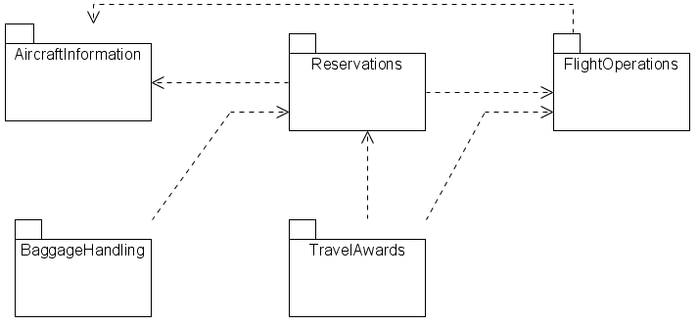
Package Diagrams
On the design stage :
On the analysis stage packages might be connected by two way dependencies
Mira Balaban and Arnon Sturm
Object-Oriented Analysis and Design

Slide 7
When to use packages
To create an overview of a large set of model elements.
To organize a large model.
To group related elements.
To separate namespaces.
Mira Balaban and Arnon Sturm
Object-Oriented Analysis and Design

Slide 8
6. Implementation Diagrams
Mira Balaban and Arnon Sturm
Object-Oriented Analysis and Design

Slide 9
Implementation Diagrams
Show aspects of model implementation, including source code structure and run-time implementation structure.
Types :
  Component diagram
  Deployment diagram
Mira Balaban and Arnon Sturm
Object-Oriented Analysis and Design

Slide 10
Component Diagram
Shows the organizations and dependencies among (logical) software components.
Components include:
  Source code components.
  Binary code components.
  Executable components.
Mira Balaban and Arnon Sturm
Object-Oriented Analysis and Design

Slide 11
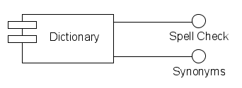
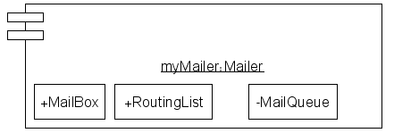
Components
Mira Balaban and Arnon Sturm
Object-Oriented Analysis and Design

Slide 12
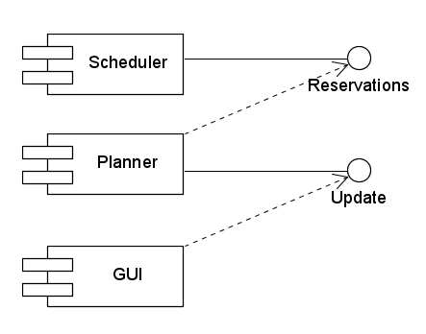
Component Diagram
Mira Balaban and Arnon Sturm
Object-Oriented Analysis and Design

Slide 13
Deployment Diagram - 1
Shows the configuration of run-time processing elements and the software components, processes and objects that live on them.
Deployment diagrams is used to show which components may run on which nodes.
Mira Balaban and Arnon Sturm
Object-Oriented Analysis and Design

Slide 14
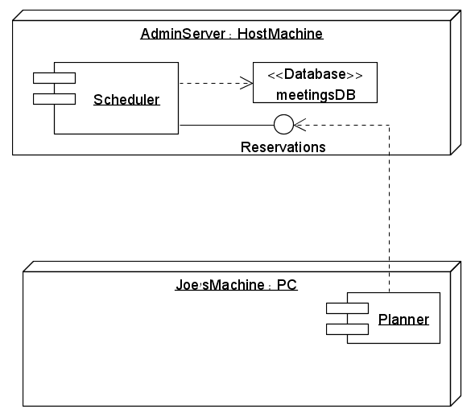
Deployment Diagram - 2
Mira Balaban and Arnon Sturm
Object-Oriented Analysis and Design

Slide 15
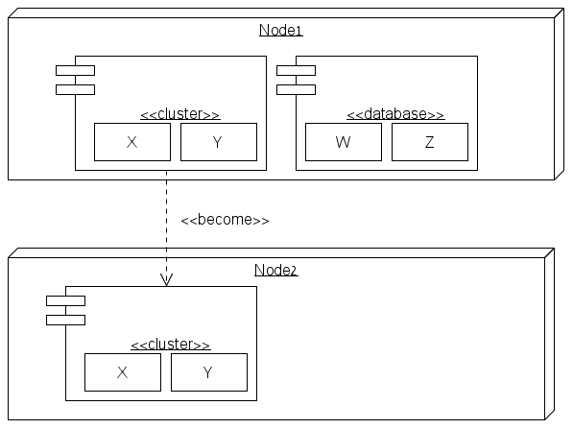
Deployment Diagram - 3
Mira Balaban and Arnon Sturm
Object-Oriented Analysis and Design

Slide 16
7. Architecture
Mira Balaban and Arnon Sturm
Object-Oriented Analysis and Design

Slide 17
Logical architecture
Logical architecture: Large-scale organization of the software classes into
  packages (or namespaces)
  subsystems
  layers
Distinct from “deployment architecture”
  No decision about how the elements are deployed
    to different OS processes
    across physical computers in a network
A layer: A coarse-grained grouping of classes, packages or subsystems that together have responsibility for one major aspect of a system
Examples of layers:
  UI layer
  Application logic and domain objects layer
  Technical services (interfacing with a database, error logging)
    Typically application-independent and reusable

Slide 18
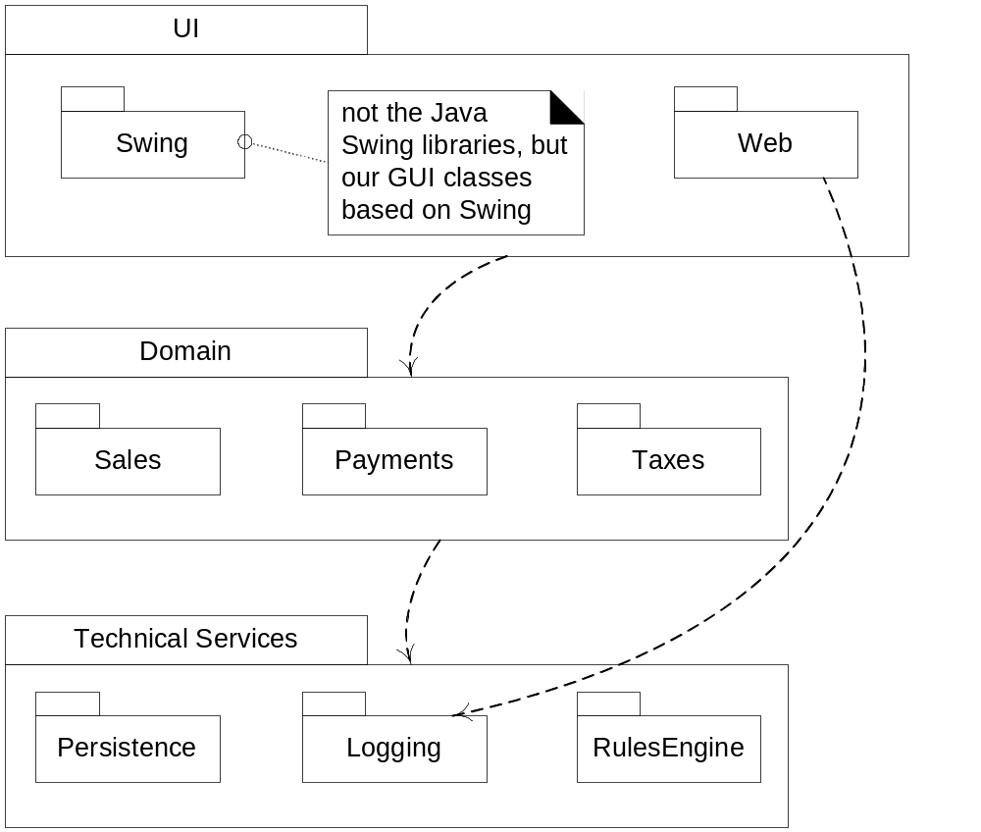
Logical architecture

Slide 19
Architecture
Strict layered architecture: Each layer only calls upon services of the layer directly below it.
  Common in network protocol stacks
  Not so common in information systems
You do NOT have to use a layered architecture
  But it is very common to do so
What is architecture then?
  The set of significant decisions about
    the organization of a software system
      hieararchical composition of smaller subsystems to progressively larger subsystems
      the selection of structural elements and interfaces
    the style that guides this organization
Architecture: Related to large scale, not implementation details.

Slide 20
UML Package Diagrams
UML Package Diagrams:
  Used to illustrate the logical architecture of a system
    Layers, subsystems, Java packages
  Provides a way to group elements
    Different from (more general than) a Java package
    Can group anything
      Classes, other packages, diagrams, use cases, …
    Nesting packages is very common

Slide 21
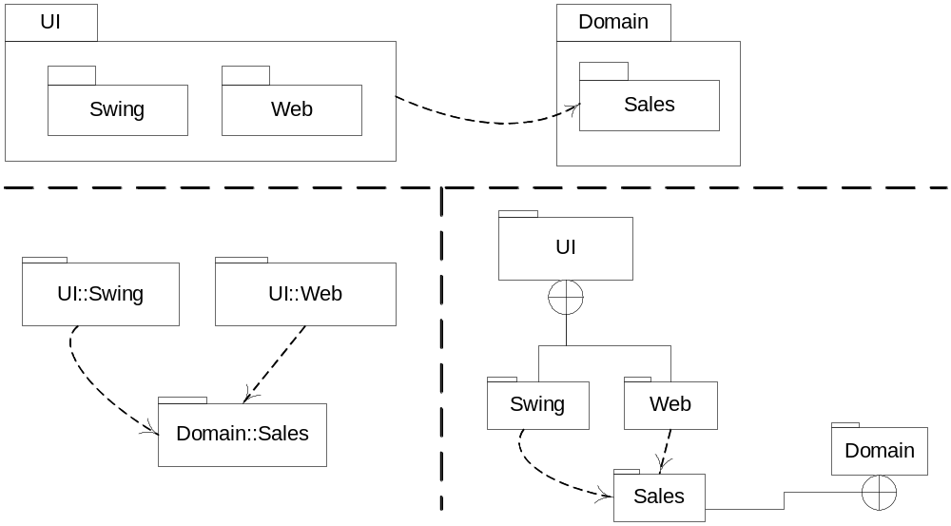
Alternative UML Package Diagram Notations

Slide 22
UML Packages
A package represents a “namespace”
  Example: A Date class can be defined in two packages
    Fully qualified names: java::util::Date

Slide 23
Layers: Why?
Two key architectural principles
  Separation of concerns
  Maintaining high cohesion
Separation of concerns:
  Discrete layers of distinct, related responsibilities
  Clean cohesive separation of duties:
    Lower layers: Low-level, general services
    Higher layers: More application-specific services
  Easier to define boundaries for different developers
Collaboration and coupling from higher to lower layers

Slide 24
Layers: Why? (continued)
Limiting dependencies between subsystems:
  Source code changes ripple throughout the system if many parts are tightly coupled
  Example: If application logic is intertwined with UI,
    it cannot be distributed to another physical node
    It cannot be used with a different UI
General technical services and business logic can be re-used, replaced or moved to another physical node

Slide 25
Some more issues, terms
What if the organization of code into packages changes later on?
  Follow a good package naming convention
  Use CASE tools to reverse-engineer code into UML packages
What is a tier?
  Originally, it meant a logical layer
  Common usage today: Physical processing node (or cluster of nodes)
What is a partition?
  Division into relatively parallel subsystems for a layer

Slide 26
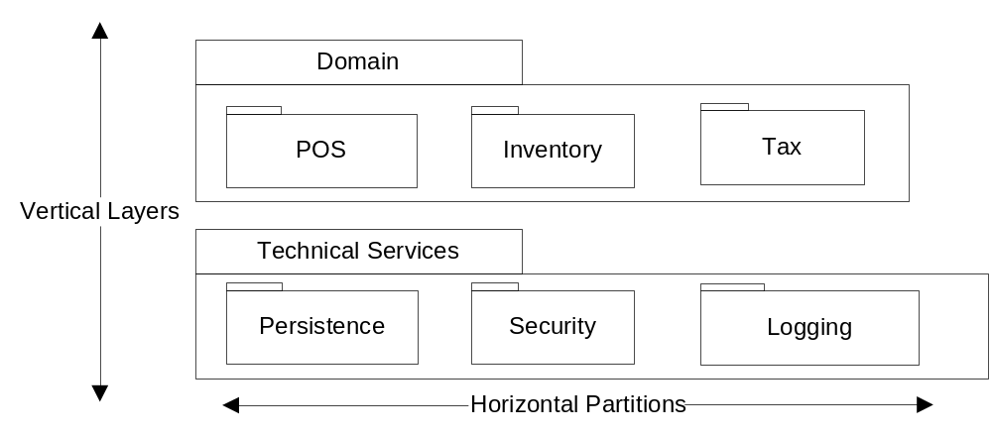
Layers vs. Partitions

Slide 27
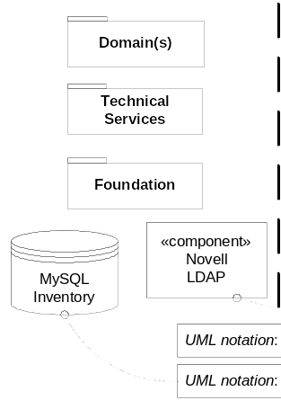

Slide 28
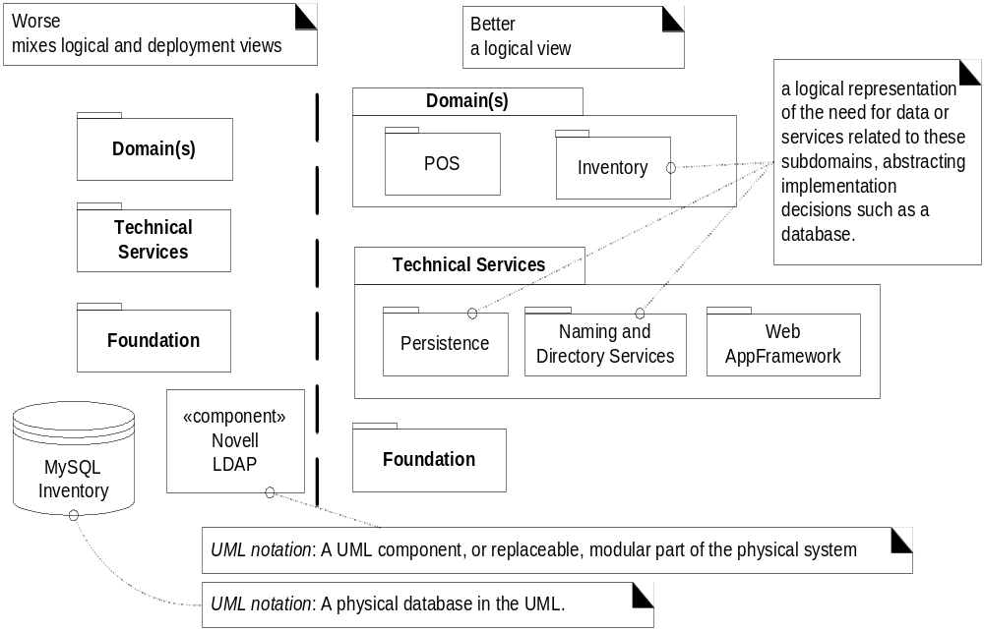
Don’t mix physical implementation components and logical architecture components

Slide 29
The Model-View Separation Principle
Model-view separation:
  Do not put application logic (such as tax calculation code) in the UI objects
    UI objects should only
      initialize UI elements,
      receive UI events (mouse click, etc.)
      delegate requests for application logic on to non-UI objects
  Do not connect non-UI objects to UI objects
  Example: a Sale object should not have a reference to a JFrame window object
    Why not?
    What if we want to use the application logic with different windows or multiple views?

Slide 30
What if domain objects need to notify the UI?
A relaxation of the model-view principle: the Observer pattern
  Domain objects send messages to UI objects viewed only in terms of an interface
  Example: PropertyListener interface
    Domain object is aware of existence of object implementing PropertyListener
      But not of particular object
    Notification happens using interface methods

Slide 31
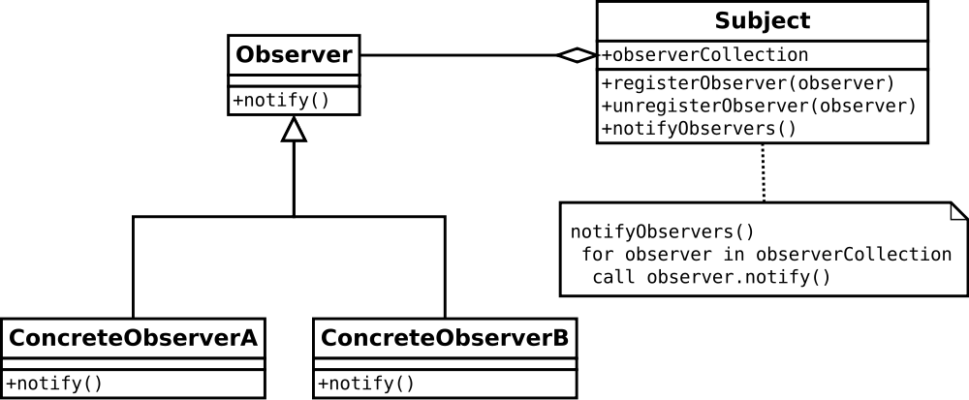
Observer pattern
Mira Balaban and Arnon Sturm
Object-Oriented Analysis and Design

Slide 32
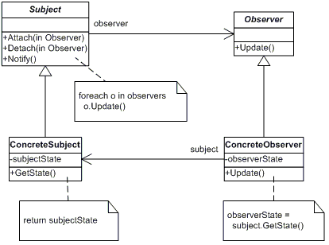
Observer pattern (cont)
Mira Balaban and Arnon Sturm
Object-Oriented Analysis and Design

Slide 33
Motivation for the model-view principle
Domain objects focus on domain processes
  Not on user interfaces
Domain objects and UI can be developed separately
Effect of requirements changes in one component to the other one minimized
New views (UIs) connected to existing domain layer
Multiple simultaneous views (e.g. a GUI and a text-based interface) on the same model object
Domain layer operable without needing UI layer to be on
Basically, modularity.

Slide 34
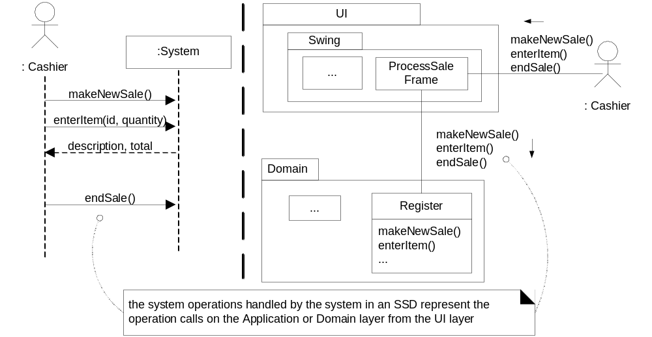
Relationship between System Sequence Diagrams
System Operations and Layers
Messages on SSDs: Messages sent from UI layer to the domain layer

Slide 35
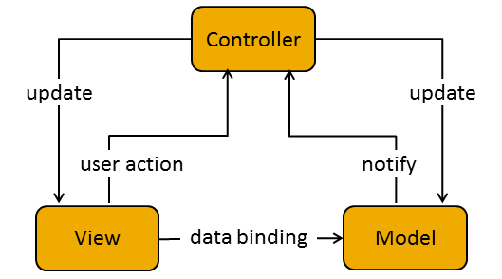
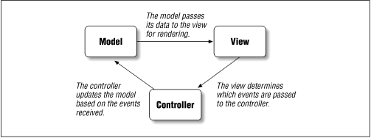
Model-view-controller
Mira Balaban and Arnon Sturm
Object-Oriented Analysis and Design

Slide 36
Model-view-adapter
Mira Balaban and Arnon Sturm
Object-Oriented Analysis and Design

Slide 37
Model-view-presenter
Mira Balaban and Arnon Sturm
Object-Oriented Analysis and Design

Slide 38
Design Steps
Step 1 – Choose Your Layering Strategy
Step 2 – Determine the Layers You Require
Step 3 – Decide How to Distribute Layers and Components
Step 4 – Determine If You Need to Collapse Layers
Step 5 – Determine Rules for Interaction between Layers
Step 6 – Identify Cross Cutting Concerns
Step 7 – Define the Interfaces between Layers
Step 8 – Choose Your Deployment Strategy
Step 9 – Choose Communication Protocols
Microsoft Application Architecture, Design Fundamentals, Chapters 5-9, 19
https://msdn.microsoft.com/en-us/library/ee658116.aspx
Mira Balaban and Arnon Sturm
Object-Oriented Analysis and Design

Slide 39
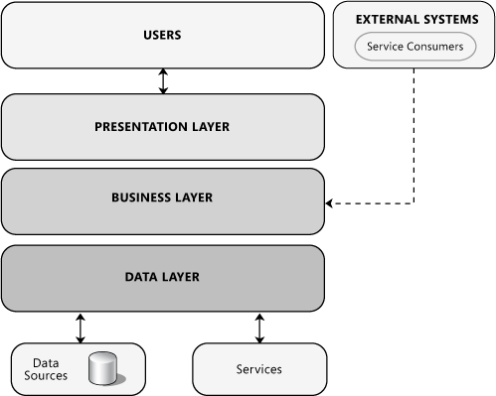
Common Layering
Microsoft Application Architecture, Design Fundamentals, Chapters 5-9, 19 https://msdn.microsoft.com/en-us/library/ee658116.aspx
Mira Balaban and Arnon Sturm
Object-Oriented Analysis and Design
Notes:
Presentation layer. This layer contains the user oriented functionality responsible for managing user interaction with the system, and generally consists of components that provide a common bridge into the core business logic encapsulated in the business layer. For more information about designing the presentation layer, see Chapter 6 "Presentation Layer Guidelines." For more information about designing presentation components, see Chapter 11 "Designing Presentation Components."
Business layer. This layer implements the core functionality of the system, and encapsulates the relevant business logic. It generally consists of components, some of which may expose service interfaces that other callers can use. For more information about designing the business layer, see Chapter 7 "Business Layer Guidelines." For more information about designing business components, see Chapter 12 "Designing Business Components."
Data layer. This layer provides access to data hosted within the boundaries of the system, and data exposed by other networked systems; perhaps accessed through services. The data layer exposes generic interfaces that the components in the business layer can consume. For more information about designing the data layer, see Chapter 8 "Data Layer Guidelines." For more information about designing data components, see Chapter 15 "Designing Data Components."

Slide 40
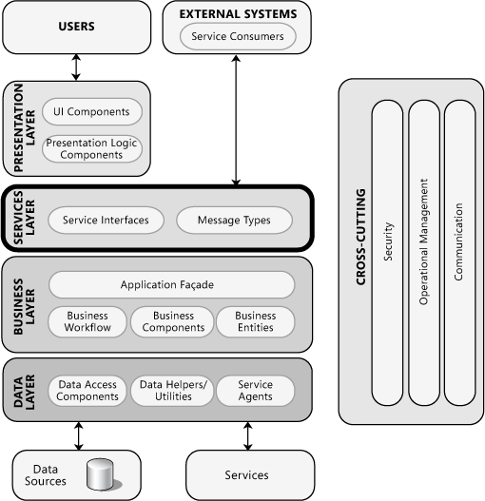
Service Based Applications
provide services to other applications,
implement features to support clients directly
expose the business functionality of the application
Microsoft Application Architecture, Design Fundamentals, Chapters 5-9, 19 https://msdn.microsoft.com/en-us/library/ee658116.aspx
Mira Balaban and Arnon Sturm
Object-Oriented Analysis and Design

Slide 41
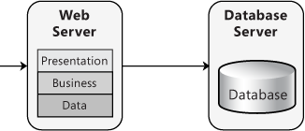
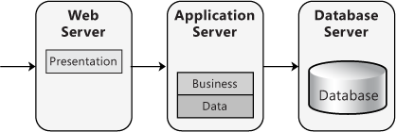
Physical Tiers and Deployment
Non-distributed Deployment
Distributed Deployment
Java Servlets and JavaServer Pages
ASP.NET, COM+,
PHP applications
Microsoft Application Architecture, Design Fundamentals, Chapters 5-9, 19 https://msdn.microsoft.com/en-us/library/ee658116.aspx
Mira Balaban and Arnon Sturm
Object-Oriented Analysis and Design

Slide 42
Performance and Design Considerations
When layers communicate across physical boundaries,
How you will manage state across tiers?
  Stateless – the state will be provided as a parameter to a call
    More scalable
    Harder to design
  Stateful – State will be stored or recovered for each client request
    require more resources
    more convenient for client
Client
Call(…)
Provider
Microsoft Application Architecture, Design Fundamentals, Chapters 5-9, 19 https://msdn.microsoft.com/en-us/library/ee658116.aspx
Mira Balaban and Arnon Sturm
Object-Oriented Analysis and Design

Slide 43
Performance and Design Considerations
Communication between layers
  asynchronous calls,
  one-way calls,
  message queuing
Rely on operating system services to the extent possible
  E.g. authentication
Simplest possible interfaces with robust / flexible signature
  Changing signatures of function calls between tiers is expensive
Separate long-running critical processes from other processes that may fail
  Use different process / hardware to run critical and non-critical (and therefore less-validated) software
Microsoft Application Architecture, Design Fundamentals, Chapters 5-9, 19 https://msdn.microsoft.com/en-us/library/ee658116.aspx
Mira Balaban and Arnon Sturm
Object-Oriented Analysis and Design

Slide 44
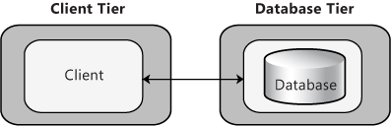
2-Tier Deployment
Microsoft Application Architecture, Design Fundamentals, Chapters 5-9, 19 https://msdn.microsoft.com/en-us/library/ee658116.aspx
Mira Balaban and Arnon Sturm
Object-Oriented Analysis and Design

Slide 45
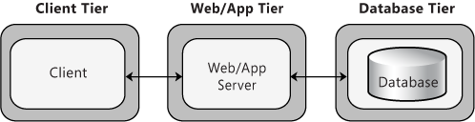
3-Tier Deployment
Microsoft Application Architecture, Design Fundamentals, Chapters 5-9, 19 https://msdn.microsoft.com/en-us/library/ee658116.aspx
Mira Balaban and Arnon Sturm
Object-Oriented Analysis and Design

Slide 46
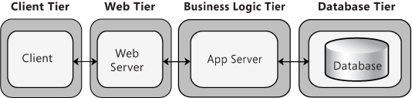
4-Tier Deployment
Microsoft Application Architecture, Design Fundamentals, Chapters 5-9, 19 https://msdn.microsoft.com/en-us/library/ee658116.aspx
Mira Balaban and Arnon Sturm
Object-Oriented Analysis and Design

Slide 47
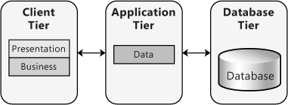
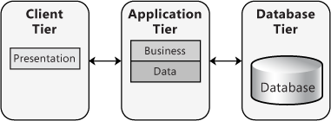
Rich Client Application Deployment
Microsoft Application Architecture, Design Fundamentals, Chapters 5-9, 19 https://msdn.microsoft.com/en-us/library/ee658116.aspx
Mira Balaban and Arnon Sturm
Object-Oriented Analysis and Design

Slide 48
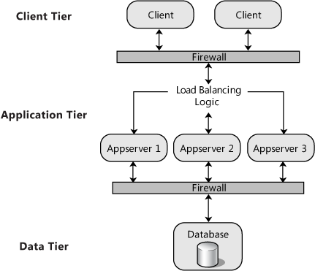
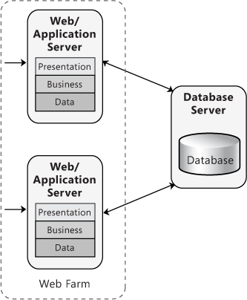
Load-balanced Cluster
Microsoft Application Architecture, Design Fundamentals, Chapters 5-9, 19 https://msdn.microsoft.com/en-us/library/ee658116.aspx
Mira Balaban and Arnon Sturm
Object-Oriented Analysis and Design

Slide 49
Service Based Applications
provide services to other applications,
implement features to support clients directly
expose the business functionality of the application
Microsoft Application Architecture, Design Fundamentals, Chapters 5-9, 19 https://msdn.microsoft.com/en-us/library/ee658116.aspx
Mira Balaban and Arnon Sturm
Object-Oriented Analysis and Design

Slide 50
Presentation Layer Guidelines
Choose the appropriate application type.
  rich (smart) client, thin client, a Web client,
Choose the appropriate UI technology.
  ASP.NET, Silverlight, HTML5, SWING
Use the relevant patterns.
Design for separation of concerns.
  Use dedicated UI components for e.g. rendering, display, and user interaction; for business logic and data
Consider human interface guidelines.
  Implement your organization's guidelines
  accessibility, localization, and usability
Adhere to user driven design principles.
  understand your customer through surveys, usability studies, and interviews
Microsoft Application Architecture, Design Fundamentals, Chapters 5-9, 19 https://msdn.microsoft.com/en-us/library/ee658116.aspx
Mira Balaban and Arnon Sturm
Object-Oriented Analysis and Design
Notes:
Observer, Lightweight,

Slide 51
Business Layer Guidelines
Decide if you need a separate business layer.
  use a separate business layer where possible with the exception of applications that have few or no business rules (other than data validation).
Identify the responsibilities and consumers of your business layer.
  what tasks the business layer must accomplish?
  processing business rules, transforming data, applying policies, validation.
  if business layer will be used by your presentation layer and by an external application, you may choose to expose your business layer through a service.
Do not mix different types of components in your business layer.
  avoid mixing presentation and data access code with business logic code
Reduce round trips when accessing a remote business layer.
  If the business layer is on a separate physical tier from layers and clients with which it must interact, consider implementing a message-based remote application façade or service layer that combines fine-grained operations into a smaller number of coarse-grained operations.
Avoid tight coupling between layers.
Microsoft Application Architecture, Design Fundamentals, Chapters 5-9, 19 https://msdn.microsoft.com/en-us/library/ee658116.aspx
Mira Balaban and Arnon Sturm
Object-Oriented Analysis and Design

Slide 52
Data Layer Guidelines
Choose an appropriate data access technology.
  ADO.NET, Hibernate, …
Decide how to map application entities to data source structures.
  e.g. Object/Relational Mapping (O/RM)
Decide how you will manage connections.
  create and manage all connections to all data sources
  store and protect connection information (server addresses, passwords)
Determine how you will handle data exceptions.
  catch and (at least initially) handle all exceptions associated with data sources and CRUD (Create, Read, Update, and Delete) operations.
Consider security risks.
Reduce round trips by batching commands.
Consider performance and scalability objectives.
Microsoft Application Architecture, Design Fundamentals, Chapters 5-9, 19 https://msdn.microsoft.com/en-us/library/ee658116.aspx
Mira Balaban and Arnon Sturm
Object-Oriented Analysis and Design

Slide 53
Service Layer Guidelines
Design services to be application-scoped and not component-scoped.
  fine grained service operations can result in performance problems.
  ensure that the services do not return very large volumes of data (paging)
Design services and data contracts for extensibility and without the assumption that on who the client is or how will he use the service
Design only for the service contract.
  internal implementation and details of a service should never be exposed to external consumers.
  if you need to change the service contract to include new functionality which is not backward compatible with the existing contracts, define new operations exposed by the service in a new version of a service contract.
Separate service layer concerns from infrastructure concerns.
  Code to manage crosscutting concerns should not be combined with service logic code within the service layer.
Microsoft Application Architecture, Design Fundamentals, Chapters 5-9, 19 https://msdn.microsoft.com/en-us/library/ee658116.aspx
Mira Balaban and Arnon Sturm
Object-Oriented Analysis and Design

Slide 54
Service Layer Guidelines
Compose entities from standard elements.
  When possible, use standard elements to compose the complex types and data transfer objects used by your service.
Design to assume the possibility of invalid requests.
  Implement validation logic to check all input based on value, range, and type; and reject or sanitize all invalid data.
Ensure that the service can detect and manage repeated messages (idempotency).
  When designing the service, implement well-known patterns such as Idempotent Receiver and Replay Protection to ensure that duplicate messages are not processed, or that repeated processing has no effect on the result.
Ensure that the service can manage messages arriving out of order (commutativity).
  If it is possible that messages will arrive out of order, implement a design that will store messages and then process them in the correct order.
Microsoft Application Architecture, Design Fundamentals, Chapters 5-9, 19 https://msdn.microsoft.com/en-us/library/ee658116.aspx
Mira Balaban and Arnon Sturm
Object-Oriented Analysis and Design

Slide 55
Blackboard Architecture
Shared Data Repository Model
The Balckboard
  All shared data is held in a central database that can be accessed by all subsystems.
  Entire state of the system
  The only means by which system components interact with eachother
Knowledge source
  Computations are performed by separate independent components
  Encapsulates the domain knowledge
  Interacts with external entities
Control
  Knowledge sources respond to changes in the blackboard
Mira Balaban and Arnon Sturm
Object-Oriented Analysis and Design

Slide 56
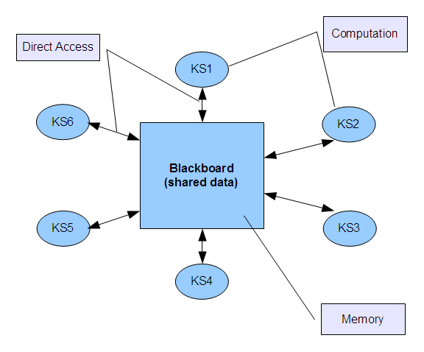
Blackboard Architecture
Mira Balaban and Arnon Sturm
Object-Oriented Analysis and Design

Slide 57
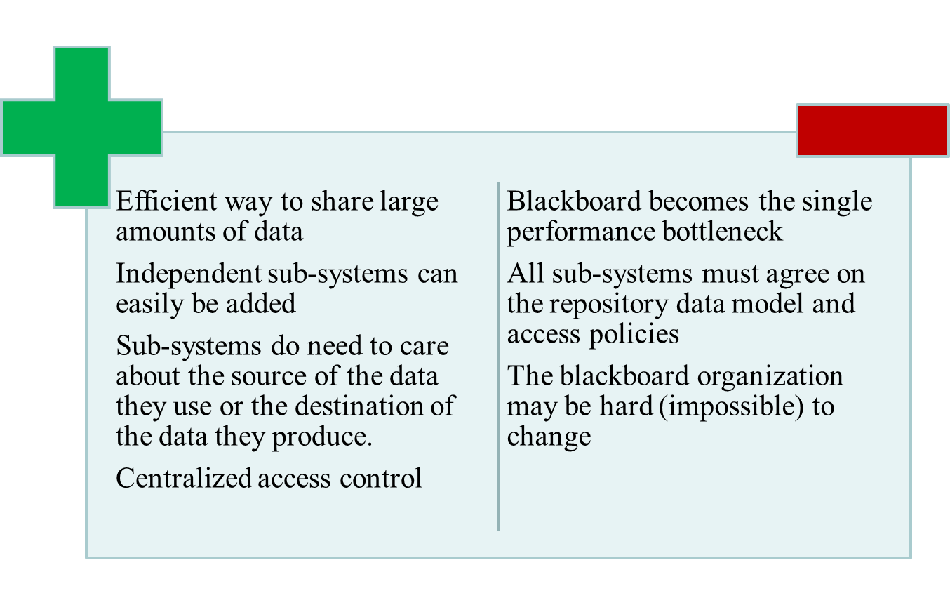
Blackboard Architecture
Mira Balaban and Arnon Sturm
Object-Oriented Analysis and Design
Notes:
It is an efficient way to share large amounts of data. There is no need to transmit data explicitly from one sub-system to another.
However, sub-systems must agree on the repository data model. Inevitably, this is a compromise between the specific needs of each tool. Performance may be adversely affected by this compromise. It may be difficult or impossible to integrate new sub-systems if their data models do not fit the agreed schema.
Sub-systems that produce data need not be concerned with how that data is used by other sub-systems.
However, evolution may be difficult as a large volume of information is generated according to an agreed data model. Translating this to a new model will certainly be expensive; it may be difficult or even impossible.
Activities such as backup, security, access control and recovery from error are centralized. They are the responsibility of the repository manager. Tools can focus on their principal function rather than be concerned with these issues.
However, different sub-systems may have different requirements for security, recovery and backup policies. The repository model forces the same policy on all sub-systems.
The model of sharing is visible through the repository schema. It is straightforward to integrate new tools given that they are compatible with the agreed data model.
However, it may be difficult to distribute the repository over a number of machines. Although it is possible to distribute a logically centralized repository, there may be problems with data redundancy and inconsistency.

Slide 58
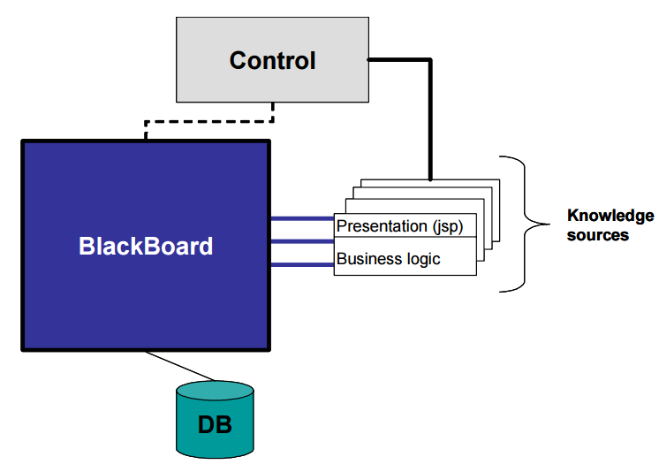
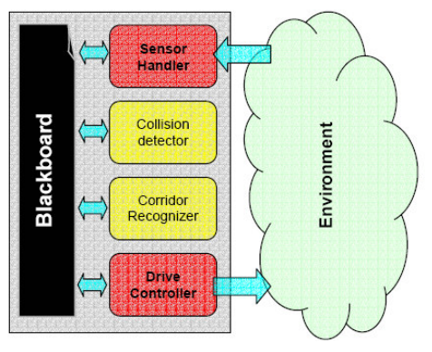
Examples of Balckboard applications
A mobile robot for corridor navigation: a multi-agent approach
ONO Y., Uchiyama H., Potter W., ACM Southeast Regional Conference Proceedings of the 42nd annual Southeast regional conference SESSION: Artificial intelligence #1, 2004, pp. 379 – 384.
Using a Blackboard Architecture in a Web Application
Metzner, Christlane, Leonardo Cortez, and Doritza Chacín, Informing Science: International Journal of an Emerging Transdiscipline 2 (2005): 747-755.‏
Mira Balaban and Arnon Sturm
Object-Oriented Analysis and Design

Slide 59
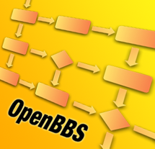
A toolkit for writing Blackboard systems
Open BlackBoard System:
Architecture for your Workflows
Mira Balaban and Arnon Sturm
Object-Oriented Analysis and Design

Slide 60
Pipes and Filters
A pipe is a message queue.
A message can be anything.
A filter is a function / component that
  reads messages from an input pipe,
  processes each message,
  writes the result to an output pipe.
Pipe / data flow
Filter
Filter
Filter
Computation
Mira Balaban and Arnon Sturm
Object-Oriented Analysis and Design

Slide 61

Pipes and Filters
Filters maintain little to no state between activations.
Pipes move data between filters
A pipeline system executes pipes and filters until no more computation need to be performed
Filters have no direct dependencies between them
Filters depend on Pipes and on the Data Model objects
Toy example: sum the squares of odd integers
Mira Balaban and Arnon Sturm
Object-Oriented Analysis and Design

Slide 62
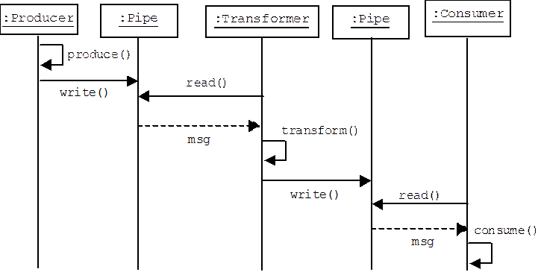
Pipes and Filters: control flow
Data-Driven
Mira Balaban and Arnon Sturm
Object-Oriented Analysis and Design

Slide 63
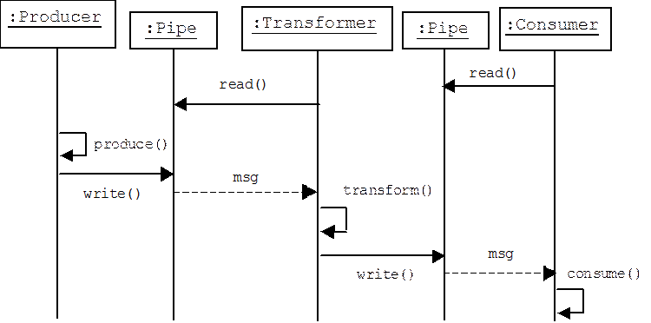
Pipes and Filters: control flow
Demand-Driven
Mira Balaban and Arnon Sturm
Object-Oriented Analysis and Design

Slide 64
Pipes and Filters
How does the transformer know when to call pipe1.read()?
How does the data-driven consumer know when to call pipe2.read()?
How does the demand-driven producer know when to produce a message?
Active filters solve this problem by polling their input pipes or blocking when they read from an empty input pipe, but this is only feasible if each filter is running in its own thread or process.
Add dependencies between Filters
  We could have the producer in the data-driven model signal the transformer after it writes a message into pipe 1.
  In the demand-driven model the consumer could signal the transformer when it needs data
Mira Balaban and Arnon Sturm
Object-Oriented Analysis and Design

