Slide 1
Object-Oriented Analysis and Design
Session 4: Object-Oriented Software Construction
Mira Balaban & Arnon Sturm

Slide 2
Goal
This session introduces the object-oriented software development process.
(Larman: Applying UML and Patterns).
Mira Balaban & Arnon Sturm

Slide 3
CASE STUDY: Point-of-Sale
A Point Of Sale (POS) is a computerized application used (in part) to record sales and handle payments. Typically used in a retail store.
Includes hardware and software.
Interfaces to service applications, e.g., tax calculator and inventory control.
Fault tolerant, e.g., remote services failure.
Support varied client-side terminals and interfaces.
Provide flexibility and customization -- different business rule processing, e.g., when a new sale is initiated.
Mira Balaban & Arnon Sturm

Slide 4
Stages in a development cycle:
Understanding requirements – use cases.
Static modeling – Conceptual class diagram.
III. Identify operations and create their contracts.
IV. Assign responsibilities and design interaction diagrams.
Design level class diagrams, implementation and testing.
The stages are not performed in sequence.
Mira Balaban & Arnon Sturm

Slide 5
II. Static modeling -- Conceptual class diagram.
Described by class diagrams.
Iterative development.
In the analysis stage:
White diagrams: Classes, Associations, Multiplicity constraints.
Add attributes, Qualifiers.
Advanced features: Generalization (sub-typing), Aggregation, Association classes, packaging.
In the design stage -- add:
Navigability (directions to associations).
Types for attributes.
Methods.
Mira Balaban & Arnon Sturm

Slide 6
II. Static modeling -- Conceptual class diagram.
A customer arrives at a checkout with items to purchase. The cashier uses the POS system to record each purchased item. The system presents a running total and line-item details. The customer enters payment information, which the system validates and records. The system updates inventory. The customer receives a receipt from the system and then leaves with the items.
Mira Balaban & Arnon Sturm

Slide 7
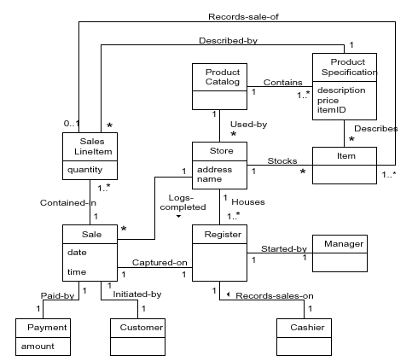
II. Static modeling -- Conceptual class diagram.
Mira Balaban & Arnon Sturm

Slide 8
I. Understanding requirements – Use Cases
A use case is a narrative document – a story -- that describes the sequence of events of an actor using a system to complete a process.
A use case describes a typical interaction between an external entity (the actor – person, system, organization) to the system.
A use case describes multiple scenarios.
A scenario is a single path through the use case.
A use case depends on partial understanding of the requirements.
Use cases can be found by looking for their initiator actors.
Mira Balaban & Arnon Sturm

Slide 9
I. Understanding requirements – Use Cases
Example: Use case Process Sale, in a brief format.
A customer arrives at a checkout with items to purchase. The cashier uses the POS system to record each purchased item. The system presents a running total and line-item details. The customer enters payment information, which the system validates and records. The system updates inventory. The customer receives a receipt from the system and then leaves with the items.
Mira Balaban & Arnon Sturm

Slide 10
I. Understanding requirements – Use Cases
Finding use cases:
Choose system boundary: Decide what is outside the system.
For POS – cashier, payment authorization, inventory control, …
Identify primary actors.
Identify actor goals.
Define use cases that satisfy actor goals.
Mira Balaban & Arnon Sturm

Slide 11
I. Understanding requirements – Use Cases
What use cases are not ?
A common mistake about use cases:
A use case is a relatively large, end-to-end
process description, that typically includes
many steps or transactions; it is not normally
an individual step or activity.
For example: “print the receipt” is a step,
system function, not a use case.
Mira Balaban & Arnon Sturm

Slide 12
I. Understanding requirements – Use Cases
Essential versus real use cases:
Essential – conceptual specification of expanded use cases.
The customer identifies himself/herself.
Real – Concrete specification of the process.
The customer inserts his/her credit card and
types the code.
Only in design level.
Mira Balaban & Arnon Sturm

Slide 13
I. Understanding requirements – Use Cases
Visualization of use cases – use case
diagrams:
A use case diagram illustrates:
A set of use cases for a system.
Their actors.
Relationships between actors and use cases.
Inter-relationships between use cases.
Mira Balaban & Arnon Sturm

Slide 14
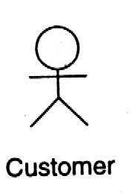
I. Understanding requirements – Use Cases
A use case visualization in UML – an icon:
Process Sale
An actor visualization:
Mira Balaban & Arnon Sturm

Slide 15
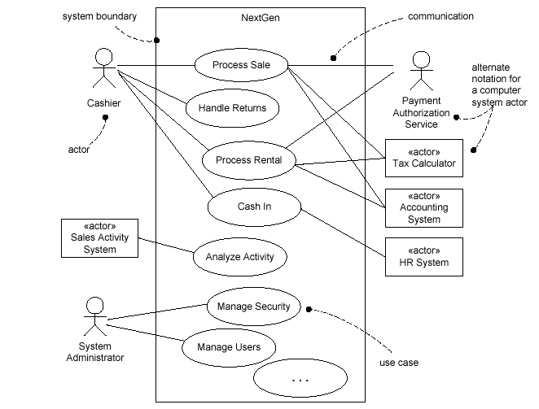
I. Understanding requirements – Use Cases
A partial use case diagram for the POS application:
Mira Balaban & Arnon Sturm

Slide 16
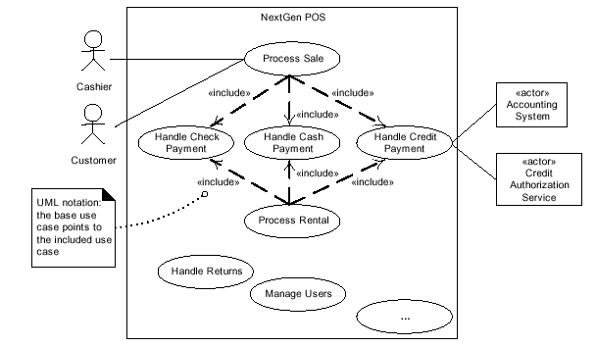
I. Understanding requirements – Use Cases
Relating Multiple Use Cases – The embedded alternatives
can be singled out as independent use cases.
Mira Balaban & Arnon Sturm

Slide 17
I. Understanding requirements – Use Cases
Relating Multiple Use Cases:
Alternatives are turned into full use cases.
The Buy Items use case “uses” the new use cases:
    Pay by Cash.
    Pay by Credit.
    Pay by Check.
In the use case document:
1. Insert an explicit reference in the alternatives section.
2. Add a section: Related Use Cases.
Mira Balaban & Arnon Sturm

Slide 18
I. Understanding requirements – Use Cases
Relationships between use cases:
<<uses>> (also called <<includes>>) is a relationship that denotes references between use cases.
<<extends>> is a relationship that denotes a “special case”:
Pay by
Check
Limits
“extends”
Exceeded
<<extends>> is used to emphasize similarity and diversion:
    Capture the normal use case.
    Describe variations.
Mira Balaban & Arnon Sturm

Slide 19
I. Understanding requirements – Use Cases
Use Case Modeling Tips
Make sure that each use case describes a significant chunk of system usage that is understandable by domain experts, customers, and programmers
When defining use cases in text, use nouns and verbs accurately and consistently to help derive objects and messages for interaction diagrams
Factor out common usages that are required by multiple use cases
  If the usage is required use <<include>>
  If the base use case is complete and the usage may be optional, consider use <<extend>>
A use case diagram should
  contain only use cases at the same level of abstraction
  include only actors who are required
Complexity management
Mira Balaban & Arnon Sturm

Slide 20
I. Understanding requirements – Use Cases
Example: Use case Process Sale, in a brief format.
A customer arrives at a checkout with items to purchase. The cashier uses the POS system to record each purchased item. The system presents a running total and line-item details. The customer enters payment information, which the system validates and records. The system updates inventory. The customer receives a receipt from the system and then leaves with the items.
Mira Balaban & Arnon Sturm

Slide 21
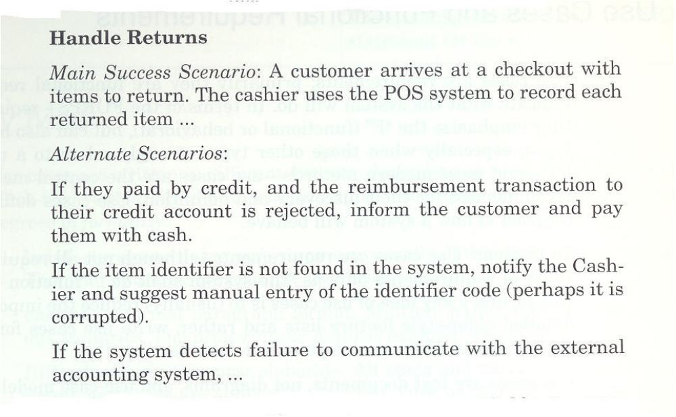
I. Understanding requirements – Use Cases
Example: Use case Handle Returns, in a casual format.
Mira Balaban & Arnon Sturm

Slide 22
I. Understanding requirements – Use Cases
The detailed format for use cases includes the main story of the
described process, the alternatives, and characterize the general
Situation. The usecases.org format (www.usecases.org) includes:
Name.
Primary actor.
Stakeholders and interests.
Preconditions.
Post conditions.
Main success scenario.
Alternative flows.
Special requirements.
Technology variations.
Frequency of occurrence.
Open issues.
Mira Balaban & Arnon Sturm

Slide 23
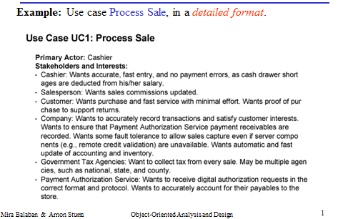
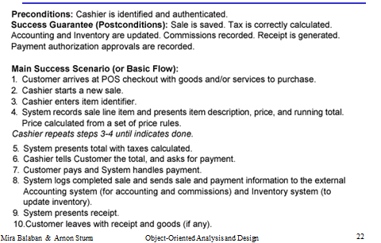
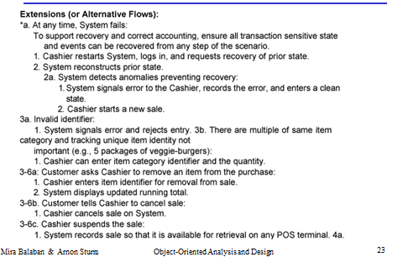
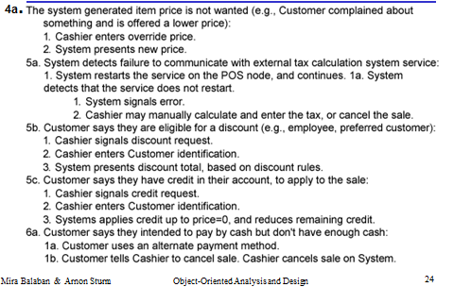
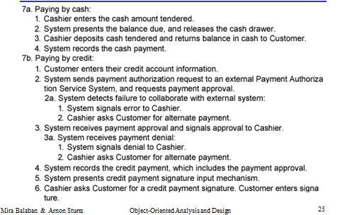
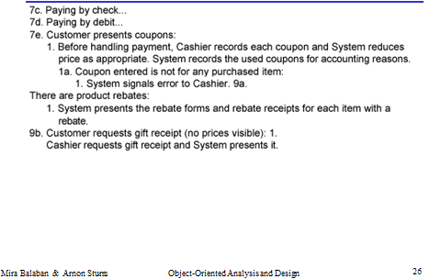
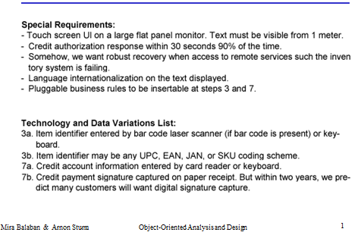
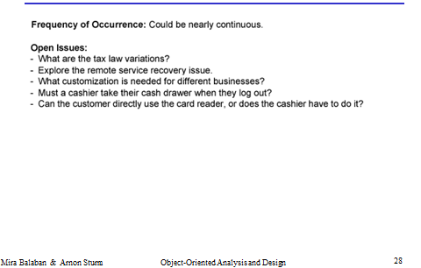
I. Understanding requirements – Use Cases
The detailed format
Mira Balaban & Arnon Sturm

Slide 24
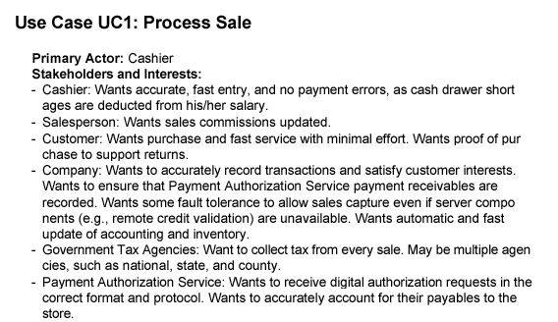
I. Understanding requirements – Use Cases
Example: Use case Process Sale, in a detailed format.
Mira Balaban & Arnon Sturm

Slide 25
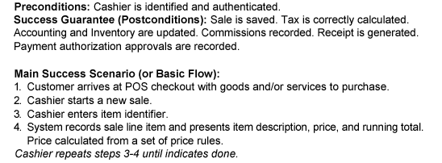
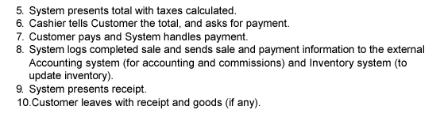
I. Understanding requirements – Use Cases
Mira Balaban & Arnon Sturm

Slide 26
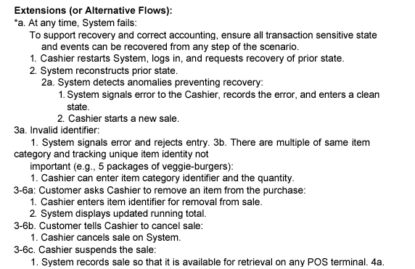
I. Understanding requirements – Use Cases
Mira Balaban & Arnon Sturm

Slide 27
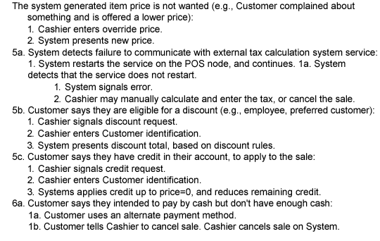
I. Understanding requirements – Use Cases
4a.
Mira Balaban & Arnon Sturm

Slide 28
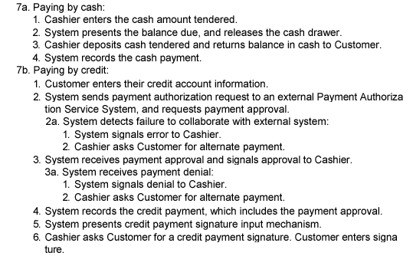
I. Understanding requirements – Use Cases
Mira Balaban & Arnon Sturm

Slide 29
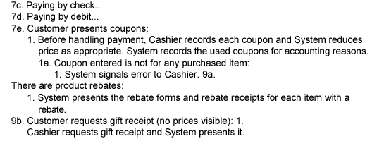
I. Understanding requirements – Use Cases
Mira Balaban & Arnon Sturm

Slide 30
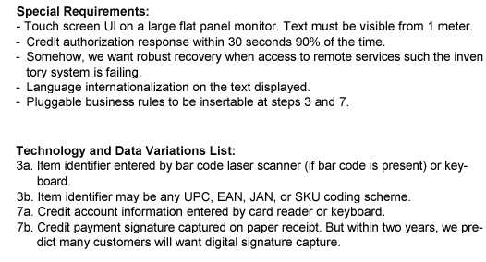
I. Understanding requirements – Use Cases
Mira Balaban & Arnon Sturm

Slide 31
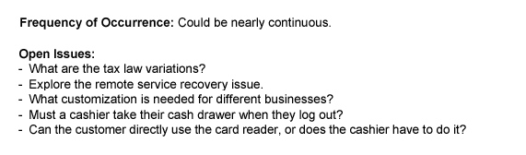
I. Understanding requirements – Use Cases
Mira Balaban & Arnon Sturm

Slide 32
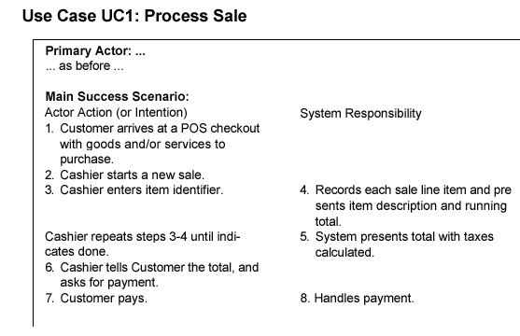
I. Understanding requirements – Use Cases
A two-column conversation format between an actor and
the system:
Mira Balaban & Arnon Sturm

Slide 33
II. Static modeling -- Conceptual class diagram.
Mira Balaban & Arnon Sturm

Slide 34
III. Identify operations and create their contracts
Steps:
Identify system events that trigger system operations.
Create contracts for the identified operations.
Mira Balaban & Arnon Sturm

Slide 35
III. Identify operations and create their contracts
System events:
The system events and their associated operations are identified by observing the course of events in use cases.
Within a use case – follow the actions of actors that directly interact with the system.
For the simple Cash-only scenario of the Process Sale use case, the cashier is the only actor that directly interacts with the system. It generates the events:
  makeNewSale()
  enterItem(itemID, quantity)
  endSale()
  makePayment(amount)
Mira Balaban & Arnon Sturm

Slide 36
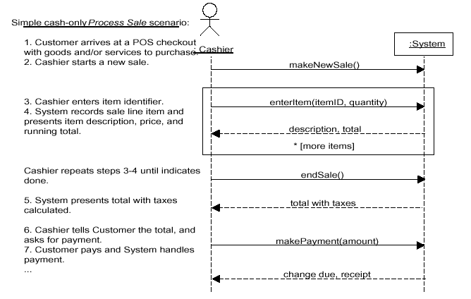
III. Identify operations and create their contracts
System events: The events can be described in a
System Sequence Diagram:
Mira Balaban & Arnon Sturm

Slide 37
III. Identify operations and create their contracts
System sequence diagrams are important!
They serve for connecting the application logic layer
to other layers:
  If the actor is human – connection to the presentation
layer.
  If the actor is an external service – application interface.
They serve for implementing the use case scenarios.
Mira Balaban & Arnon Sturm

Slide 38
III. Identify operations and create their contracts
A contract is a document that describes what an operation
commits to achieve. A contract is expressed with:
pre-conditions – Assumptions about the state of the system at the beginning of the operation.
post-conditions – State of the system after the operation has finished:
    Instance creation and deletion.
    Attribute modification.
    Links formed and broken.
Goal: Create contracts for complex system operations.
Contracts are used to derive interaction diagrams for the operations.
Mira Balaban & Arnon Sturm

Slide 39
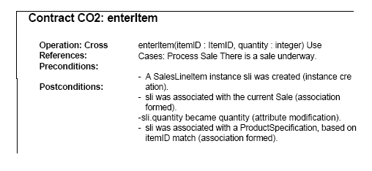
III. Identify operations and create their contracts
Create contracts:
Post conditions specify what must happen during a system
operation, but not how!
Mira Balaban & Arnon Sturm

Slide 40
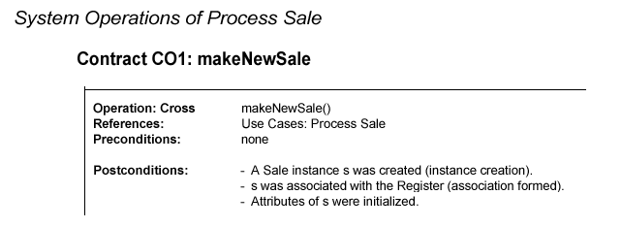
III. Identify operations and create their contracts
Create contracts – The POS example:
Mira Balaban & Arnon Sturm

Slide 41
III. Identify operations and create their contracts
Create contracts – The POS example:
Mira Balaban & Arnon Sturm

Slide 42
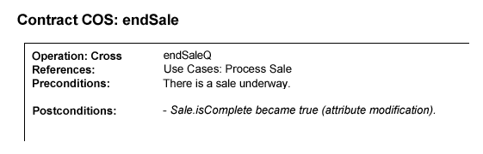
III. Identify operations and create their contracts
Create contracts – The POS example:
3:
Mira Balaban & Arnon Sturm

Slide 43
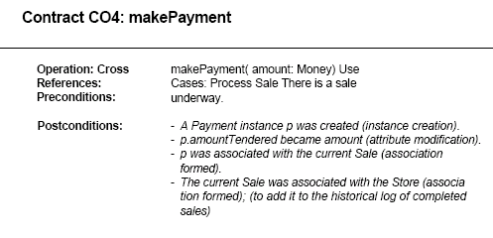
III. Identify operations and create their contracts
Create contracts – The POS example:
Mira Balaban & Arnon Sturm

Slide 44
III. Identify operations and create their contracts
Create contracts:
Contracts might imply changes to the static domain model:
For example, add a boolean isComplete attribute to the Sale class, to mark the end of a sale.
Contracts for operations can be expressed in OCL.
Preconditions and postconditions are written as OCL constraints in the context of the contract operation.
Mira Balaban & Arnon Sturm

Slide 45
IV. Assign responsibilities and Design interaction diagrams
Two interwoven tasks:
1. Impose responsibilities – assign operations to classes.
Design operations – sequence/collaboration diagrams.
Mira Balaban & Arnon Sturm

Slide 46
IV. Assign responsibilities and Design interaction diagrams
Input to this stage: A contract built for a system operation.
Output of this stage: An interaction diagram.
The design is based on Principles (Patterns) for Assigning
Responsibilities –
GRASP (General Responsibility Assignment Software Patterns).
Mira Balaban & Arnon Sturm

Slide 47
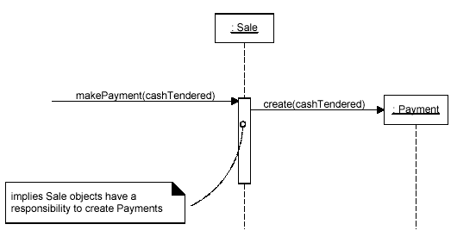
IV. Assign responsibilities and Design interaction diagrams
Responsibility assignment:
Determine the class whose objects are responsible for performing
an operation. The operation becomes a method of that class.
Mira Balaban & Arnon Sturm

Slide 48
IV. Assign responsibilities and Design interaction diagrams
Responsibility assignment - Based on patterns
A pattern is a named problem/solution pair that can be applied in
new context, with advice on how to apply it in novel situations
and discussion of its trade-offs.
Patterns exist in various paradigms.
In Software Engineering they are idioms for software creation.
They are expressed in narrative documents, programming code and more quasi formal languages like UML diagrams.
Mira Balaban & Arnon Sturm

Slide 49
IV. Assign responsibilities and Design interaction diagrams
Responsibility assignment - Based on patterns
Major GRASP patterns:
    Information Expert
    Creator
    High Cohesion
    Low Coupling
    Controller
They address very basic, common questions and fundamental design
issues.
Mira Balaban & Arnon Sturm

Slide 50
IV. Assign responsibilities and Design interaction diagrams
Responsibility assignment - Based on patterns
GRASP patterns are introduced as required for the design of
interaction diagrams for the POS problem.
We consider 2 use cases:
    Process Sale.
    Start-up.
Mira Balaban & Arnon Sturm

Slide 51
IV. Assign responsibilities and Design interaction diagrams
Reminder: The overall steps towards the development of
interaction diagrams:
Use cases + conceptual model
→ Identify system events (operations) – use SSDs.
→ Build contracts
→ Interaction diagrams.
Mira Balaban & Arnon Sturm

Slide 52
IV. Assign responsibilities and Design interaction diagrams
Importance of interaction diagrams:
Express decisions about responsibilities for operations.
Complement the conceptual model.
The conceptual model and the interaction diagrams are the most important artifacts created in the object-oriented analysis and design.
Good quality interaction diagrams express codified patterns, principles and idioms.
Mira Balaban & Arnon Sturm

Slide 53
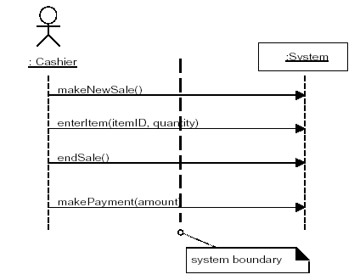
IV. Assign responsibilities and Design interaction diagrams
The events singled out for the Process Sale use case:
Mira Balaban & Arnon Sturm

Slide 54
IV. Assign responsibilities and Design interaction diagrams
First question:
Which class is responsible for each operation?
An advice is given by the Controller pattern.
Its problem is:
“Who should be responsible for handling an input system event?”
Mira Balaban & Arnon Sturm

Slide 55
IV. Assign responsibilities and Design interaction diagrams
The Controller Pattern
Problem: Who should be responsible for handling a system event?
The controller pattern provides an advice for selecting a controller for a system event – an operation triggered by an external actor.
A controller is a domain layer object responsible for handling a system event. A controller defines a method for a system operation.
Mira Balaban & Arnon Sturm

Slide 56
IV. Assign responsibilities and Design interaction diagrams
The Controller Pattern
Solution: Assign the responsibility for receiving or handling a system
event message to a class representing one of the following choices:
Facade controller -- Represents the overall system, device, or subsystem.
Use case controller -- Represents a use case scenario within which the system event occurs.
Common name: <UseCaseName>Handler.
Role controller – Represents something that can be involved in the task.
Mira Balaban & Arnon Sturm

Slide 57
IV. Assign responsibilities and Design interaction diagrams
The Controller Pattern
For the enterItem event in the Process-sale use case:
Possible facade controllers are:
  Register – represents the overall system.
  Store – represents the overall organization.
Possible role controller is Cashier – represents something that can be involved in the task.
Use case controller: ProcessSaleHandler– its instances represent sessions (conversations) with an actor.
  In that case – all system events in the same use case are handled by the same controller.
Mira Balaban & Arnon Sturm

Slide 58
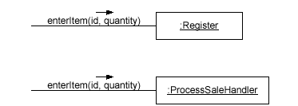
IV. Assign responsibilities and Design interaction diagrams
The Controller Pattern – possible options for the
enterItem event:
Mira Balaban & Arnon Sturm

Slide 59
IV. Assign responsibilities and Design interaction diagrams
The Controller Pattern
A facade controller is a good option if there are only few
system events.
Otherwise – the façade controller takes too many
Responsibilities
→ It becomes incohesive.
Mira Balaban & Arnon Sturm

Slide 60
IV. Assign responsibilities and Design interaction diagrams
The Controller Pattern
Decision among various options suggested by a pattern:
Use the general criteria:
  High cohesion.
  Low coupling.
Mira Balaban & Arnon Sturm

Slide 61
IV. Assign responsibilities and Design interaction diagrams
The Controller Pattern
For the events of the Process Sale use case:
Possible façade controllers are:
Register, Store.
Based on cohesion → select Register.
Mira Balaban & Arnon Sturm

Slide 62
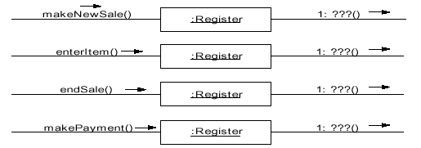
IV. Assign responsibilities and Design interaction diagrams
The Controller Pattern
Mira Balaban & Arnon Sturm

Slide 63
IV. Assign responsibilities and Design interaction diagrams
Design interaction diagrams –
Use contracts built for the system events that are singled
out for a use case.
In each contract – use the post conditions section!
For the Process Sale use case --
4 interaction diagrams for the events:
makeNewSale, enterItem, endSale, makePayment.
Mira Balaban & Arnon Sturm

Slide 64
IV. Assign responsibilities and Design interaction diagrams
Design interaction diagrams –
System events:
1. makeNewSale.
2. enterItem.
3. endSale.
4. Sale – getTotal: Presentation requirement.
5. makePayment.
6. Payment – getBalance: Presentation requirement.
7. startUp.
Mira Balaban & Arnon Sturm

Slide 65
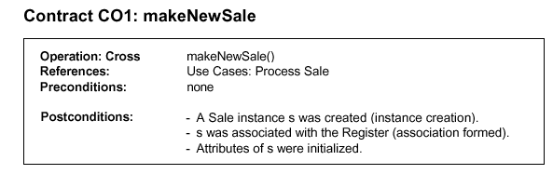
IV. Assign responsibilities and Design interaction diagrams
Mira Balaban & Arnon Sturm

Slide 66
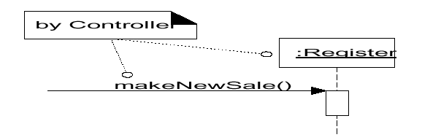
IV. Assign responsibilities and Design interaction diagrams
Interaction diagram for makeNewSale:
First decision: By the Controller pattern – assign
responsibility on the Register class.
Mira Balaban & Arnon Sturm

Slide 67
IV. Assign responsibilities and Design interaction diagrams
Interaction diagram for makeNewSale:
Post condition -- instance creation:
“A Sale instance was created”.
Use the Creator pattern for determining the object that
triggers the Sale constructor – the Creator.
Mira Balaban & Arnon Sturm

Slide 68
IV. Assign responsibilities and Design interaction diagrams
The Creator pattern
Problem: Who should be responsible for creating a new instance
of some class?
Solution: Assign class B the responsibility to create an instance of
class A if one of the following holds:
B aggregates objects of A.
B contains objects of A.
B records instances of objects of A.
B closely uses objects of A.
B has initializing data that will be passed to A when it is created (B is an Expert with respect to creating A).
Mira Balaban & Arnon Sturm

Slide 69
IV. Assign responsibilities and Design interaction diagrams
The Creator pattern -- In the makeNewSale event:
Sale can be a creator for SalesLineItem – A Sale instance contains SalesLineItem objects.
Register can be a creator for Sale – Register records and is associated with Sale objects.
Mira Balaban & Arnon Sturm

Slide 70
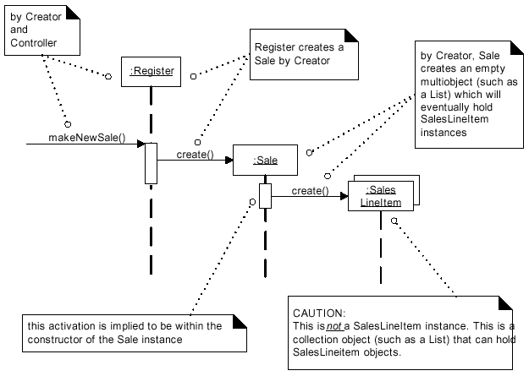
IV. Assign responsibilities and Design interaction diagrams
Interaction
diagram for
makeNewSale:
Sale is a container for
SaleLineItem objects
A Sale
Constructor must
create a container (a
collection) for
SaleLineItems objects.
Mira Balaban & Arnon Sturm

Slide 71
IV. Assign responsibilities and Design interaction diagrams
Design interaction diagrams –
System events:
√ 1. makeNewSale.
2. enterItem.
3. endSale.
4. Sale – getTotal: Presentation requirement.
5. makePayment.
6. Payment – getBalance: Presentation requirement.
7. startUp.
Mira Balaban & Arnon Sturm

Slide 72
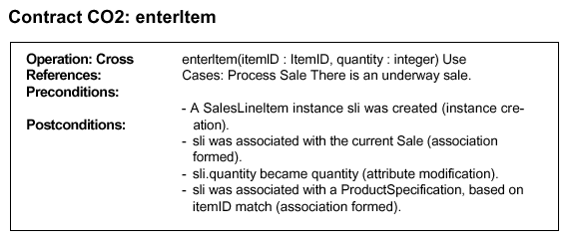
IV. Assign responsibilities and Design interaction diagrams
Mira Balaban & Arnon Sturm

Slide 73
IV. Assign responsibilities and Design interaction diagrams
Interaction diagram for enterItem:
3 first post conditions:
A SalesLineltem instance sli was created (instance creation).
- sli was associated with the current Sale (association formed).
- sli.quantity became quantity (attribute modification).
→
creation, initialization, association (linking) of a SalesLineItem object.
Mira Balaban & Arnon Sturm

Slide 74
IV. Assign responsibilities and Design interaction diagrams
Interaction diagram for enterItem:
Creator for a SalesLineItem object.
Creator -- Sale is the creator. It contains SalesLineItems objects.
Association over time – the new object is stored in the collection of SalesLineItem objects contained in Sale.
Quantity: The new SalesLineItem has quantity. Must be passed as a parameter.
Mira Balaban & Arnon Sturm

Slide 75
IV. Assign responsibilities and Design interaction diagrams
Interaction diagram for enterItem:
Creator for a SalesLineItem object.
Register → Sale: makeLineItem message.
Sale creates a SalesLineItem and stores it in its permanent collection.
Mira Balaban & Arnon Sturm

Slide 76
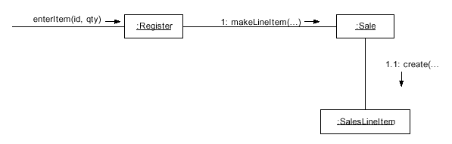
IV. Assign responsibilities and Design interaction diagrams
Interaction diagram for enterItem – so far:
Mira Balaban & Arnon Sturm

Slide 77
IV. Assign responsibilities and Design interaction diagrams
Interaction diagram for enterItem:
Parameters to makeLineItem:
First parameter: quantity – recoded by SalesLineItem.
4th postcondition:
sli was associated with a ProductSpecification, based
on itemID match.
→
Second parameter: productSpecification – matches the ID
code.
Mira Balaban & Arnon Sturm

Slide 78
IV. Assign responsibilities and Design interaction diagrams
Interaction diagram for enterItem:
Finding a productSpecification based on an ID code.
Task: Retrieve a ProductSpecification based on an ID code
match.
Question: Who is responsible for knowing the
ProductSpecification based on an ID code match?
→ Use the Expert pattern.
Mira Balaban & Arnon Sturm

Slide 79
IV. Assign responsibilities and Design interaction diagrams
The Expert pattern
Problem: What is the most basic principle by which
responsibilities are assigned in object-oriented design?
Solution: Assign a responsibility to the information expert
– the class that has the information necessary to fulfill the
responsibility.
Mira Balaban & Arnon Sturm

Slide 80
IV. Assign responsibilities and Design interaction diagrams
The Expert pattern – in the POS example:
“who knows about the grand total of a sale?”
To answer – consider the classes in the conceptual model.
A Sale total needs subtotals of all SalesLineItems.
Who knows about all SalesLineItems
→ answer = Sale.
Expert advice should be combined with
→ Low coupling and High cohesion.
Mira Balaban & Arnon Sturm

Slide 81
IV. Assign responsibilities and Design interaction diagrams
Interaction diagram for enterItem:
By the Expert pattern:
Look for an object that knows about all ProductSpecifications.
→ By the class diagram: ProductCatalog.
Who should send the find-specification message to the
ProductCatalog?
→ By visibility considerations: Register.
Explanation: ProductCatalog and Register are (singletons) created once in the Start Up use case.
Mira Balaban & Arnon Sturm

Slide 82
IV. Assign responsibilities and Design interaction diagrams
Interaction diagram for enterItem:
Summary of decisions:
Register sends a specification message to ProductCatalog (visibility argument).
ProductCatalog sends a find message to the collection (object) of ProductSpecifications that it contains.
Mira Balaban & Arnon Sturm

Slide 83
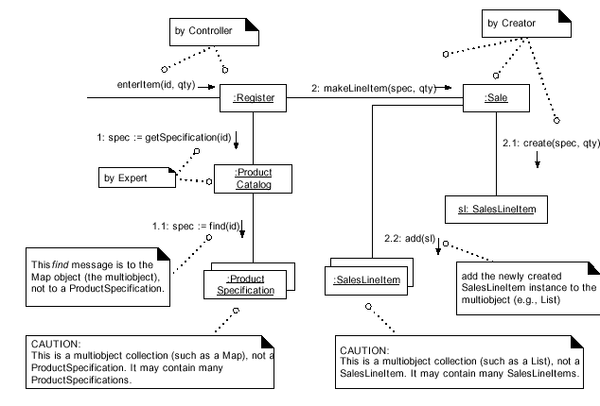
IV. Assign responsibilities and Design interaction diagrams
Interaction diagram for enterItem:
Mira Balaban & Arnon Sturm

Slide 84
IV. Assign responsibilities and Design interaction diagrams
Design interaction diagrams –
System events:
√ 1. makeNewSale.
√ 2. enterItem.
3. endSale.
4. Sale – getTotal: Presentation requirement.
5. makePayment.
6. Payment – getBalance: Presentation requirement.
7. startUp.
Mira Balaban & Arnon Sturm

Slide 85
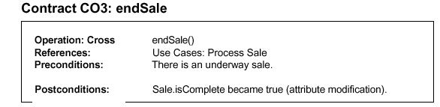
IV. Assign responsibilities and Design interaction diagrams
Interaction diagram for endSale:
Mira Balaban & Arnon Sturm

Slide 86
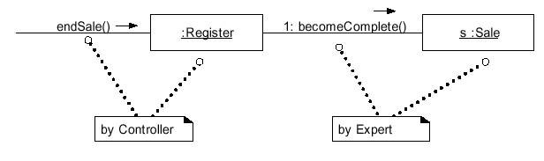
IV. Assign responsibilities and Design interaction diagrams
Interaction diagram for endSale:
Controller: Register.
Mira Balaban & Arnon Sturm

Slide 87
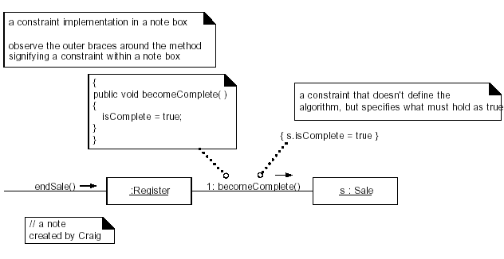
IV. Assign responsibilities and Design interaction diagrams
Interaction diagram for endSale:
Mira Balaban & Arnon Sturm

Slide 88
IV. Assign responsibilities and Design interaction diagrams
Design interaction diagrams –
System events:
√ 1. makeNewSale.
√ 2. enterItem.
√ 3. endSale.
4. Sale – getTotal: Presentation requirement.
5. makePayment.
6. Payment – getBalance: Presentation requirement.
7. startUp.
Mira Balaban & Arnon Sturm

Slide 89
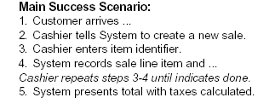
IV. Assign responsibilities and Design interaction diagrams
Calculating the Sale Total:
The endSale event is associated with computation of the sale total.
The Process Sale use case:
Mira Balaban & Arnon Sturm

Slide 90
IV. Assign responsibilities and Design interaction diagrams
Calculating the Sale Total:
The presentation is not handled in designing the domain layer –
Model-View separation principle.
But – the domain layer should provide the Sale-Total service.
Who will trigger this operation – probably the presentation layer.
→ getTotal can be viewed as a regular system operation (event).
Mira Balaban & Arnon Sturm

Slide 91
IV. Assign responsibilities and Design interaction diagrams
Calculating the Sale Total:
Responsibility: Sale – by Expert.
Summary of needed information:
total of sale = sum of subtotals,
taken over all SalesLineItem objects
contained in Sale.
subtotal of a SalesLineItem = SalesLineItem.quantity *
ProductSpecification.price.
Mira Balaban & Arnon Sturm

Slide 92
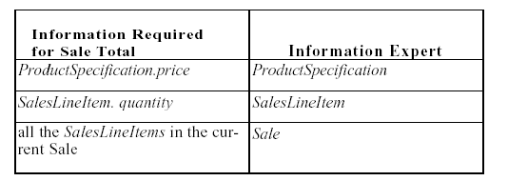
IV. Assign responsibilities and Design interaction diagrams
Calculating the Sale Total:
Information required and Expert classes:
Mira Balaban & Arnon Sturm

Slide 93
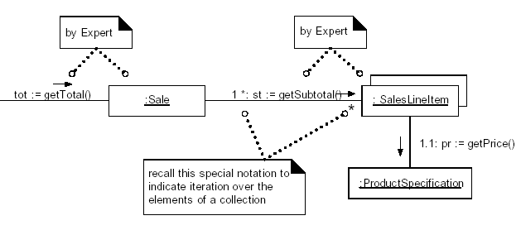
IV. Assign responsibilities and Design interaction diagrams
Calculating the Sale Total:
SalesLineItem – responsible for subtotal() – since it knows about quantity, and is associated with productSpecification.
→ Sale --- responsible for total ()
Mira Balaban & Arnon Sturm

Slide 94
IV. Assign responsibilities and Design interaction diagrams
Design interaction diagrams –
System events:
√ 1. makeNewSale.
√ 2. enterItem.
√ 3. endSale.
√ 4. Sale – getTotal: Presentation requirement.
5. makePayment.
6. Payment – getBalance: Presentation requirement.
7. startUp.
Mira Balaban & Arnon Sturm

Slide 95
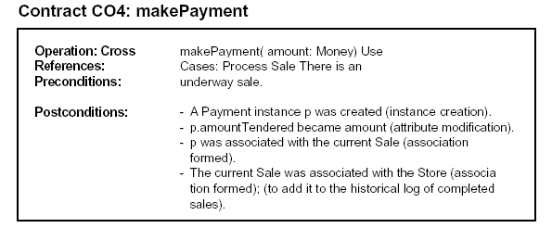
IV. Assign responsibilities and Design interaction diagrams
Mira Balaban & Arnon Sturm

Slide 96
IV. Assign responsibilities and Design interaction diagrams
Interaction diagram for makePayment:
Choose the Controller class: Register – same controller for all system events in a single use case.
Post condition: “A Payment was created”.
Question: “Who sends the create message to class Payment?”
→ Use the Creator pattern.
→ Use the Expert pattern.
Based on: “Who knows, aggregates or records payments?”
→ 2 candidates: Register, Sale.
Mira Balaban & Arnon Sturm

Slide 97
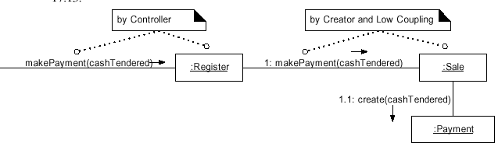
IV. Assign responsibilities and Design interaction diagrams
Interaction diagram for makePayment:
2 candidates for Payment creation: Register, Sale.
Based on: High cohesion.
Low coupling.
→ select Sale.
Mira Balaban & Arnon Sturm

Slide 98
IV. Assign responsibilities and Design interaction diagrams
Interaction diagram for makePayment:
Post condition: “The Sale was associated with the Store, to add it to the historical log of completed sales”.
Question: “Who knows about logged sales?”
“Who is responsible for doing the logging?”
→ Use the Expert pattern.
→ Consulting the conceptual schema:
select Store.
Mira Balaban & Arnon Sturm

Slide 99
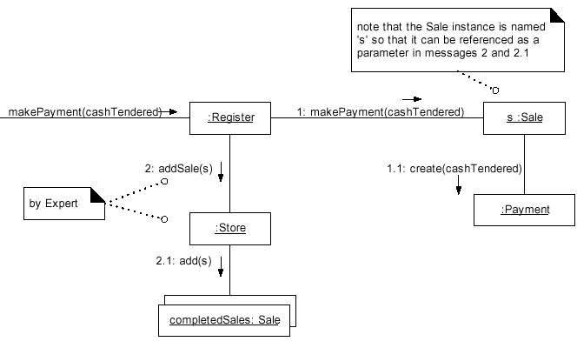
IV. Assign responsibilities and Design interaction diagrams
Interaction diagram for makePayment:
Decision: Register sends the logging message to Store.
Store does the logging.
Mira Balaban & Arnon Sturm

Slide 100
IV. Assign responsibilities and Design interaction diagrams
Design interaction diagrams –
System events:
√ 1. makeNewSale.
√ 2. enterItem.
√ 3. endSale.
√ 4. Sale – getTotal: Presentation requirement.
√ 5. makePayment.
6. Payment – getBalance: Presentation requirement.
7. startUp.
Mira Balaban & Arnon Sturm

Slide 101
IV. Assign responsibilities and Design interaction diagrams
Calculating the balance of the payment:
By the Process Sale use case –
The makePayment event is associated with
  Balance computation,
  receipt printing,
  balance display.
Mira Balaban & Arnon Sturm

Slide 102
IV. Assign responsibilities and Design interaction diagrams
Calculating the balance of the payment :
The presentation is not handled in designing the domain layer –
Model-View separation principle.
But – the domain layer should provide the getBalance service.
Who will trigger this operation – probably the presentation layer.
→ getBalance can be viewed as a regular system operation (event).
Mira Balaban & Arnon Sturm

Slide 103
IV. Assign responsibilities and Design interaction diagrams
Calculating the balance of the payment :
Question: “Who knows about balance?”
Needed information:
  Sale total;
  Cash tendered.
By Expert:
→ Candidate classes: Sale,
Payment.
Mira Balaban & Arnon Sturm

Slide 104
IV. Assign responsibilities and Design interaction diagrams
Calculating the balance of the payment :
Considerations:
  Choosing Payment →
Payment-Sale visibility (Payment asks Sale for the total).
  Choosing Sale →
Sale-Payment visibility (Sale asks Payment for cash-tendered).
BUT: Already exists (Sale is Payment’s creator)!
Mira Balaban & Arnon Sturm

Slide 105
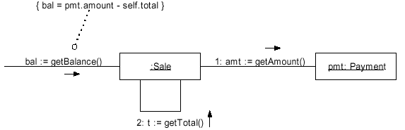
IV. Assign responsibilities and Design interaction diagrams
Calculating the balance of the payment :
Decision: Assign the getBalance responsibility to Sale.
Argumentation: Supports low-coupling.
Mira Balaban & Arnon Sturm

Slide 106
IV. Assign responsibilities and Design interaction diagrams
Design interaction diagrams –
System events:
√ 1. makeNewSale.
√ 2. enterItem.
√ 3. endSale.
√ 4. Sale – getTotal: Presentation requirement.
√ 5. makePayment.
√ 6. Payment – getBalance: Presentation requirement.
7. startUp.
Mira Balaban & Arnon Sturm

Slide 107
IV. Assign responsibilities and Design interaction diagrams
Application Start Up – system initialization
The start up of an application represents its initialization.
Design idiom (pattern):
  Create an initial domain object.
  Send a run message to the initial domain object, or to any of the domain objects that it creates.
The initial domain object is responsible for the creation of other problem domain objects and their initialization.
Mira Balaban & Arnon Sturm

Slide 108
IV. Assign responsibilities and Design interaction diagrams
Application Start Up – system initialization
How to choose the initial domain object?
  A class that represents the entire logical information system.
  A class that represents the overall business or organization.
Use the High Cohesion and Low Coupling criteria for choosing.
Mira Balaban & Arnon Sturm

Slide 109
IV. Assign responsibilities and Design interaction diagrams
Application Start Up – system initialization
Who creates and runs the application?
  Creation of the initial domain object – Message sent by an object of the presentation (interface) layer.
  Running (controlling) the application – Either the initial domain object or the presentation layer.
Mira Balaban & Arnon Sturm

Slide 110
IV. Assign responsibilities and Design interaction diagrams
Application Start Up for the POS system:
Initial domain object: Choose between
  Register – entire logical information system.
  Store – overall business.
→ Decision based on high cohesion: Store.
Who creates and runs in POS:
  Creation -- A presentation object like a GUI object.
  Running -- A presentation object.
Mira Balaban & Arnon Sturm

Slide 111
IV. Assign responsibilities and Design interaction diagrams
Application Start Up for the POS system:
Persistent object decisions – database objects:
A persistent object persists throughout the life of the system.
Stored persistently: files, databases.
Decision on persistent objects –
In POS: ProductSpecification.
Decision on a mediating object –
In POS: ProductCatalog.
Mira Balaban & Arnon Sturm

Slide 112
IV. Assign responsibilities and Design interaction diagrams
Application Start Up for the POS system:
The implementation of persistent classes in a database requires a mapping that accounts for:
  Attributes. Key attributes. Attribute domains.
  Associations. Association classes.
  Multiplicity constraints.
  Abstractions – sub-typing, aggregation.
Mira Balaban & Arnon Sturm

Slide 113
IV. Assign responsibilities and Design interaction diagrams
The POS Start Up contract – Store create:
A Store, Register, ProductCatalog and ProductSpecifications need to be created.
The ProductCatalog needs to be associated with ProductSpecifications.
Store needs to be associated with ProductCatalog.
Store needs to be associated with Register.
Register needs to be associated with ProductCatalog.
Mira Balaban & Arnon Sturm

Slide 114
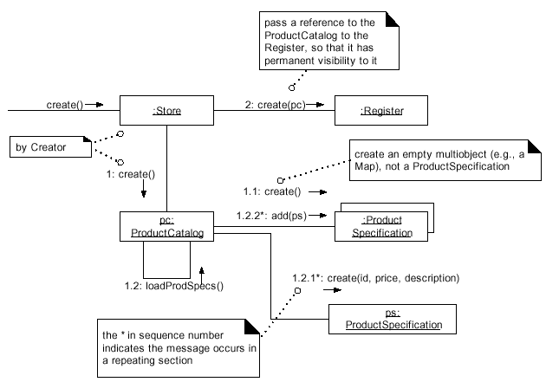
IV. Assign responsibilities and Design interaction diagrams
Simplifying
assumption:
ProductSpecification
Instances are
“magically” created
in memory by the
Singleton
ProductCatalog.
Mira Balaban & Arnon Sturm

Slide 115
IV. Assign responsibilities and Design interaction diagrams
Design interaction diagrams –
System events:
√ 1. makeNewSale.
√ 2. enterItem.
√ 3. endSale.
√ 4. Sale – getTotal: Presentation requirement.
√ 5. makePayment.
√ 6. Payment – getBalance: Presentation requirement.
√ 7. startUp.
Mira Balaban & Arnon Sturm

Slide 116
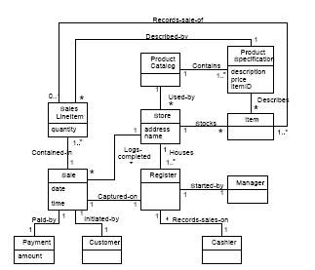
V. Design level class diagrams –
implementation and testing.
Mira Balaban & Arnon Sturm

Slide 117
V. Design Class Diagrams – Implementation
This stage is responsible for mapping design
artifacts to code.
Two steps:
Develop Design Class Diagrams (DCDs).
Implement.
Design class diagrams are developed
in parallel to
the development of interaction diagrams!
Mira Balaban & Arnon Sturm

Slide 118
12 - DOMAIN MODEL: ADDING TTRIBUTES
Register
Item Store
address name
Sale date time
Payment amount
Sales LineItem quantity
Cashier Customer
Manager
Product Catalog
Product Specification description price itemID
Stocks
*
Houses
1..*
Used-by
*
Contains
1..*
Describes
*
Captured-on
Contained-in
1..*
Described-by
*
Records-sale-of
0..1
Started-by
Paid-by Initiated-by
Logs-completed 6
*
3 Records-sales-on
1
1
1
1
1
1..*
1 1
1
1
1
1
1
1
1
1 1
1
Figure 12.9 A partial domain model.
176
V. Design Class Diagrams – Implementation
A Design Class Diagram (DCD) provides
specification for a software class or interface.
It includes:
Classes, associations, typed attributes, data-types.
Interfaces – with operations.
Methods – with signatures.
Navigability – permanent (attribute) visibility.
Dependencies – temporary visibilities.
Mira Balaban & Arnon Sturm

Slide 119

V. Design Class Diagrams – Implementation
Developing Design Class Diagrams (DCDs):
1. Identify classes.
Mira Balaban & Arnon Sturm

Slide 120

V. Design Class Diagrams – Implementation
Developing Design Class Diagrams (DCDs):
2,3. Add typed attributes and methods with signatures.
Mira Balaban & Arnon Sturm

Slide 121
V. Design Class Diagrams – Implementation
Developing Design Class Diagrams (DCDs):
4,5. Add navigability and dependency.
Visibility Between Objects – the ability of one object to
see or have reference to another.
Four kinds of visibility:
1. Attribute visibility – Permanent.
2. Parameter visibility – Temporary.
3. Local visibility – Temporary.
4. Global visibility – Permanent.
Mira Balaban & Arnon Sturm

Slide 122
V. Design Class Diagrams – Implementation
1. Attribute visibility – B is a reference attribute of A.
Example: Sale -> SalesLineItem.
2. Parameter visibility – B is a parameter of a method of A.
Example: Register sends to Sale: makeLineItem(spec, qty).
3. Local visibility – B is declared as a local object in a methods of A.
Example: register -> ProductSpecification.
4. Global visibility – B is globally visible.
Example: B has static methods.
Mira Balaban & Arnon Sturm

Slide 123

V. Design Class Diagrams – Implementation
Attribute, parameter and local visibility:
Mira Balaban & Arnon Sturm

Slide 124

V. Design Class Diagrams – Implementation
Design Class Diagrams with navigability and dependency.
Mira Balaban & Arnon Sturm

Slide 125

V. Design Class Diagrams – Implementation
Implement – based on the DCD and the interaction
Diagrams.
1. Adding reference attributes:
Mira Balaban & Arnon Sturm

Slide 126

V. Design Class Diagrams – Implementation
Implement – based on the DCD and the interaction
Diagrams.
1. Adding collection attributes:
Mira Balaban & Arnon Sturm

Slide 127

V. Design Class Diagrams – Implementation
Implement – based on the DCD and the interaction
Diagrams.
2. Adding methods:
Mira Balaban & Arnon Sturm

Slide 128

V. Design Class Diagrams – Implementation
Implement – based on the DCD and the interaction
Diagrams. Possible test-and-implement ordering:
Mira Balaban & Arnon Sturm

Slide 129

V. Design Class Diagrams – Implementation
Possible POS implementation (1st cycle):
Mira Balaban & Arnon Sturm

Slide 130


V. Design Class Diagrams – Implementation
Possible POS implementation (1st cycle):
Mira Balaban & Arnon Sturm

Slide 131

V. Design Class Diagrams – Implementation
Possible POS implementation (1st cycle):
Mira Balaban & Arnon Sturm

Slide 132

V. Design Class Diagrams – Implementation
Possible POS implementation (1st cycle):
Mira Balaban & Arnon Sturm

Slide 133


V. Design Class Diagrams – Implementation
Possible POS implementation (1st cycle):
Mira Balaban & Arnon Sturm

Slide 134

V. Design Class Diagrams – Implementation
Possible POS implementation (1st cycle):
Mira Balaban & Arnon Sturm

Slide 135

V. Design Class Diagrams – Implementation
Possible POS implementation (1st cycle):
Mira Balaban & Arnon Sturm

Slide 136
Persistency decisions
Persistency decisions involve objects that deserve
persistent storage – e.g., files, databases.
In the POS problem – move ProductSpecification to the
database. The ProductCatalog serves as a communication
channel to the persistent objects.
The object → relational mapping poses many problems,
due to the mismatch between the data-structures.
Mira Balaban & Arnon Sturm

Slide 137

Using Packages to Organize the Domain
Model
Package partitioning guidelines:
The overall domain layer is itself a package!
Mira Balaban & Arnon Sturm

Slide 138

Using Packages to Organize the Domain
Model
Package organization for the POS domain model:
Mira Balaban & Arnon Sturm

Slide 139


Using Packages to Organize the Domain Model
Package dependencies:
Mira Balaban & Arnon Sturm

