Slide 1
Object-Oriented Analysis and Design
Session 2a: Structure Modeling
Object-Oriented Analysis and Design

Slide 2
Outline
Objects and Classes…………………………………4
Basic Association Concepts……………………….17
Class Diagrams and Object (instance) Diagrams….32
Multiplicity constraints on associations…………...51
Associations as objects………………………….....65
Class hierarchies…...………………………………77
Constraints on associations……………………….103
Aggregations ……………………………………..110
Relationship overview…………………………….118
Attribute characterization………….……………...125
Object-Oriented Analysis and Design

Slide 3
What is structural modeling?
A structural model is a momentary snapshot (view) of a system showing the structure of the objects, their classifiers, relationships, attributes and operation signatures.
It shows:
  The identified abstract entities:
    Classes, interfaces.
  The abstract entities internal structure:
    Attributes.
  Relationships between the abstract entities:
    Associations, dependencies, inheritance.
It does not show:
  temporal information
    Method definitions, processes, threads.
Object-Oriented Analysis and Design

Slide 4
1. Objects and Classes
Object-Oriented Analysis and Design

Slide 5
Object - 1
Object – A thing that is meaningful for an application:
  Proper nouns: Ben-Gurion-University, Moshe.
  Physical objects: A table, a contract.
  Abstract objects: An agreement, a sale, an algorithm, a formula, an access permission.
  A composite object: A list, a table.
An object has an identity that distinguishes it from all other objects.
An object belongs to a Class, based on:
  Similarity of structure (attributes).
  Similarity of behavior (methods).
Object-Oriented Analysis and Design

Slide 6



Object - 2
Visual notation:
Possibly named instance (object) figures.
Examples:
Object-Oriented Analysis and Design

Slide 7




Object - 3
Examples:
Object names are optional!
Constraint : Object name can not be repeated for a class (in a specific context)
Object-Oriented Analysis and Design

Slide 8
Class - 1
Class – A group of objects (instances) that have common:
  Properties.
  Behavior.
  Relationships to other objects .
  Semantics.
Finding classes in text: Common nouns, noun phrases.
Constraint: In the context of a single diagram, a class has a unique name that identifies it!
Object-Oriented Analysis and Design

Slide 9
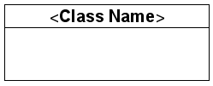
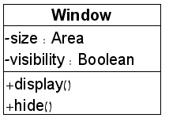


Class - 2
Visual notation:
Example:
Class information
Class Name
Attributes
Data type
Operations
Object-Oriented Analysis and Design

Slide 10
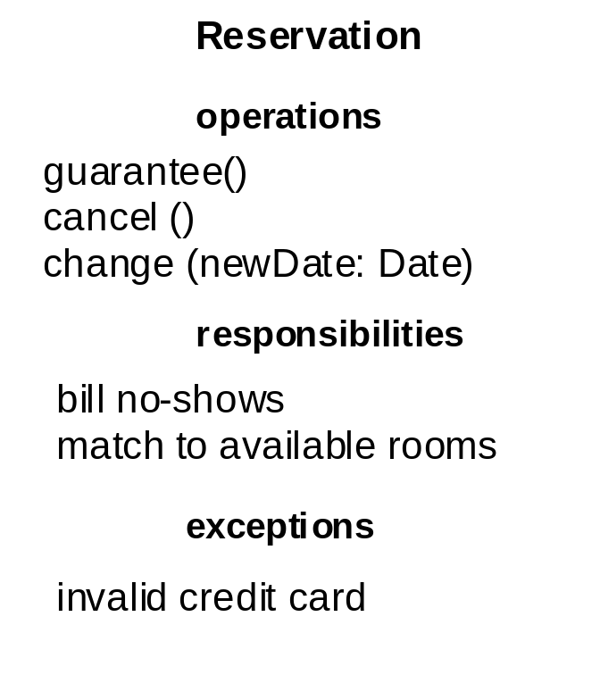
Class - 3
More class information visualized
Window
{abstract,
author=Joe,
status=tested}
+size:Area = (100,100)
#visibility:Boolean = invisible
+default-size:Rectangle
#maximum-size:Rectangle
-xptr: XWindow*
+display ()
+hide ()
+create ()
-attachXWindow(xwin:Xwindow*)
Object-Oriented Analysis and Design

Slide 11
Class - 4
Class and object visualization is by default incomplete:
  Having no attributes does not mean that there are no attributes.
  Having no attribute types does not mean that there are no attribute types.
  Having no operations…..
The only mandatory part is the class name: unique.
Responsibility: A specification of the class intention.
  Always recommended (recall the high cohesion principle!)
  Understood as a contract or an obligation of a class.
  As the model is refined the responsibilities are transformed into attributes and operations.
Object-Oriented Analysis and Design

Slide 12
Attributes
Attribute: A named property within in a class
An attribute is a mapping:
Class → Value-domain (Data type)
Visual notation: Names in the lower part of a class
rectangle.
Finding attributes in text: adjectives, value abstractions.
Constraint: Unique name per class!
Object-Oriented Analysis and Design

Slide 13
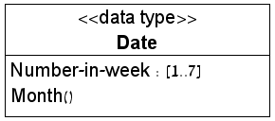
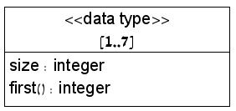
Data types and Values
Value: A piece of data. No identity.
Data type: like an Abstract data type (interface):
A set of values + operations.
Values might have their own attributes.
Finding values in text:
  Enumerations
  Examples in problem documentation.
Visualization:
Object-Oriented Analysis and Design

Slide 14
Objects vs. Values
Objects have identities, can have attributes, operations, and participate in relationships.
  Two forms of equality:
    Identity equality.
    Content equality.
Values – do not have identities
  A single form of equality: Value equality
  Value “duplications” are indistinguishable.
Values - can only be used to form other values, or as the values of attributes and parameters for operations.
Object-Oriented Analysis and Design

Slide 15
Objects vs. Values
An object attribute value is a VALUE not an object
  An element of a data type.
To be an object or to be a value, that is the question
  Depends on the application (one application values may become an object in another application):
    In a library system Date is probably a data type. Its elements are values.
    In a calendars translation system Date is probably a class. Its elements are objects.
Object-Value heuristic rule:
If it’s important it’s an object!
Object-Oriented Analysis and Design

Slide 16
Terminology
A Class is a set of objects (instances)
A Data type is a set of data values
An Attribute is a mapping from a class
into a data type.
Object-Oriented Analysis and Design

Slide 17
2. Basic Association Concepts
Object-Oriented Analysis and Design

Slide 18
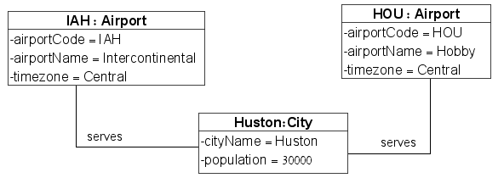
Link and Association concepts - 1
Link – conceptual or physical connection between objects
A link is (denotes) a tuple
A binary link is a pair. A ternary link is a triplet, etc.
Visual notation: Possibly labeled line among objects. The label is the name of the association to which the link belongs.
Object-Oriented Analysis and Design

Slide 19
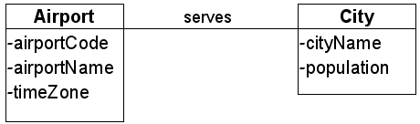
Link and Association concepts - 2
Association – A group of links with common structure and common semantics :
  Links among objects from the same classes and with the same structure (similar properties)
Visual notation : Possibly labeled line among classes.
Object-Oriented Analysis and Design

Slide 20
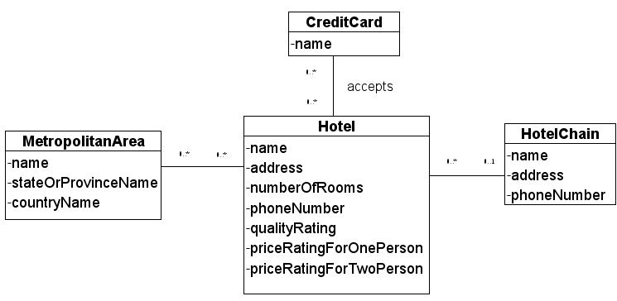
Link and Association concepts - 3
The line label is the name of the association
It is optional (but mandatory for multiple associations among classes)
Associations are not directed!
Finding Associations in text: verbs.
Constraint: The name of an association between a
set of classes is unique!
Object-Oriented Analysis and Design

Slide 21
Classes and Associations
A link is an instance of an association.
A link is not a value.
A link is not an object: No identity.
Analogy: Association – link
Class – object
Object-Oriented Analysis and Design

Slide 22
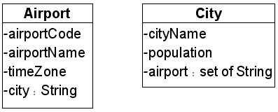
Associations vs. Attributes - 1
• Novice modelers (especially with DB experience)
tend to overuse attributes instead of associations.
Associations are the essence of object-oriented modeling. Connections between objects are always modeled as links.
Attributes provide additional (secondary) information about identified objects.
Attribute heuristic rule:
If it’s important it’s not an attribute!
Object-Oriented Analysis and Design

Slide 23
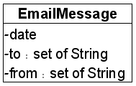
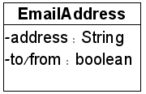
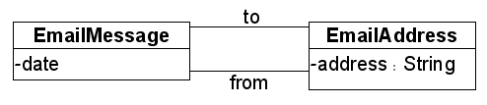
Associations vs. Attributes - 1
Example:
Consider: An Email Message has To Addresses and From Addresses.
Question: Is the To or From an attribute of EmailAddress? Or of EmailMessage?
Answer: NO NO NO!
The To and From describe relationships between a message and its email addresses.
→ To and From belong to two different associations between EmailMessage and EmailAddress:
Object-Oriented Analysis and Design

Slide 24

White Class Diagrams
White class diagrams are diagrams with no attribute information. They are used in the first stage of a system modeling in order to enforce concentration on classes and associations.
Example:
• A white diagram:
• A non-white diagram:
Object-Oriented Analysis and Design

Slide 25
Link and Association concepts: Roles - 1
A role is a relation between
  a class in an association
  the association
A role denotes the “role” of the class in the association.
It provides a (conceptual) direction on the association.
A (binary) association has exactly two roles.
A role has a name.
Object-Oriented Analysis and Design

Slide 26
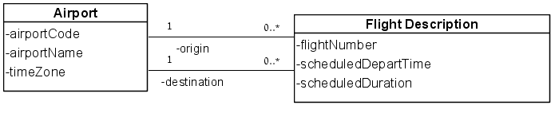
Link and Association concepts: Roles - 2
Visual notation: The role name is marked as a label on
the class edge in the association line.
Role names are used in the Object Constraint Language (OCL) for traversing associations:
aFlightDescription.origin – accesses the origin airport.
aFlightDescription.destination– accesses the destination airport.
Object-Oriented Analysis and Design

Slide 27

Link and Association concepts: Roles - 3
Role names function as pseudo-attributes –
  Should be distinguished from the attributes of the origin class:
If the name of a class adequately describes its role, you may omit role names.
The class name is used as the role name, if needed.
A
role
B
≠ role
DriverLicense.Owner
Object-Oriented Analysis and Design

Slide 28
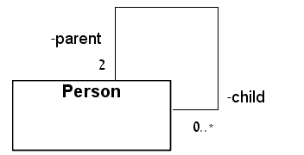
Link and Association concepts: Roles - 4
Constraint: Role names are mandatory
in ambiguous situations:
1. Multiple nameless associations between classes.
2. Multiple roles for a single class in an association.
aPerson.parent – accesses the parents of a person.
aPerson.child – accesses the children of a person.
The parent-child association is cyclic (recursive).
Describes hierarchical instance structures (directed graphs).
Object-Oriented Analysis and Design

Slide 29
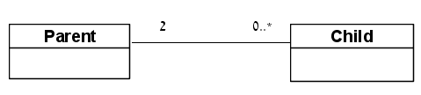
Roles vs. Objects - 1
Roles should not be confused with objects.
Example:
Consider: A person has exactly two parents and any
number of children.
Question: Are Person, Parent, Child roles or objects?
Answer: Person is a class;
parent, child are roles in a parent-child recursive association on Person.
Wrong Model
Correct Model
Object-Oriented Analysis and Design

Slide 30
Roles vs. Objects - 2
• To be a role or to be an object, that is the question
– depends on the application (one application roles
may become another application objects).
Object-Role heuristic rule:
It’s an object only if it is an entity characterization!
Think if you wish to characterize it with attributes and associations.
Otherwise, it’s a role in an association!
In most applications:
  Person is a characterization of people.
  Parent, child are not characterizations of entities :
    a child can be a parent.
    a parent can be a child.
But in a school application Parent and Child might be appropriate classes.
Object-Oriented Analysis and Design

Slide 31
Roles vs. Objects - 3
Examples:
Consider: A Flight Description has an Origin Airport and
Destination Airport.
Question: Are Flight Description, Airport, Origin Airport,
Destination Airport roles or objects?
Answer: In standard airports:
Flightdescription, Airport are classes;
destination, origin are roles in flightDescription-
airport associations between flightDescription and Airport.
Consider: A Sale Transaction has a Seller and a Buyer.
Question: Are Sale Transaction, Seller, Buyer roles or objects?
Answer: ???
Object-Oriented Analysis and Design

Slide 32
3. Class Diagrams and Object (instance) Diagrams
Object-Oriented Analysis and Design

Slide 33
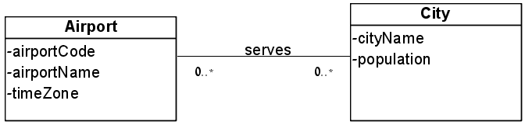
Class diagrams: Syntax - 1
A class diagram is a visual specification of UML class
level concepts.
It includes: Classes, associations, attributes, roles,
multiplicity constraints, and more.
Alternative names: Object model, class model.
Object-Oriented Analysis and Design

Slide 34
Class diagrams: Syntax - 2
Syntactically correct class diagram :
  An association line connects only class figures, not associations.
  No class name repetitions
  No association name repetitions among same classes.
  Mandatory role-name constraints.
  No attribute name repetitions within a class.
  And more…
Object-Oriented Analysis and Design

Slide 35
Class diagrams: Syntax - 3
A class diagram describes (constrains) possible realities (worlds).
Such a world consists of:
– classes which are sets of objects.
– associations which are (are) sets of links
(object tuples).
– attributes which are mappings.
– data types which are sets of data values.
– roles which are relations between
associations and classes.
– and more…
data level
class level
Object-Oriented Analysis and Design

Slide 36
Class diagrams: Syntax - 4
Possible worlds:
W1: Classes: Airport = {AOU, JAH}; City = {Houston};
Associations: Serves = {(AOU, Houston), (JAH, Houston)};
Attributes: city name(Houston) = “Houston”;…
W2: Classes: Airport = {}; City = {c1, c2};
Associations: Serves = {};
Attributes: city name(c1) = “Tel-Aviv”;…
W3: Classes: Airport = City = {};
Associations: Serves = {};
W4: ……
Question: How many worlds are there?
Object-Oriented Analysis and Design

Slide 37
Class diagrams: Syntax - 5
A possible world of a class diagram consists of:
  An instantiation :
    For all classes, associations, and attributes in the diagram
    Only for classes, associations, and attributes in the diagram
  It should satisfy all constraints imposed in the diagram.
  Every symbol/figure has an instantiation!
  Only symbols/figures in the diagram have instantiations!
  All constraints hold!
Object-Oriented Analysis and Design

Slide 38
Class diagrams: Semantics
The semantics (meaning, denotation) of a class diagram is the set of worlds that it describes.
A world that is described by a class diagram can be
empty – all classes are empty;
non-empty – some classes are non-empty;
finite – all classes are finite;
infinite – some classes are infinite.
Intended worlds: Finite non-empty.
• The UML specification: http://www.uml.org/ does not provide formal semantics.
• Enormous research efforts (academic and industry).
Object-Oriented Analysis and Design

Slide 39
Instance (Object) diagrams
Symbolic description of possible worlds is annoying and not readable.
  Visualization can help in this case
  Possible worlds are visualized by instance diagrams.
An instance diagram describes part of a world denoted by a class diagram:
  The all requirement in a possible world is waived
  The only and all constraints requirements must be satisfied
Object-Oriented Analysis and Design

Slide 40
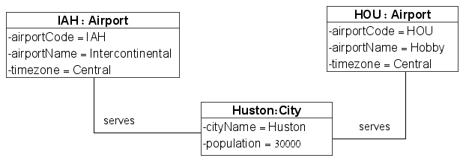
Instance (Object) diagrams: Syntax - 1
An instance diagram is a visual specification of UML instance (data) level concepts.
It includes : Instances, links, attributes values, roles.
attributes
data values
objects
links
An instance diagram visualizes a non-empty and finite world.
Empty means that it includes no objects → no diagram!
Infinite means that it includes an infinite number of objects:
Diagrams cannot be visualized!
Object-Oriented Analysis and Design

Slide 41
Instance (Object) diagrams: Syntax - 2
Syntactically correct instance diagram:
– An object (instance) cannot be repeated – each
instance figure stands for a different object.
Instance names cannot be repeated within a class.
– A link line connects instances.
– A link cannot be repeated. Different links between same objects must belong to different associations.
– Attribute values are data values not objects.
Object-Oriented Analysis and Design

Slide 42
Instance (Object) diagrams: Usage
Instance diagrams are always used relatively to a class diagram.
They are used for:
– Analyzing the intended application by demonstrating the worlds that can be described by the class diagram.
– Validating a class diagram by testing whether the worlds described by the class diagram meet the intentions of the designer.
Object-Oriented Analysis and Design

Slide 43
Instance (Object) diagrams: Terminology
An instance diagram instantiates/populates a class diagram
An instance diagram is an instance of a class diagram if it instantiates only elements from the class diagram: Classes, associations, attributes
An instance diagram is a legal instance of a class diagram if it is an instance and it satisfies all constraints imposed by the class diagram
Object-Oriented Analysis and Design

Slide 44
Instance (Object) diagrams: Examples - 1
For the class diagram:
The instance diagram:
is a legal instance
It visualizes the world:
W₁: Classes: Airport = {AOU, JAH}; City = {Houston};
Associations: Serves = {(AOU, Houston), (JAH, Houston)};
Attributes: cityName(Houston) = “Houston”;…
Object-Oriented Analysis and Design

Slide 45

Instance (Object) diagrams: Examples - 2
For the class diagram:
The instance diagram:
is a legal instance
It visualizes a portion of the W₁ world:
– No Airport objects are visualized.
– No attributes of the City object are visualized.
Note: The object name is not part of the described world – objects are nameless. They exist by virtue of their identities. In the instance diagram, every object figure stands for an object identity. Names are added just for convenience of user references.
Object-Oriented Analysis and Design

Slide 46
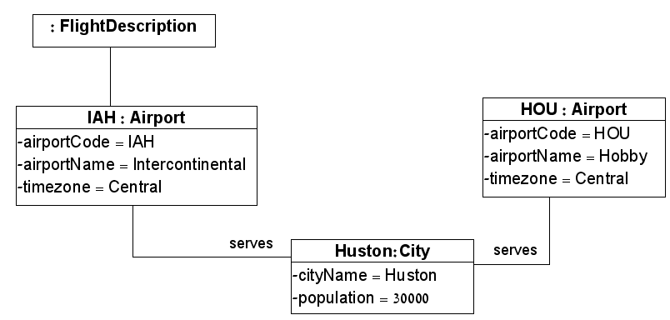
Instance (Object) diagrams: Examples - 3
For the class diagram:
The instance diagram:
is not a valid instance diagram
Object-Oriented Analysis and Design

Slide 47
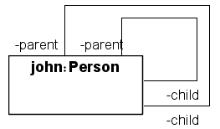
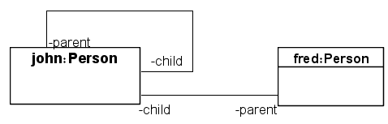
Instance (Object) diagrams: Examples - 4
For the class diagram:
A syntactically incorrect instance:
A legal instance:
It visualizes the world: Classes: Person = {john, fred};
Associations: parent-child = {(john, john), (john, fred)};
This is a legal not-intended instance!
→ The class diagram is too weak to enforce the designer intentions!
Object-Oriented Analysis and Design

Slide 48
Instance (Object) diagrams: Consistency
A class diagram is satisfiable (consistent) if it has a non-empty legal instance.
A class diagram is strongly satisfiable if it has a non-empty legal instance that populates all classes (no empty classes).
Later on we will see examples of unsatisfiable class
diagrams. Ideally, CASE tools should:
  either reject such diagrams as semantically incorrect ones,
  or correct (provide advice) such diagrams.
  or reject and advice as to how to correct such diagrams.
Object-Oriented Analysis and Design

Slide 49
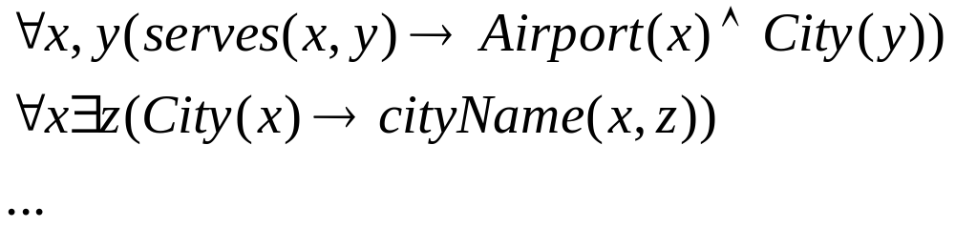
Class & instance diagrams : the logic analogy
UML static diagrams are “sentences” in a visual language.
UML diagram logic
symbols: visual figures language symbols
syntax: class diagram universally quantified equality/implication formulae
Object-Oriented Analysis and Design

Slide 50
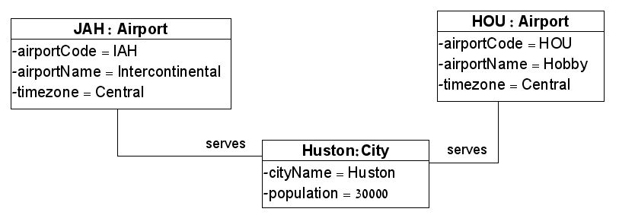
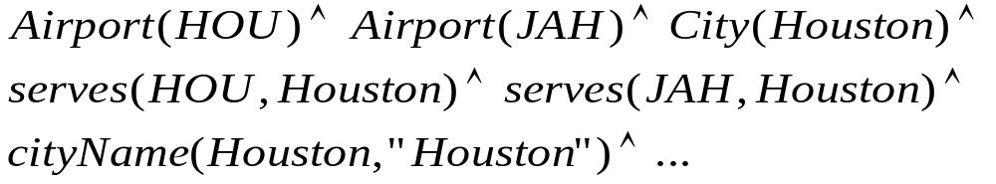
Class & instance diagrams : the logic analogy
UML diagram logic
syntax: …
instance diagram data assertions
semantics: instantiation structure (interpretation)
consistency: possible world model/world
legal instance diagrams
Object-Oriented Analysis and Design

Slide 51
4. Multiplicity constraints on associations
Object-Oriented Analysis and Design

Slide 52
Multiplicity constraints on associations - 1
A multiplicity constraint specifies the number of instances that can be related through links in the association, to a single instance of an associated class.
Notations:
* – 0 or more: min=0, max= infinity.
0..* – 0 or more: min=0, max= infinity.
1 – exactly 1: Min=max=1
1..* – 1 or more: Min=1, max=infinity.
0..1 – 0 or 1: Min=0, max=1.
2..4 – between 2 to 4: Min=2, max=4.
5 – exactly 5: Min=max=5.
2,4 – 2 or 4.
Object-Oriented Analysis and Design

Slide 53
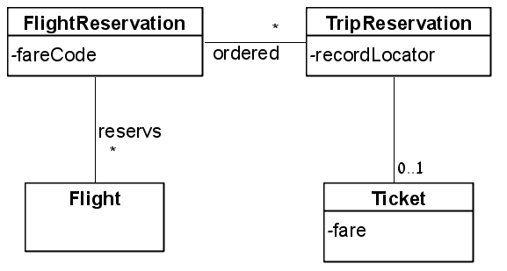
Multiplicity constraints on associations - 2
Object-Oriented Analysis and Design

Slide 54
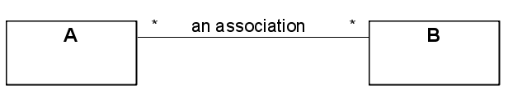

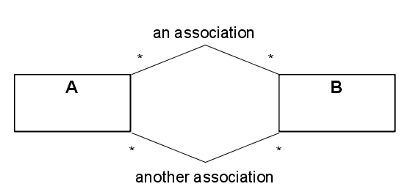

Multiplicity constraints on associations - 3
Multiplicity constraints refer to class diagrams.
They are meaningless for instance diagrams:
The 2 links must instantiate 2 different associations.
Object-Oriented Analysis and Design

Slide 55

Multiplicity constraints on associations - 4
Existence dependency: An exactly 1 multiplicity implies existential dependency between objects:
Deletion of an owner implies deletion of
its driver license.
Object-Oriented Analysis and Design

Slide 56

Multiplicity constraints on associations - 5
Multiplicity constraints do not involve attribute values:
What is the meaning of this diagram?
  Draw a legal but unintended instance diagram.
  Draw an illegal but intended instance diagram.
Object-Oriented Analysis and Design

Slide 57
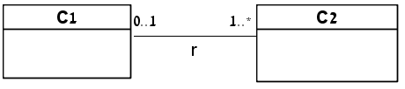
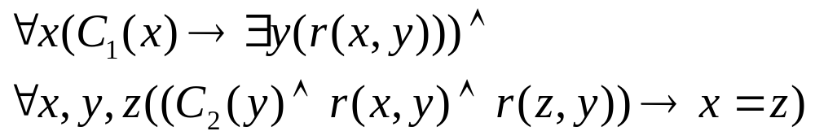
Multiplicity constraints on associations - 6
Multiplicity constraints can be expressed in logic:
A minimum constraint requires existential quantification.
A maximum constraint requires universal quantification.
Object-Oriented Analysis and Design

Slide 58
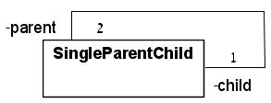
Multiplicity constraints on associations - 7
An unsatisfiable class diagram – has either an empty or an infinite legal instance diagrams:
A legal instance has the structure of a directed binary tree, where every node has:
  exactly one incoming edge (the child).
  exactly two outgoing edges (the parents).
  an infinite structure!
Object-Oriented Analysis and Design

Slide 59



Qualified Associations -1
A qualifier is a means for disambiguating the objects in a “many” role:
  A qualifier can be an attribute or a role
  A qualifier selects among the target objects.
Not qualified:
Qualified:
b, a1, a2, n ( (Bank(b) &
Account(a1) & accountNumber(a1, n) & r(b, a1) &
Account(a2) & accountNumber(a2, n) & r(b, a2) ) → a1 = a2)
Object-Oriented Analysis and Design

Slide 60
Qualified Associations -2
A qualified association is more informative:
• Reduces multiplicity.
• Implies direction for traversing the association.
• Usually affects only the maximum bound.
Object-Oriented Analysis and Design

Slide 61

Qualified Associations - 3
Partial disambiguation:
Qualification cascade:
Object-Oriented Analysis and Design

Slide 62
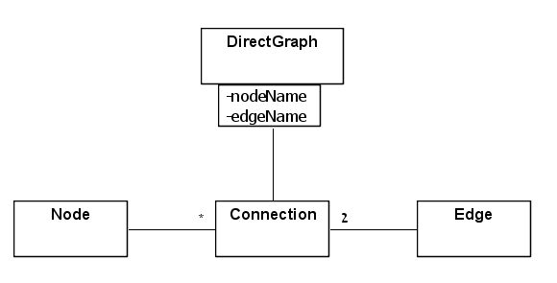
Qualified Associations - 4
Compound Qualifier:
Object-Oriented Analysis and Design

Slide 63
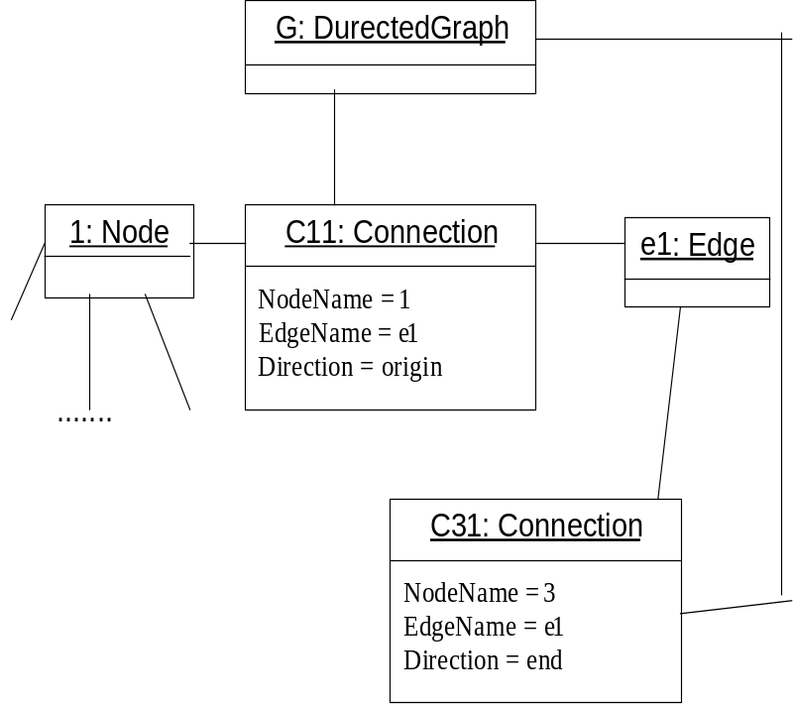
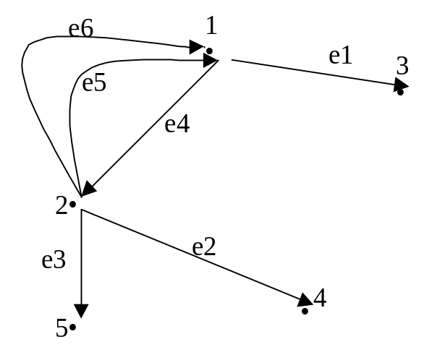
Qualified Associations - 5
This class diagram can describe the graph and the legal instance diagram:
Note that it has also non-intended but legal instance diagrams!
Object-Oriented Analysis and Design

Slide 64
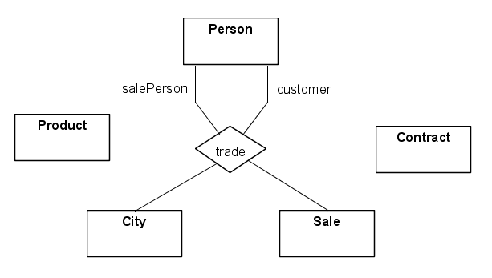
N-ary Associations
An n-ary association is an association among n classes.
Its links are n-tuples.
No convention for multiplicity constraints.
Object-Oriented Analysis and Design

Slide 65
5. Associations as objects
Object-Oriented Analysis and Design

Slide 66
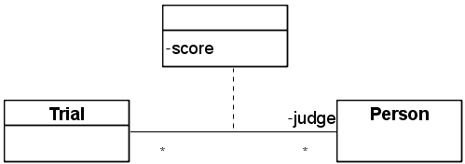
Link Attributes - 1
A link attribute is a named property of an association that describes a value held by each link in the association.
Identified – by following the adverbs, or by abstracting known values.
Visual notation:
Object-Oriented Analysis and Design

Slide 67
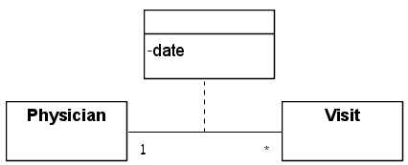

Link Attributes - 2
Link attributes are intuitively understandable for associations with many-many multiplicity – as in the Trial-Person association.
But – can be confused with object attributes in
1:1 or 1:many associations
Object-Oriented Analysis and Design

Slide 68
Association classes - 1
An association class is an association whose links have identities.
They can participate in other associations
An association class is both:
  A Class.
  An Association.
Object-Oriented Analysis and Design

Slide 69
Association classes - 2
The link identities derive from the identities of the related instances.
Association classes add an extra constraint:
  A single instance of the association between any 2 instances of the associated class - the regular association constraint!
An association class can have attributes.
Object-Oriented Analysis and Design

Slide 70
Association classes : Examples - 1
Authorization in a relational DBMS:
  A user may own multiple tables.
  The owner of a table may authorize 1 or more other users access to the table.
  An authorized user may grant more permissions.
  Example: A owner of T. B, C are grantees for T by A, the grantor. B can authorize D, E, etc.
Object-Oriented Analysis and Design

Slide 71
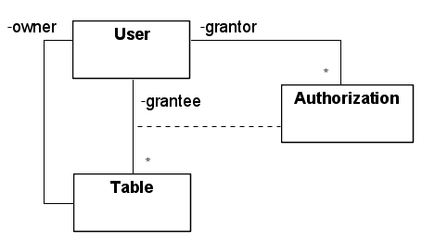
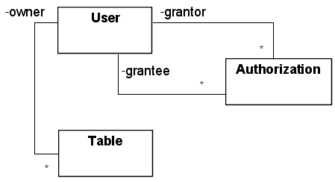
Association classes : Examples - 1
*
*
Preferred model with association class
Degraded model with ordinary class
Drawbacks of the regular class model:
1. Symmetric dependencies between Authorization and the
User and Table classes.
2. grantee-Table association and its unique multiplicity
dependency on grantor is lost.
3. No traversal path for reading the diagram.
Object-Oriented Analysis and Design

Slide 72
Association classes : Examples - 1
Does any class model (of the two given) capture all the requirements? Here are the requirements again:
  The user may own multiple tables.
  The owner of a table may authorize 1 or more other users access to the table.
  An authorized user can grant more permissions.
Requirements 2 and 3 are not fully enforced! Why?
  To see that – provide a legal instance diagram that does not meet the requirements.
  or – rewrite the class diagrams in logic and provide a model that does satisfy the requirements.
Object-Oriented Analysis and Design

Slide 73
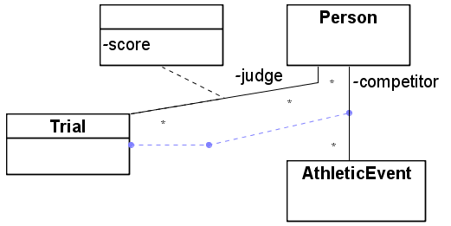
Association classes : Examples - 2
Consider the former class diagram:
New information:
  A participation of a competitor in an athletic event is termed a trial.
  There are several competitors within an athletic event.
  In every trial there are several judges. Each judge assigns a score.
  A judge might serve in many trials.
Trial uniquely characterizes a
competitor-AthleticEvent pair
  Trial is an association
A trial is related to judges
  Trial must be a class!
Object-Oriented Analysis and Design

Slide 74
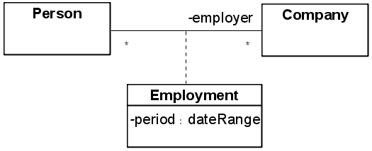
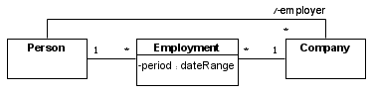
Association classes : Examples - 3
Employment association (a):
Employment association (b):
Object-Oriented Analysis and Design

Slide 75
Association classes : Examples - 3
In (a), every person can be employed only once in a single company! (why?)
In (b), a person can work for the same company several times.
Note the changes in the multiplicity constraints.
Object-Oriented Analysis and Design

Slide 76
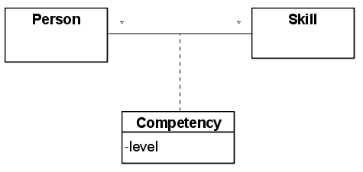
Association classes : Examples - 4
Compare the following :
(a):
(b):
(a) is not appropriate if people can work for the same company in several different periods.
(b) states the reasonable situation: A single person has a single level for a given skill.
Object-Oriented Analysis and Design

Slide 77
6. Class Hierarchies
Object-Oriented Analysis and Design

Slide 78
Class Hierarchies : Classification
Class Hierarchy is a new kind of relationship between classes: It relates a class (the super-class) with some of its sub-classes.
Class Hierarchy organizes classes by:
  Similarity.
  Differences.
Class Hierarchy arises either from generalization or from specialization (sub-typing):
  Generalization -- a bottom-up notion.
  Specialization -- a top-down notion.
Object-Oriented Analysis and Design

Slide 79
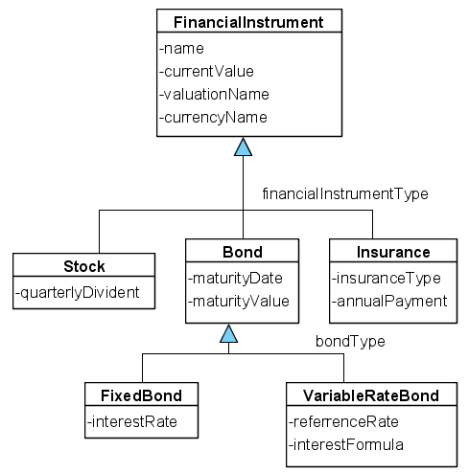
Class Hierarchies : Classification
Size of a sub-classes group is greater or equal to 1.
Object-Oriented Analysis and Design

Slide 80
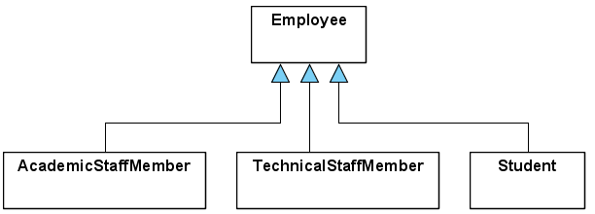
A Class Hierarchy Without Grouping
Size of each “sub-classes group” is equal to 1.
Object-Oriented Analysis and Design

Slide 81
Class Hierarchy : Semantics - 1
A class hierarchy denotes the subset relation between the involved classes:
  Stock, Bond, insurance are subsets of FinancialInstrument
  FixedRateBond, VariableRateBond are subsets of Bond
In logic:
b (Bond(b) → Finantialinstrument(b))
Object-Oriented Analysis and Design

Slide 82
Class Hierarchy : Semantics - 2
The subset semantics implies :
  Inheritance – A subclass inherits from its super-
  classes their attributes, associations,
  operations, state-charts
  Class hierarchy is transitive - A class hierarchy specification associates a single direct super-class with each subclass, but possibly multiple non-direct super-classes.
Object-Oriented Analysis and Design

Slide 83
Class Hierarchy Group Annotations - 1
Kinds of group annotations:
  Discriminator.
  Generalization Constraints:
    Incomplete
    Complete
    Disjoint
    Overlapping
  Dynamic.
Object-Oriented Analysis and Design

Slide 84
Class Hierarchy Group Annotations - 2
In UML2:
  The discriminator annotation is removed.
  Class hierarchy groupings are termed generalization sets.
Object-Oriented Analysis and Design

Slide 85
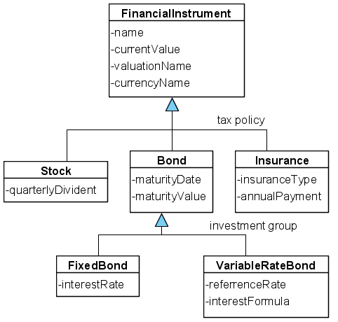
Group Annotations – 3 : Discriminator
A discriminator to a class hierarchy group specification is an attribute of the super-class whose values distinguish between objects of the subclasses. For each subclass it assigns a common value to all of its objects.
investment group
is an attribute of Bond. All FixedRateBond instances have a common investment group value which is different from the common investment group value of VariableRateBond instances.
Object-Oriented Analysis and Design

Slide 86
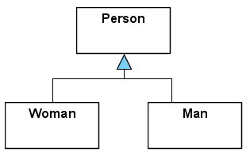
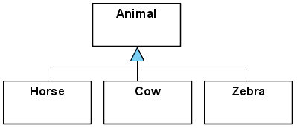
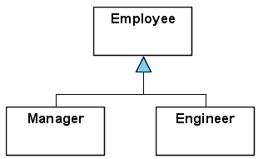
Group Annotations – 4
Generalization Constraints.
  Built-in generalization constraints:
{incomplete}
{complete}
{disjoint}
{overlapping}
Object-Oriented Analysis and Design

Slide 87


Group Annotations – 5
Generalization constraints in logic :
  Complete :
  Incomplete :
  Disjoint :
  Overlapping :
Overlapping and disjoint semantics is ambiguous. can refer to:
  the intersection of all subclasses in the group – non-liberal.
  the intersection of every two subclasses in the group – mildly-liberal.
  the intersection of some two subclasses in the group – liberal.
Object-Oriented Analysis and Design

Slide 88
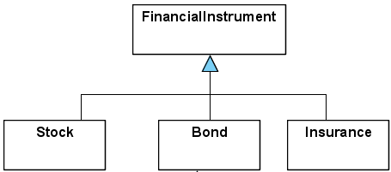
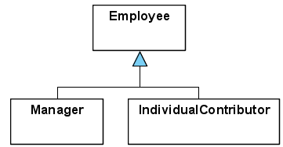
Group Annotations – 6
Abstract and Concrete Classes.
A concrete class – can have direct instances.
An abstract class – no direct instances.
<<concrete>>
<<abstract>>
Object-Oriented Analysis and Design

Slide 89
Group Annotations – 7: Inter-Relationships
A discriminator implies:
  a disjoint class annotation.
Abstract super-class annotation is equivalent to a complete group annotation.
Concrete super-class annotation is equivalent to a incomplete group annotation.
Complete and incomplete annotations are contradictory.
Disjoint and overlapping annotations are contradictory.
Object-Oriented Analysis and Design

Slide 90
Group Annotations – 8: Dynamic
Dynamic annotation – marks that objects can change types within a class hierarchy structure, during their life time.
Class Person:
  Subclasses Female, Male – with discriminator sex;
  Usually will not be marked as <<dynamic>>.
But: Class Person:
  Subclasses Manager, Engineer, Salesperson
    with Discriminator job;
  can have the annotation <<dynamic>>
Object-Oriented Analysis and Design

Slide 91
Group Annotations – 9:Multiple sub-groups
A class can have multiple sub-groupings – each distinguished by a discriminator. All subclasses with the same discriminator are disjoint:
Class Person :
  Subclasses Female, Male – with discriminator sex;
  Subclasses Doctor, Nurse, PhysioTherapist - with discriminator role;
  Subclass Patient.
The super-class is abstract.
CASE tools do not enforce group annotation consistency.
Object-Oriented Analysis and Design

Slide 92
Group Annotations – 10
Support by implementation languages
Standard programming languages do not support:
  Class hierarchy grouping.
    Discriminator annotation.
  Overlapping annotation: An object cannot be an instance of multiple classes that are not related by sub-typing relationships. Only class hierarchy polymorphism is supported
  Complete/incomplete is supported via the Abstract class annotation.
  Dynamic annotation.
Object-Oriented Analysis and Design

Slide 93
Kinds of Class Hierarchies - 1
Simple class hierarchy: A class is a sub-class of at most a single class hierarchy construct.
  Implies single inheritance.
  A tree structure class diagram.
  Entity-relationship modeling supports only simple class hierarchies.
Complex class hierarchies: A class might have multiple direct super-classes.
  Implies multiple inheritance.
  A Directed Acyclic Graph (DAG) class diagram.
  Multiple inheritance might lead to contradictions.
    Requires policies for resolving inheritance contradictions.
Object-Oriented Analysis and Design

Slide 94
Kinds of Class Hierarchies - 2
Simple class hierarchy:
  Restricted expressivity: In reality objects might have multiple categorization and multiple responsibilities:
    e.g., FullTime-Consultant, Local-Car, Student-Employee, …
  Supported by all Object-Oriented programming languages.
Complex class hierarchies:
  Real world compatible expressivity.
  Not supported by some Object-Oriented programming languages.
  Requires methods for transforming complex hierarchies into simple ones.
Object-Oriented Analysis and Design

Slide 95
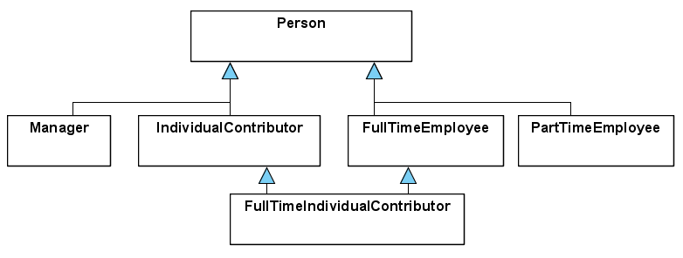

Removing complex class hierarchies - 1
Multiple inheritance from a single ancestor with different discriminators:
Managerial status
Employment status
Removing multiple inheritance by factoring:
Managerial status
Employment status
Employment status
Object-Oriented Analysis and Design

Slide 96


Removing complex class hierarchies - 2
Multiple inheritance without a common ancestor:
Removing multiple inheritance by subclass fragmenting:
Object-Oriented Analysis and Design

Slide 97

Removing complex class hierarchies - 3
Multiple inheritance without a common ancestor:
Removing multiple inheritance by replacing generalization with exclusive-or associations:
Object-Oriented Analysis and Design

Slide 98


Association cycles within class hierarchies
Example: Directed graph.
Consists of nodes and edges. Each edge connects 2 nodes. An edge has a direction.
Left : Directed graphs with at most a single edge between 2 nodes – edges are captured by the Branch – Node association.
Right : Any directed graph.
Object-Oriented Analysis and Design

Slide 99

Association cycles within class hierarchies
Observing an instance diagram can help selecting a desired class diagram.
Object-Oriented Analysis and Design

Slide 100


Association cycles within class hierarchies
Instance diagram for left mode :
Instance diagram for right mode :
Object-Oriented Analysis and Design

Slide 101
Association cycles within class hierarchies
Evaluation:
  Right diagram:
    More complex.
    Both Nodes and Edges are conceived as objects.
  Left diagram:
    Simpler.
    Direct correspondence to the graph model.
    The left diagram provides a structural enforcement of the constraint:
      At most a single edge between any two nodes.
Object-Oriented Analysis and Design

Slide 102


Association cycles within class hierarchies
Another directed graph. This graph cannot be represented by the left model.
Instance diagram for right mode :
Object-Oriented Analysis and Design

Slide 103
7. Constraints on Associations
Object-Oriented Analysis and Design

Slide 104

Constraints on associations: exclusive-or:1
Exclusive-or is a grouping of associations that involves
a single source class.
Visual notation:
UML 1.5 par 3.42.5.1
Object-Oriented Analysis and Design

Slide 105

Constraints on associations: exclusive-or:2
The semantics is that an object of the source class can participate in at most single link, out of all associations in the grouping.
No exclusive-or grouping overlap.
The semantics of exclusive-or constraint dominates the regular semantics of multiplicity constraints.
Object-Oriented Analysis and Design

Slide 106

Constraints on associations: exclusive-or:3
Modeling with exclusive-or is more accurate:
The left model is preferable since:
  It enables a single link for every header instance (source class object).
  The right model loses the multiplicity differences between the two associations.
Object-Oriented Analysis and Design

Slide 107


Constraints on associations: exclusive-or:4
What is the preferred model?
Object-Oriented Analysis and Design

Slide 108

Constraints on associations: inclusion-1
Association inclusion means inclusion of the link sets.
member
manager
Does association inclusion extend UML expressivity?
Answer: NO (why?)
UML 1.5 par 3.16.1
Object-Oriented Analysis and Design

Slide 109

Constraints on associations: inclusion-2
Association inclusion constraints are popular especially in the presence of class hierarchies, where the association of a sub-class provides more specific information.
Object-Oriented Analysis and Design

Slide 110
8. Aggregations
Object-Oriented Analysis and Design

Slide 111

Aggregation - 1
Aggregation : is an association between a class –
the assembly – to its parts – the component classes.
Visual Notation:
Object-Oriented Analysis and Design

Slide 112
Aggregation - 2
The aggregation relation is singled out in UML as a special kind of association.
Aggregation is transitive.
  The transitive closure of an assembly is the full set of its parts.
Aggregation is anti-symmetric.
Aggregation is not ordered.
Different aggregation assemblies are not visualized. May be marked/commented
Object-Oriented Analysis and Design

Slide 113

Recursive Aggregation
Creates Tree or DAG structures of unbounded depth.
Object-Oriented Analysis and Design

Slide 114
Physical and Logical Aggregations - 1
Logical (catalog) Aggregation – a component can be used in multiple assemblies.
Physical (composition) Aggregation – a component belongs to at most a single assembly.
UML offers two kinds of aggregation notations:
  Logical (catalog) aggregation – denoted:
  Physical (composition) aggregation – denoted:
Examples:
  A concrete car vs. a car model.
  The Program aggregation – physical or logical?
Object-Oriented Analysis and Design

Slide 115
Physical and Logical Aggregations - 2
The instances of a physical aggregation are trees.
The instances of a logical aggregation are Directed Acyclic Graphs (DAGs).
The instances of a recursive aggregation have unbounded depth.
Tree aggregation can support:
  Propagation of properties.
  Default values.
DAG aggregation requires resolution of clashes.
Object-Oriented Analysis and Design

Slide 116

Physical and Logical Aggregations - 3
Logical elements exist independently of physical ones.
Object-Oriented Analysis and Design

Slide 117

Physical and Logical Aggregations - 4
A catalog part may belong to multiple assemblies and contain multiple parts.
A catalog part is identified by its role in the assembly.
A physical part may belong to at most a single assembly and contain multiple parts.
There might be indistinguishable catalog parts (like nail kinds). The Contains associations has a quantity attribute for quantifying these parts.
Object-Oriented Analysis and Design

Slide 118
9. Relationships Overview
Object-Oriented Analysis and Design

Slide 119
Relationships reviewed in UML
All relationships are visualized by lines between classes.
  Sub-typing / generalization (in class hierarchies). Denoted by a solid line and an empty arrow.
  Instantiation. Denoted by a dashed line labeled <<instance>>.
  Association. Denoted by a solid line.
  Aggregation. Denoted by a solid line ended with a solid or empty diamond.
Object-Oriented Analysis and Design

Slide 120
Sub-typing\Generalization
Not inter-object relationships!
They distinguish:
  Similarities and differences.
  Emphasize different aspects of instances.
  An OR grouping.
  Involve classes alone.
  Important during design, for reuse.
  Eliminate duplications.
Object-Oriented Analysis and Design

Slide 121


Instantiation
Instantiation: Involves an object and a class. Mixture of class diagram and instance diagram elements.
Generalization
Instantiation
Object-Oriented Analysis and Design

Slide 122

Association
Association: Describes relationships (links) among instances. Adds information beyond a class boundary. Important during analysis.
Generalization
Association
Object-Oriented Analysis and Design

Slide 123

Association vs. Sub-typing
Association: Do not confuse subclasses with roles:
Subclasses – Specialization.
Roles – Usage.
Use generalization only when there are attributes or associations to distinguish: there are clear sub-types!
Clear sub-types
Usage
Object-Oriented Analysis and Design

Slide 124

Aggregation
Aggregation: A special kind of association between a whole and a part.
An AND grouping – relates different objects that together compose an assembly.
Generalization
Aggregation
Object-Oriented Analysis and Design

Slide 125
10. Attribute Characterization
Object-Oriented Analysis and Design

Slide 126
Class level attributes and operations - 1
A class attribute/operation refers to the class itself as an object.
It can take one of two roles:
  Characterize the class as an object:
    Average age of employees.
    Update/management operations.
  Can stand for a property whose value is common to all instances of the class:
    Interest rate of all accounts of a common type.
    The location of BGU buildings.
    The origin country of all French cars.
Object-Oriented Analysis and Design

Slide 127


Class level attributes and operations - 2
Class attributes/operations are not recommended!
A better modeling: Add a new class of which the older class is an instance.
Discouraged Model
Preferred Model
Object-Oriented Analysis and Design

Slide 128

Attribute Values – 1: Multiplicity
Attribute multiplicity specifies the possible number of values for an attribute of an object. This specification is relevant mainly for database purposes (persistent classes).
Object-Oriented Analysis and Design

Slide 129

Attribute Values – 2: Key Constraints
A Key Constraint on a class (candidate key) is a minimal combination of attributes whose values uniquely identify objects of a class.
This specification is relevant mainly for database purposes (persistent classes).
Object-Oriented Analysis and Design

Slide 130

Attribute Values – 3: Key Constraints
A Key Constraint on an association is a minimal combination of roles and qualifiers that uniquely identify links of the association.
{CK =(Semester.id, Professor.id, Course.name) }
“A course with a given name is given by at most a single professor, in a given semester”.
Object-Oriented Analysis and Design

Slide 131

Attribute Values – 4: Key Constraints
CK = (Product.catalogNo, City.name) }
“A product is sold by at most a single sales person, in a given city”.
Key constraints take the role of multiplicity constraints for non-binary associations.
Object-Oriented Analysis and Design

Slide 132


Attribute Values – 5: Domains
An attribute can be followed by:
  Key indication.
  multiplicity indication.
  domain indication.
  default value.
Object-Oriented Analysis and Design

Slide 133
Attribute Values – 6: Domains
A domain (Type) is a named set of possible values for an attribute.
  It has associated operations.
  Domain values do not participate in associations.
A domain can be described in different ways:
  Intentionally: ODD = { n / n in NAT, n/2 not in NAT }
  Extensionally (enumeration domain): PriorityType = {NORMAL, URGENT, INFORMATIONAL }
  Structured: {PhoneNumber} – a set of phone numbers.
  Date = < year: YEAR, month: MONTH, day: DAY >
Object-Oriented Analysis and Design

Slide 134

Derived Attributes
Derived data is information that can be calculated from other elements in a diagram:
For a flightDescription:
scheduledArrivalTime = scheduledDepartureTime + scheduledDuration.
Visual notation: a preceding slash:
/scheduledArrivalTime
Object-Oriented Analysis and Design

Slide 135

Derived Attributes
Derived associations are also denoted using a preceding slash:
Derived association:
Object-Oriented Analysis and Design

