Slide 1
딥러닝 프레임워크 비교
송준이
socurites@aidentify.io

Slide 2
목차
딥러닝 프레임워크 종류
딥러닝 프레임워크 비교 Sheet
주요 특성 관점
Tech. Stack 관점
설계 관점
딥러닝 프레임워크 사용 예시

Slide 3
딥러닝 프레임워크 종류

Slide 4









딥러닝 프레임워크 Timeline
2010
2013
2014
2015
2016
2017
(Nov.)
(Dec.)
(Jun.)
(Mar.)
(Jan.)
(Apr.)
(Jul.)
(Jun.)
On GitHub
(Debut: Apr. ‘2015)
(Oct.)
(Nov.)
https://github.com/Theano/Theano/blob/master/HISTORY.txt
https://www.embedded-vision.com/industry-analysis/technical-articles/caffe-deep-learning-framework-interview-core-developers
https://www.preferred-networks.jp/en/news/8531
https://www.microsoft.com/en-us/research/blog/microsoft-computational-network-toolkit-offers-most-efficient-distributed-deep-learning-computational-performance/github/#sm.0000qz6ljpzl3fnrxby1iwpo5v5rf
https://www.wired.com/2014/06/skymind-deep-learning/
https://twitter.com/fchollet/status/581627598741999616
https://github.com/dmlc/mxnet/issues?q=is%3Aissue+is%3Aopen+sort%3Acreated-asc
https://www.wired.com/2015/11/google-open-sources-its-artificial-intelligence-engine/
https://github.com/Theano/Theano/blob/master/HISTORY.txt
https://www.facebook.com/yann.lecun/posts/10152142434782143
https://techcrunch.com/2017/04/18/facebook-open-sources-caffe2-its-flexible-deep-learning-framework-of-choice/

Slide 5
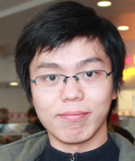
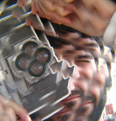
Caffe
http://caffe.berkeleyvision.org/
주체
Created by
Yangqing Jia (http://daggerfs.com/)
UC Berkerey 컴퓨터 과학 Ph.D. / 지도 교수(Trevor Darrell, BAIR 책임자)
구글 브레인 TensorFlow 프로젝트 참여
페이스북 리서치 사이언티트
Evan Shellhamer (http://imaginarynumber.net/)
UC Berkerey 컴퓨터 과학 Ph.D. / 지도 교수(Trevor Darrell, BAIR 책임자)
Maintained by
BAIR(Berkeley Artificial Intelligence Research, http://bair.berkeley.edu/)
릴리즈
‘2013: DeCAF (https://arxiv.org/abs/1310.1531)
Dec. ‘2013: Caffe v0
적용 사례
Facebook, Adobe, Microsoft, Samsung, Flickr, Tesla, Yelp, Pinterest, etc.
Motivation
‘2012 ILSVRC에서 발표한 AlexNet을 재현
DNN 정의/훈련/배포하기 위한 범용 F/W 구현

Slide 6
Caffe
http://caffe.berkeleyvision.org/
특징
장점
이미지 처리에 특화
프로그래밍하는 대신 설정 파일로 학습 방법을 정의
Caffe Model Zoo를 통한 다양한 Pre-trained Model 제공
이미지 기반 참조 모델의 de facto standard
단점
이미지 이외의 텍스트, 사운드 등의 데이터 처리에는 부적합
유연하지 못한 API
새로운 기능 추가의 경우 C++/CUDA로 직접 구현 필요
문서화가 잘 안되어 있음
F/W | 주체 | 플랫폼 | 모바일 | 언어 | 인터페이스 | OpenMP | CUDA | OpenCL | 멀티GPU | 분산
Caffe | BAIR | Linux, Mac | - | C++ | Python, MATLAB | Y | Y | - | Y
Caffe2(http://caffe2.ai/) 출시
- By Facebook
Android 지원, iOS 지원(예정)
분산 처리 지원

Slide 7
Chainer
http://docs.chainer.org/en/latest/index.html
주체
Created & Maintained by
Preferred Networks, Inc.(https://www.preferred-networks.jp/ja/)
릴리즈
Jun. ‘2015
적용 사례
Toyota motors, Panasonic (https://www.wsj.com/articles/japan-seeks-tech-revival-with-artificial-intelligence-1448911981)
FANUC (http://www.fanucamerica.com/FanucAmerica-news/Press-releases/PressReleaseDetails.aspx?id=79)
Motivation
Define-by-Run 아키텍처
실행 시점에 네트워크 그래프가 정의됨
복잡한 네트워크 정의를 보다 유연하게 지원할 수 있게 함

Slide 8
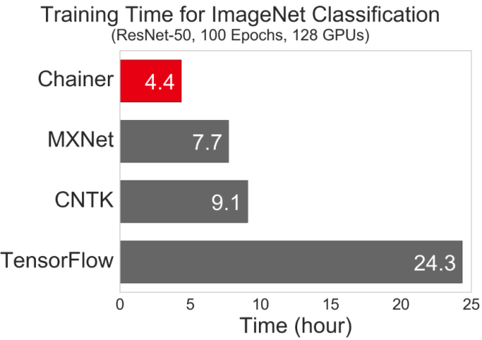
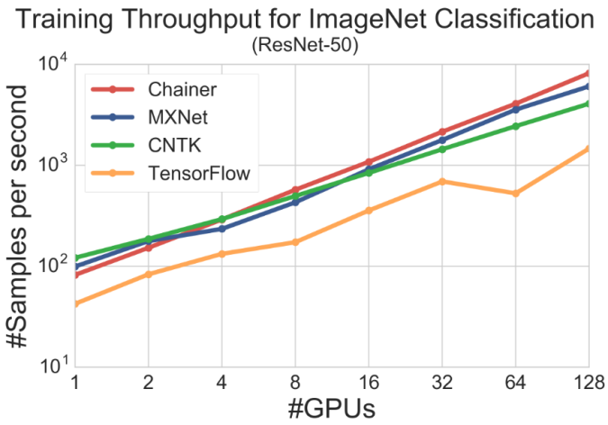
Chainer
http://docs.chainer.org/en/latest/index.html
특징
장점
빠른 속도
F/W | 주체 | 플랫폼 | 모바일 | 언어 | 인터페이스 | OpenMP | CUDA | OpenCL | 멀티GPU | 분산
Chainer | Preferred Networks | Linux | - | Python | Python | - | Y | - | Y | Y
출처: Performance of Distributed Deep Learning using ChainerMN
http://chainer.org/general/2017/02/08/Performance-of-Distributed-Deep-Learning-Using-ChainerMN.html

Slide 9
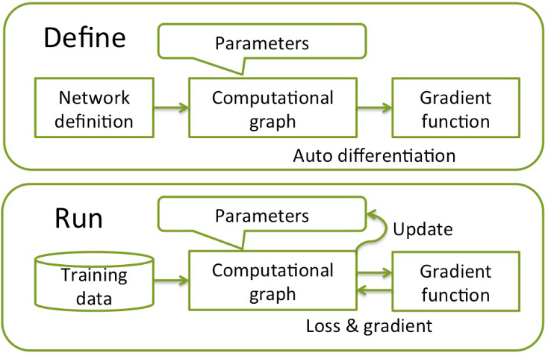
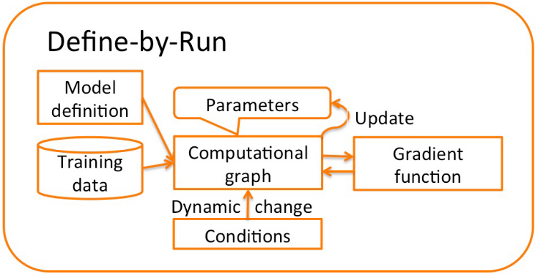
Chainer
http://docs.chainer.org/en/latest/index.html
특징
장점
Define-by-Run 모델 기반의 유연성 제공
단점
협소한 사용자 커뮤니티
[Define-and-Run (TensorFlow)]
[Define-by-Run (Chainer, PyTorch)]
출처: Complex Neural networks made easy by Chainer
https://www.oreilly.com/learning/complex-neural-networks-made-easy-by-chainer

Slide 10
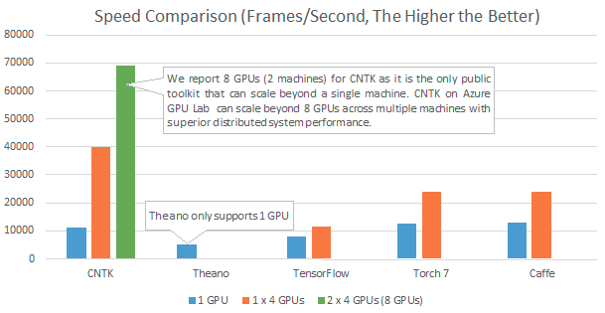
CNTK
https://www.microsoft.com/en-us/research/product/cognitive-toolkit/
주체
Created & Maintained by
Microsoft Research
릴리즈
Jan. ‘2016
적용 사례
Microsoft’s speech recognition engine
Skype’s Translator
Motivation
Efficient performance on distributed environments
https://www.microsoft.com/en-us/research/blog/microsoft-computational-network-toolkit-offers-most-efficient-distributed-deep-learning-computational-performance/

Slide 11
CNTK
https://www.microsoft.com/en-us/research/product/cognitive-toolkit/
특징
장점
처리 성능의 linear scaling
단점
협소한 사용자 커뮤니티
F/W | 주체 | 플랫폼 | 모바일 | 언어 | 인터페이스 | OpenMP | CUDA | OpenCL | 멀티GPU | 분산
CNTK | Microsoft | Linux, Windows | - | C++ | Python, C++ | Y | Y | - | Y | Y
[2015. 7]
출처: Microsoft Computational Network Toolkit offers most efficient distributed deep learning computational performance https://www.microsoft.com/en-us/research/blog/microsoft-computational-network-toolkit-offers-most-efficient-distributed-deep-learning-computational-performance/

Slide 12
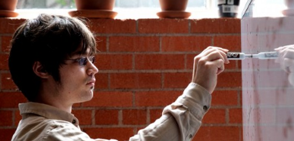

DL4J
https://deeplearning4j.org/
주체
Created by
Adam Gibson @Skymind (CTO)
Chris Nicholson @Skymind (CEO)
Maintained by
Skymind (https://skymind.ai/)
릴리즈
Jun. ‘2014
적용 사례
은행 Fraud Detection 연구 파트너쉽 with Nextremer in Japan (https://skymind.ai/press/nextremer)
Motivation
가장 많은 프로그래머를 보유하는 Java 기반의 딥러닝 프레임워크 개발
추론엔진에 대해 엔터프라이즈 서비스급 안정성을 보장

Slide 13
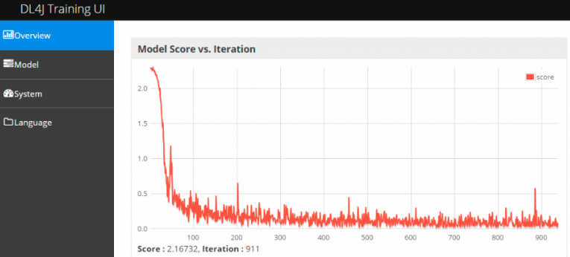
DL4J
https://deeplearning4j.org/
특징
장점
Java를 기반으로 한 쉬운 이식성 및 엔터프라이즈 시스템 수준의 안전성 제공
Spark 기반의 분산 처리 지원
문서화가 잘 되어 있음 / 학습 디버깅을 위한 시각화 도구 DL4J UI 제공
기업 대상 기술 컨설팅 제공
단점
Java 언어로 인한 학습 및 테스트 과정의 번거로움
협소한 사용자 커뮤니티
부족한 예제
F/W | 주체 | 플랫폼 | 모바일 | 언어 | 인터페이스 | OpenMP | CUDA | OpenCL | 멀티GPU | 분산
DL4J | SkyMind | Cross-platform (JVM) | Android | Java | Java, Scala, Python | Y | Y | - | Y | Y (Spark)

Slide 14
Keras
https://keras.io/
주체
Created & Maintained by
Francois Chollet @Google
릴리즈
Mar. ‘2015
적용 사례
TensorFlow (http://www.fast.ai/2017/01/03/keras)
Motivation
Provide a high-level interface based on deep learning framework like Theano, TensorFlow
Easy to use
최소화, 단순화, 모듈화
다양한 딥러닝 프레임워크와의 쉬운 연동

Slide 15
Keras
https://keras.io/
특징
장점
직관적인 API 인터페이스
Caffe, Torch, TensorFlow 등 다양한 딥러닝 프레임워크 모델 import 기능 제공
문서화가 잘되어 있음
단점
기반 Theano 프레임워크에서 문제가 발생시 debugging이 어려움
F/W | 주체 | 플랫폼 | 모바일 | 언어 | 인터페이스 | OpenMP | CUDA | OpenCL | 멀티GPU | 분산
Keras | François Chollet | Linux, Mac, Windows | - | Python | Python | Y(Theano) N(TF) | Y | - | Y

Slide 16
MXNet
http://mxnet.io/
주체
Created by
CMU (http://www.cs.cmu.edu/~muli/file/mxnet-learning-sys.pdf)
Maintained by
DMLC(Distributed Machine Learning Community)
CMU, NYU, NVIDIA, Baidu, Amazon, etc.
릴리즈
Oct. ‘2015
적용 사례
AWS (https://www.infoq.com/news/2016/11/amazon-mxnet-deep-learning)
Motivation
Support for Mixed Programming Model: Imperative & Symbolic
Support for Portability: Desktops, Clusters, Mobiles, etc.
Support for Multiple Languages: C++, R, Python, Matlab, Javascript, etc.

Slide 17
MXNet
http://mxnet.io/
특징
장점
다양한 프로그래밍 인터페이스 제공
모바일 지원
빠르게 발전
low-level / high-level API 모두 제공
Imperative / Graph 프로그래밍 모델 모두 지원
F/W | 주체 | 플랫폼 | 모바일 | 언어 | 인터페이스 | OpenMP | CUDA | OpenCL | 멀티GPU | 분산
MXNet | DMLC | Linux, Mac, Windows, Javascript | Android, iOS | C++ | C++, Python, Julia, MATLAB, JavaScript, Go, R, Scala, Perl | Y | Y | - | Y | Y

Slide 18
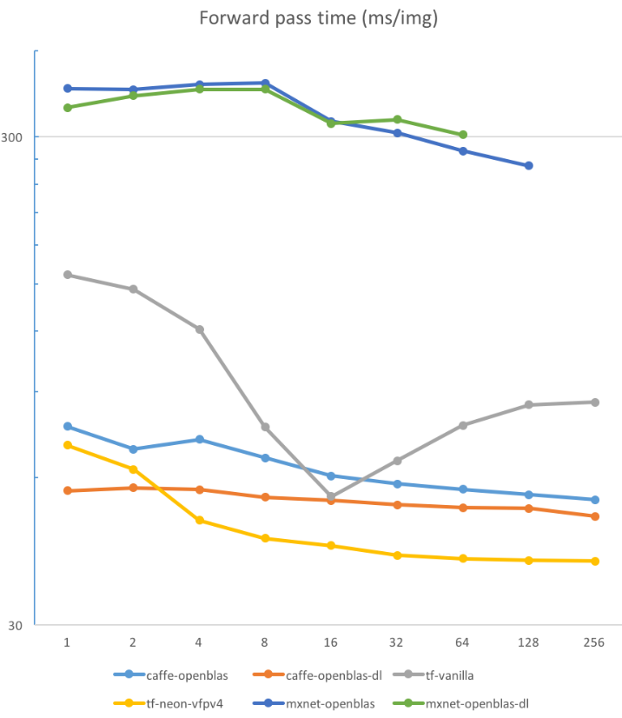
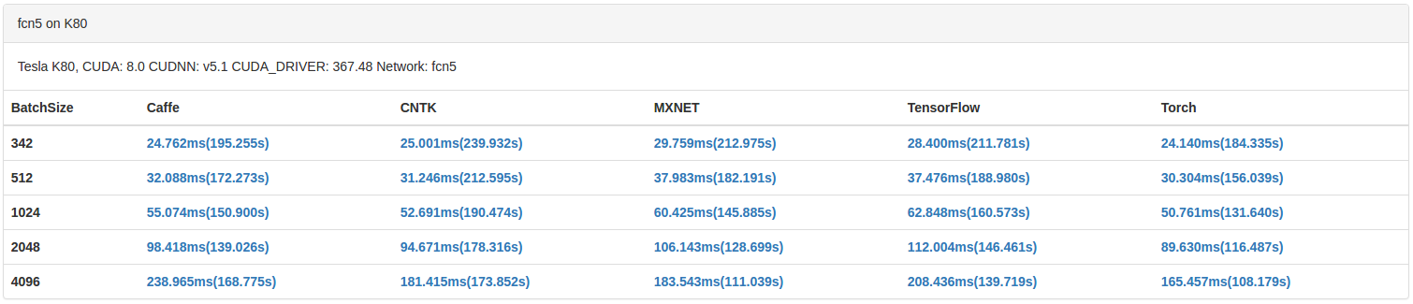
MXNet
http://mxnet.io/
단점
다소 처리 속도 느림
출처: Benchmarking State-of-the-Art Deep Learning Software Tools
http://dlbench.comp.hkbu.edu.hk/?v=v7
출처: How to run deep neural networks on weak hardware
https://www.linkedin.com/pulse/how-run-deep-neural-networks-weak-hardware-dmytro-prylipko

Slide 19
TensorFlow
https://www.tensorflow.org/
주체
Created & Maintained by
Google Brain
릴리즈
Nov. ‘2015
적용 사례
Google
Search Signals (https://www.bloomberg.com/news/articles/2015-10-26/google-turning-its-lucrative-web-search-over-to-ai-machines)
Email auto-responder (https://research.googleblog.com/2015/11/computer-respond-to-this-email.html)
Photo Search (https://techcrunch.com/2015/11/09/google-open-sources-the-machine-learning-tech-behind-google-photos-search-smart-reply-and-more/#.t38yrr8:fUIZ)
Motivation
It’s Google

Slide 20
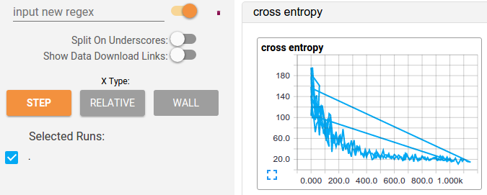
TensorFlow
https://www.tensorflow.org/
특징
장점
추상화된 그래프 모델
학습 디버깅을 위한 시각화 도구 TensorBoard 제공
모바일 지원
low-level / high-level API 모두 제공
F/W | 주체 | 플랫폼 | 모바일 | 언어 | 인터페이스 | OpenMP | CUDA | OpenCL | 멀티GPU | 분산
TensorFlow | Google | Linux, Mac, Windows | Android, iOS | C++, Python | Python, C/C++, Java, Go | N | Y | - | Y | Y

Slide 21
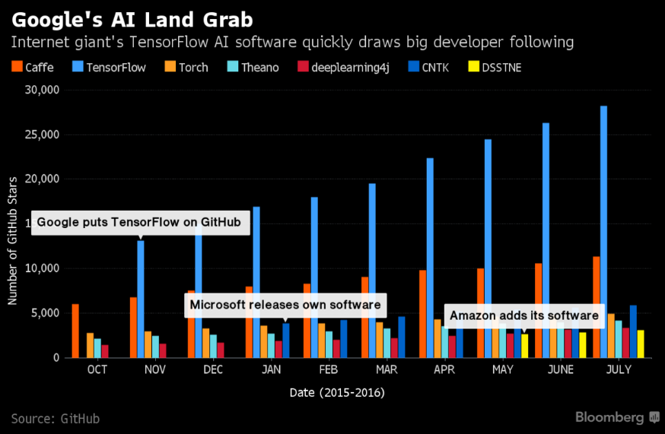
TensorFlow
https://www.tensorflow.org/
장점
방대한 사용자 커뮤니티
출처: Machine Learning Frameworks Comparison
https://blog.paperspace.com/which-ml-framework-should-i-use

Slide 22
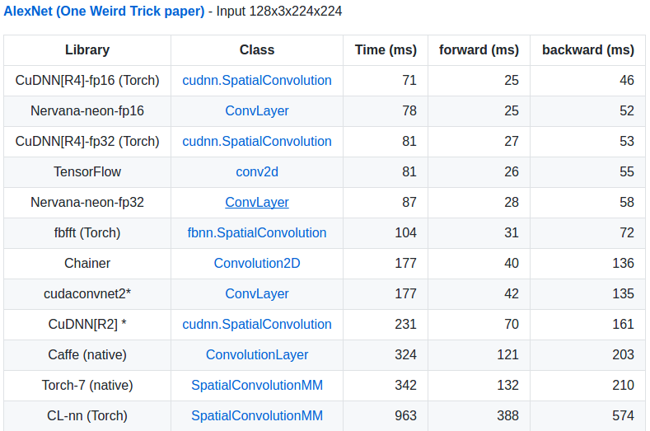
TensorFlow
https://www.tensorflow.org/
단점
Define-and-Run 모델 / 런타임에 그래프 변경 안됨
Torch에 비해 느림
출처: soumith/convnet-benchmarks
https://github.com/soumith/convnet-benchmarks

Slide 23
Theano
http://deeplearning.net/software/theano/index.html
주체
Created by
James Bergstra, Frederic Bastien, etc. (http://www.iro.umontreal.ca/~lisa/pointeurs/theano_scipy2010.pdf_
Maintained by
LISA lab @ Université de Montréal
릴리즈
Nov ‘2010
적용 사례
Keras
Lasagne
Blocks
Motivation
There’s any.

Slide 24
Theano
http://deeplearning.net/software/theano/index.html
특징
장점
low-level을 제어할 수 있는 API
추상화된 그래프 모델 지원
빠르고 유연함
Keras, Lasagne, Blocks 등 Wrapper 프레임워크의 기반 프레임워크
단점
low-level API의 복잡성
F/W | 주체 | 플랫폼 | 모바일 | 언어 | 인터페이스 | OpenMP | CUDA | OpenCL | 멀티GPU | 분산
Theano | Université de Montréal | Linux, Mac, Windows | - | Python | Python | Y | Y | - | Y

Slide 25
Torch
http://torch.ch/
주체
Created & Maintained by
Ronan Collobert: Research Scientist @ Facebook
Clément Farabet: Senior Software Engineer @ Twitter
Koray Kavukcuoglu: Research Scientist @ Google DeepMind
Soumith Chinatala: Research Engineer @ Facebook
릴리즈
Jul. ‘2014
적용 사례
Facebook, Google, Twitter, Element Inc., etc.
Motivation
Unlike Caffe, for research rather than mass market
Unlike Theano, easy to use based on imperative model rather than symbolic model

Slide 26
Torch
http://torch.ch/
특징
장점
알고리즘 모듈화가 잘 되어 있어 사용이 용이
다양한 데이터 전처리 및 시각화 유틸리티 제공
간단한 Lua 프로그래밍 구문
Imperative 프로그래밍 모델 기반의 직관적인 API
OpenCL 지원
모바일 지원
단점
파이썬 인터페이스 없음(PyTorch 별도 존재)
문서화가 잘 안되어 있음
협소한 사용자 커뮤니티
심볼릭 모델 미제공
상용 어플레케이션이 아니라 연구용으로 적합
F/W | 주체 | 플랫폼 | 모바일 | 언어 | 인터페이스 | OpenMP | CUDA | OpenCL | 멀티GPU | 분산
Torch | Ronan, Clément, Koray, Soumith | Linux, Mac, Windows | Android, iOS | C, Lua | Lua | Y | Y | Y | Y | Not officially

Slide 27
딥러닝 프레임워크 비교 Sheet

Slide 28
오픈소스 딥러닝 프레임워크
비교 기준
주요 특성
설치 플랫폼
모바일 지원
개발 언어
프로그래밍 인터페이스
OpenMP 지원
CUDA / OpenCL 지원
멀티 노드 지원
프로그래밍 모델
Tech. Stack
시각화
워크플로우 관리
Computational Graph(CG) 관리
Multi-dimensional array 처리
Numerical computation
Computational Device

Slide 29
오픈소스 딥러닝 프레임워크
비교 기준
설계
(Which) Interface Language
(How) Compute backprop
(How) Update parameters
(When) Run user codes
(How) Optimize CG
(How) Scale up training

Slide 30
딥러닝 프레임워크 Sheet – 주요 특성
F/W | 주체 | 플랫폼 | 모바일 | 언어 | 인터페이스 | OpenMP | CUDA | OpenCL | 멀티GPU | 분산
Caffe | BAIR | Linux, Mac | - | C++ | Python, MATAB | Y | Y | - | Y
Chainer | Preferred Networks | Linux | - | Python | Python | - | Y | - | Y | Y
CNTK | Microsoft | Linux, Windows | - | C++ | Python, C++ | Y | Y | - | Y | Y
DL4J | SkyMind | Cross-platform (JVM) | Android | Java | Java, Scala, Python | Y | Y | - | Y | Y (Spark)
Keras | François Chollet | Linux, Mac, Windows | - | Python | Python | Y(Theano) N(TF) | Y | - | Y
MXNet | DMLC | Linux, Mac, Windows, Javascript | Android, iOS | C++ | C++, Python, Julia, MATLAB, JavaScript, Go, R, Scala, Perl | Y | Y | - | Y | Y
TensorFlow | Google | Linux, Mac, Windows | Android, iOS | C++, Python | Python, C/C++, Java, Go | N | Y | - | Y | Y
Theano | Université de Montréal | Linux, Mac, Windows | - | Python | Python | Y | Y | - | Y
Torch | Ronan, Clément, Koray, Soumith | Linux, Mac, Windows | Android, iOS | C, Lua | Lua | Y | Y | Y | Y | Not officially
출처: Comparison of deep learning software
https://en.wikipedia.org/wiki/Comparison_of_deep_learning_software#cite_note-29

Slide 31
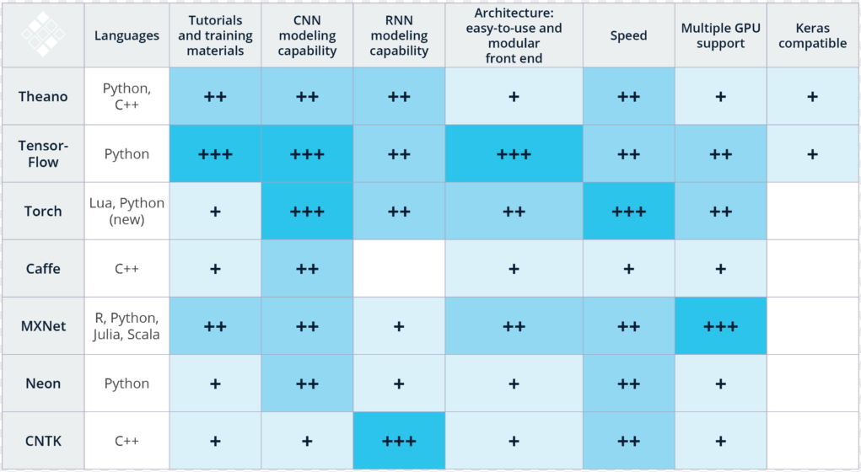
딥러닝 프레임워크 Sheet – 주요 특성
출처: Getting Started with Dep Learning
https://svds.com/getting-started-deep-learning/

Slide 32
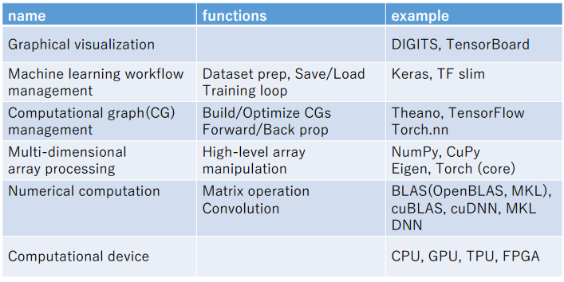
딥러닝 프레임워크 Sheet – Tech. Stack
딥러닝 프레임워크의 주요 Tech. Stack
출처: DLIF: Common design of neural network implementations https://www.dropbox.com/s/qfz34ba3ftuli6b/AAAI2017-2-0203.pdf

Slide 33
딥러닝 프레임워크 Sheet
출처: DLIF: Common design of neural network implementations https://www.dropbox.com/s/qfz34ba3ftuli6b/AAAI2017-2-0203.pdf
시각화
Chainer
워크플로우 관리
Caffe
CG 관리
Multi-dimensional
Array 처리
blob
Numpy
Cupy
Numerical
computation
BLAS
cuBLAS
cuDNN
BLAS
cuBLAS
cuDNN
Computational
Device
CPU
GPU
CPU
GPU
[Caffe]
[Chainer]
시각화
TensorBoard
DL4J UI
워크플로우 관리
CNTK
DL4J
CG 관리
Multi-dimensional
Array 처리
Tensor
ND4J
Numerical
computation
BLAS
cuBLAS
cuDNN
BLAS
cuBLAS
cuDNN
Computational
Device
CPU
GPU
CPU
GPU
[CNTK]
[DL4J]

Slide 34
딥러닝 프레임워크 Sheet
출처: DLIF: Common design of neural network implementations https://www.dropbox.com/s/qfz34ba3ftuli6b/AAAI2017-2-0203.pdf
시각화
mxnet.viz
TensorBoard
TF slim
워크플로우 관리
MXNet
TensorFlow
CG 관리
Multi-dimensional
Array 처리
mxnet.ndarray
Tensor
Numerical
computation
BLAS
cuBLAS
cuDNN
BLAS
cuBLAS
cuDNN
Computational
Device
CPU
GPU
CPU
GPU
[MXNet]
[TensorFlow]
시각화
Keras, Lasgane, Blocks, etc
visdom
워크플로우 관리
Torch
CG 관리
Theano
Multi-dimensional
Array 처리
Numpy
libgpuarray
Tensor
Numerical
computation
BLAS
CUDA, OpenCL
CUDA Toolkit
BLAS
cuBLAS
cuDNN
Computational
Device
CPU
GPU
CPU
GPU
[Theano]
[Torch]

Slide 35
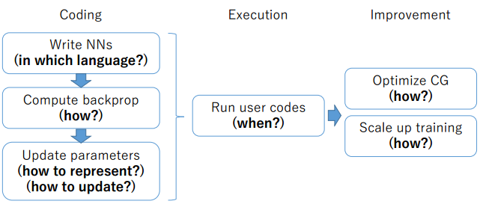
딥러닝 프레임워크 Sheet – 설계
딥러닝 프레임워크의 설계 전략
출처: DLIF: Differences of deep learning frameworks https://www.dropbox.com/s/6sbt9jmrwg414c8/AAAI2017-3-0331.pdf

Slide 36
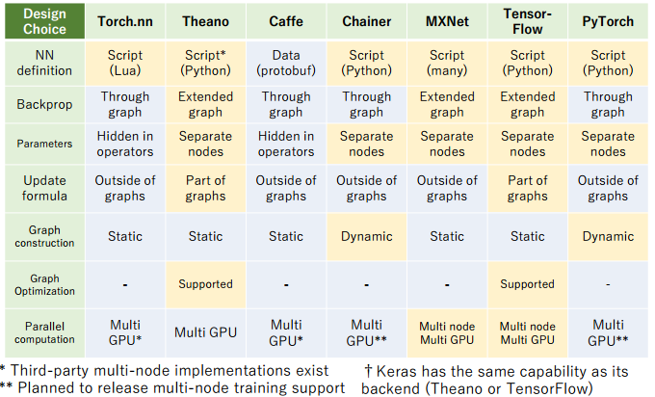
딥러닝 프레임워크 Sheet – 설계
출처: DLIF: Differences of deep learning frameworks https://www.dropbox.com/s/6sbt9jmrwg414c8/AAAI2017-3-0331.pdf

Slide 37
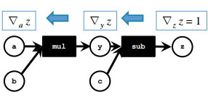
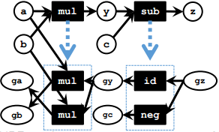
딥러닝 프레임워크 Sheet – 설계
Write NNs – in Which Languges?
Declarative Config. File | High portability | Low flexibility | Caffe
Procedural Scripting | High flexibility | Low portability | Others
Compute backprop – How?
Graph | Easy and simple to implement | Low flexibility | Torch Caffe Chainer
Extended Graph | High flexibility Backprop extended graph에도 오퍼레이션 가능(eg. Backrprop of backprop) | Implementation gets complicated | Theano MXNet TensorFlow
출처: DLIF: Differences of deep learning frameworks https://www.dropbox.com/s/6sbt9jmrwg414c8/AAAI2017-3-0331.pdf

Slide 38

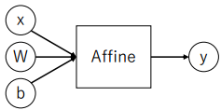
딥러닝 프레임워크 Sheet – 설계
Update parameters – How to represent?
Parameters as part of operator nodes | Intuitiveness | Low flexibility and reusability | Torch Caffe MXNet
Parameters as separate nodes in the graph | High flexibility and reusability We can apply any operations that can be done for variable nodes to the parameters |  | Theano Chainer TensorFlow
출처: DLIF: Differences of deep learning frameworks https://www.dropbox.com/s/6sbt9jmrwg414c8/AAAI2017-3-0331.pdf

Slide 39
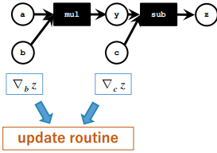
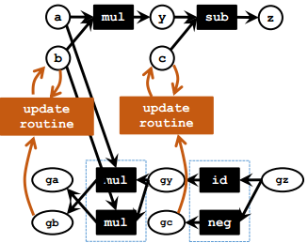
딥러닝 프레임워크 Sheet – 설계
Update parameters – How to update?
by routines outside of the graph | Easy to impelement | Low integrity | Torch Caffe MXNet Chainer
As a part of the graphs | High integrity | Implement gets complicated | Theano TensorFlow
출처: DLIF: Differences of deep learning frameworks https://www.dropbox.com/s/6sbt9jmrwg414c8/AAAI2017-3-0331.pdf

Slide 40
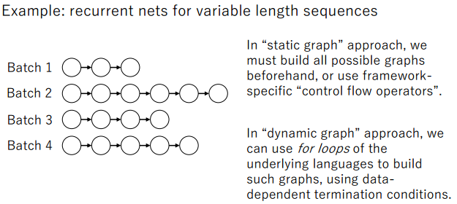
딥러닝 프레임워크 Sheet – 설계
Run user codes – When?
Static CG (Define-and-run) | Easy to optimize the computations | Low flexibility and usability | Others
Dynamic CG (Define-by-run) | High flexibility and usability Users can build different graphs for different iterations using language syntaxes | Hard to optimize the computations Difficult to do optimization every iteration due to its computational cost | Chainer
출처: DLIF: Differences of deep learning frameworks https://www.dropbox.com/s/6sbt9jmrwg414c8/AAAI2017-3-0331.pdf

Slide 41
딥러닝 프레임워크 Sheet – 설계
Optimize CG – How to extend current F/W?
Transform the graph to optimize the computations |  |  | Theano TensorFlow
Provide easy ways to write custom operator nodes |  |  | Torch MXNet Chainer Chainer : also provides ways to write custom CUDA kernels with JIT compilation
Scale up training – How?
Multi-GPU |  |  | All
Distributed Computations |  |  | MXNet TensorFlow CNTK Chainer DL4J Torch(Not Officially)
출처: DLIF: Differences of deep learning frameworks https://www.dropbox.com/s/6sbt9jmrwg414c8/AAAI2017-3-0331.pdf

Slide 42
딥러닝 프레임워크 사용 예시
- MNIST -

Slide 43
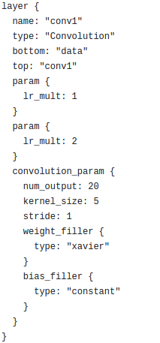
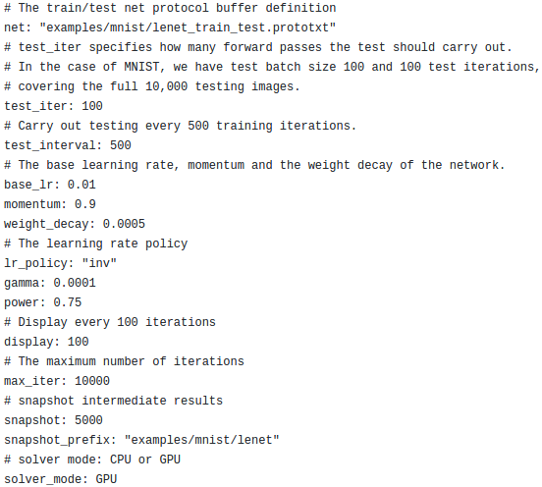
Caffe
https://github.com/BVLC/caffe/tree/master/examples/mnist
모델 정의
학습 정의

Slide 44
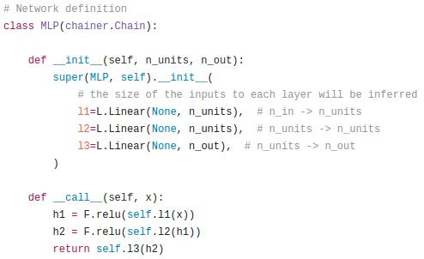
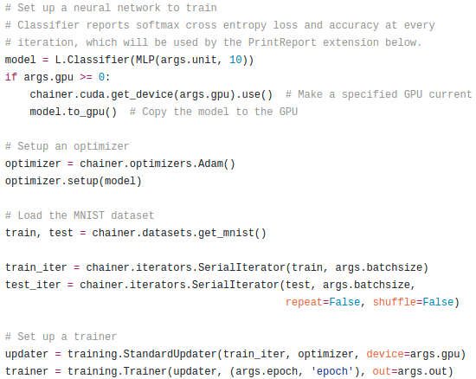
Chainer
https://github.com/pfnet/chainer/tree/master/examples/mnist
모델 정의
학습 정의

Slide 45
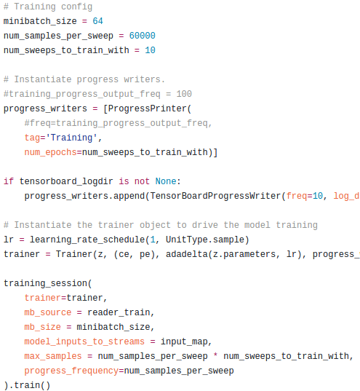
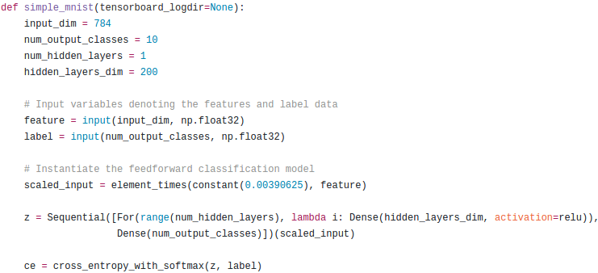
CNTK
https://www.microsoft.com/en-us/research/product/cognitive-toolkit/
모델 정의
학습 정의

Slide 46
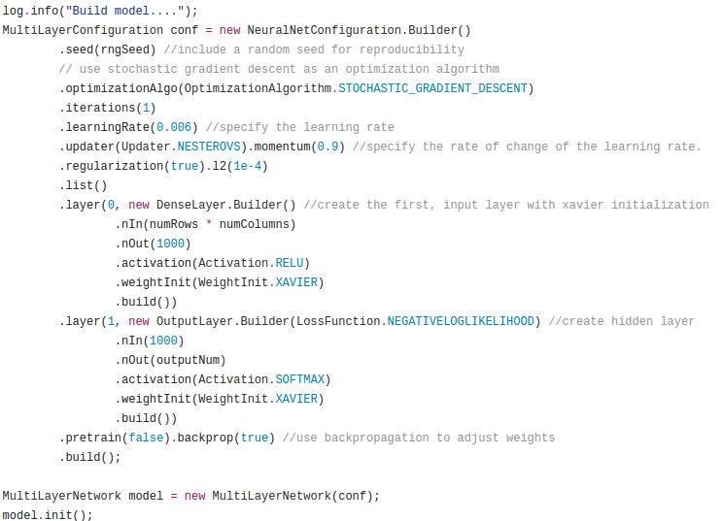
DL4J
https://github.com/deeplearning4j/dl4j-examples/tree/master/dl4j-examples/src/main/java/org/deeplearning4j/examples/feedforward
학습 정의
모델 정의

Slide 47
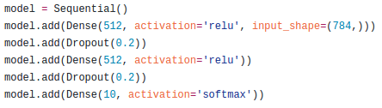
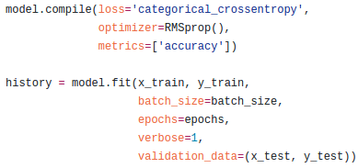
Keras
https://github.com/fchollet/keras/blob/master/examples/mnist_mlp.py
모델 정의
학습 정의

Slide 48
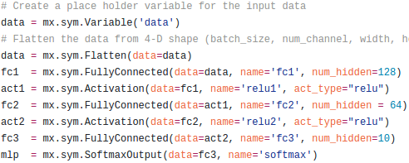
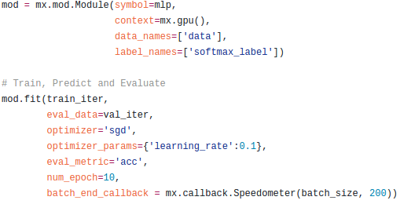
MXNet
http://mxnet.io/tutorials/python/mnist.html
모델 정의
학습 정의

Slide 49
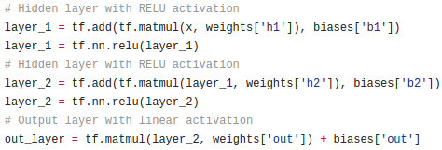
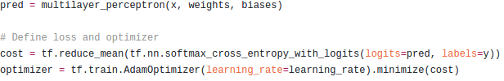
TensorFlow
https://github.com/aymericdamien/TensorFlow-Examples/
모델 정의
학습 정의

Slide 50
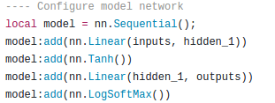
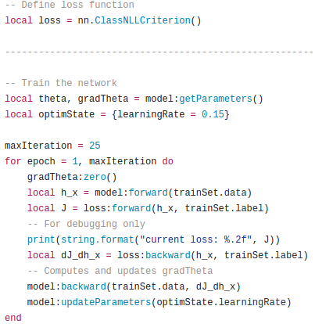
Torch
https://github.com/socurites/torch-book-examples/tree/master/model/chap1
모델 정의
학습 정의

Slide 51
References
Comparison of deep learning software https://en.wikipedia.org/wiki/Comparison_of_deep_learning_software#cite_note-29
Deep Learning Frameworks https://developer.nvidia.com/deep-learning-frameworks
Comparing Frameworks: Deeplearning4j, Torch, Theano, TensorFlow, Caffe, Paddle, MxNet, Keras & CNTK https://deeplearning4j.org/compare-dl4j-torch7-pylearn#caffe
Performance of Distributed Deep Learning using ChainerMN http://chainer.org/general/2017/02/08/Performance-of-Distributed-Deep-Learning-Using-ChainerMN.html
Comparison with Other Frameworks http://docs.chainer.org/en/latest/comparison.html
Complex Neural networks made easy by Chainer https://www.oreilly.com/learning/complex-neural-networks-made-easy-by-chainer

Slide 52
References
How is PyTorch different from Tensorflow? https://hackernoon.com/how-is-pytorch-different-from-tensorflow-2c90f44747d6
How to run deep neural networks on weak hardware https://www.linkedin.com/pulse/how-run-deep-neural-networks-weak-hardware-dmytro-prylipko
Deep Learning frameworks: a review before finishing 2016 https://medium.com/@ricardo.guerrero/deep-learning-frameworks-a-review-before-finishing-2016-5b3ab4010b06
Microsoft Computational Network Toolkit offers most efficient distributed deep learning computational performance https://www.microsoft.com/en-us/research/blog/microsoft-computational-network-toolkit-offers-most-efficient-distributed-deep-learning-computational-performance/

Slide 53
References
Machine Learning Frameworks Comparison https://blog.paperspace.com/which-ml-framework-should-i-use/
soumith/convnet-benchmarks https://github.com/soumith/convnet-benchmarks
Getting Started with Deep Learning https://svds.com/getting-started-deep-learning/
Benchmarking State-of-the-Art Deep Learning Software Tools http://dlbench.comp.hkbu.edu.hk/?v=v7
DLIF: Common design of neural network implementations https://www.dropbox.com/s/qfz34ba3ftuli6b/AAAI2017-2-0203.pdf
DLIF: Differences of deep learning frameworks https://www.dropbox.com/s/6sbt9jmrwg414c8/AAAI2017-3-0331.pdf
Complex neural networks made easy by Chainer https://www.oreilly.com/learning/complex-neural-networks-made-easy-by-chainer

Slide 54
References
Microsoft Computational Network Toolkit offers most efficient distributed deep learning computational performance https://www.microsoft.com/en-us/research/blog/microsoft-computational-network-toolkit-offers-most-efficient-distributed-deep-learning-computational-performance/
Torch vs Theano http://fastml.com/torch-vs-theano/

