Slide 1
MotionComics - Intro

Slide 2



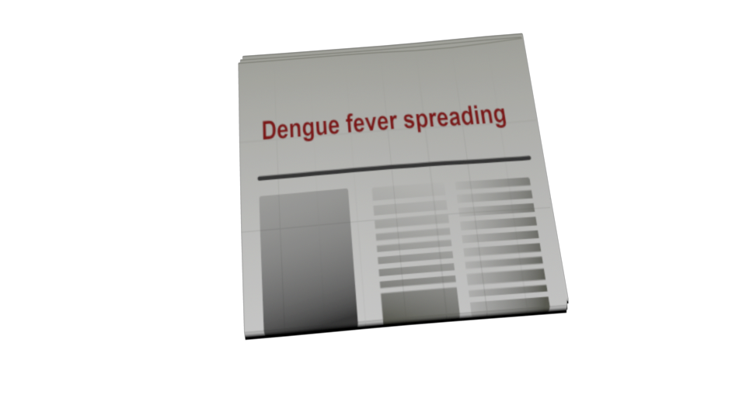
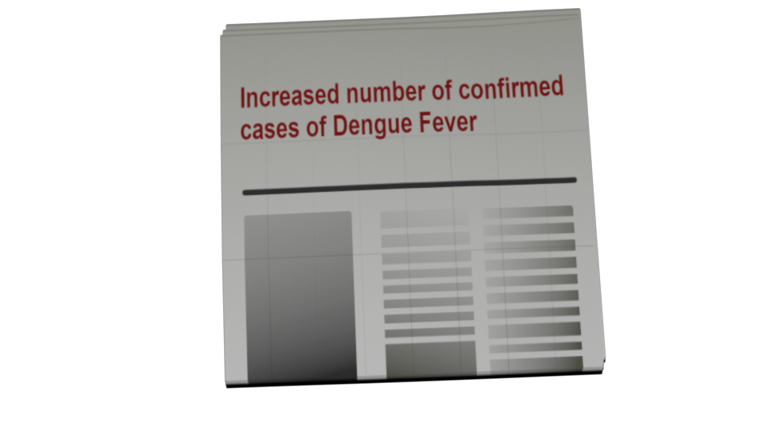
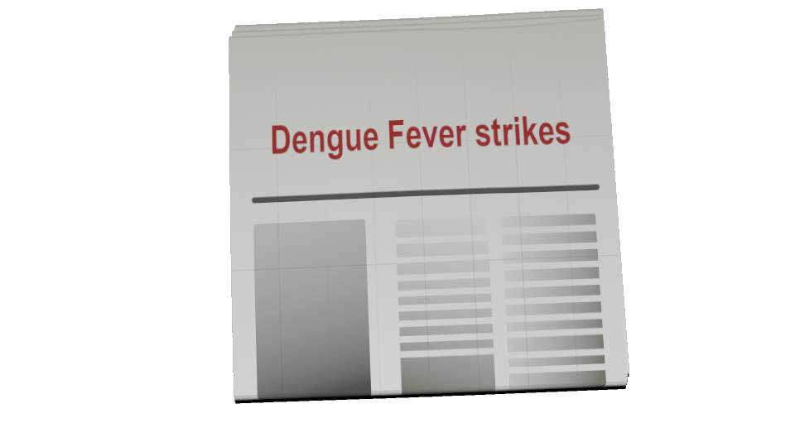

Slide 3
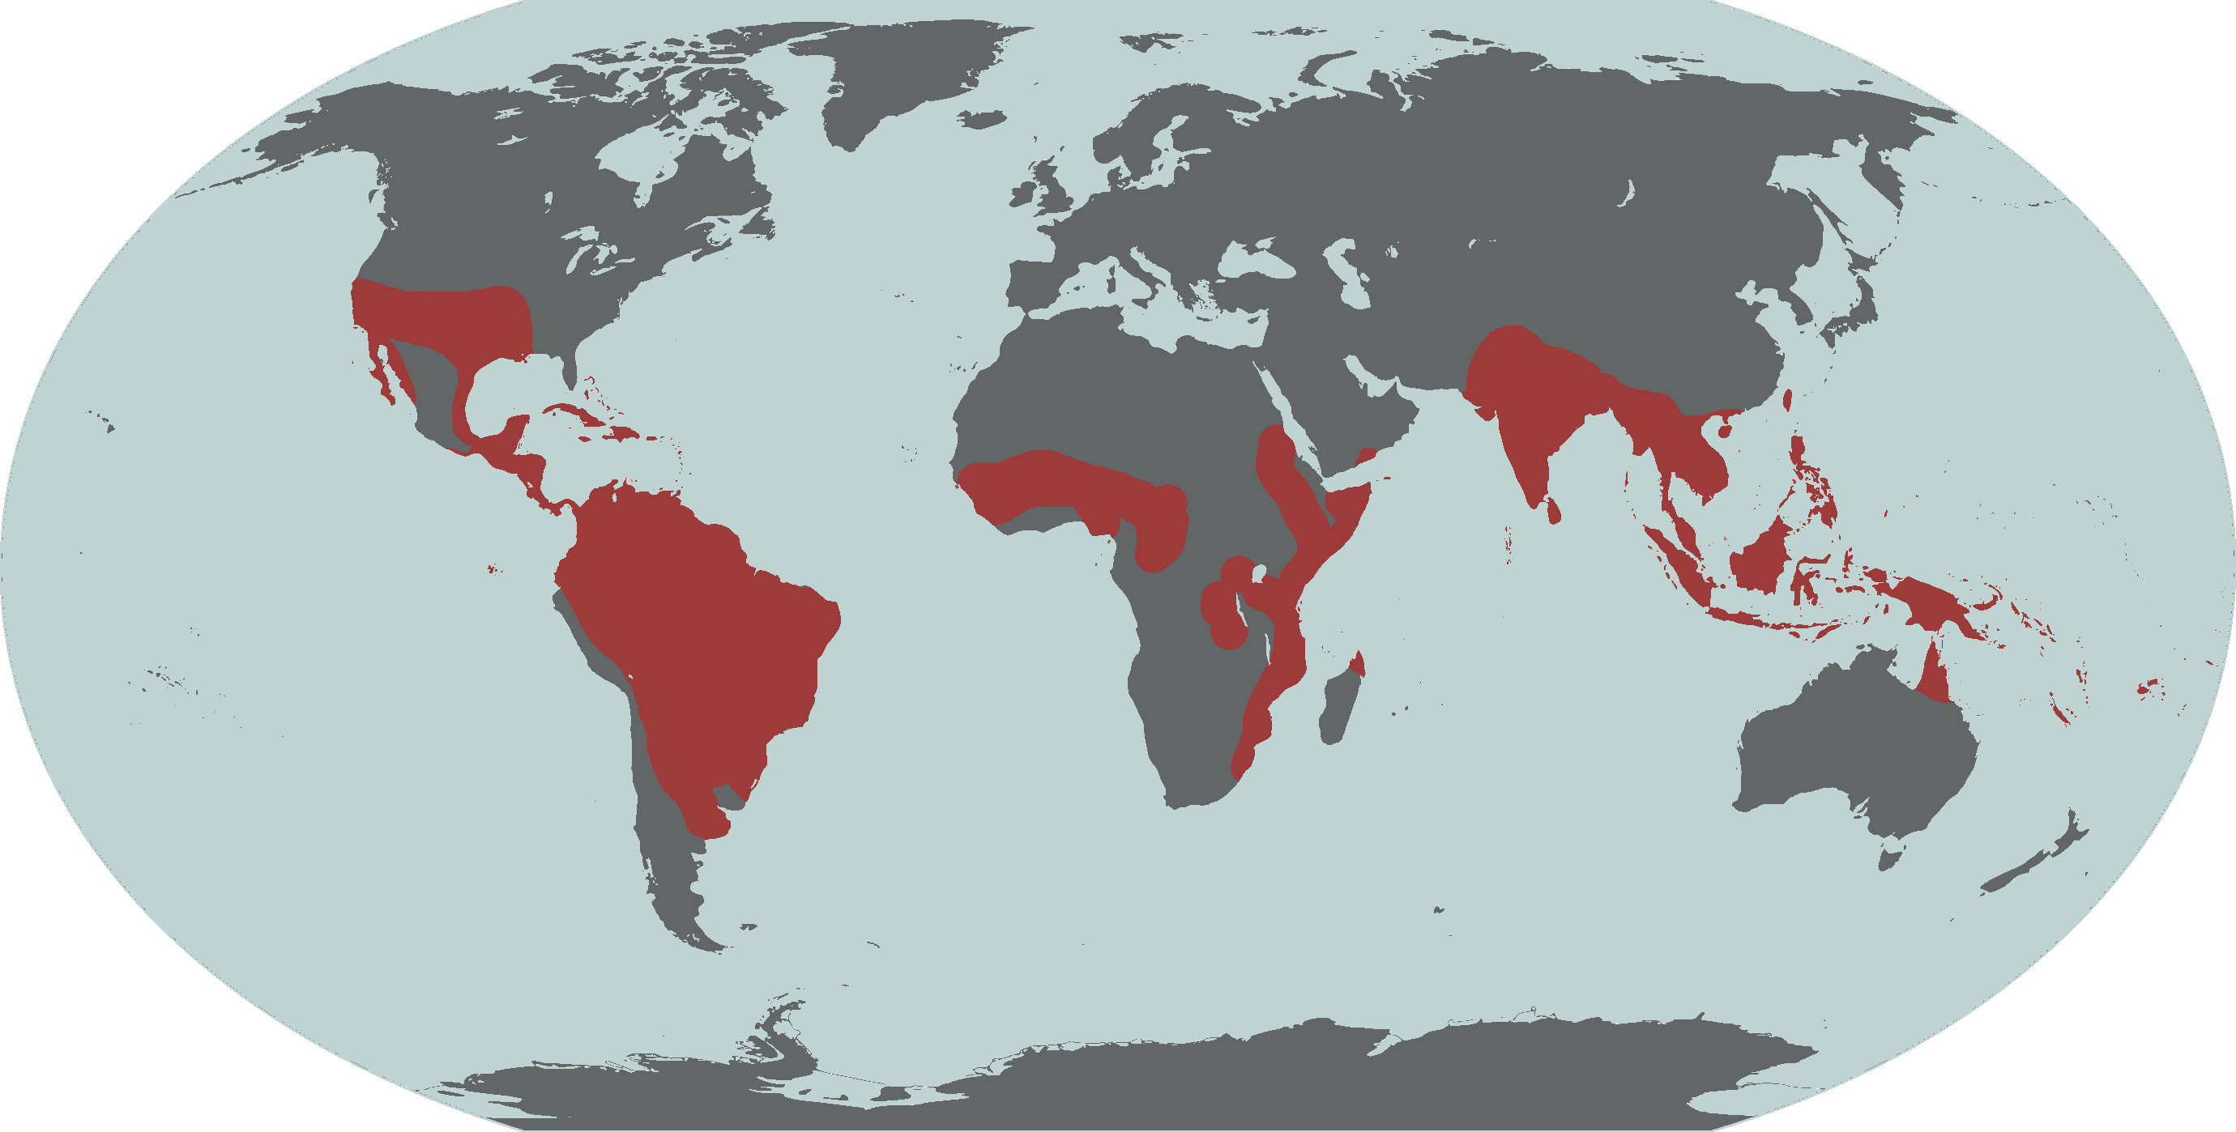

Slide 4
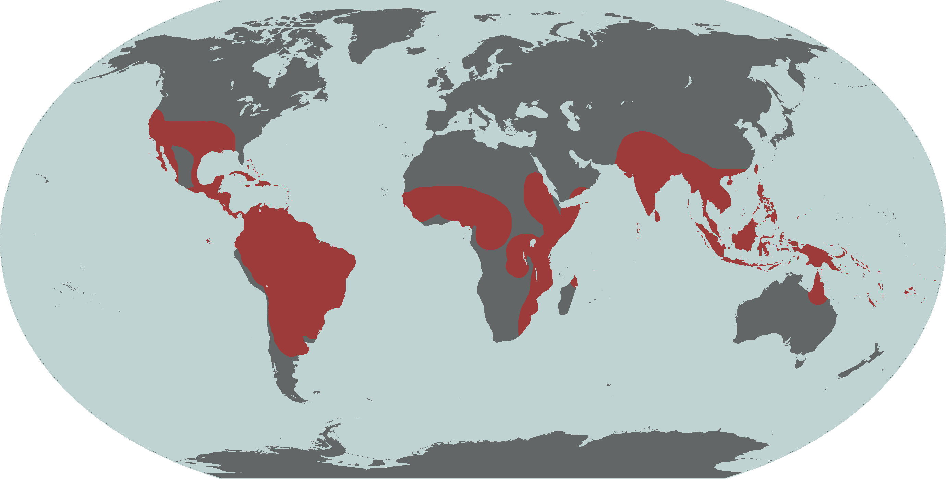

Slide 5
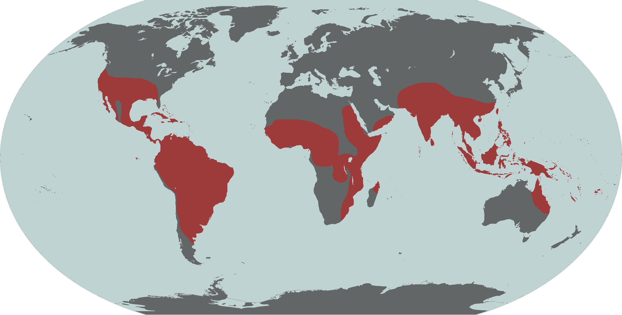

Slide 6
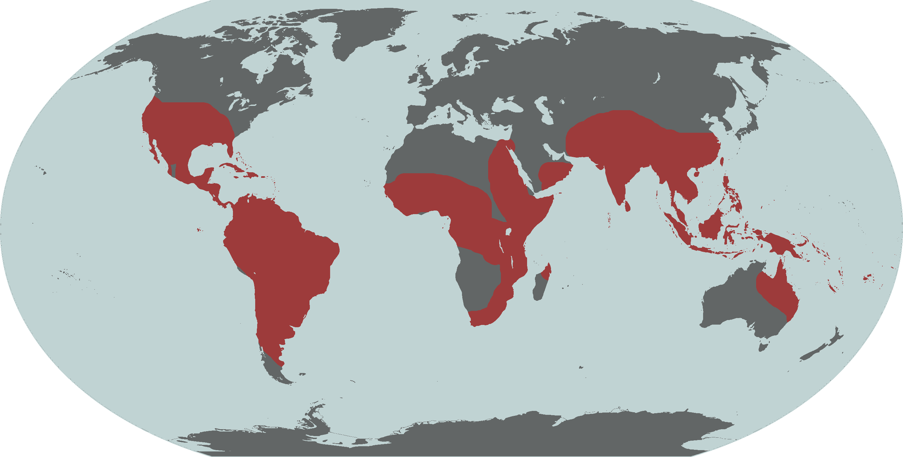

Slide 7
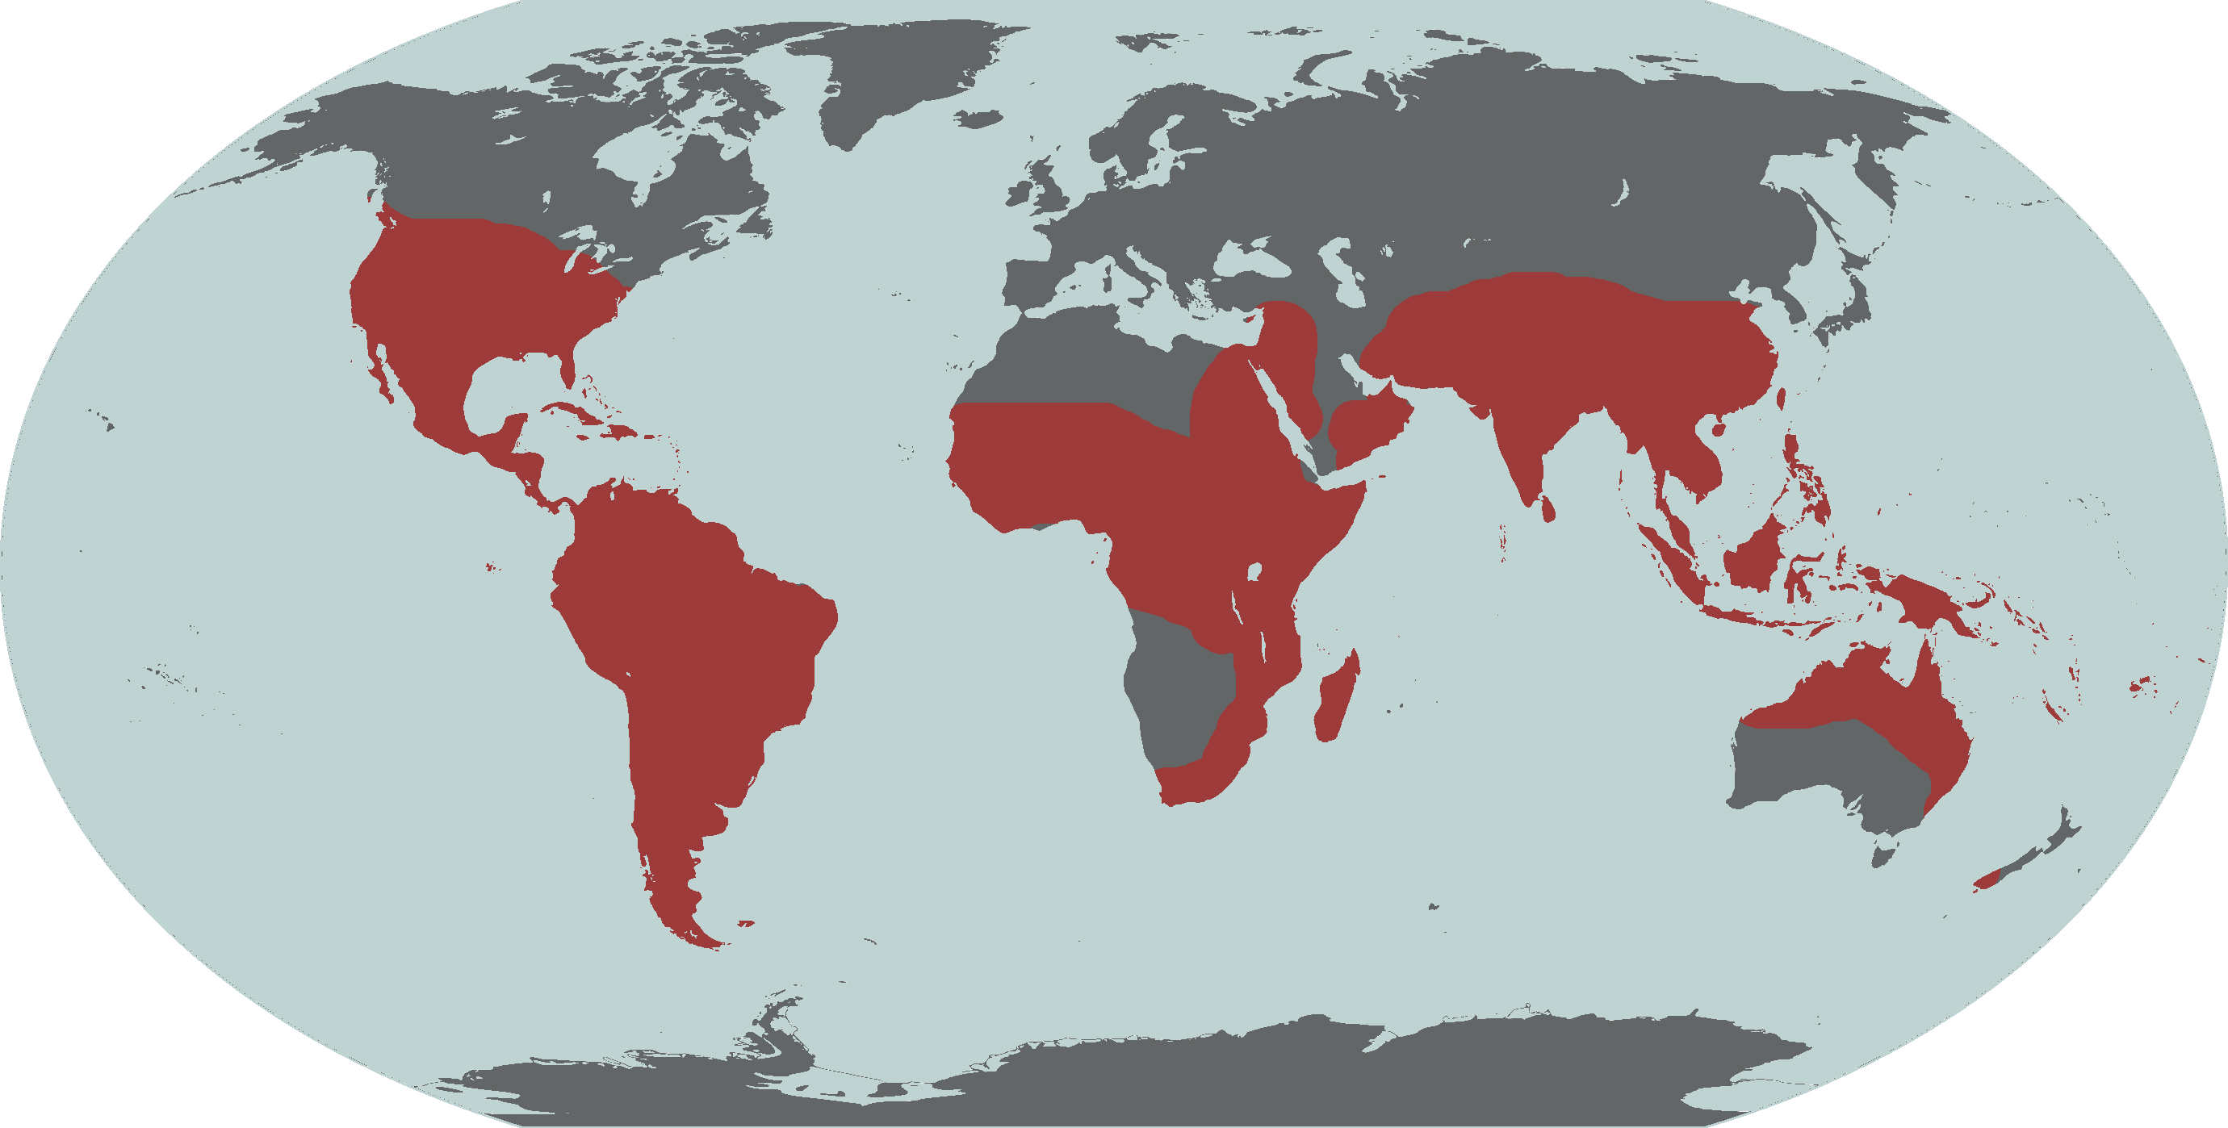

Slide 8
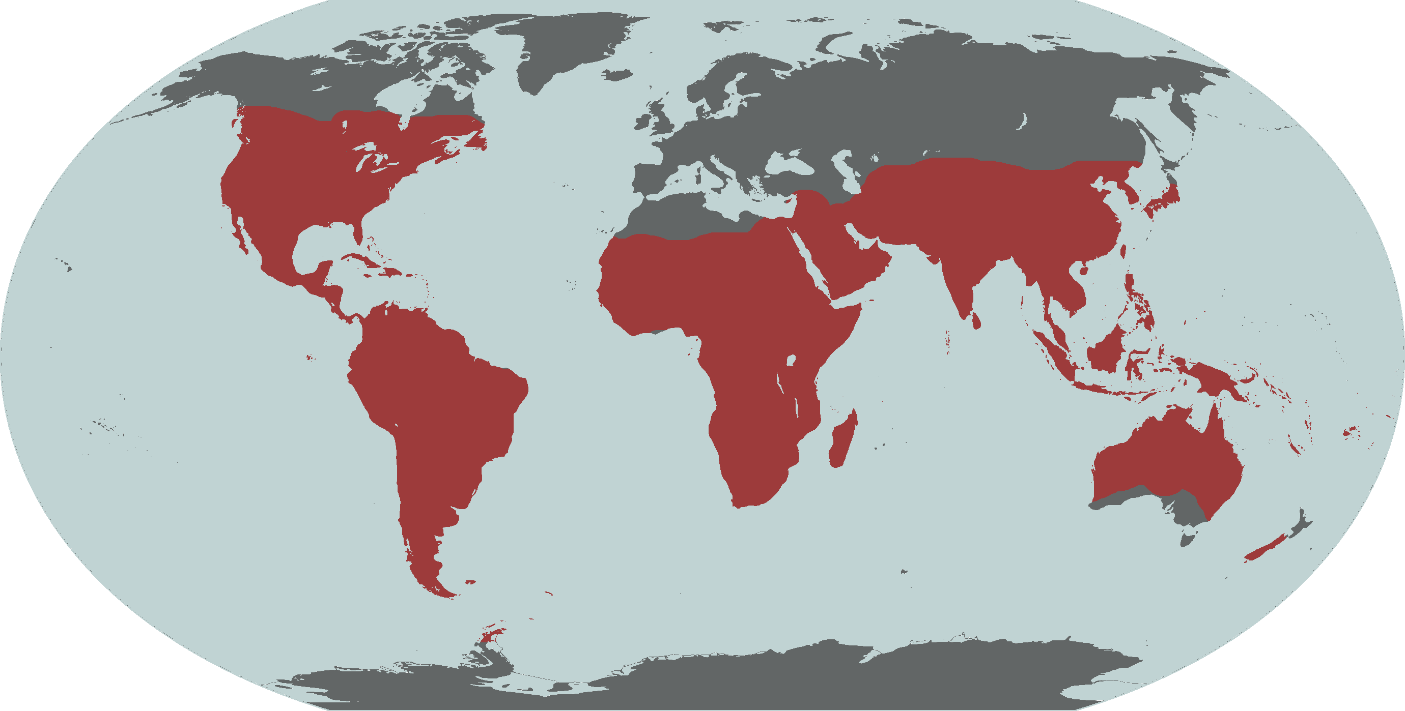

Slide 9
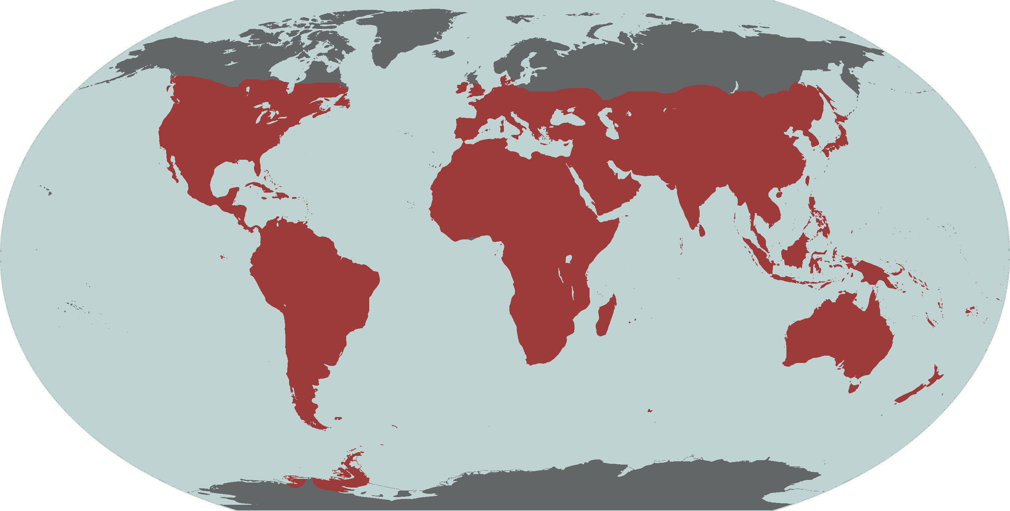

Slide 10


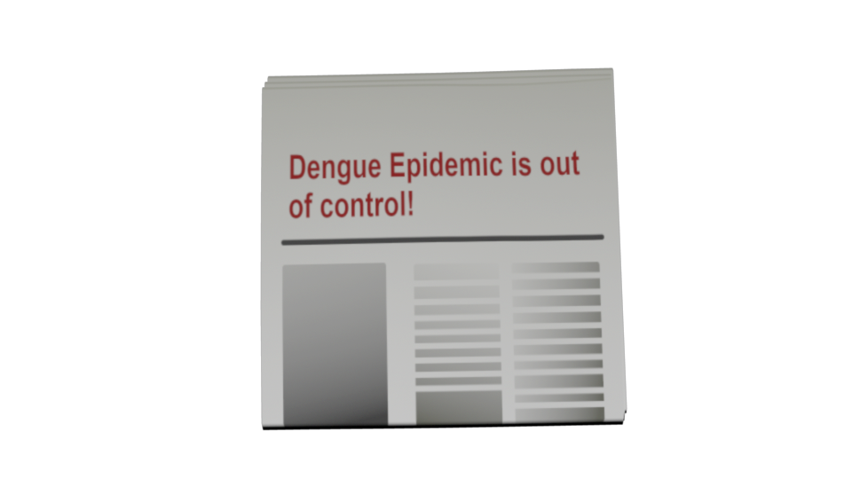


Slide 11
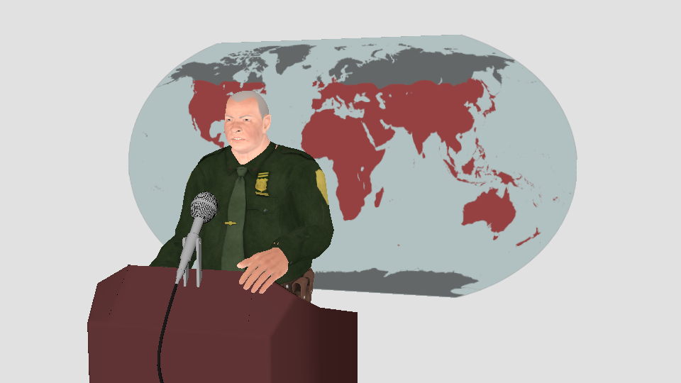
We are doing everything in our power to solve this crisis.
All courses of action are being carefully evaluated.

Slide 12
Meanwhile in a Genetics Laboratory

Slide 13
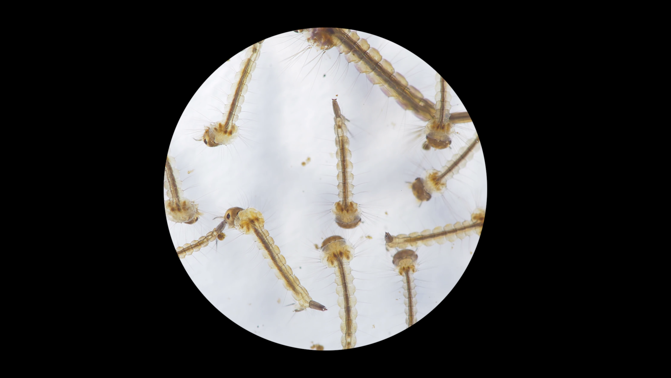
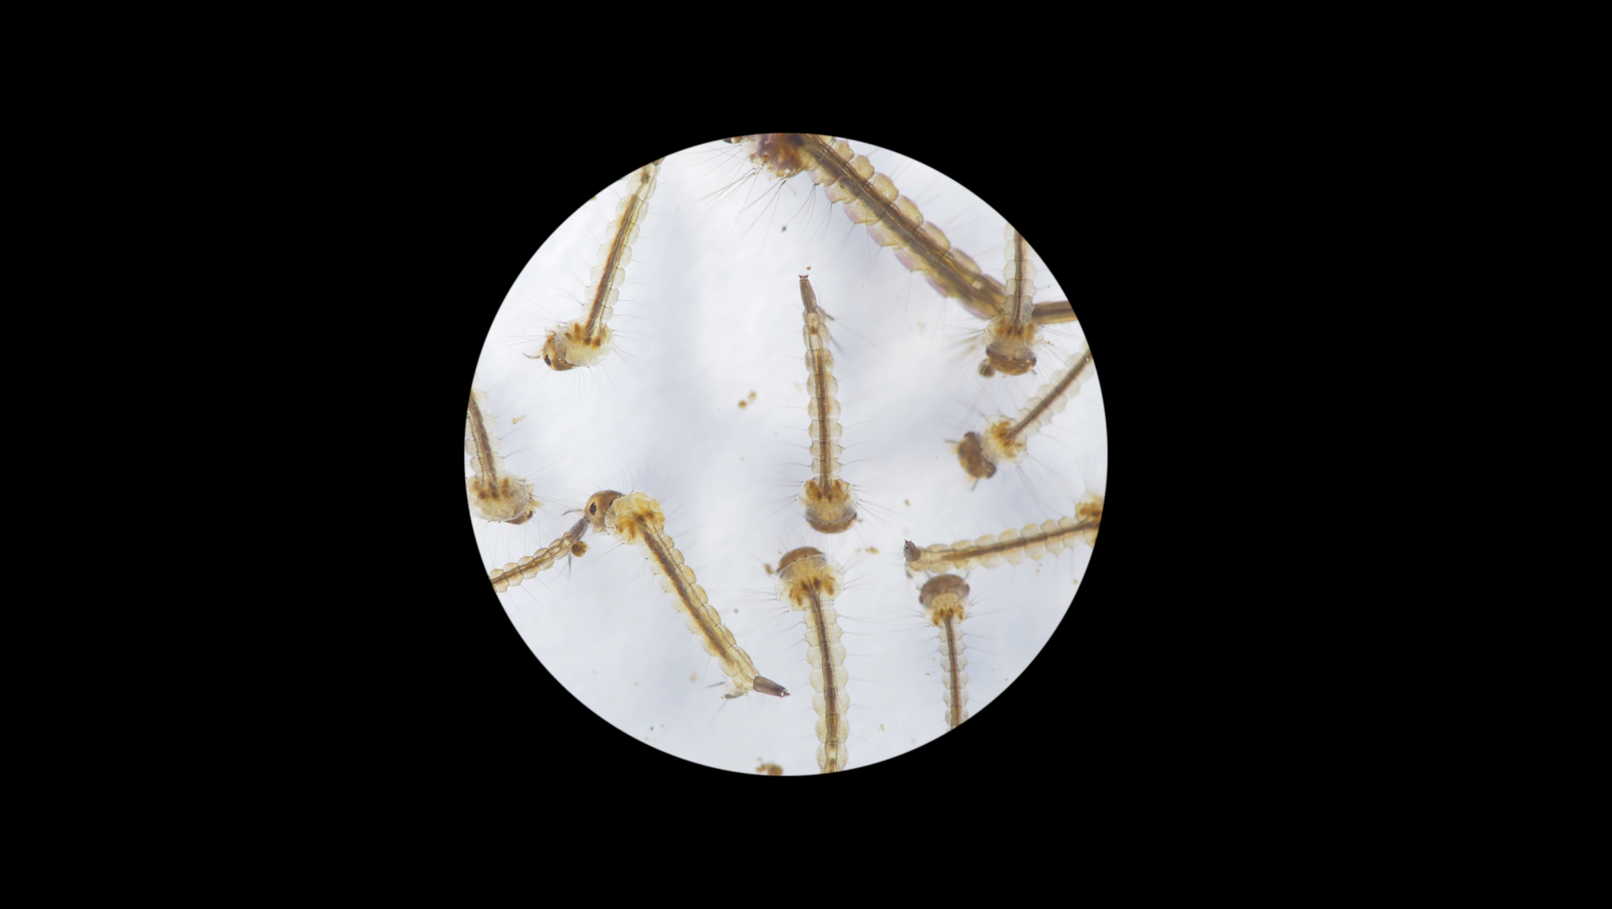
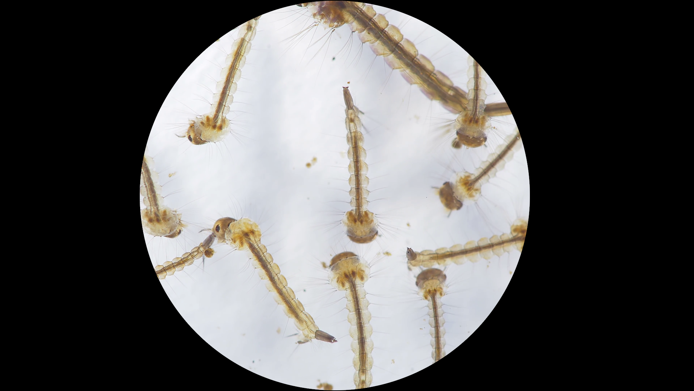
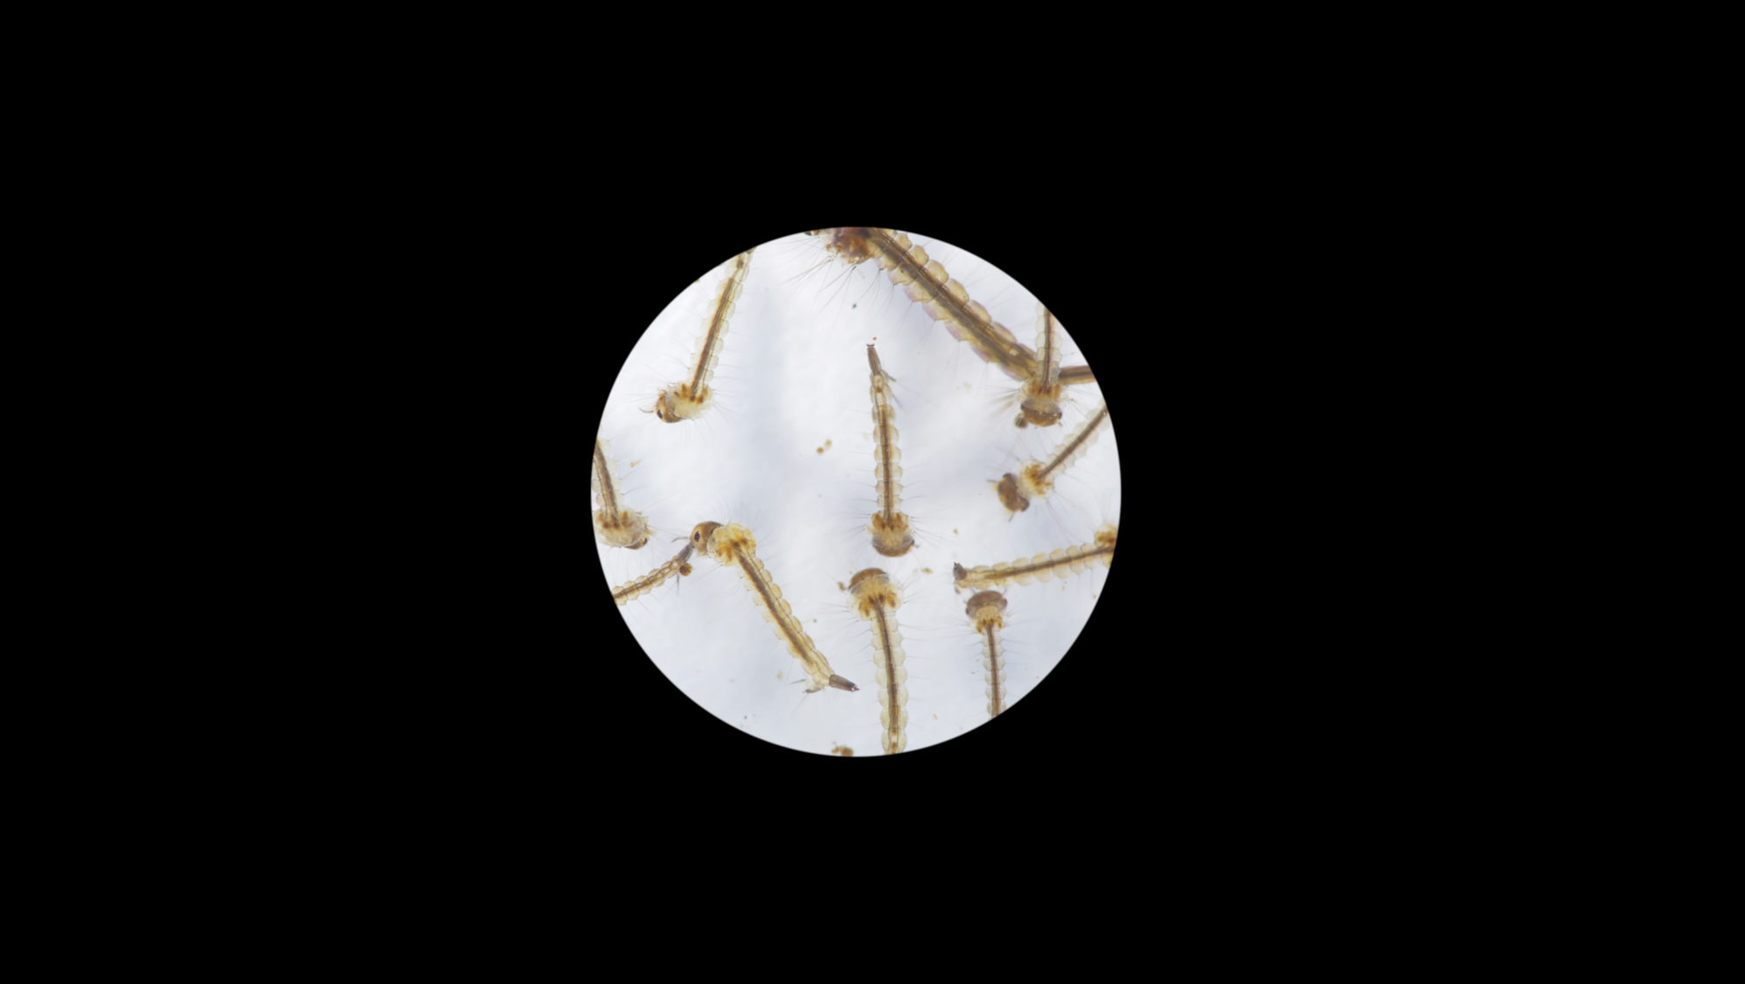
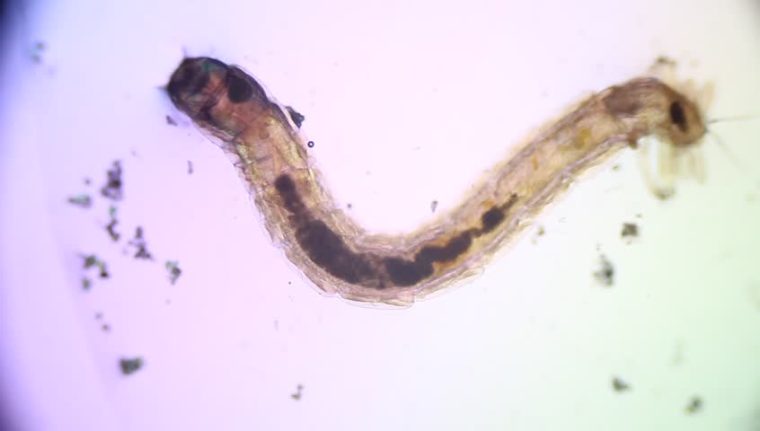
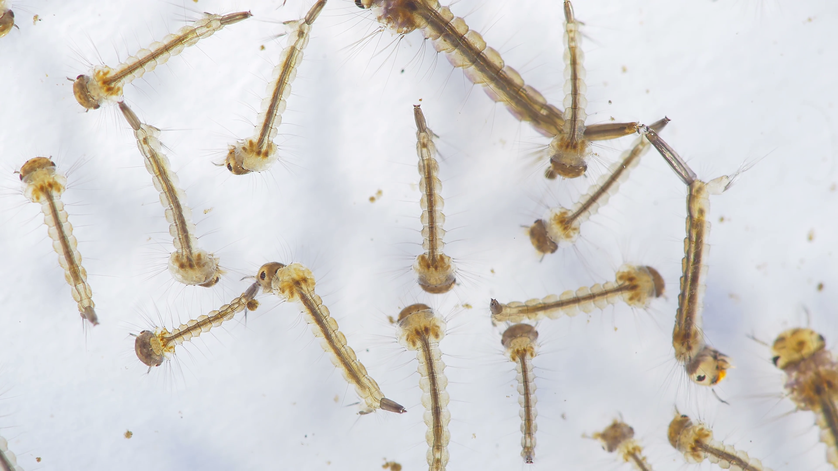

Slide 14
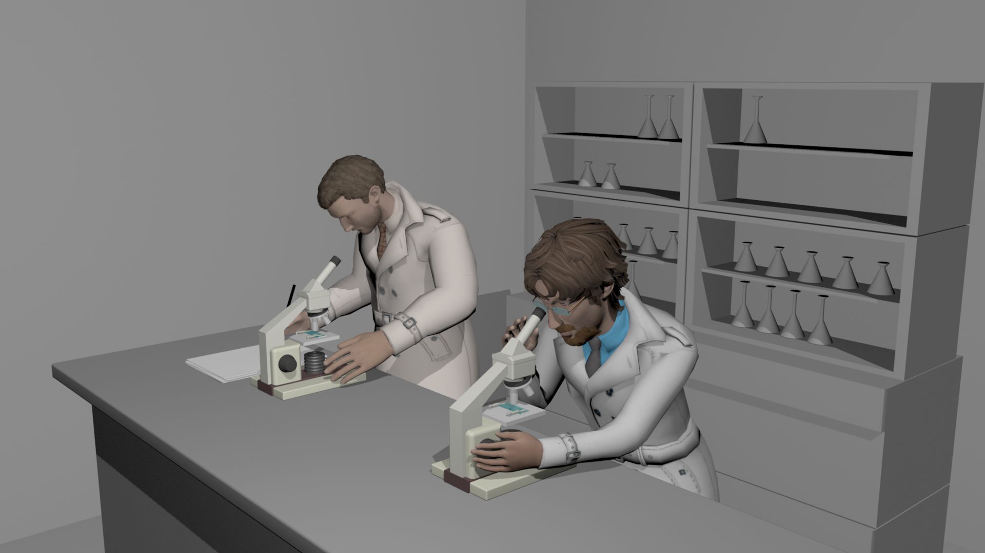
That is it! This generation won't be able to carry the disease forward...

Slide 15
Doctor Arthur, how long will this new hybrid mosquito you created be ready to release in our cities?

Slide 16
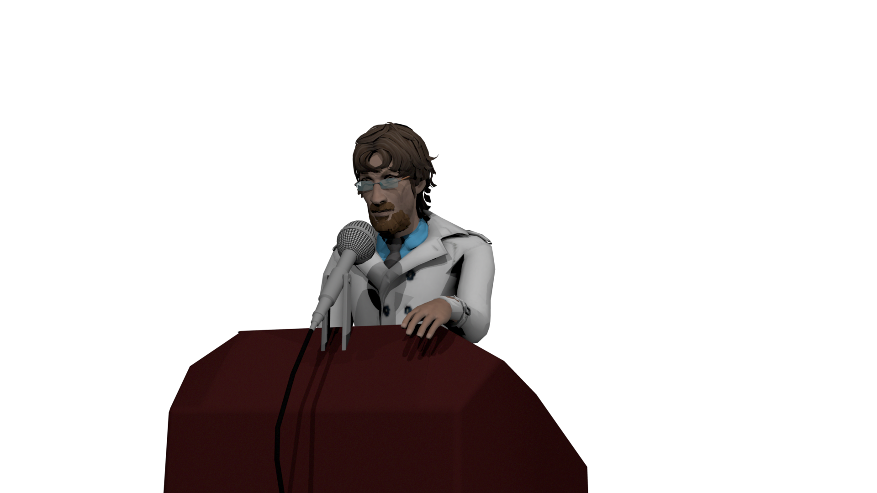
I am afraid it will take some time, we need to understand how the new generations will react to the mutations we induced. If we release them now it is difficult to predict what might happen

Slide 17



Slide 18
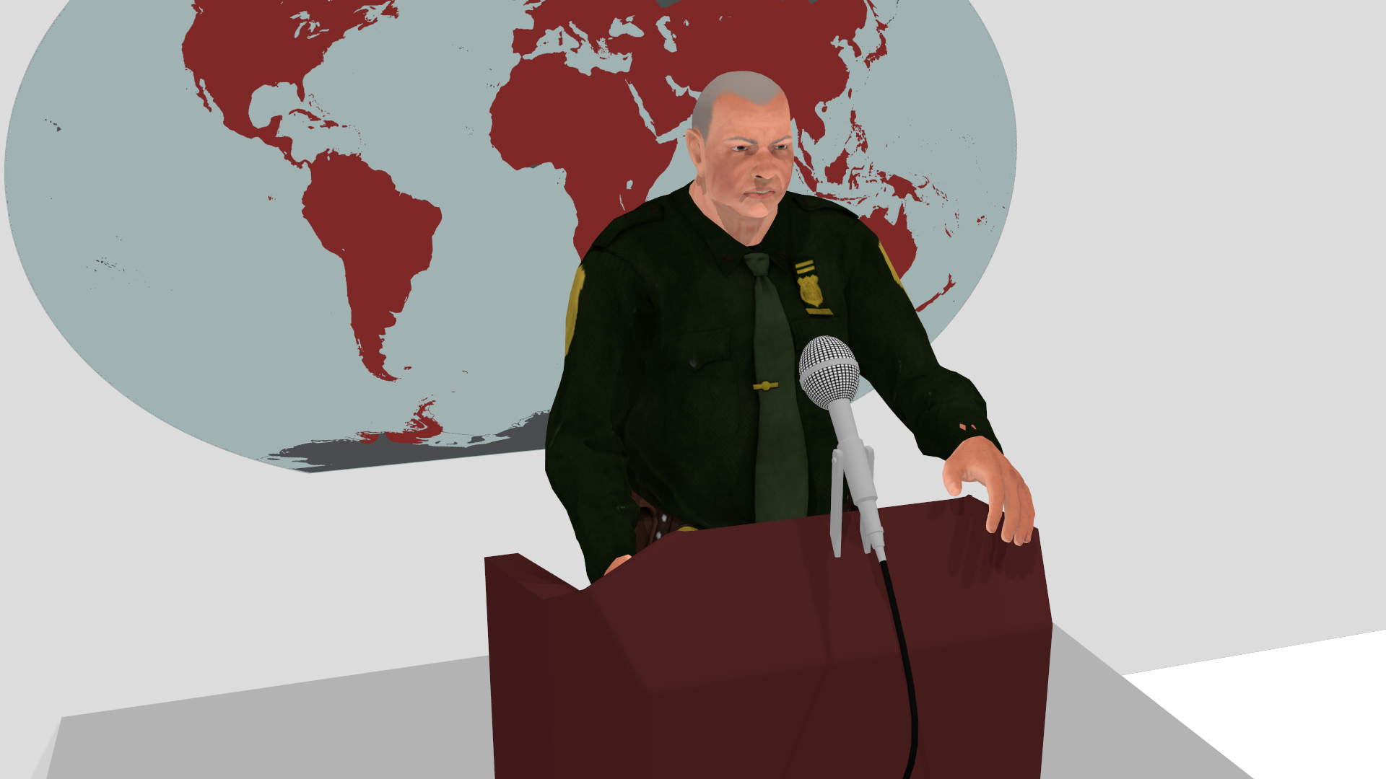
I have talked with the genetics researcher Arthur, we understand the risks, but we need to take action immediately.
We start deploying the hybrid mosquitoes now.

Slide 19
3 years later...

