Slide 1
600 μm
Feedhorn Array
Feedhorn Array
Au Heat Capacity Ring
Air gap
Al TES
Si Substrate
SiN Membrane
Metalized Backshort Wafer

Slide 2
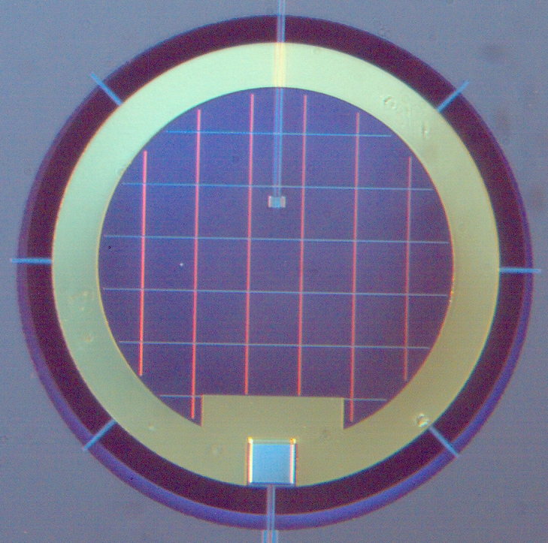
ch5-proto-pixel-labeled.png
E
D
C
B
A
200 μm

Slide 3
T_{cov}
τ_{cov}
T₁
ε₁
T_{amb}
τ_{cov} T_{amb}
(1- ε₁)τ²_{cov} T_{amb}
(1- ε₁)τ_{cov} T_{amb}
Imaging System
(1-τ_{cov})T_{cov}
(1-τ_{cov})T_{cov}
τ_{cov}(1- ε₁)(1-τ_{cov})T_{cov}
(1- ε₁)(1-τ_{cov})T_{cov}
τ_{cov}ε₁T₁
ε₁T₁
T_{tot} = (1- ε₁)τ²_{cov} T_{amb} + (1 + τ_{cov}(1- ε₁))(1-τ_{cov})T_{cov} + τ_{cov}ε₁T₁

Slide 4
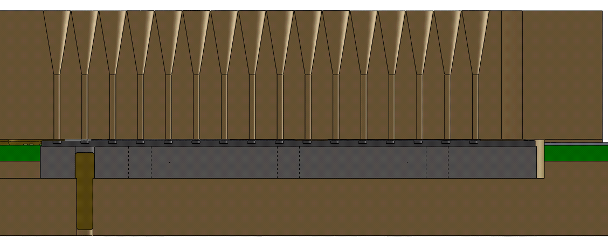
Feedhorn Array
Circuit Board
1 in
Alignment Pin
Detector and Backshort Wafers
Focal Plane Platter
Invar Plate

Slide 5
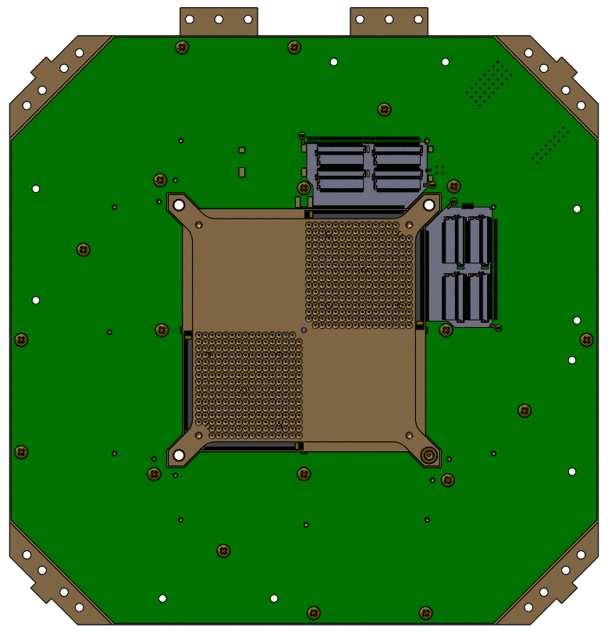
Mount points for link to 1 K cold plate
Feedhorn array
Wiring chip with multiplexing and interface chips
Spider mount points
4 in

