Slide 2
Al TES
Au Heat Capacity Ring
Si Substrate
SiN Membrane
Metalized Backshort Wafer

Slide 3
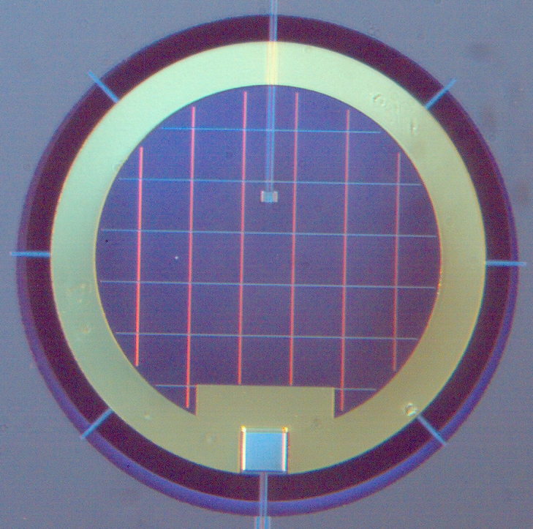
ch5-proto-pixel-labeled.png
E
D
C
B
A
200 μm

