Slide 1
600 μm
Feedhorn Array
Feedhorn Array
Au Heat Capacity Ring
Air gap
Al TES
Si Substrate
SiN Membrane
Metalized Backshort Wafer

Slide 2
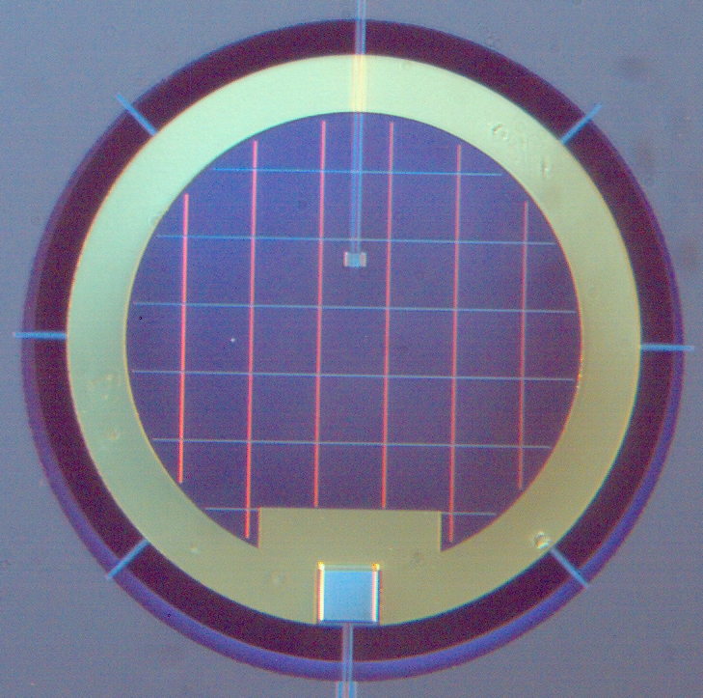
ch5-proto-pixel-labeled.png
E
D
C
B
A
200 μm

