Slide 1
Introduction to Python programming language
Bhava Avula
Week#2, 9/14/2016

Slide 2
Today’s Agenda
General Introduction to Python
Indentation, Comments, Variables, Expressions, Strings, Numbers, Other data types
Getting Input from Users
Lists
Indexing, Slicing, Indexing, Append, Insert, Delete, Reverse, Copy, Sort, Concatenate, “in” operator etc.
FOR loop

Slide 3
Python Basics – Indentation and block structuring
In other languages (eg: C), braces delimit a block of code, and indentation is optional. But in Python indentation itself delimits the block of code, and is therefore required.
Eg:
n=9 r=1 while n > 0:
r=r*n
n=n-1
r=2
(Notice how there are no beginning and ending parentheses for the while loop)

Slide 4
Indentation
Benefits
It’s impossible to have missing or extra braces.
The visual structure of the code reflects its real structure. This makes it easy to grasp the skeleton of code just by looking at it.
Python coding styles are mostly uniform.

Slide 5
Indentation
Annoyances
A Tab character and 4 Spaces are not the same even though they visually appear to be equally spaced.
Good practice: Never use tabs, always use spaces.
Python interpreter returns an error message if you have a space (or spaces) preceding the commands you enter at a prompt.
Avoid space(s) at the beginning of a command.

Slide 6
Comments
Anything following a # symbol in a Python file is a comment and is disregarded by the language. Eg:
x = 3 # Now x is 3
Exception: If the # character appears in a string, the following text is not treated as a comment. Eg: x = "# This is not a comment"

Slide 7
Variables and Assignments
Code to create a variable ‘x’ and assign the value 5 to ‘x’ is: >>> x = 5
Note there is no delimiter (Eg: a semi-colon) at the end of the statement.
Note that you do not have to specify the type of variable (eg: int)

Slide 8
Variables
The same variable ‘x’ can be immediately assigned to another data type, a string for example: >>> x = 5 >>> x = ‘hello’
The variable can be deleted to remove it from Python’s memory: >>> x = 5 >>> print(x) 5 >>> del x >>> print(x) Traceback (most recent call last): File "<stdin>", line 1, in <module> NameError: name 'x' is not defined >>>

Slide 9
Expressions
Most arithmetic expressions are similar to other languages. Eg: >>> x=3 >>> y=5 >>> z = (x + y) / 2
Note, however, that the division (‘/’) operator returns a floating value. If you want the truncated integer, use ‘//’ instead. x = 3 / 2 # Returns 1.5 x = 7 // 2 # Returns 3
x = 7 % 2 # Returns 1

Slide 10
Strings
Python has a rich and powerful collections of operators that can be applied to strings.
You can use single quoted strings, double-quoted strings, or even triple quoted strings.
Backslashes can be used to escape special characters. x = "\tThis string starts with a \"tab\"." x = "This string contains a single backslash(\\)."

Slide 11
Strings
Single and double quoted strings are equivalent, except that you don’t need to backslash " characters in single-quoted strings or ' characters in double-quoted strings: x = "Don't need a backslash" x = 'Can\'t get by without a backslash' x = "Backslash your \" character!" x = 'You can leave the " alone'

Slide 12
Strings
With triple quoted strings, you do not need to escape any characters: x = """Starting and ending a string with triple " characters permits embedded newlines, and the use of " and ' without backslashes"""
In the above example, x is the entire sentence between the """ delimiters including special characters

Slide 13
Numbers
Python offers 4 kinds of numbers: integers, floats, complex numbers, and Boolean numbers.
Integers:
X = 5
Floats:
Y = 2.0e-8
Integers can be converted to floats and vice versa:
>>> int(2e2) 200 >>> float(200) 200.0

Slide 14
Numbers
Numbers can be arbitrarily large in Python, as big as the system’s memory will allow.
Built-in numeric functions:
abs, divmod, float, hex, int, long, max, min, oct, pow, round
See documentation for details
Use the standard module ‘math’ for more advanced mathematical functions.
Also see the Python extension ‘NumPy’ for more advanced numeric computational methods.

Slide 15
None
It is a special data type that defines a single special data object called None.
Represents an empty value.
There is only 1 instance of this data type in entire Python.
None is equivalent only to itself.

Slide 16
Getting input from the user
Use the input() method: >>> name = input("Name? ") Name? Vern >>> print(name) Vern >>> age = int(input("Age? ")) Age? 28 >>> print(age) 28 >>>
Text in red above is entered by the user

Slide 17
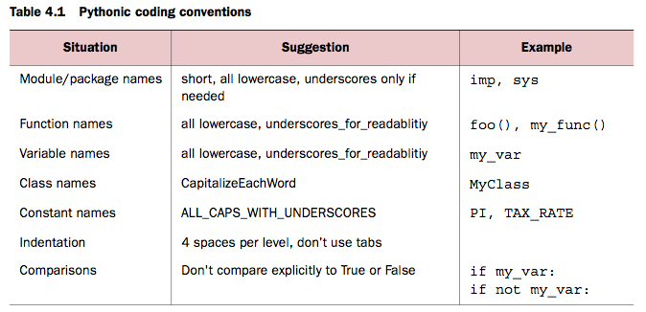
Basic Python Style
More information at: www.python.org/dev/peps/pep-0008/

Slide 18
Lists
Lists are like arrays, but far more powerful and flexible. Eg: # This assigns a three-element list to x x = [1, 2, 3]
Note that you do not have to declare that x is a list. Also you do not have to specify its size ahead of time.
An element of a list can be of any type. Eg: # First element is a number,
#second is a string, third is
# another list. x = [2, "two", [1, 2, 3]]

Slide 19
Lists
len() method returns the length of the list. >>> x = [2, "two", [1, 2, 3]] >>> len(x) 3
Individual elements of the list can be accessed by using indices: >>> x = ["first", "second", "third", "fourth"] >>> x[0] 'first' >>> x[2] 'third'

Slide 20
Lists
Individual elements can also be accessed from the end of the list by using negative numbers. -1 refers to the last element in the list, -2 refers to the last but one element, and so on. Eg: >>> a = x[-1] >>> a 'fourth' >>> x[-2] 'third'

Slide 21
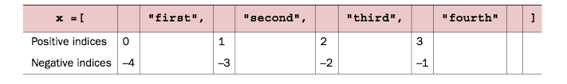
Lists
For more advanced operations, it is actually convenient to think of the indices as indicating positions between elements
>>> x[1:-1] ['second', 'third'] >>> x[0:3]
['first', 'second', 'third'] >>> x[-2:-1] ['third'] >>> x[-1:2] []
4

Slide 22
Lists
Omitting one or the other index means either “Go from the beginning of the list” or “Go to the end of the list” >>> x[:3] ['first', 'second', 'third'] >>> x[2:] ['third', 'fourth']

Slide 23
Lists
Omitting both the indices makes a copy of the list. Eg: >>> y = x[:] >>> y[0] = '1 st' >>> y ['1 st', 'second', 'third', 'fourth'] >>> x ['first', 'second', 'third', 'fourth']

Slide 24
Lists
You can modify the list by simply accessing the elements using the indices: >>> x = [1, 2, 3, 4] >>> x[1] = "two" >>> x [1, 'two', 3, 4]

Slide 25
Lists
Modifying list >>> x = [1, 2, 3, 4] >>> x[len(x):] = [5, 6, 7] >>> x [1, 2, 3, 4, 5, 6, 7] >>> x[:0] = [-1, 0] >>> x [-1, 0, 1, 2, 3, 4, 5, 6, 7] >>> x[1:-1] = [] >>> x [-1, 7]

Slide 26
Lists
Appending to a list is a common operation that there is a dedicated method just for that: >>> x = [1, 2, 3] >>> x.append("four") >>> x [1, 2, 3, 'four']
extend is like append, except that it allows adding one list to another: >>> x = [1, 2, 3, 4] >>> y = [5, 6, 7] >>> x.extend(y) >>> x [1, 2, 3, 4, 5, 6, 7]

Slide 27
Lists
insert method can be used to insert a new element into the list: >>> x = [1, 2, 3] >>> x.insert(2, "hello") >>> print(x) [1, 2, 'hello', 3] >>> x.insert(0, "start") >>> print(x) ['start', 1, 2, 'hello', 3]

Slide 28
Lists
Elements can be deleted from the list using the ‘del’ method: >>> x = ['a', 2, 'c', 7, 9, 11] >>> del x[1] >>> x ['a', 'c', 7, 9, 11] >>> del x[:2] >>> x [7, 9, 11]

Slide 29
Lists
remove looks for the first instance of a given value in a list and removes that value from the list: >>> x = [1, 2, 3, 4, 3, 5] >>> x.remove(3) >>> x [1, 2, 4, 3, 5]
>>> x.remove(3) >>> x [1, 2, 4, 5] >>> x.remove(3) Traceback (innermost last):
File "<stdin>", line 1, in ? ValueError: list.remove(x): x not
in list

Slide 30
Lists
reverse method efficiently reverses a list in place: >>> x = [1, 3, 5, 6, 7] >>> x.reverse() >>> x [7, 6, 5, 3, 1]

Slide 31
Lists
Lists can be sorted using the built-in Python sort method: >>> x = [3, 8, 4, 0, 2, 1] >>> x.sort() >>> x [0, 1, 2, 3, 4, 8]
Note that it does ‘in-place’ sorting.

Slide 32
Lists
Sorted() function returns a sorted list: >>> x = [4, 3, 1, 2] >>> y = sorted(x) >>> y [1, 2, 3, 4]

Slide 33
Lists
in operator can test if a particular value is present in the list: >>> 3 in [1, 3, 4, 5] True >>> 3 not in [1, 3, 4, 5] False >>> 3 in ["one", "two", "three"] False >>> 3 not in ["one", "two", "three"] True

Slide 34
Lists
Lists can be concatenated by using the + operator >>> z = [1, 2, 3] + [4, 5] >>> z [1, 2, 3, 4, 5]
List can be initialized with the * operator: >>> z = [None] * 4 >>> z [None, None, None, None] >>> z = [3, 1] * 2 >>> z [3, 1, 3, 1]

Slide 35
Lists
min() and max() methods can be used to determine the minimum and maximum of the values present in the list. But all the elements in the list need to be of the same type: >>> min([3, 7, 0, -2, 11]) -2 >>> max([4, "Hello", [1, 2]]) Traceback (most recent call last): File "<pyshell#58>", line 1, in <module> max([4, "Hello",[1, 2]]) TypeError: unorderable types: str() > int()

Slide 36
List
List search with index. Use the index method to find where in a list a value can be found: >>> x = [1, 3, "five", 7, -2] >>> x.index(7) 3 >>> x.index(5) Traceback (innermost last): File "<stdin>", line 1, in ? ValueError: list.index(x): x not in list

Slide 37
Lists
Count method searches a list, looking for a value, but it returns the number of times a value is found in the list: >>> x = [1, 2, 2, 3, 5, 2, 5] >>> x.count(2) 3 >>> x.count(5) 2 >>> x.count(4) 0

Slide 38
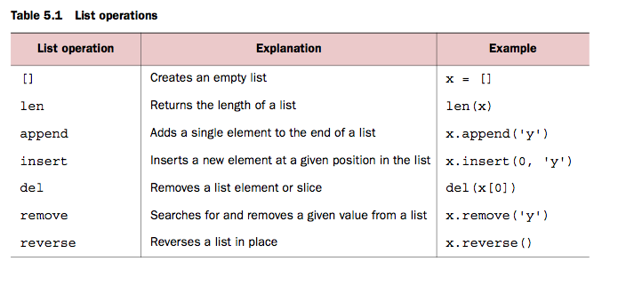
Lists

Slide 39
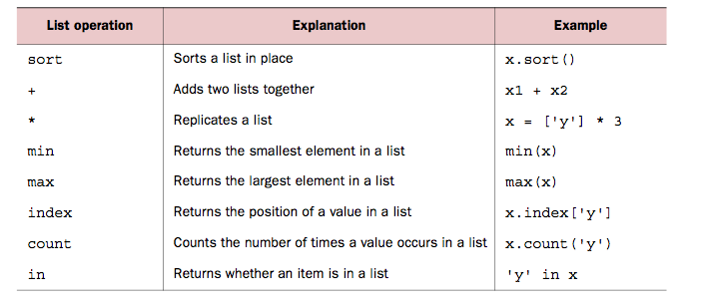
Lists
Index method should have parentheses, not square brackets, i.e, x.index(‘y’)

Slide 40
To read at home
Custom sorting (Page 51)
Nested Lists and Deep Copies (Page 55)
Tuples (Page 57)
Sets (Page 60)

Slide 41
FOR loop
Slightly different from other languages in how it works:
In Python, the for loop iterates over the values of a sequence (i.e, a list), not the indices of the sequence.
for item in sequence:
body
Eg: x = [12, 32, 2] for value in x: print(1 / value)

Slide 42
WHILE loop
Loop end event is determined by a condition:
while expression:
statement(s)
Eg:
x = 0
while x < 10:
x = x+2
print(x)

Slide 43
Home Exercise
Given a list of lists, return the count of the number of sub-lists where the list length is 2 or more and the first and last elements of the sub-list are the same. Eg: If input is [[1],[1,2],[4,2,4],[3,3,3],[1,6,6,4],[1,1]], then the output should be 3.
def match_ends(words):
# +++your code here+++
return

Slide 44
Home Exercise
Given a list of numbers, return a list where all duplicate elements have been reduced to a single element, so [1,4,2, 2, 3, 1,2,3] returns [1,4,2,3]. You may create a new list or modify the passed in list.
def remove_duplicates(nums):
# +++your code here+++
return

Slide 45
Home Exercise
Given a list of numbers, return a list where all adjacent equal elements have been reduced to a single element, so [1, 2, 2, 3,2,3] returns [1, 2, 3,2,3]. You may create a new list or modify the passed in list.
def remove_adjacent(nums):
# +++your code here+++
return
(Exercises taken from http://code.google.com/edu/languages/google-python-class/lists.html)

Slide 46
Home Exercise
Name: Reverse list Question: - Write a function to return the reverse of the input list. Hint: Think about iterating backwards.
Skeleton:
def reverse_list(l):
# write your
# solution code
# here
Test:
input = [1,2,5,4,3]
result = reverse(input)
Expect: result=[3,4,5,2,1]
Note: Please try to solve this without using the ‘reverse’ method.
Taken from: http://people.csail.mit.edu/pgbovine/python/questions/reverse.txt

Slide 47
Home Exercise
Given a list of numbers, return a list with the list in sorted order, except group all the elements whose value is 3 at the beginning.
Eg. If the input list is [3,8,44,2,1,3,2] the output should be [3,3,1,2,2,8,44]
def front_3(lst):
# +++your code here+++
return

Slide 48
Home Exercise
Write a function that takes in a list of numbers, and
(a) Removes from the list the maximum value of all the elements
(b) Removes from the list the minimum value of all the elements
(c ) Removes all occurrences of the number 3 from the list
Return the remaining list after removing all the above elements.
For example, if the input list is [1,3,5,6,2,3,5,6,8,8], the output list should be [5,6,2,5,6].
1 is removed since it is the minimum value.
The two 8’s are removed since 8 is the maximum value.
And finally all the 3’s are removed as well.
def remove_elements(lst):
# +++your code here+++
return new_lst

Slide 49
Home Exercise
Given two lists, create and return a merged list of all the elements in sorted order. You may modify the passed in lists.
def linear_merge(list1, list2):
# +++your code here+++
Eg: linear_merge([1,2,6],[0,3,4]) should return [0,1,2,3,4,6]
* Please also try to solve this without using the sort() or sorted() methods.

Slide 50
Home Exercise
Write a funtion num_freq() that takes a list of integers as an input and prints out the number of times each number is present in that list.
def num_freq(list1):
# +++your code here+++
Eg: num_freq([1,2,6,1,1,3,4,6,0,3,4]) should output the following:
1 appears 3 times
2 appears 1 time
6 appears 2 times
3 appears 2 times
4 appears 2 times
0 appears 1 time

Slide 51
Home Exercise
Implement the following python’s inbuilt methods on lists:
def len(lst): Accept a list as an input and returns its length.
def min(lst): Accept a list as an input and returns its minimum value.
def max(lst): Accept a list as an input and returns its maximum value.
def append(lst, element): Accept a list and an element as inputs, append that element at the end of the list and return the new list.
def insert(lst, element, position): Accept a list, an element, and a number as inputs, insert the element into that list at the specified position, and return the new list.
def index(lst, element): Accept a list and an element as inputs, and return the position at which that element appears in the list.
If the element is not present in the list, return -1.
def count(lst, element): Accept a list and an element as inputs, and return the number of times the element appears in the list.
Please do not use the corresponding inbuilt methods. Instead iterate thru the list using ‘for’ loop and determine the necessary outputs.

