Slide 1
Introduction to Python programming language
Bhava Avula
Week#3, 9/21/2016

Slide 2
Agenda
Strings in Python
String operations
Escape Sequences
String printing
Split, join methods
Converting strings to numbers
Strip, find, index, count, startswith, endswith methods

Slide 3
Strings
String manipulation is a very common task in most programming exercises.
Python has extensive set of string related methods.

Slide 4
Strings as a sequence of characters
For the purposes of extracting characters and substrings, strings can be considered as a sequence of characters.
This means you can use index or slice notation.
>>> x = "Hello"
>>> x[0]
'H’
>>> x[-1]
'o'
>>> x[1:]
'ello'

Slide 5
String Operations
Just like lists, you can use the ‘len’ method to determine the length of the string:
>>> len("Goodbye")
7
Strings can be concatenated:
>>> x = "Hello " + "World"
>>> x 'Hello World'

Slide 6
String Operations
Multiplication Operator:
>>> 8 * "x"
'xxxxxxxx’
Special characters and escape sequences:
Sequences of characters that start with a backslash and that are used to represent other characters are called escape sequences.

Slide 7
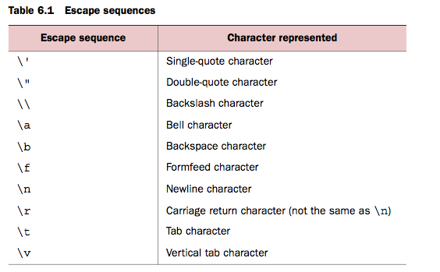
Strings – Basic escape sequences

Slide 8
Strings – Numeric (Octal and Hexadecimal) escape sequences
An Octal escape sequence is a backslash followed by 3 digits defining an octal number.
A hexadecimal escape sequence is similar but starts with \x rather than just \ and can consist of any number of hexadecimal digits.
>>> 'm'
'm'
>>> '\155'
'm'
>>> '\x6D'
'm'

Slide 9
Numeric escape sequences
>>> '\n'
'\n'
>>> '\012'
'\n'
>>> '\x0A'
'\n'

Slide 10
Printing strings with escape sequences
A string that is evaluated at the top level of an interactive Python session will be shown with all of its special characters as octal escape sequences.
The print function passes the string directly to the terminal program, which may interpret special characters in special ways.
>>> 'a\n\tb'
'a\n\tb' >>> print('a\n\tb')
a
b

Slide 11
String Print
Print adds a newline to the string.
But giving the print function an ‘end’ parameter of “” causes the print function to not append the newline.
>>> print("abc\n")
abc
>>> print("abc\n", end="")
abc >>>

Slide 12
Strings – split method
split returns a list of substrings in the string.
By default split uses whitespace as the delimiter to the strings it is splitting, but you can change that via an optional argument.
>>> x = "You\t\t can have tabs\t\n \t and newlines \n\n mixed in"
>>> x.split() ['You', 'can', 'have', 'tabs', 'and', 'newlines', 'mixed', 'in']
>>> x = "Mississippi”
>>> x.split("ss")
['Mi', 'i', 'ippi’]

Slide 13
Strings – split method
You can also specify the maximum number of splits that can occur: >>> x = 'a b c d'
>>> x.split(' ', 1)
['a', 'b c d'] >>> x.split(' ', 2)
['a', 'b', 'c d']
>>> x.split(' ', 9)
['a', 'b', 'c', 'd']

Slide 14
Strings – join method
join takes a list of strings and puts them together to form a single string with the original string between each element.
Join method is more efficient than string concatenation using + operator
>>> " ".join(["join", "puts", "spaces", "between", "elements"])
'join puts spaces between elements'
>>> "::".join(["Separated", "with", "colons"]) 'Separated::with::colons'
>>> "".join(["Separated", "by", "nothing"])
'Separatedbynothing’

Slide 15
Converting Strings to Numbers
You can use int and float functions to convert strings to integer or floating point numbers:
>>> float('123.456')
123.456
>>> float('xxyy') Traceback (innermost last):
File "<stdin>", line 1, in ValueError: invalid literal
>>> int('3333') 3333
>>> int('123.456')
Traceback (innermost last):
File "<stdin>", line 1, in ValueError: invalid literal
>>> int('10000', 8) 4096

Slide 16
Converting Strings to Numbers
>>> int('101', 2)
5
>>> int('ff', 16)
255
>>> int('123456', 6)
Traceback (innermost last):
File "<stdin>", line 1, in ? ValueError: invalid literal for int() with base 6: '123456’

Slide 17
Strings – strip, rstrip, lstrip methods
strip returns a new string that’s the same as the original string, except that any whitespace at the beginning and end of the string has been removed.
lstrip and rstrip work similarly, except that they remove whitespace only at the left or right end of the original string, respectively.

Slide 18
Strings – strip, rstrip, lstrip methods
>>> x = " Hello, World\t\t "
>>> x.strip() 'Hello, World' >>> x.lstrip()
'Hello, World\t\t '
>>> x.rstrip()
' Hello, World'

Slide 19
Strings – strip, rstrip, lstrip methods
You can also specify the specific characters you want to strip off instead of the white space.
>>> x = "www.python.org"
>>> x.strip("w")
'.python.org' >>> x.strip("gor")
'www.python.'
>>> x.strip(".gorw")
'python'

Slide 20
String searching - find
find – It takes one required argument: the substring being searched for. find returns the position of the first character of the first instance of substring in the string object, or –1 if substring doesn’t occur in the string:
>>> x = "Mississippi"
>>> x.find("ss")
2
>>> x.find("zz")
-1

Slide 21
String searching - find
find can also take one or two additional, optional arguments.
The first of these, if present, is an integer start; it causes find to ignore all characters before position start in string when searching for substring.
The second optional argument, if present, is an integer end; it causes find to ignore characters at or after position end in string after position end in string:
>>> x = "Mississippi"
>>> x.find("ss", 3)
5
>>> x.find("ss", 0, 3)
-1

Slide 22
String searching - rfind
rfind is almost the same as find, except that it starts its search at the end of string and so returns the position of the first character of the last occurrence of substring in string:
>>> x = "Mississippi"
>>> x.rfind("ss")
5
rfind can also take one or two optional arguments, with the same meanings as those for find.

Slide 23
String searching – index and rindex
index and rindex are identical to find and rfind, respectively, except for one difference: if index or rindex fails to find an occurrence of substring in string, it doesn’t return –1 but rather raises a ValueError exception.

Slide 24
String methods - count
Count returns the number of non-overlapping times the given substring occurs in the given string:
>>> x = "Mississippi"
>>> x.count("ss")
2
>>> x.count(“issi")
1

Slide 25
String methods – startswith and endswith
startswith and endswith return True or False depending on whether the string they are used on starts or ends with one of the strings given as parameters:
>>> x = "Mississippi"
>>> x.startswith("Miss")
True >>> x.startswith("Mist")
False >>> x.endswith("pi")
True >>> x.endswith("p")
False

Slide 26
Modifying Strings
Strings are immutable. This is an important difference between strings and lists.
But strings have methods that can operate on that string and return a new string that is a modified version of the original.

Slide 27
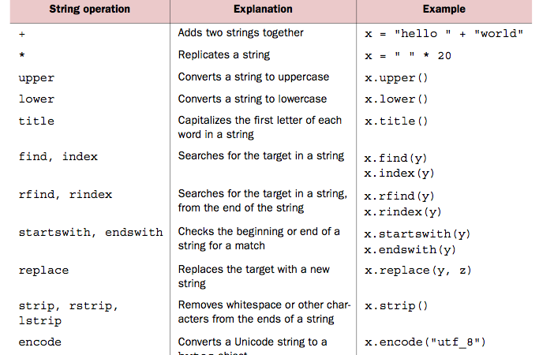
String methods

Slide 28
Strings - Exercises
Donuts: Given an int count of a number of donuts, return a string of the form 'Number of donuts: <count>', where <count> is the number passed in. However, if the count is 10 or more, then use the word 'many’ instead of the actual count.
donuts(5) returns 'Number of donuts: 5’
donuts(23) returns 'Number of donuts: many’
def donuts(count):
# +++your code here+++

Slide 29
Strings - Exercises
both_ends: Given a string s, return a string made of the first 2 and the last 2 chars of the original string, so 'spring' yields 'spng'. However, if the string length is less than 2, return instead the empty string.
def both_ends(s):
# +++your code here+++
return

Slide 30
Strings - Exercises
fix_start: Given a string s, return a string where all occurences of its first char have been changed to '*', except do not change the first char itself. e.g. 'babble' yields 'ba**le’ Assume that the string is length 1 or more.
def fix_start():
# +++your code here+++
return
>>> fix_start()
Please enter the input string: babble
The output is ba**le

Slide 31
Strings - Exercises
MixUp: Given strings a and b, return a single string with a and b separated by a space '<a> <b>', except swap the first 2 chars of each string. Assume a and b are of length 2 or more.
e.g. 'mix', ‘pod' -> 'pox mid’
E.g: 'dog', 'dinner' -> 'dig donner’
def mix_up():
# +++your code here+++
return
>>> mix_up()
Please enter the first string: mix
Please enter the second string: pod
The output is pox mid

Slide 32
Strings - Exercises
Given a list of strings, return the count of the number of strings where the string length is 2 or more and the first and last chars of the string are the same. Eg: If input is [‘a’, ‘hello’, ‘helloh’, ‘abcda’, ‘qqqqq’], then the output should be 3.
def match_ends(words):
# +++your code here+++
return

Slide 33
Strings - Exercises
Given a list of strings, return a list with the strings in sorted order, except group all the strings that begin with 'x' first.
Eg. ['mix', 'xyz', 'apple', 'xanadu', 'aardvark'] yields ['xanadu', 'xyz', 'aardvark', 'apple', 'mix']
def front_x(words):
# +++your code here+++
return
(Exercises taken from http://code.google.com/edu/languages/google-python-class/lists.html)

Slide 34
Strings - Exercises
Given two strings, return True if either of the strings appears at the very end of the other string, ignoring upper/lower case differences (in other words, the computation should not be "case sensitive"). Note: s.lower() returns the lowercase version of a string.
end_other('Hiabc', 'abc') → True
end_other('AbC', 'HiaBc') → True
end_other('abc', 'abXabc') → True
end_other('abc', 'XabcY') → False
end_other(‘abc’,’def’) -> False

Slide 35
Strings - Exercises
Given a string, return a string where for every char in the original, there are two chars.
>>> double_char()
Please enter the string: The
The output is TThhee
>>> double_char()
Please enter the string: AAbb
The output is AAAAbbbb
>>> double_char()
Please enter the string: Hi-There
The output is HHii--TThheerree

Slide 36
Strings - Exercises
Return True if the string "cat" and "dog" appear the same number of times in the given string.
cat_dog('catdog') → True
cat_dog('catcat') → False
cat_dog('catdogcatdog') → True
cat_dog('1cat1cadodog') → True

Slide 37
Home Exercises
Write a function that converts the time to 24hr format.
>>> time24hr(‘09:34am')
'0934hr'
>>> time24hr('12:34am')
'0034hr'
>>> time24hr('12:15pm')
'1215hr‘
>>> time24hr(‘02:15pm')
‘1415hr'

Slide 38
Home Exercises
Define a function that takes in 3 values and determine if they can form the sides of an triangle.
Hint: The sum of the lengths of any two sides of a triangle is greater than the length of the third side.
>>> is_triangle()
Please enter the length of the first side of the triangle: 3
Please enter the length of the second side of the triangle: 4
Please enter the length of the third side of the triangle: 5
These three lengths can be used to create a triangle
>>> is_triangle()
Please enter the length of the first side of the triangle: 1
Please enter the length of the second side of the triangle: 3
Please enter the length of the third side of the triangle: 1
These three lengths can NOT be used to create a triangle

Slide 39
Strings - Exercises
Given a string of characters, print the characters, one at a time, in reverse order.
Run your code from the OS shell by specifying the python interpreter and the file name. See below.
In file str.py
def str_reverse(s):
##Your code here
Return
Bhavas Mac$ python3 str.py
Please enter the string: hello
The output is olleh
Bhavas Mac$ python3 str.py
Please enter the string: how are you ?
The output is ? uoy era woh

Slide 40
Strings - Exercises
Given a string of characters, write a function to print every other character in the string, in reverse order:
For example, if the supplied string is “abcdefgh”, your function should print “hfdb”
If the supplied string is“abcdefg”, your function should print “geca”
def everyother_reverse(s):
#Your code here
return

Slide 41
Strings - Exercises
Return the number of times that the string "code" appears anywhere in the given string, except we'll accept any letter for the 'd', so "cope" and "cooe" count.
Run your code from the OS shell by specifying the python interpreter and the file name. See below.
In file code.py
def count_code():
#Your code here
return
Bhavas Mac$ python3 code.py
Please enter the string: aaacodebbb
The answer is 1
Bhavas Mac$ python3 code.py
Please enter the string: codexxcode
The answer is 2
Bhavas Mac$ python3 code.py
Please enter the string: cozexxcope
The answer is 2
Bhavas Mac$ python3 code.py
Please enter the string: cozexxcopexxxxcoe
The answer is 2
(Some exercises taken from codingbat.com)

Slide 42
Strings - Exercises
Implement the following python’s inbuilt methods on strings:
def len(str): Accept a string as an input and returns its length.
def split(str, sep): Accept a string and a separator sub-string as inputs, and return the list of words in the string using ‘sep’ as the delimiter string.
Eg: split(“mississippi”, “ss”) returns [‘mi’, ‘i’, ‘ippi’]
def join(sep, lst): Takes a separator string and a list of strings as input, and returns a concatenated string by combining all the strings in the list with the ‘sep’ string inserted in between.
Eg: join(“ss”, [‘mi’, ‘i’, ‘ippi’]) returns “mississippi”
def strip(str, stripstr): Accept a string and another stripstring as arguments. Return a copy of the string str with leading and trailing characters from stripstr removed.
Eg: strip(“www.python.org”,”.gorw”) returns “python”
def find(str, substr): Accept a string and a substring as argument. Return the position of the first character of the first instance of substring in the string object, or –1 if substring doesn’t occur in the string.
Eg: find(“mississippi”, “ss”) returns 2
Eg: find(“mississippi”, “zz”) returns -1
def count(str, substr): Accept a string and a substring as inputs, and return the number of non-overlapping times the substring appears in the string.
Eg: count(“mississippi”, “ss”) returns 2
Eg: count(“mississippi”, “issi”) returns 1
def startswith(str, substr): Accept a string and a substring as inputs, and return true if the string str begins with the substring, false otherwise:
Eg: startswith(“mississippi”, “miss”) returns true
Eg: startswith(“mississippi”, “Miss”) returns false
def endswith(str, substr): Accept a string and a substring as inputs, and return true if the string str ends with the substring, false otherwise:
Eg: startswith(“mississippi”, “ippi”) returns true
Eg: startswith(“mississippi”, “zz”) returns false
* Please do not use the corresponding inbuilt methods. Instead iterate thru the list using ‘for’ loop and determine the necessary outputs.

