Slide 1

Kleine Einführung in Go
Softwerkskammer Lübeck, am 04.06.2015
Daniel Bimschas

Slide 2
Inhalt
Motivation
Introduction into the language
Goroutines and Channels
Unit Testing and Benchmarking
Web Development
What‘s next?

Slide 3
1. Motivation

Slide 4
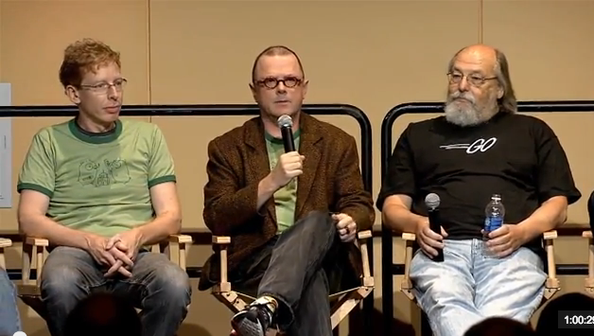
Who made it?
Robert Griesemer (V8, HotSpot, ...)
Rob Pike (First window system for Unix 1981, Plan9, UTF-8, …)
Ken Thompson (ken) (Unix, B, UTF-8, …)

Slide 5
Nice properties of Go
Fast (theoretically between C++ / Java)
Compiles incredibly fast (no time to wander off in thoughts)
Easy to program concurrently (multi-core)
Native compiles, self-containing binaries -> no runtime installation required
Compiler-Errors for (almost) everything (even unused imports, variables)
Great runtime error messages (e.g. deadlocks)
Garbage-collected

Slide 6
Nice properties of Go
Very simple type system & syntax (lang. spec. 46 pages, including examples)
Very rich but simple standard library
Not 1000 ways to do one thing
go command(s)
go installs, builds, tests, benchmarks Go programs using nothing more than source as build specification (!)
gofmt, automatic standardized code formatting
godoc, analog zu JavaDoc
gofix, automates the rewriting of code to use new language features or updated libraries
go get, built-in package manager (git, mercurial)

Slide 7
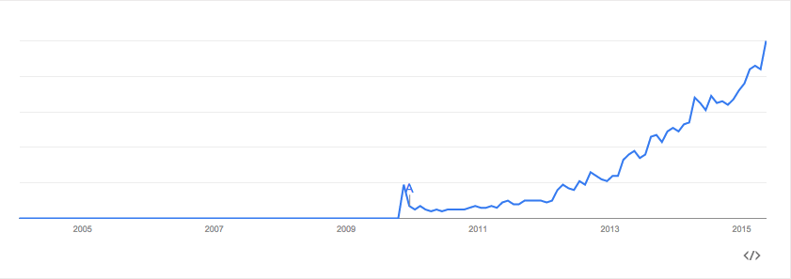
Does it have a future?
Quelle: https://www.google.com/trends/explore#q=golang

Slide 8
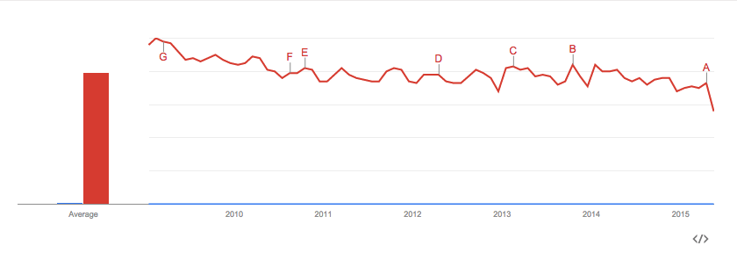
Does it have a future? Go vs. Java
Quelle: https://www.google.com/trends/explore#q=golang%2C%20java&date=1%2F2009%2084m&cmpt=q&tz=

Slide 9
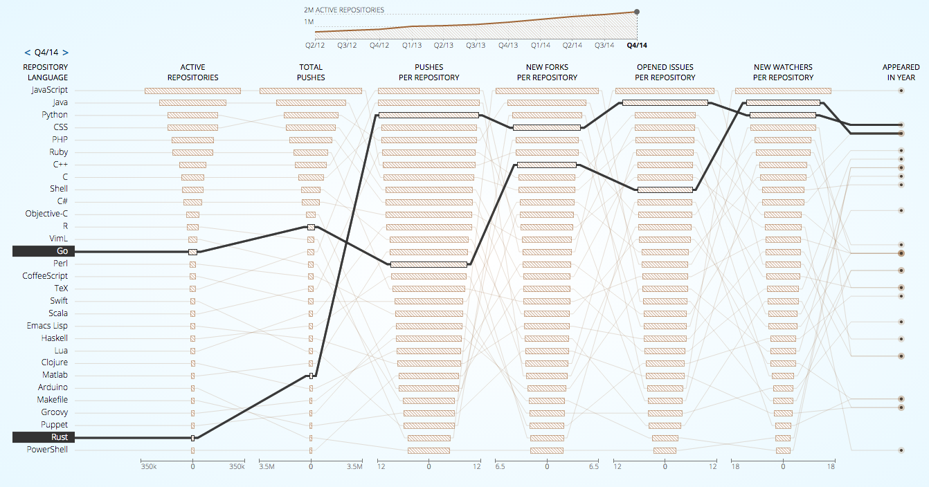
Does it have a future?
Quelle: http://githut.info/

Slide 10
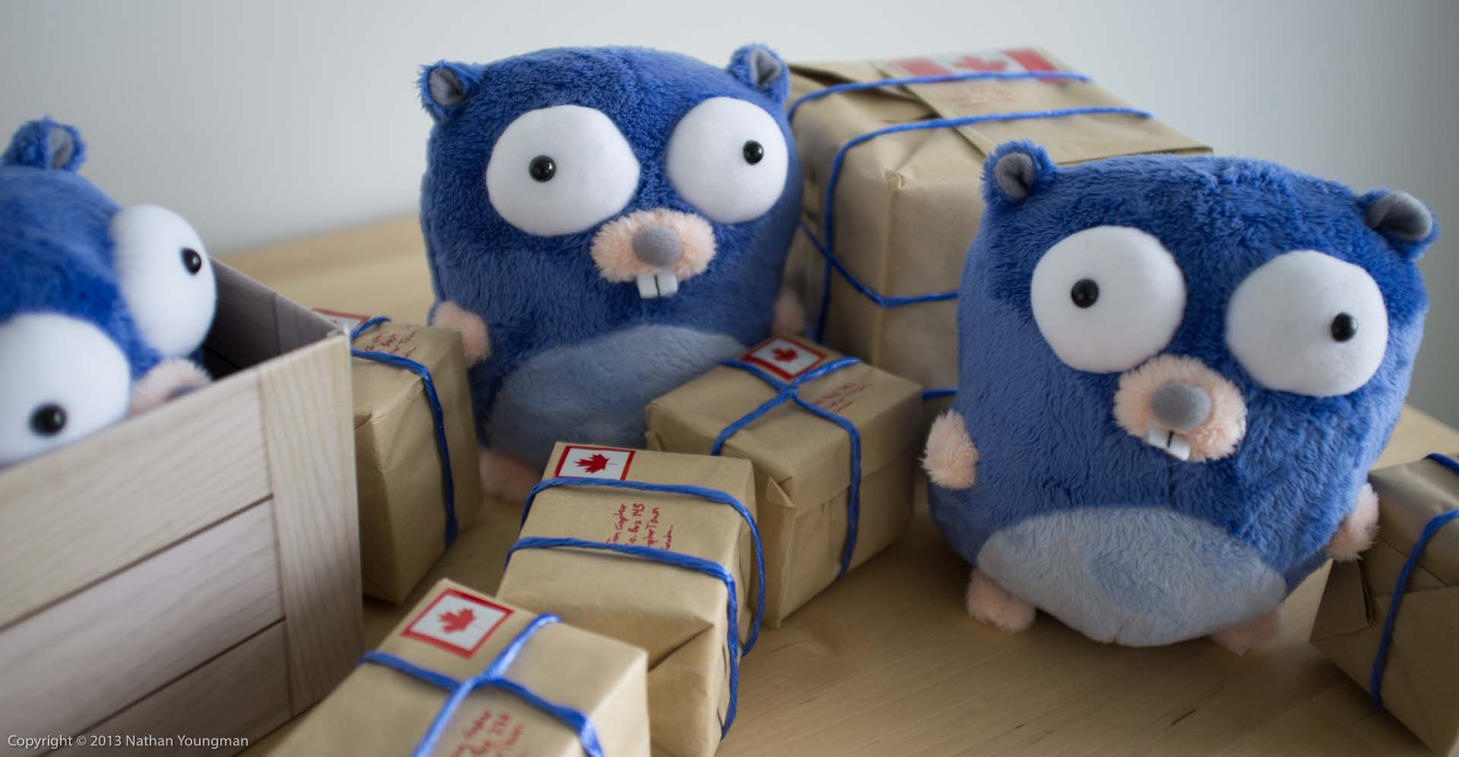
2. Introduction into the language

Slide 11
2. Introduction into the language
Properties
statically-typed
garbage-collected
structs
variable length arrays ("slices“)
key-value maps
awesome concurrency features
type inference
methods on types (no classes!)
pointers
Simple language Specification
no type inheritance
no method or operator overloading
no circular dependencies among packages
no pointer arithmetic
no assertions
no generic programming
no implicit type conversions
no public / protected / private keywords

Slide 12
2. Introduction into the language
Variablen und Typen
intro1: Hello, World
intro2: Variablen und primitive Typen
Flußkontrolle
flow1: for, switch
flow2: defer
flow3: panic
flow4: recover
flow5: error

Slide 13
2. Introduction into the language
Funktionen
func1: Deklarationstypen
func2: Functions as values
func3: Closures
Typen
types1: structs
types2: slices
types3: maps
types4: methods for custom types
types5: methods for existing types
types6: interfaces

Slide 14


(Static) Duck Typing / Structural Typing
“When I see a bird that walks like a duck and swims like a duck and quacks like a duck, I call that bird a duck”

Slide 15
2. Introduction into the language
Packages
packages1: export, import, rename

Slide 16
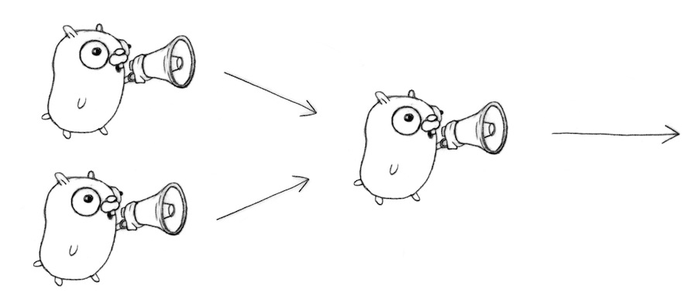
3. GoRoutines and Channels
Bild: http://devel.io/2013/09/11/go-fanin-function/

Slide 17
3. Concurrency vs. Parallelism
Concurrency: „Programming as the composition of independently executing processes“ (!= OS process)
Parallelism: „Programming as simultaneous execution of (possibly) related computations“
„Concurrency provides a way to structure a solution to solve a problem that may (but not necessarily) be parallelizable“
„Concurrency is about structure, parallelism is about execution“
Source: https://talks.golang.org/2012/waza.slide#8

Slide 18
3. Goroutines and Channels
“Concurrency is a way to structure a program by breaking it into pieces that can be executed independently.”
“Communication is the means to coordinate independent executions”
Go approach based on C.A.R. Hoares “Communicating Sequential Processes” (CSP, 1978)

Slide 19

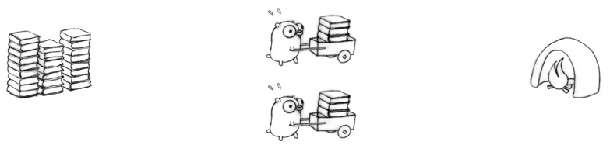
3. Goroutines and Channels
Slow: only one worker
Faster, but: bottlenecks at pile and incinerator, plus synchronization needed

Slide 20
3. Goroutines and Channels
Faster, but scale-out necessary (additional resources)

Slide 21
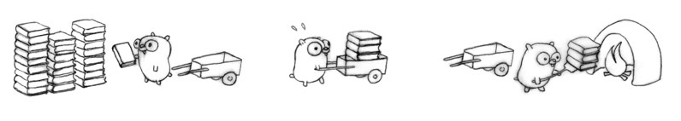
3. Goroutines and Channels

Slide 22
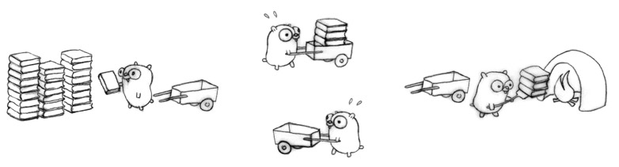
3. Goroutines and Channels
(Ideally) 4 times as “fast“ as the original design
Even though we do more work (!)
4 independent procedures with different jobs
4 different synchronisation points
Execution not necessarily parallel, but valid “concurrent design”

Slide 23
3. Goroutines and Channels
Concurrent Design for a scalable Web service
Book pile => Web content
Gopher => CPU
Cart => marshalling, rendering or networking
Incinerator => proxy, browser or other consumer

Slide 24
3. Goroutines and Channels
Concurrency primitives in Go
Concurrent execution (goroutines)
Synchronisation and messages (channels)
Multi-way concurrent control (select)
Code
goroutines1: synchronous channel communication
goroutines2: sync. + flag channel
goroutines3: buffered channels
goroutines4: timeout concurrent operations
goroutines5: query replicated service

Slide 25
3. Goroutines and Channels
Most APIs are blocking, sequential code
The go keyword makes it easy to execute concurrently
Synchronisation is the harder part

Slide 26
4. Unit Testing And Benchmarking

Slide 27
4. Unit Testing
Unit Testing
Run tests: go test
Code Coverage
Install cover tool: go get golang.org/x/tools/cmd/cover
Run coverate test: go test –cover
Generate outfile: go test -coverprofile=coverage.out
Function breakdown: go tool cover -func=coverage.out
HTML view: go tool cover -html=coverage.out
Counting mode (outfile): go test -covermode=count -coverprofile=count.out
Print counting results: go tool cover -func=count.out
HTML counting view: go tool cover -html=count.out
Benchmarking
Run benchmark: go test -bench .
Print mem stats: go test -bench . -benchmem

Slide 28
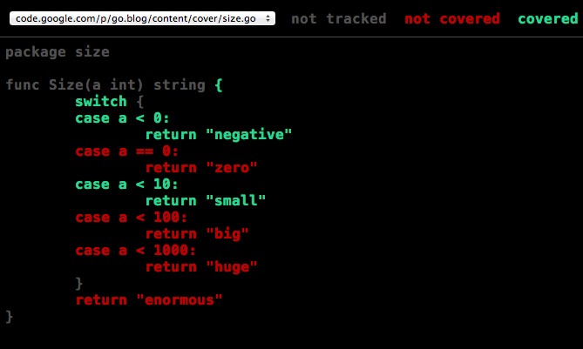
4. Unit Testing

Slide 29
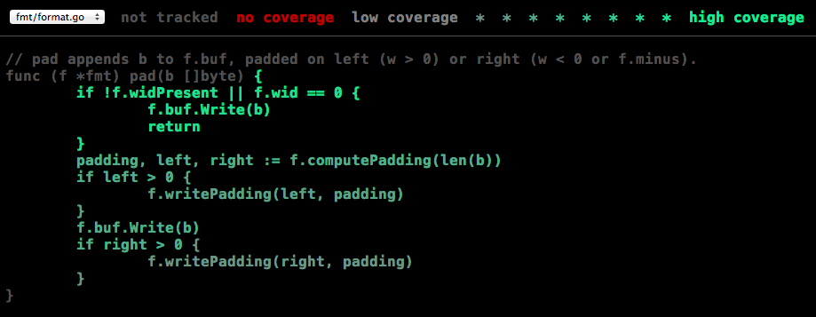
4. Unit Testing

Slide 30
5. Web Development

Slide 31
5. Web Development
web1: Hello World Web server
web2: Simple file server
web3: Templates using html/template package

Slide 32
6. What’s Next?

Slide 33
6. What’s next?
Concurrency Patterns
Functional Programming (map/transform/…)
Hackathon?
Refactorings
Debugging and Profiling
Dependency Management
More Web Development
Popular Go-Projects and -Libraries
Deployment (e.g., Docker + Go)

