Slide 1

Kleine Einführung in Go
Softwerkskammer Lübeck, am 07.05.2015
Daniel Bimschas

Slide 2
Inhalt
Motivation
Einführung in die Sprache
Goroutines and Channels
Unit Testing und Benchmarking
Web-Entwicklung
Ausblick

Slide 3
1. Motivation

Slide 4
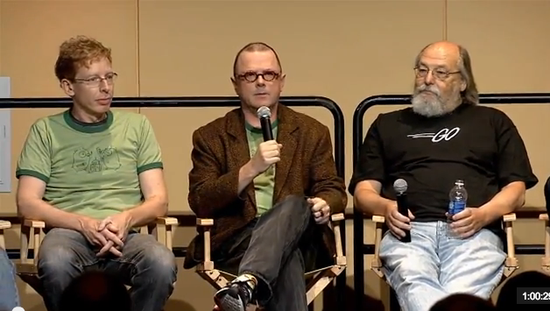
Wer hat’s erfunden?
Robert Griesemer (V8, HotSpot, ...)
Rob Pike (First window system for Unix 1981, UTF-8, …)
Ken Thompson (ken) (Unix…)

Slide 5
Nice properties of Go
Fast (theoretically between C++ / Java, easy to program concurrently)
Compiles incredibly fast (no time to wander off in thoughts)
Native compiles, self-containing binaries -> no runtime installation required
Compiler-Errors for (almost) everything (even unused imports, variables)
Great runtime error messages (e.g. deadlocks)
go command(s)
installs, builds, tests, benchmarks Go programs using nothing more than source as build specification (!)
gofmt, automatic standardized code formatting
godoc, analog zu JavaDoc
gofix, automates the rewriting of code to use new language features or updated libraries
Go get, built-in package manager (git, mercurial)

Slide 6
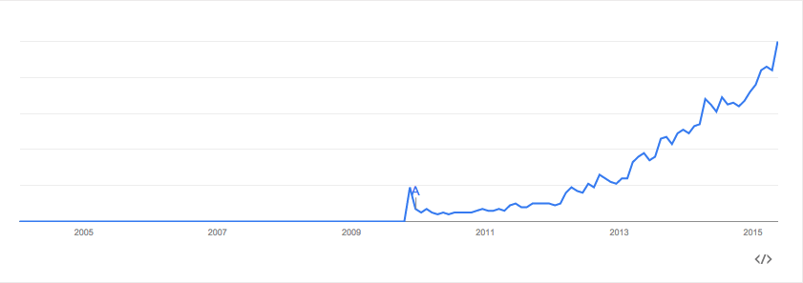
Hat es eine Zukunft?
Quelle: https://www.google.com/trends/explore#q=golang

Slide 7
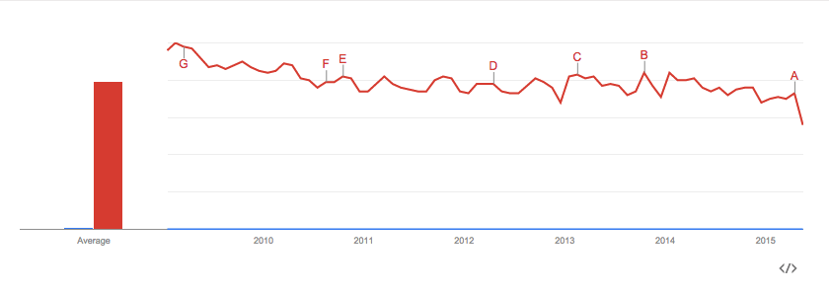
Hat es eine Zukunft? Go vs. Java
Quelle: https://www.google.com/trends/explore#q=golang%2C%20java&date=1%2F2009%2084m&cmpt=q&tz=

Slide 8
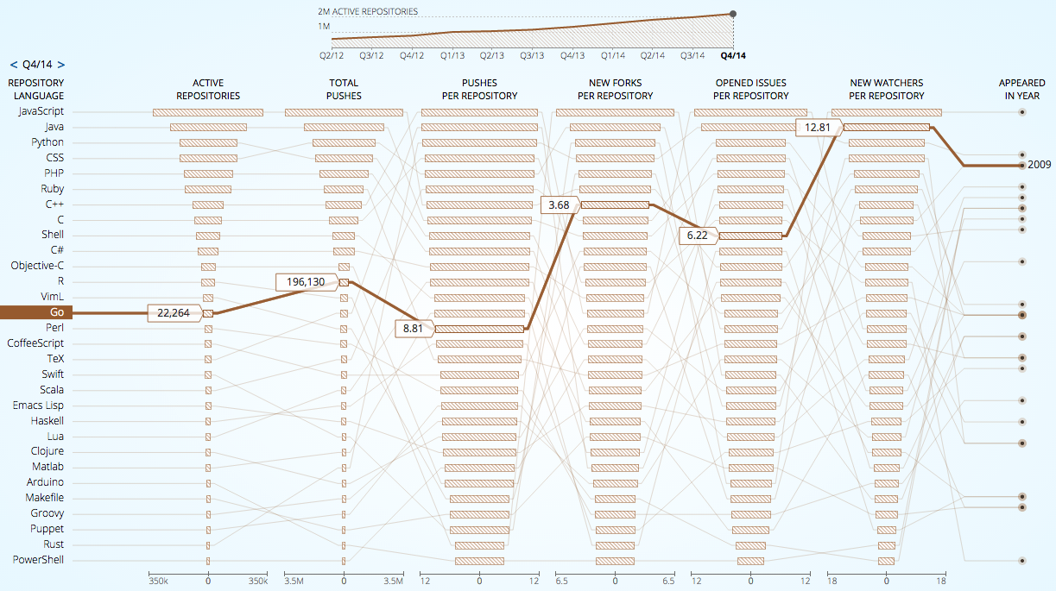
Hat es eine Zukunft?
Quelle: http://githut.info/

Slide 9
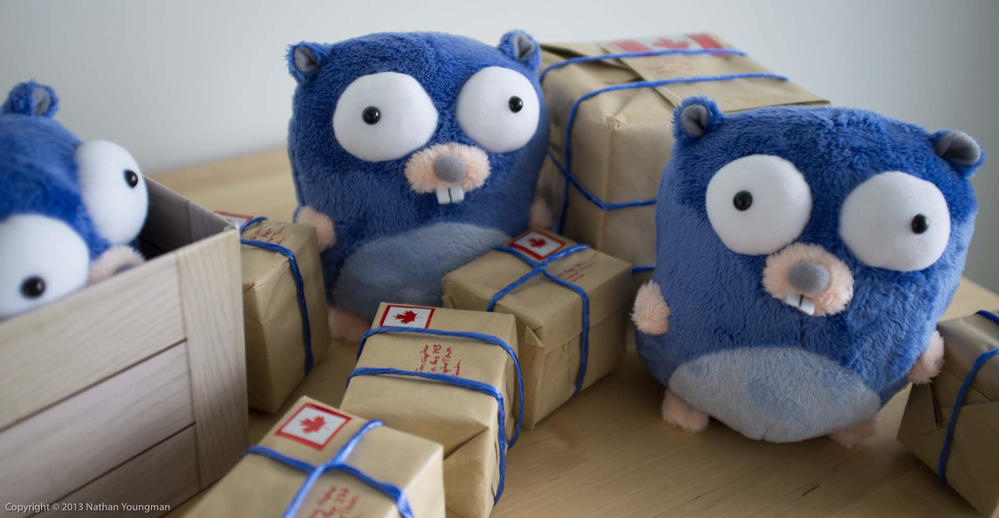
2. Einführung in die Sprache

Slide 10
2. Einführung in die Sprache
Properties
statically-typed
garbage-collected
structs
variable length arrays ("slices“)
key-value maps
awesome concurrency features
type inference
methods on types (no classes!)
pointers
Simple language Specification
no type inheritance
no method or operator overloading
no circular dependencies among packages
no pointer arithmetic
no assertions
no generic programming
no implicit type conversions
no public / protected / private keywords

Slide 11
2. Einführung in die Sprache
Variablen und Typen
intro1: Hello, World
intro2: Variablen und primitive Typen
Flußkontrolle
flow1: for, switch
flow2: defer
flow3: panic
flow4: recover

Slide 12
2. Einführung in die Sprache
Funktionen
func1: Deklarationstypen
func2: Functions as values
func3: Closures
Typen
types1: structs
types2: slices
types3: maps
types4: methods for custom types
types5: methods for existing types
types6: interfaces

Slide 13
2. Einführung in die Sprache
Packages
packages1: export, import, rename

Slide 14
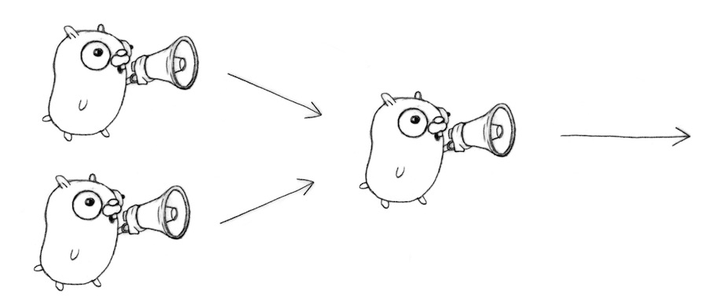
3. GoRoutines and Channels
Bild: http://devel.io/2013/09/11/go-fanin-function/

Slide 15
3. Goroutines and Channels
Concurrency primitives in Go
Concurrent execution (goroutines)
Synchronisation and messages (channels)
Multi-way concurrent control (select)
Code
goroutines1: synchronous channel communication
goroutines2: sync. + flag channel
goroutines3: buffered channels
goroutines4: timeout concurrent operations
goroutines5: query replicated service

Slide 16
3. Goroutines and Channels
Most APIs are blocking, sequential code
The go keyword makes it easy to execute concurrently
Synchronisation is the harder part

Slide 17
3. Concurrency vs. Parallelism
Concurrency: „Programming as the composition of independently executing processes“ (!= OS process)
Parallelism: „Programming as simultaneous execution of (possibly) related computations“
„Concurrency provides a way to structure a solution to solve a problem that may (but not necessarily) be parallelizable“
„Concurrency is about structure, parallelism is about execution“
https://talks.golang.org/2012/waza.slide#8

Slide 18
3. Goroutines and Channels
“Concurrency is a way to structure a program by breaking it into pieces that can be executed independently.”
“Communication is the means to coordinate independent executions”
Basiert auf “Communication Sequential Processes” (CSP, 1978) von C.A.R Hoare

Slide 19

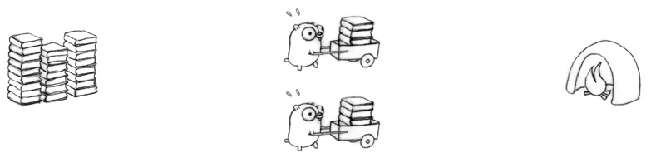
3. Goroutines and Channels
Slow: only one worker
Faster, but: bottlenecks at pile and incinerator, plus synchronization needed

Slide 20
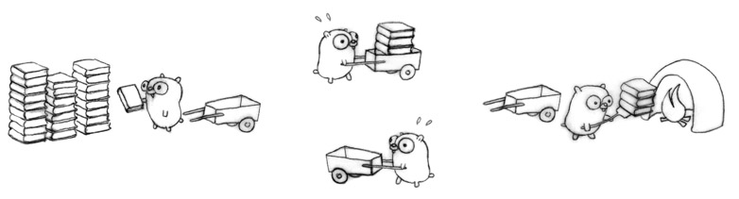
3. Goroutines and Channels
(Im Idealfall) Fast 4 mal so schnell wie das ursprüngliche Design
obwohl mehr Arbeit erledigt wird (!)
4 unabhängige Prozeduren mit unterschiedlichen Aufgaben + 4 Synchronisationspunkte
Ausführung nicht zwangsweise parallel aber valides “concurrent design”

Slide 21
3. Goroutines and Channels
Concurrent Design for a scalable Web service
Book pile => Web content
Gopher => CPU
Cart => marshalling, rendering or networking
Incinerator => proxy, browser or other consumer

Slide 22
4. Unit Testing und Benchmarking

Slide 23
4. Unit Testing
Unit Testing
Run tests: go test
Code Coverage
Install cover tool: go get golang.org/x/tools/cmd/cover
Run coverate test: go test –cover
Generate outfile: go test -coverprofile=coverage.out
Function breakdown: go tool cover -func=coverage.out
HTML view: go tool cover -html=coverage.out
Counting mode (outfile): go test -covermode=count -coverprofile=count.out
Print counting results: go tool cover -func=count.out
HTML counting view: go tool cover -html=count.out
Benchmarking
Run benchmark: go test -bench .
Print mem stats: go test -bench . -benchmem

Slide 24
5. Web-Entwicklung

Slide 25
5. Web-Entwicklung
web1: Hello World Web-Server
web2: Einfacher File-Server
web3: Templates mit html/template

Slide 26
6. Ausblick

Slide 27
6. Ausblick
Concurrency Patterns
Functional Programming (map/transform/…)
Debugging and Profiling
Dependency Management
Mehr Web-Entwicklung
Populäre Go-Projekte und -Bibliotheken
Deployment (e.g., Docker + Go)

