Slide 1
Temperature and Water Quality
Field Ecology
Dan Bregar (Please put your name and your partner’s name here!)

Slide 2
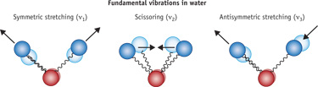
What is Temperature?
Temperature is a measurement of the vibration of the individual atoms and molecules that make up a substance.
This vibration is caused by energy – when certain types of energy are transferred into or out of something, its temperature goes up or down.

Slide 3
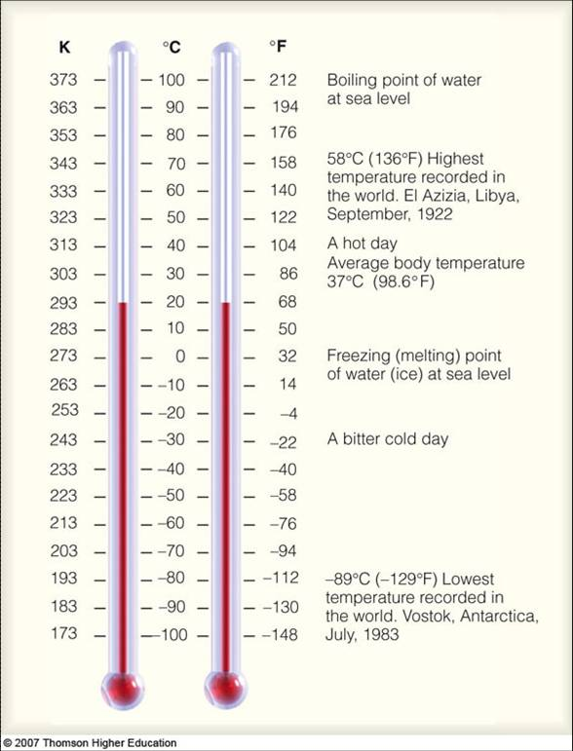
How is it measured?
We can use a thermometer or a sensor to measure temperature.
Temperature is measured in Fahrenheit degrees or in Celsius
In Fahrenheit, 32 degrees is freezing and 212 is boiling. Room temperature is around 67-70.
In Celsius, 0 is freezing and 100 is boiling. Room temperature is about 18-21.

Slide 4
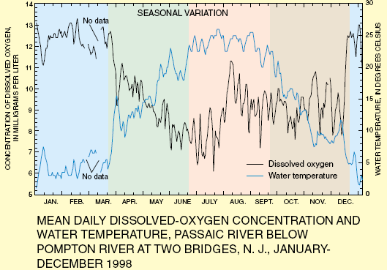
Why is it Important?
Chemical reactions generally occur at different rates when temperature changes. Therefore, all aquatic organisms are adapted to a particular temperature range that is best for their metabolism.
Also, as temperature increases, the amount of dissolved oxygen in water decreases. Since many aquatic organisms depend on dissolved oxygen to breathe, water temperature can be critical.
Finally, humans and other organisms often prefer to drink water that is relatively cool (room temperature or below).

