Slide 1
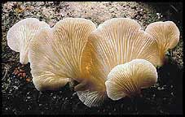
Growing Mushrooms
Polly and the Plumbers

Slide 2
Members
Brad McRae: Team Captain, Data Captain
Ashley Hardin: General help
Quin Hall: Data recorder/ Computer “Stuff”
Lizzy Brock: Head recorder/ Scribe
Hillary Bender: Measurements/ Recorder/ General help

Slide 3
Substrate
Our substrate
Recycled paper from various sources
Chose for of quantity and ease of access
Control substrate
Straw

Slide 4
Procedures (page 1)
Procedure for getting Substrate
Step 1: decided to use old homework
Step 2: had everyone bring as much of their old homework as possible
Step 3: collected substrate from group.
Procedure for prepping substrate for grain spawn.
Step 1: get 2 new substrate bags
Step 2: transfer substrate from pasteurizing bags into substrate bags.
Procedure for planting grain spawn
Step 1: Planted spawn into jar of grain
Step 2: leave jars closed for 6 days at room temp.
Step 3: dump half of grain spawn into each bag of substrate.
Step 4: spread grain spawn around on the substrate by shaking the bag.
Procedure for Pasteurizing Substrate
Step 1: got 2 bags for use in pasteurizing substrate
Step 2: put holes in both sides of bags
Step 3: Shredded substrate by ripping it up
Step 4: Stuffed as much shredded substrate into each bag as possible.
Step 5: Closed bag and twisted top
Step 6: attached string to top of bag.
Step 7: put both bags into pasteurizer.

Slide 5
Procedures (page 2)
Procedure for taking substrate temp
Step 1: Sterilize knife and thermometer with rubbing alcohol.
Step 2: poke small hole in substrate bag using a sterile knife.
Step 3: Stick a digital thermometer attached to the computer into substrate.
Step 4: record data.
Step 5: pull out thermometer and cover hole with tape.
Step 6: repeat steps 1-4 for bag 2
Procedure for measuring Volume
Step 1: get one 12 inch ruler
Step 2: Measure the height of one clump of mushrooms.
Step 3: Measure the width of clump of mushrooms
Step 4: calculate volume of mushroom clump using : Pie x R x R x H
Step 5: repeat steps 1-4 for each clump of mushrooms on bag (if there are any others)
Step 6: add up the volume of each clump and that is the total volume of mushrooms on that bag
Step 7: repeat steps 1-6 for bag 2
Procedure for taking Ph
Step 1: sterilize knife
Step 2: Slice a small hole in side of bag
Step 3: stick Ph strip into hole and rub it around on substrate for a few seconds.
Step 4: wait a few minutes then record Ph level
Step 5: repeat steps 1-4 for bag 2

Slide 6
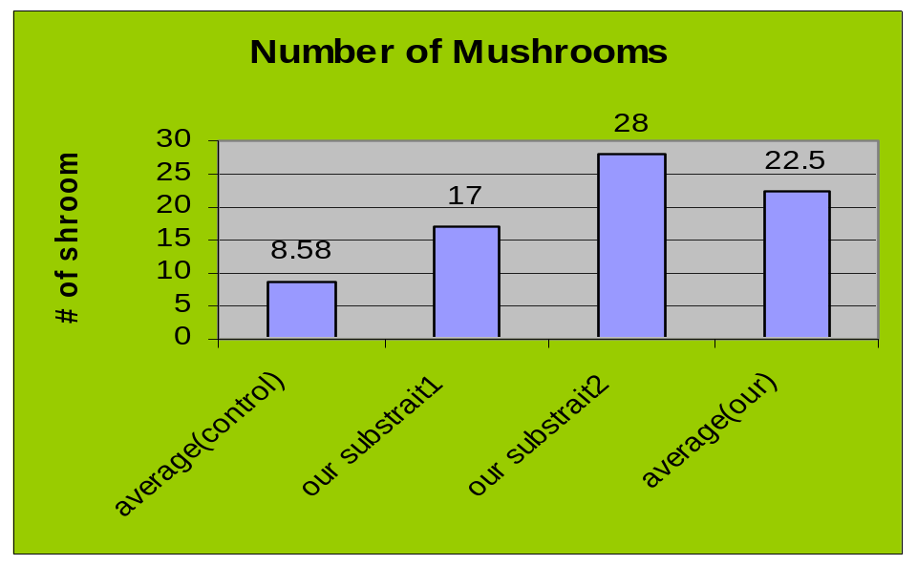
Data (part one)
 | Temp. | pH | sCO2 | fCO2 | CO2%
2/14/07 |  |  | 1602 | 2013 | 8.22
2/16/07 |  |  | 2255 | 2600 | 6.9
2/22/07 | 21.8 | 8 | 1895 | 2100 | 4.1
3/8/07 | 21.5 | 6
 | Bag #1 | Bag #2 | Average (ours) | Average (control)
# of Mushrooms | 17 | 28 | 22.5 | 8.58

Slide 7
Data (part two :Volume)
 | # of Mushrooms | Height (inches) | Radius (inches) | Volume (inches cubed)
Control Average | 8.58 | 1.92 | 1.12 | 59.53
Our substrate (average) | 22.5 | 5.25 | 3 | 165.9
 | Number of mushrooms | Height (inches) | Radius (inches) | Volume (inches cubed)
control bag 1 | 15 | 8 | 4 | 401.92
control bag 2 | 60 | 6 | 3 | 169.56
control bag 3 | 2 | 1 | 1 | 3.14
control bag 4 | 13 | 4 | 3 | 113.04
control bag 5 | 0 | 0 | 0 | 0
control bag 6 | 11 | 2 | 2 | 25.12
control bag 7 | 2 | 2 | 0.5 | 1.57
control bag 8 | 0 | 0 | 0 | 0
control bag 9 | 0 | 0 | 0 | 0
control bag 10 | 0 | 0 | 0 | 0
control bag 11 | 0 | 0 | 0 | 0
control bag 12 | 0 | 0 | 0 | 0
Average (control) | 8.58 | 1.92 | 1.12 | 59.53
our substrait1 | 17 | 4 | 2 | 50.24
our substrait2 | 28 | 6 | 4 | 326.56
Average (our) | 22.5 | 5.25 | 3 | 165.9

Slide 8
Conclusion
We could’ve done better job of washing before handling substrate.
Could’ve done a better job of distributing the work.
Taking better care when watering mushrooms.
Been more careful while testing for Ph, Temperature, Height, Radius, CO2, and calculating Volume

