Slide 1
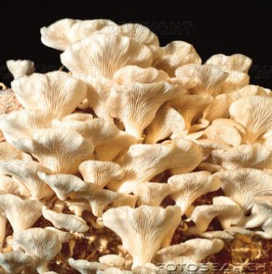
The Mushroom Project
By: Doom Shrooms
Chad Davis, Andy Engelhart, Kevin Yates, Daniel Rosenberg, and Amru

Slide 2
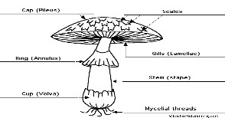
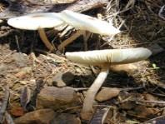
What Are Mushrooms?
Type of Fungi
We’re growing oyster mushrooms
Body is made up of strings of cells called hyphae

Slide 3
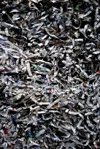
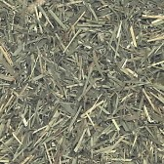
Substrate
Control Substrate: Straw
Our Substrate: Straw and shredded newspapers
Shredded
Newspaper
Straw

Slide 4
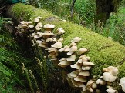
Procedures
Collected straws and newspapers
Shredded newspapers and put straw in plastic bags and then we tied the bags shut.
Then we put bag in hot water for 30 minutes for pasteurizing.
We cut fungi into squares and put rye-grain spawns in jar to make mushroom fungi.
Remove fungi from jars and add fungi into two different bags. One bag was filled with newspapers substrate and the second bag was filled with straw substrate.
We collected our data by measuring the temperature and ph on Feb. 14th, Feb. 21 and Feb. 26th.
Poked holes in bags and sprayed with water -set mushroom bags in room.
Wait for mushrooms to grow.

Slide 5
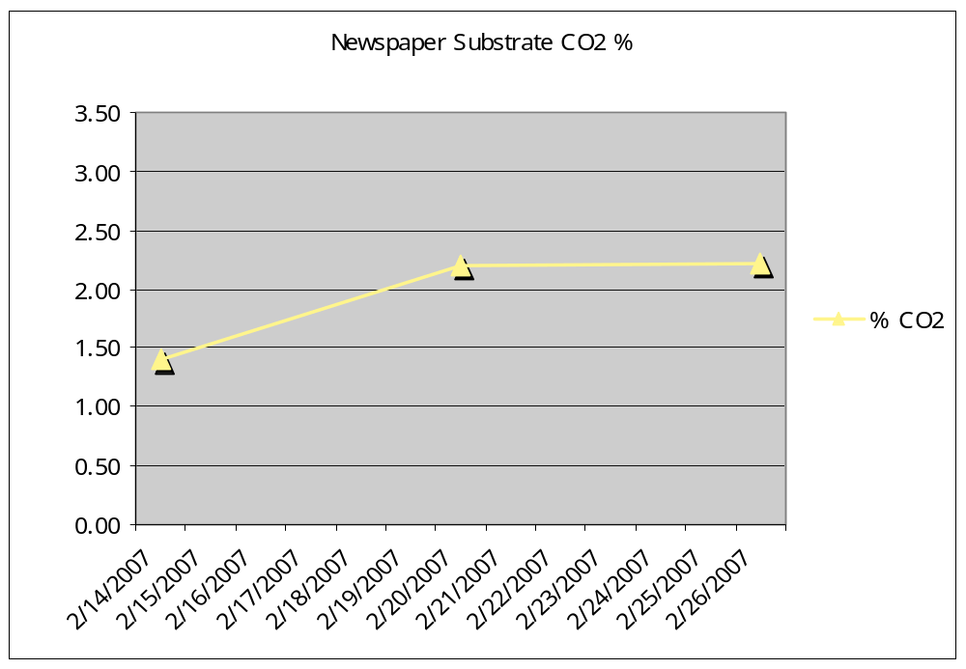
Newspaper substrate bag of Mushroom fungi measurements

Slide 6
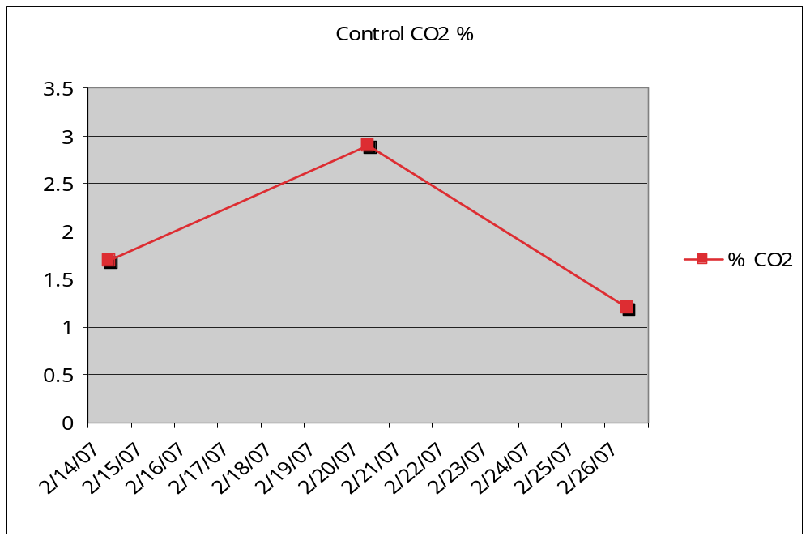
Control Bag of Mushroom
fungi measurements

Slide 7
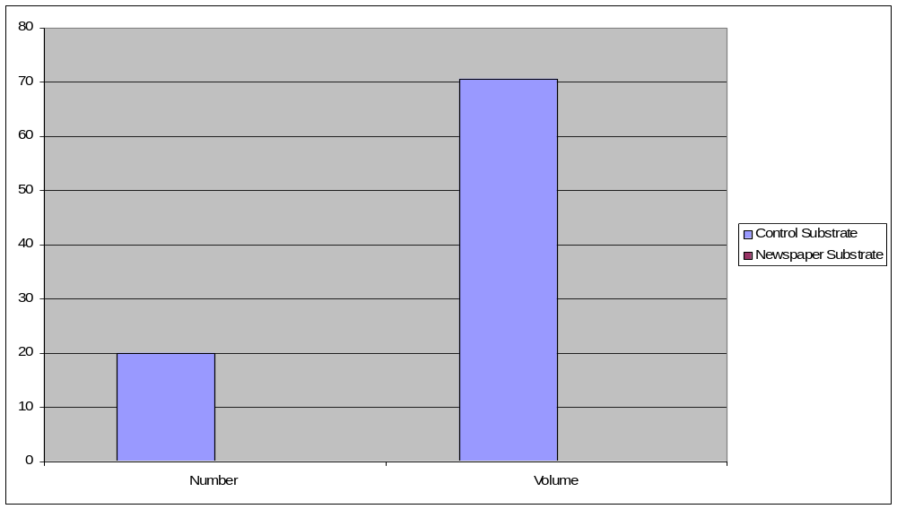
Results
As you can see the newspaper substrate produced zero mushrooms while the control substrate produced 20 mushrooms.

Slide 8
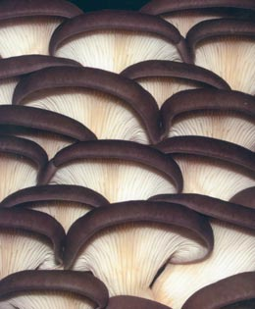
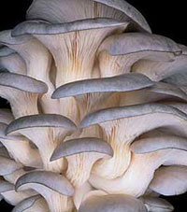
Conclusion
We discovered that using straw substrate produced more mushrooms than using newspaper substrate. We did not produce any mushrooms using the newspaper substrate. One possible explanation could be the source of our newspaper. For example, if fungicide is used on newspaper this would stop the newspaper as being a food source for the mushrooms.

