Slide 1
Mitosis
Biology

Slide 2
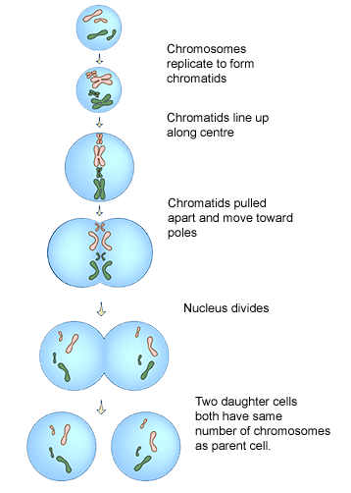
Overview
Cell division requires each cell to have an identical copy of DNA
DNA is organized into chromosomes
Before mitosis, DNA is replicated (copied!) so chromosomes are doubled into “sister chromatids”
During mitosis, sister chromatids split – each new cell gets one sister chromatid
Mitosis happens only for “somatic” cells – cells that make up the structures in each individual organism.
For reproduction, a different type of cell division is necessary
http://www.biology.arizona.edu/cell_bio/tutorials/cell_cycle/main.html
http://highered.mcgraw-hill.com/olc/dl/120073/bio14.swf

Slide 3
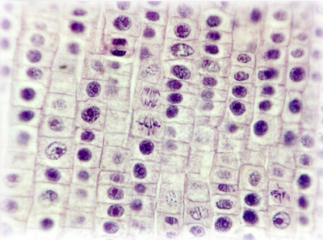
Onion Root Tips
Lots of mitosis!
Highly visible when stained
Thin sections make it easy to see different phases of mitosis

Slide 4
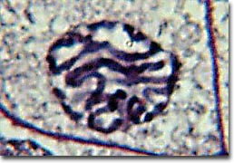
Prophase
DNA starts to condense (become visible) into chromosomes
Nuclear envelope starts to break up

Slide 5
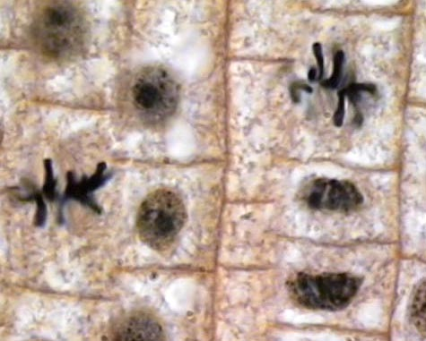
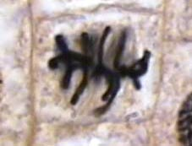
Metaphase
Chromosomes line up in the center of the cell
One sister chromatid on each side of the center

Slide 6
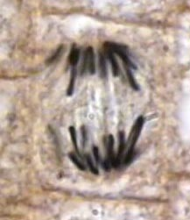
Anaphase
Sister chromatids are pulled apart
One chromatid ends up on each side of the cell

Slide 7
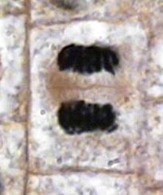
Telophase
The cell begins to pinch in half, forming two new cells
Chromasomes begin to decondense into diffuse genetic material
Nuclear envelope regenerates

Slide 8
Your job:
All team members need to find and draw one cell that is clearly in each phase of mitosis
In addition, each member of your team is primarily responsible for ONE phase of mitosis
After ½ hour, “phase experts” from each group will present to the class
What is happening during each phase of mitosis? What does this look like in the cell?

Slide 9
Discussion Quesions
What kinds of cells undergo mitosis?
What is mitosis?
What is the end result/product of mitosis?
What are the 4 phases of mitosis?
What cellular part actually divides in mitosis?
What would happen if the process of mitosis skipped metaphase? Telophase?
Are mutations of somatic cells (body cells), like skin cancer, heritable? Explain.

