Slide 2
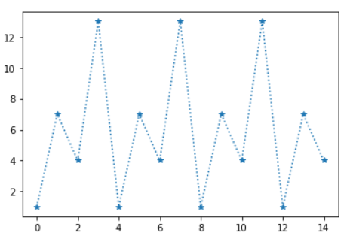
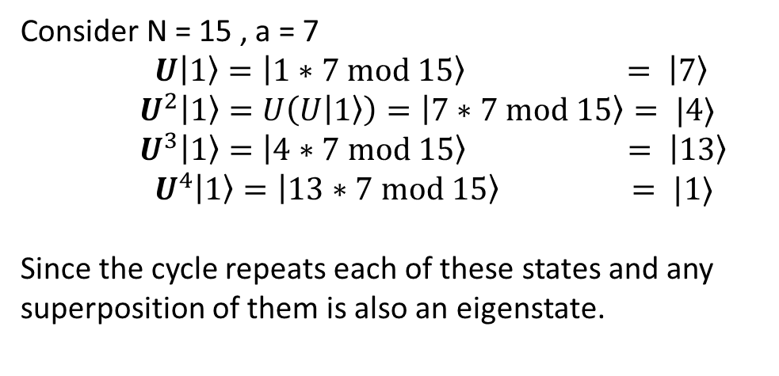
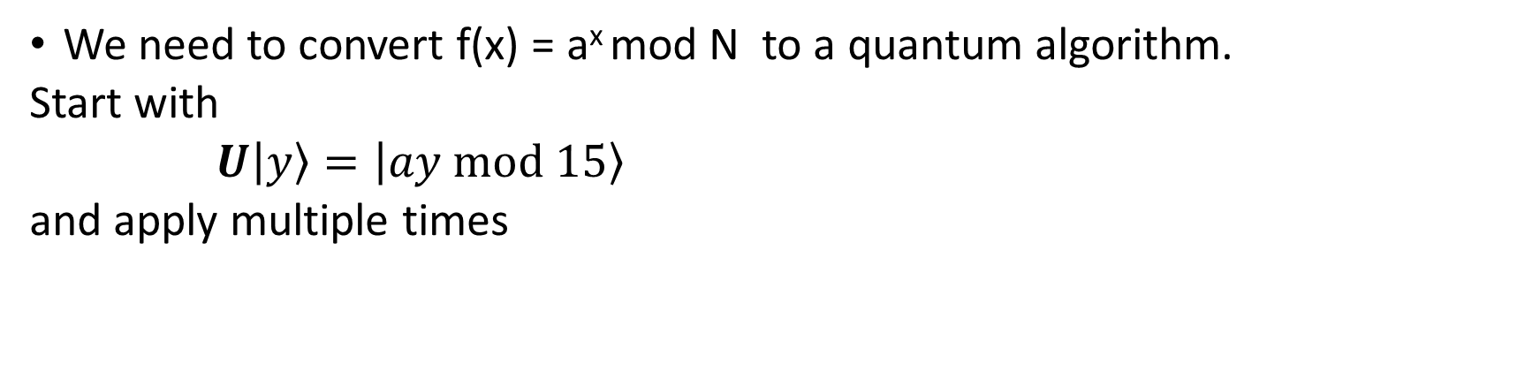


Implement f(x) as Unitary Transformations
We need to convert f(x) = a^{x} mod N to a quantum algorithm.
Start with
$U|y〉=|ay mod 15〉$
and apply multiple times
Consider N = 15 , a = 7
$U|1〉=|1∗7 mod 15〉 = |7〉$
$U^{2}|1〉=U\left(U|1〉\right)=|7∗7 mod 15〉= |4〉$
$U^{3}|1〉=|4∗7 mod 15〉 = |13〉$
$U^{4}|1〉=|13∗7 mod 15〉 = |1〉$
Since the cycle repeats each of these states and any superposition of them is also an eigenstate.
$$7^{x} mod 15$$
$$x$$

Slide 3

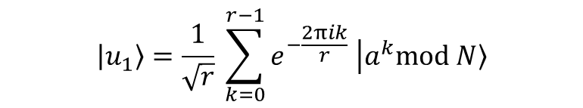
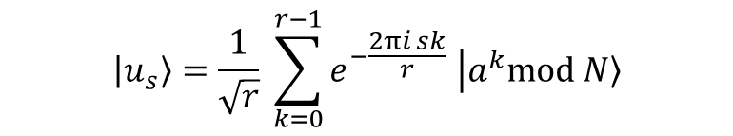
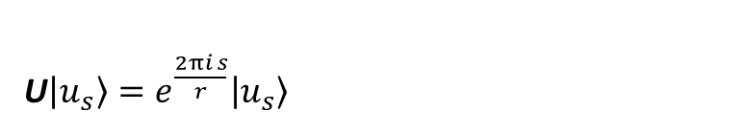
Repeated application with phase
Lets take a well chosen superposition of states ( that is also an eigenstate)
$$|u_{1}〉=\frac{1}{\sqrt{r}} \sum_{k=0}^{r−1}{e^{−\frac{2πik}{r}} \left|a^{k}mod\left. N\right\rangle \right.}$$
This will produce an eigenvalue containing r
U $|u_{1}〉=e^{\frac{2πi}{r}}|u_{1}〉$
Moreover there is a family of such solutions with integer s
$$|u_{s}〉=\frac{1}{\sqrt{r}} \sum_{k=0}^{r−1}{e^{−\frac{2πi sk}{r}} \left|a^{k}mod\left. N\right\rangle \right.}$$
U$|u_{s}〉=e^{\frac{2πi s}{r}}|u_{s}〉$

Slide 4
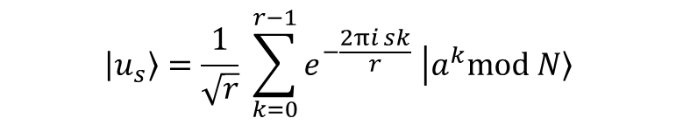
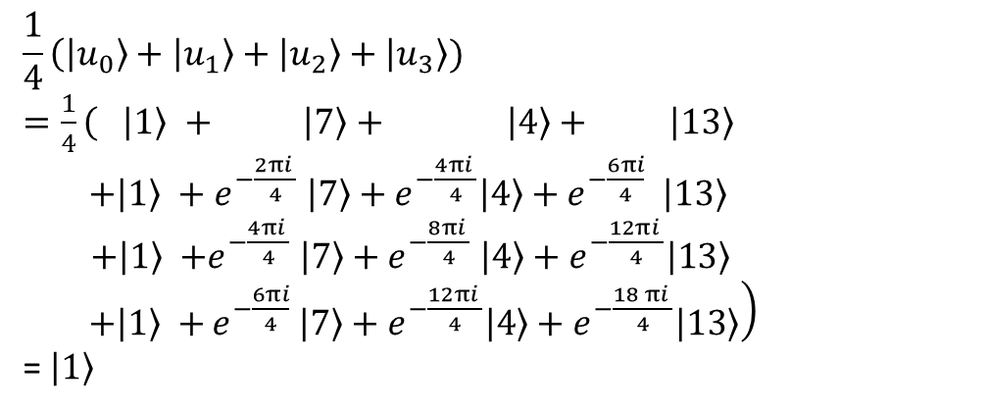
Picking some eigenstates
$$|u_{s}〉=\frac{1}{\sqrt{r}} \sum_{k=0}^{r−1}{e^{−\frac{2πi sk}{r}} \left|a^{k}mod\left. N\right\rangle \right.}$$
$|u_{s}〉$ for $0≤s≤r−1$ are eigenstates with the helpful property that the sum of them all is $|1〉$due to canceling phases
Consider N = 15 , a = 7, r=4
$$\frac{1}{4}\left(|u_{0}〉+|u_{1}〉+|u_{2}〉+|u_{3}〉) \right.$$
$=\frac{1}{4}\left( |1〉 \right.$ $+ |7〉+ |4〉+ |13〉$
$+|1〉 +$ $e^{−\frac{2πi }{4}} |7〉+e^{−\frac{4πi }{4}}|4〉+e^{−\frac{6πi}{4}} |13〉$
$+|1〉$ $+e^{−\frac{4πi }{4}} |7〉+e^{−\frac{8πi }{4}} |4〉+e^{−\frac{12πi }{4}}|13〉$
$+|1〉$ $+\left.e^{−\frac{6πi}{4}} |7〉+e^{−\frac{12πi }{4}}|4〉+e^{−\frac{18 πi }{4}}|13〉\right)$
= $|1〉$
We knew $|1〉$ was an eigenstate, but now we have an, admittedly complex, representation of $|1〉$ in $|u_{s}〉$.
Now we know we can use Quantum Phase Estimation on $|1〉$ this to find phase$ϕ=\frac{s}{r}$.

Slide 5
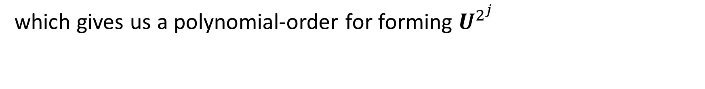

Doing this in quantum gates
In order to efficiently form U for encoded numerical states, we use repeated squaring. Assume we have a form for U, then its easy to show
$$U^{2^{j}}|y〉 =U^{2} °{ U}^{2}…°{ U}^{2}|y〉$$
j times
which gives us a polynomial-order for forming $U^{2^{j}}$

Slide 6
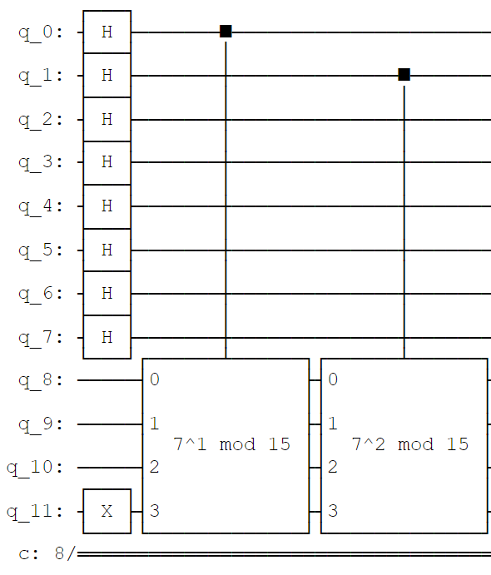
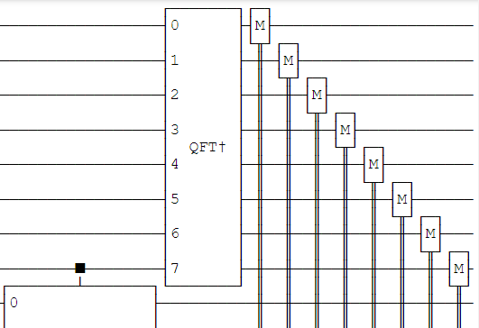
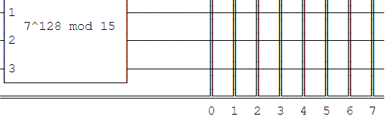


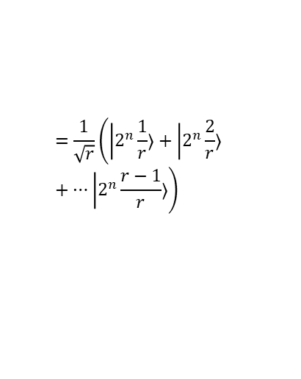

Example Quantum Circuit
Assume a=7, N=15
Get phase
Qubit registers
$$|0〉$$
…
$$=\frac{1}{\sqrt{r}}\left(|2^{n}\frac{1}{r}〉+|2^{n}\frac{2}{r}〉+…|2^{n}\frac{r−1}{r}〉\right)$$
$$|1〉$$
$$=\frac{1}{\sqrt{r}}\left(|u_{0}〉+|u_{1}〉+…|u_{r−1}〉\right)$$
Accumulate phase in outputs
Accumulate phase in outputs
Classical readout

Slide 7
Appendix
Proof mod commutes with multiply
Assume m*n mod p with m,n in the form below
mn mod p with a,b,c,d integers
m = a*p+b with b<p (=> b mod p = b)
n = c*p+d with d<p
mn = (a*p+b )(c*p+d ) mod p
= acp*p+(ad+bc)*p +bd
=bd mod p
= bd
mn = (a*p+b )(c*p+d ) mod p
= ((a*p+b )mod p) ) ((c*p+d ) mod p )
= (b mod p) (d mod p)
= bd

