Slide 1

AI-DLC / THE DEVELOPMENT CYCLE
How the development
cycle works
The AI does the planning and the typing. We do the deciding. Every change runs an AI-led loop with a person steering at the points that matter.
ENGINEERING / INTERNAL / AIRSHIP & TOGGLE
Notes:
This is the AI-DLC playbook for Engineering. One line frames it: the AI plans and types, we decide. Companion to the web page; this deck goes a layer deeper on each part.

Slide 2
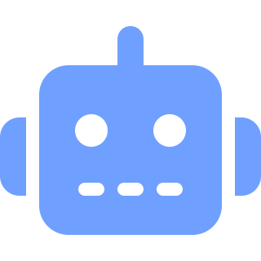
THE ONE IDEA
The AI plans and executes.
Humans decide and validate.
One sentence defines the method. The AI is never the final authority - it does the work, and a person owns every decision that matters.
THE AI
YOU
Does the work
Own the decisions
Proposes the plan for each change
Drafts the design, the code and the tests
Runs the tests and reports back
Set scope and depth before it runs
Sign off at every gate that matters
Validate the result against the goal
THE GUARDRAIL THAT COMES FIRST
02
Notes:
Everything else hangs off this. The split is deliberate: AI handles volume and speed, humans hold judgment. Keep coming back to it - if a decision is being made without a person, the method has broken.

Slide 3
THE CORE MECHANIC
Every change runs the same four-step loop
AI
AI
AI proposes
1
Proposes a plan
1
Its first-cut breakdown of how it will tackle the work.
YOU / GATE
2
Review and adjust
RUNS UNDER
Check the scope and depth, change what is wrong, then let it run.
YOU / GATE
You validate
4
2
YOU / GATE
You review
EVERY CHANGE
AI
3
Executes
Runs the approved plan, pausing at each meaningful step.
3
YOU / GATE
4
Validate
AI
AI executes
Confirm the result. Each output becomes the input for the next step.
THE LOOP
03
Notes:
Read it clockwise from the top. Blue is the AI doing work, purple with a coral square is a human gate. The loop is fractal - it runs at the level of a whole phase and again inside a single step.

Slide 4


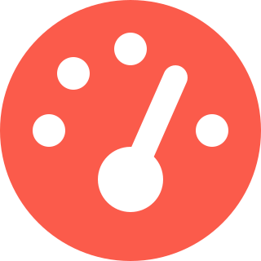

THE THREE PHASES
Work out what to build, build it, then run it
Each phase is an AI-led loop with you steering, and each hands richer context to the next. Not a rigid waterfall - work flows back and forth as understanding improves.
THIN FOR V1
Inception
Construction
Operations
WHAT TO BUILD, AND WHY
HOW TO BUILD IT
RUN IT AND KEEP IT HEALTHY
Turns a high-level Intent into a set of Units a Pod can build. The AI asks, drafts stories and risks; the Pod refines and groups them.
The build, in Bolts. Domain design, then logical design, then code and tests generated together - the Pod deciding the trade-offs at each gate.
Deploy, observe, maintain. This is the least developed phase, and where our two live platforms spend most of their time.
COMES OUT
COMES OUT
FOR NOW
Validated Units - stories, NFRs, risks, a success measure, suggested Bolts.
Tested, deployable code, traceable back to the story that produced it.
Keep production on our existing release and monitoring practice.
THREE PHASES
04
Notes:
Three phases, but treat them as a loop not a line. Inception feeds Construction feeds Operations, and findings flow back upstream. Operations is deliberately thin for v1 - flagged, decision needed.

Slide 5
PHASE 1 / INCEPTION
INCEPTION
Decide what to build, and why
Turns a high-level Intent into a set of Units a Pod can build - the work understood well enough to start.
HOW IT RUNS
AI
Asks clarifying questions - multiple choice with an Other option
RUNS IN
1
Mob Elaboration
COMES OUT
AI
Drafts user stories, NFRs and the risks it can see
Validated Units, each a block one Pod can own
Stories, NFRs and named risks
A success measure to validate against
Suggested Bolts to deliver it
2
GATE /
Pod refines, challenges and groups them into Units
INCEPTION
05
Notes:
Inception is about understanding, not code. The AI does the legwork of drafting; the Pod's job is to challenge and group. You leave with Units sized for one Pod and a clear measure of done.

Slide 6
PHASE 2 / CONSTRUCTION
CONSTRUCTION
Build it, in Bolts
The build runs as a gated sequence. The AI generates each stage; the Pod decides the trade-offs before it advances.
HOW IT RUNS
1
AI
Domain design - the shape of the problem
RUNS IN
Mob Construction
2
AI
Logical design - how it will actually work
COMES OUT
Tested, deployable code
Traceable back to the story that produced it
Trade-offs decided by people, not defaulted
3
AI
Code and tests, generated together
GATE /
Pod decides the trade-offs at each gate
CONSTRUCTION
06
Notes:
Construction is where the AI earns its keep on volume - design through code and tests. The discipline is the gate between stages: nothing advances on a design the Pod has not actually decided on.

Slide 7
PHASE 3 / OPERATIONS
OPERATIONS
Run it and keep it healthy
Deploy, observe, maintain. This is the least developed phase - and the one our two live platforms spend most of their time in.
HOW IT RUNS
AI
Deploy the validated change
FOR V1
1
Keep what works
DECISION NEEDED
AI
Observe - watch behaviour in production
Keep production on our existing release practice
Keep current monitoring as-is for now
Decide later how deep AI-DLC reaches into Ops
2
GATE /
People own incidents, releases and what ships
OPERATIONS
07
Notes:
Be honest that Operations is thin. For v1 we do not rebuild release and monitoring - we keep what is working on Airship and Toggle. How far the loop extends into Ops is an open decision, not a v1 commitment.

Slide 8




THE WORK HIERARCHY
Intent breaks into Units, Units ship in Bolts
One vocabulary for how work is sized, from the goal down to the slice you build today.
01 / INTENT
02 / UNIT
03 / BOLT
The goal
>
The block
>
The slice
A high-level statement of what you want and why. The starting point the AI decomposes into real work.
A self-contained block one Pod can build without constant cross-talk. Roughly an epic.
The smallest delivery cycle: plan to validated and done. What Scrum called a sprint, rebuilt to run short.
One Pod owns it end to end
Hours to days, not weeks
A Unit is delivered through one or more Bolts - run in parallel or back to back.
WORK HIERARCHY
08
Notes:
Three words, one ladder. Intent is the why, Unit is what one Pod owns, Bolt is the slice you finish in days. If a Bolt is creeping past a few days, it is really two Bolts.

Slide 9


WHO RUNS IT
A Pod is the team. A Mob is that team in session
Same people, two words for two states. No new ceremony to schedule - picture your Pod round a screen with the AI.
THE STANDING TEAM
THE TEAM IN SESSION
Pod
Mob
A small, cross-functional team of 4-6 that owns an outcome end to end - not a layer, not a function.
The Pod, plus whoever owns the Intent, working a phase with the AI on a shared screen.
A Pod lead clarifies, prioritises and keeps the Pods talking.
Mob Elaboration - working an Intent into Units
Mostly developers, ranging wider as the AI handles specialist legwork.
Mob Construction - building a Unit into code
No separate QA Pod - validating the AI's output is the Pod's own job.
Mob Testing - validating what got built
At our scale, realistically two Pods, maybe three if we lean on part-time specialists.
PODS AND MOBS
09
Notes:
Pod is who you are; Mob is what you are doing right now. The big change from Agile: no separate QA function - the Pod validates the AI itself. At our size, plan for two Pods, three at a stretch.

Slide 10
THE GUARDRAIL THAT COMES FIRST
Human-in-the-Loop
The AI plans and executes; humans decide and validate. Four rules keep it that way.
AI
HUMAN GATE
Does the work
The gate
Proposes the plan, drafts the design and code, runs the tests.
A person reviews and signs off at every decision that matters.
AI
HUMAN GATE
Asks, never assumes
Nothing on shaky ground
Open questions come to you as multiple choice, with an Other option.
Work is checked for contradictions and gaps before it advances.
HUMAN-IN-THE-LOOP
10
Notes:
These four are non-negotiable. The AI is fast and tireless but not accountable. The coral square is the gate - wherever you see it, a named person has signed off. No gate, no advance.

Slide 11


THE FAILURE MODE TO WATCH
Gates only work if you actually use them
Process atrophy
The signal to slow down
The failure mode is drifting into rubber-stamping the AI instead of reviewing it - letting the agent decide everything.
If you ever notice the Pod approving rather than reviewing, that is the cue.
The gates exist so automation amplifies your judgment instead of quietly replacing it.
Slow down at the checkpoints, not speed up.
PROCESS ATROPHY
11
Notes:
This is the quiet way the method dies - not by rejection but by lazy approval. Name it out loud in the Pod. The day approvals feel automatic is the day to slow the gates down, not remove them.

Slide 12
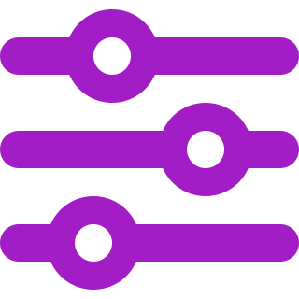
ADAPTIVE DEPTH
Scale the process to the change, not the other way round
The release valve that keeps the method light for a small team. The AI proposes a path sized to the work; you check it and adjust. Two things scale, not one.
DIAL 1
DIAL 2
Breadth - which stages run
Depth - how far each goes
A defect fix skips requirements analysis and domain modelling and goes almost straight to the fix. A new feature gets the full run. The AI proposes which stages earn their place.
Even when a stage runs, it can run light or deep. A trivial utility needs no architecture deep-dive; a new billing flow does. The gates that keep you in control are never skipped.
“Not scripted, but steered.”
When in doubt, ask what this change actually needs - then do that much, and no more.
ADAPTIVE DEPTH
12
Notes:
This is what keeps a heavy-sounding method usable for two Pods. Both breadth and depth flex. The one thing that never flexes is the gate - you can do less process, never less deciding.

Slide 13
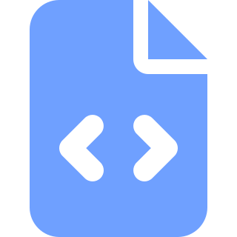
BROWNFIELD FIRST
Read the code before proposing the change
Most work is changes to Airship and Toggle, not new builds. So the loop starts by understanding what already exists.
MOST WORK
Brownfield
Changes to Airship and Toggle. Read first, then propose.
THE REVERSE-ENGINEERING STEP
The AI reads the existing code into context before proposing anything.
THE EXCEPTION
Greenfield
Proposals fit the system as it is, not a clean-sheet idea of it - so a change lands in real code rather than fighting it.
New builds get the full run from a blank start.
BROWNFIELD FIRST
13
Notes:
Default assumption: we are changing a live system, not starting fresh. The AI loads the real code first so its plan fits what exists. Greenfield is the exception, and it gets the full treatment.

Slide 14


WORKED EXAMPLE
One Bolt, start to done
The loop, made concrete - alternating AI work and human gates, inside a single slice.
AI
GATE
AI
GATE
AI
GATE
AI proposes the plan
Gate: scope and depth
AI designs
Gate: trade-offs
AI writes code and tests
Gate: validate
Which stages this slice needs, and how deep.
Pod checks the path, trims or adds before it runs.
Domain then logical design, generated for review.
Pod decides the calls the design surfaces.
Generated together, run, and reported back.
Pod checks the result against the success measure.
Done in hours to days: tested, deployable, and traceable back to the story that started it.
WORKED EXAMPLE
14
Notes:
Walk this left to right. Notice the rhythm: AI, gate, AI, gate. Six touches, three of them human. That cadence is the whole method in miniature, and it fits inside a slice measured in days.

Slide 15


WHERE WE ARE
Settled, and what still needs a call
This is an early draft. The shape is agreed; a handful of numbers are starting positions, not final.
SETTLED
NEEDS A DECISION
The four-step loop - AI proposes, you gate, AI executes, you gate
Bolt length - 1-3 days is a starting position, not a rule
Human-in-the-Loop - people decide and validate, always
Operations depth - how far the loop reaches into running systems
Intent / Unit / Bolt - one vocabulary for sizing work
Number of Pods - two, or three with part-time specialists
Pods and Mobs - standing team; same team in session
Release and monitoring - where existing practice meets the new loop
Brownfield first - read the code, then propose
First Intent - which real change we run through the loop first
Adaptive depth - scale breadth and depth to the change
WHERE WE ARE
15
Notes:
The structure is agreed; do not relitigate it. What is open is on the right - mostly numbers and how far Ops goes. The most useful next step is picking the first real Intent to run through the loop.

Slide 16
The AI builds.
We decide.
Move fast on the work, stay deliberate on the calls. That is the whole method.
3
4-6
1-3d
2
phases: Inception, Construction, Operations
people per Pod - small enough to stay high-bandwidth
per Bolt, not weeks (starting position)
roles: the AI builds, you decide
INTERNAL / AIRSHIP & TOGGLE
Early draft. Items marked “starting position” need a decision before they are final.
AI-DLC playbook - moving from Agile to an AI-driven development lifecycle, adapted for how we work on Airship and Toggle.
Notes:
Close on the one line. Then point at slide 15 - the open decisions - and ask for the first real Intent to run. The goal is to leave with a commitment to try the loop on something live.

