Slide 2
72”
72x36x36 = 404 Gals
35”
38”

Slide 3
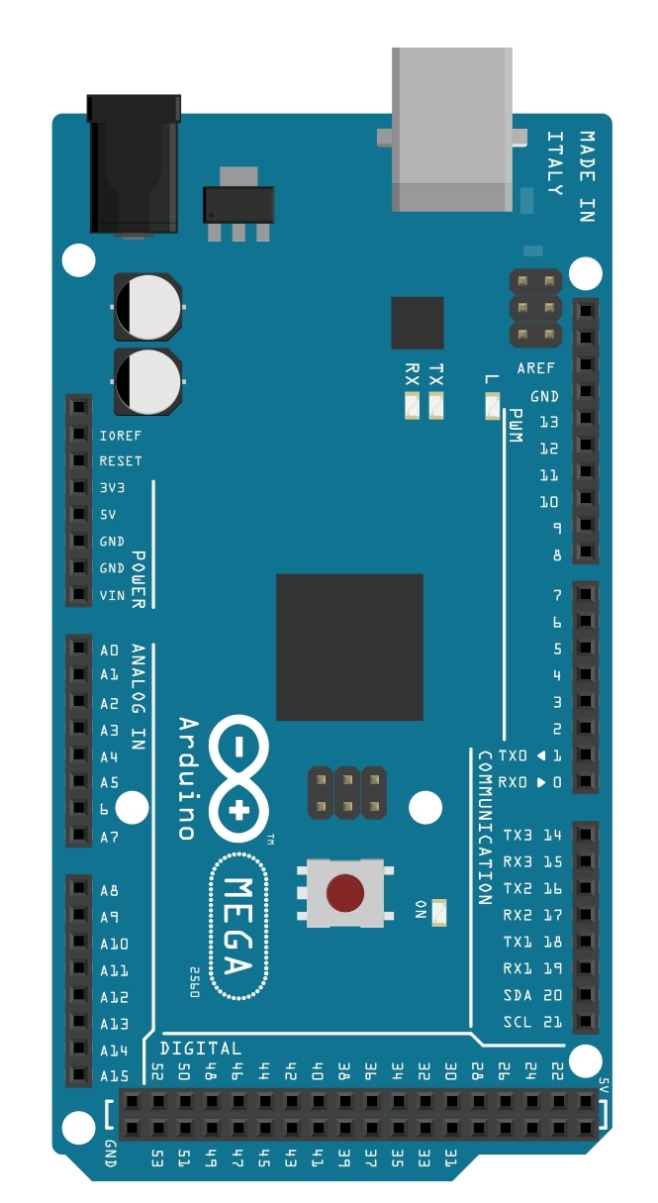
Readings & Measurement
Controller
PH 1
Lab ORP
Conductivity
Temperature
PH 2
Lab ORP
Conductivity
Temperature
Humidity
Temperature
PH 3 (RODI)
Temperature (Salt Reservoir)
Temperature (Fresh Reservoir)
Environment Controller
Water Heater 1
Water Heater 2
Feeding
Dosing
Lighting
Master Pump
Water Heater 2
Feeding
Dosing
Air Conditioner
Heater
Fan1
Fan2
Heater 1 (Salt Reservoir)
Heater 1 (Fresh Reservoir)
ATO Pump
Display Tank
Display Tank
Quarantine Tank
Quarantine Tank
Room
Room
H2O Reserve

Slide 4
Water Volume Controller
ATO
Water Change Pump
Leak Detection

