Slide 1




Why KRO matters
Build-your-own platform API becomes an hours-not-weeks task — no custom Go operator.
Reduced cognitive load
Portability, not vendor lock-in
Developers consume a 10-line API. The platform team encodes the resource graph once, not per team.
Works with any K8s resource — native or CRD. Environment differences become fields, not rewrites.
Safe & predictable
A cross-vendor standard
CEL is non-Turing-complete and validated at creation time. Errors caught before runtime, unlike Helm.
AWS, Google & Microsoft collaborate on one project — rare credibility for a true portability layer.
Maturity note: KRO is v1alpha1 — early but credible. Frame as where platform engineering is heading, not battle-tested in prod today.
Notes:
Impact slide. Lead here, right after the problem framing, before any YAML. Hit the headline: build-your-own platform API is now hours, not weeks, with no custom Go operator. Walk the four cards left-to-right, spend most time on Reduced cognitive load and Portability since those are the talk's thesis. Close on the amber caveat line as a strength: v1alpha1 means early but credible -- this is where platform engineering is heading.

Slide 2
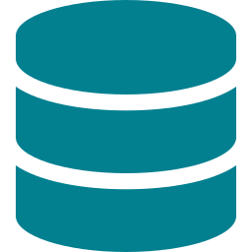

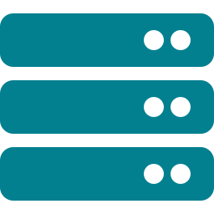


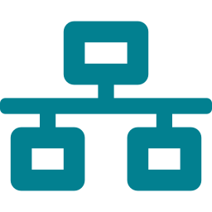
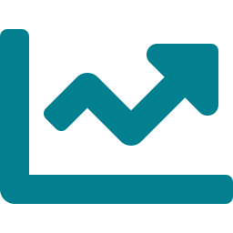
How it works — one object fans out into a managed graph
DEVELOPER WRITES
KRO CREATES & MANAGES
PersistentVolumeClaim
GenAIService
model cache
10 lines of YAML
Deployment
kind: GenAIService
name: sentiment-api
model: Qwen2.5-0.5B
replicas: 2
mode: mock
monitoring: true
vLLM-compatible, 2 replicas
Service
stable in-cluster endpoint
KRO
infers the DAG
generates the CRD
reconciles at runtime
Metrics Service
Prometheus scrape wiring
One object owns the whole graph — create and delete. No glue operator.
Notes:
Architecture panel A. This is the bridge from why to watch -- show it right before the live demo. Trace left to right: developer writes one 10-line GenAIService; KRO infers the dependency graph, generates the CRD, and reconciles; out come the PVC, Deployment, Service, and metrics wiring. The punchline at the bottom: one object owns the whole graph for create and delete, no glue operator. This mirrors exactly what the live kubectl apply will show.

Slide 3


Same template, same instance — every cluster
The only things that change between clouds are field values (mode, storageClass) — not the YAML shape, not the RGD.
One ResourceGraphDefinition + one 10-line GenAIService
authored once · applied unchanged everywhere
kind
Amazon EKS
Google GKE
Azure AKS
laptop · CPU
GPU nodes
GPU nodes
GPU nodes
mode: mock
storageClass: gp3
storageClass: premium-rwo
storageClass: managed-csi
Move from laptop to any hyperscaler by changing values in the 10-line file — no re-templating, no fork of the RGD.
Notes:
Architecture panel B -- the portability thesis, your strongest close. The shared RGD plus the 10-line instance are authored once and applied unchanged to kind, EKS, GKE, and AKS. The only per-cloud difference is field VALUES: mode flips mock-to-gpu, storageClass changes string. Emphasize all three hyperscalers ship KRO, which is why this is a real standard and not a single-vendor bet. Land it: move from laptop to any cloud by editing values in the 10-line file -- no re-templating, no fork of the RGD.

