Slide 1
See MIPS Run
Yo

Slide 2
Objectives
Introduction to programming with the MIPS instruction set
We will not be watching millions of instructions per second on the screen
Explain the format of instructions
Convert simple C code to MIPS code
Example 1: Variables and simple arithmetic
Example 2: Comparisons and branching
Example 3: Working with Main Memory, comparisons, and address offsets (with arrays)

Slide 3
Notes
These examples may not be the most efficient
There are multiple ways to solve the same problem, some are more optimized than others
This is strictly a programming exercise
We will not review MIPS registers, datapath, etc.
You will learn about in Computer Organization and Architecture
Examples and documentation are on my Github
https://github.com/danburkhol
Feel free to ask questions at any time

Slide 4
Instruction Format
 | Operation | Destination | Source | Source 2 (or Address / Immediate) | Translation
R-Format (Arithmetic): | add | $s1 | $s2 | $s3 | S1 = S2 + S3
I-Format (Immediate): | addi | $s1 | $s2 | 100 | S1 = S2 + 100
J-Format (Jump): | j |  |  | 2500 | Jump to Address 2500
Notes:
R Format - For arithmetic referring to two registers
I Format - For using immediates, which are explicitly defined values in your code

Slide 5
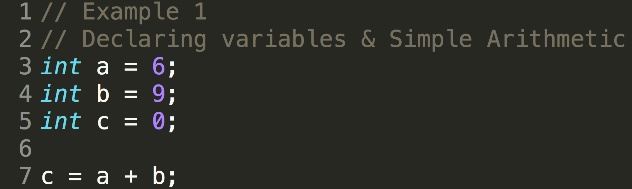

Slide 6
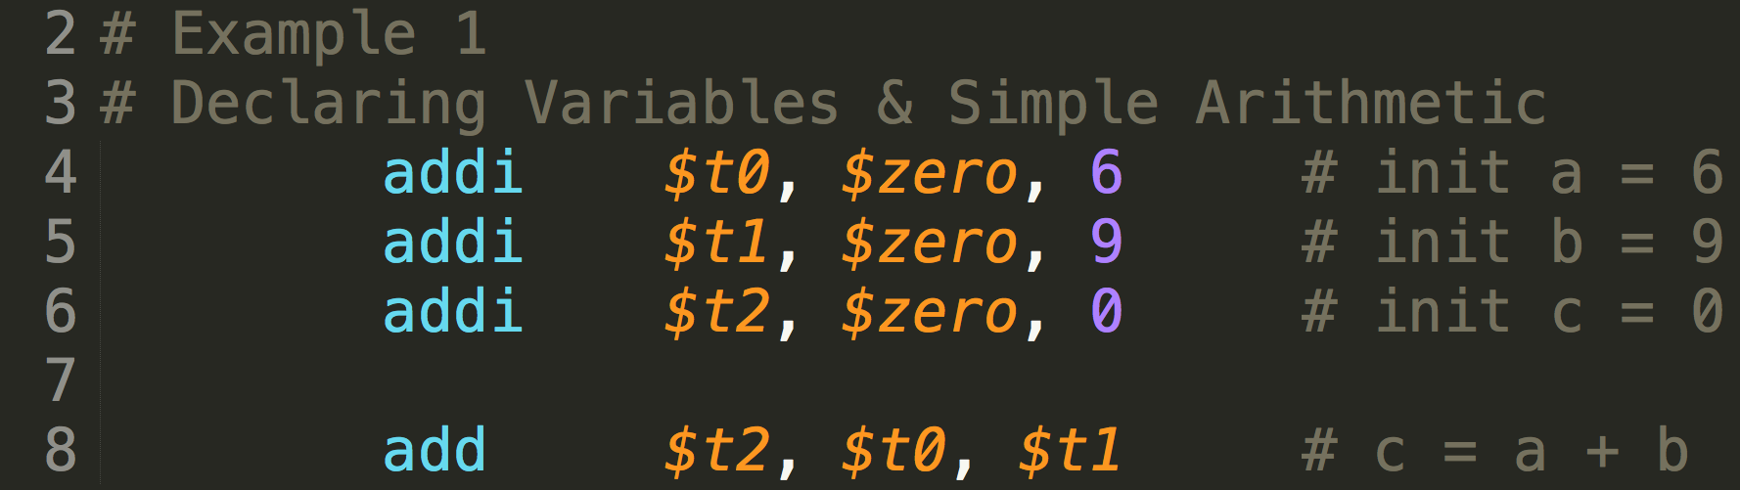

Slide 7
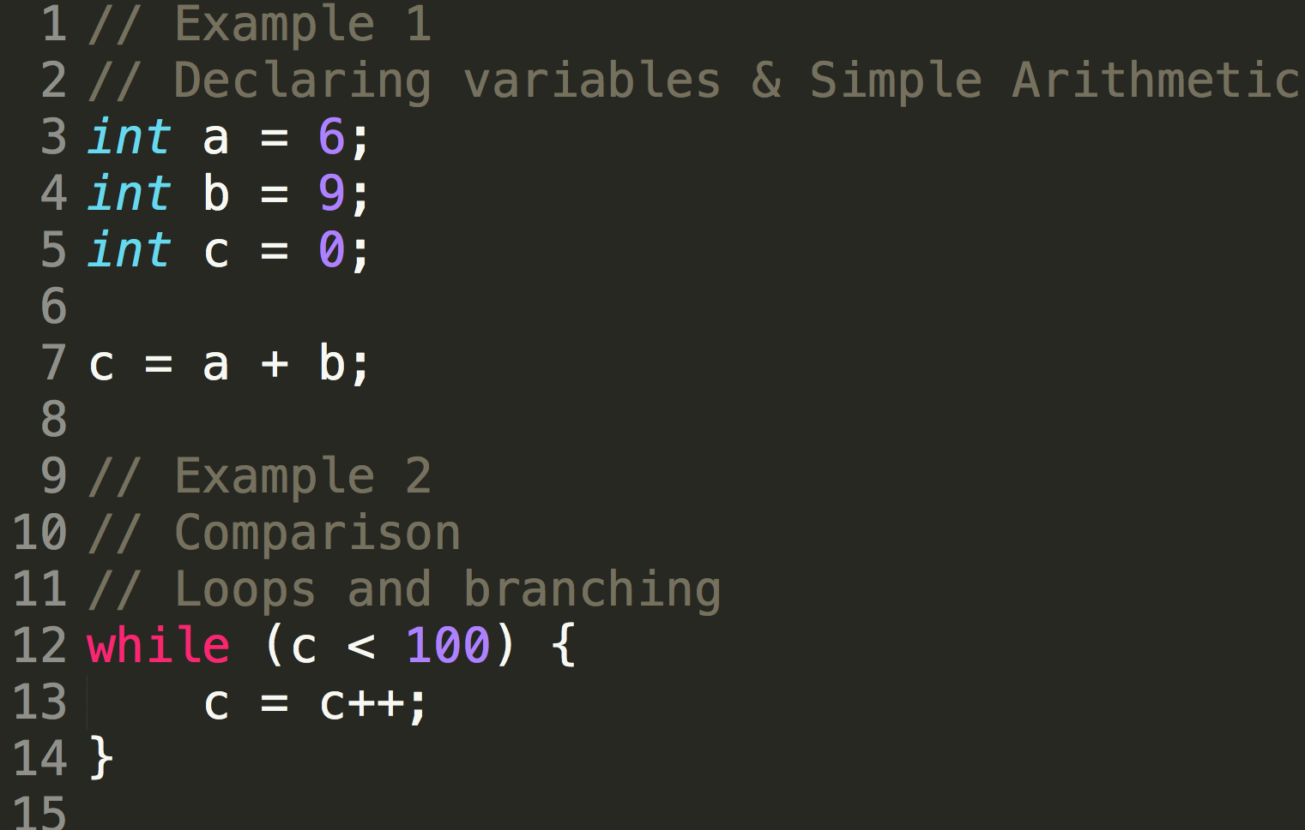

Slide 8
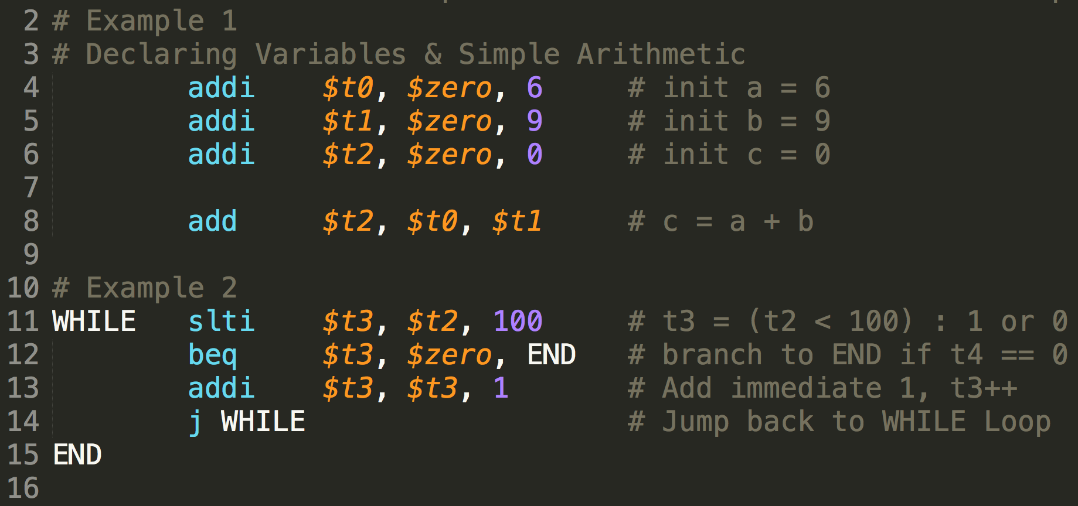

Slide 9
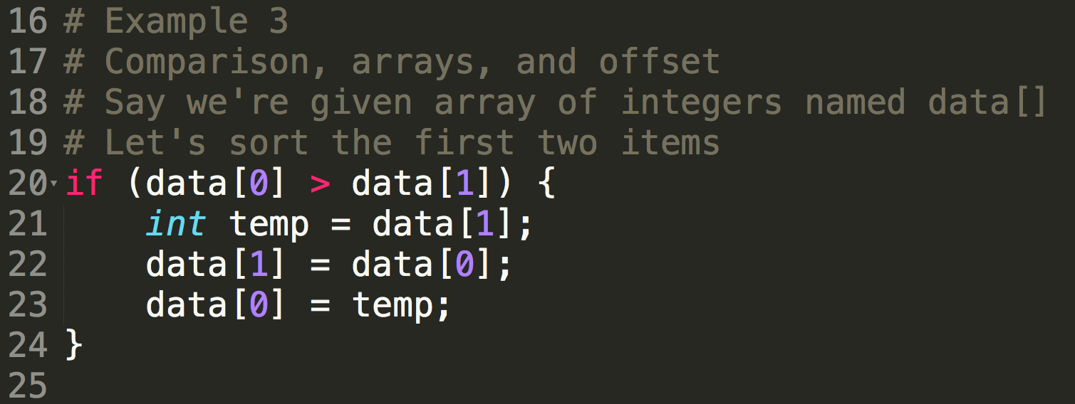

Slide 10
