Slide 1





Vroom Boom or Doom?
A data analysis exploring if 2018* was a good time to buy a used car.
* 2018 was the last year of our dataset.
Presented by: Tim O'Donoghue, Christopher Onubogu, Samantha Taysi, Dan Cabrera
February 14, 2024

Slide 2
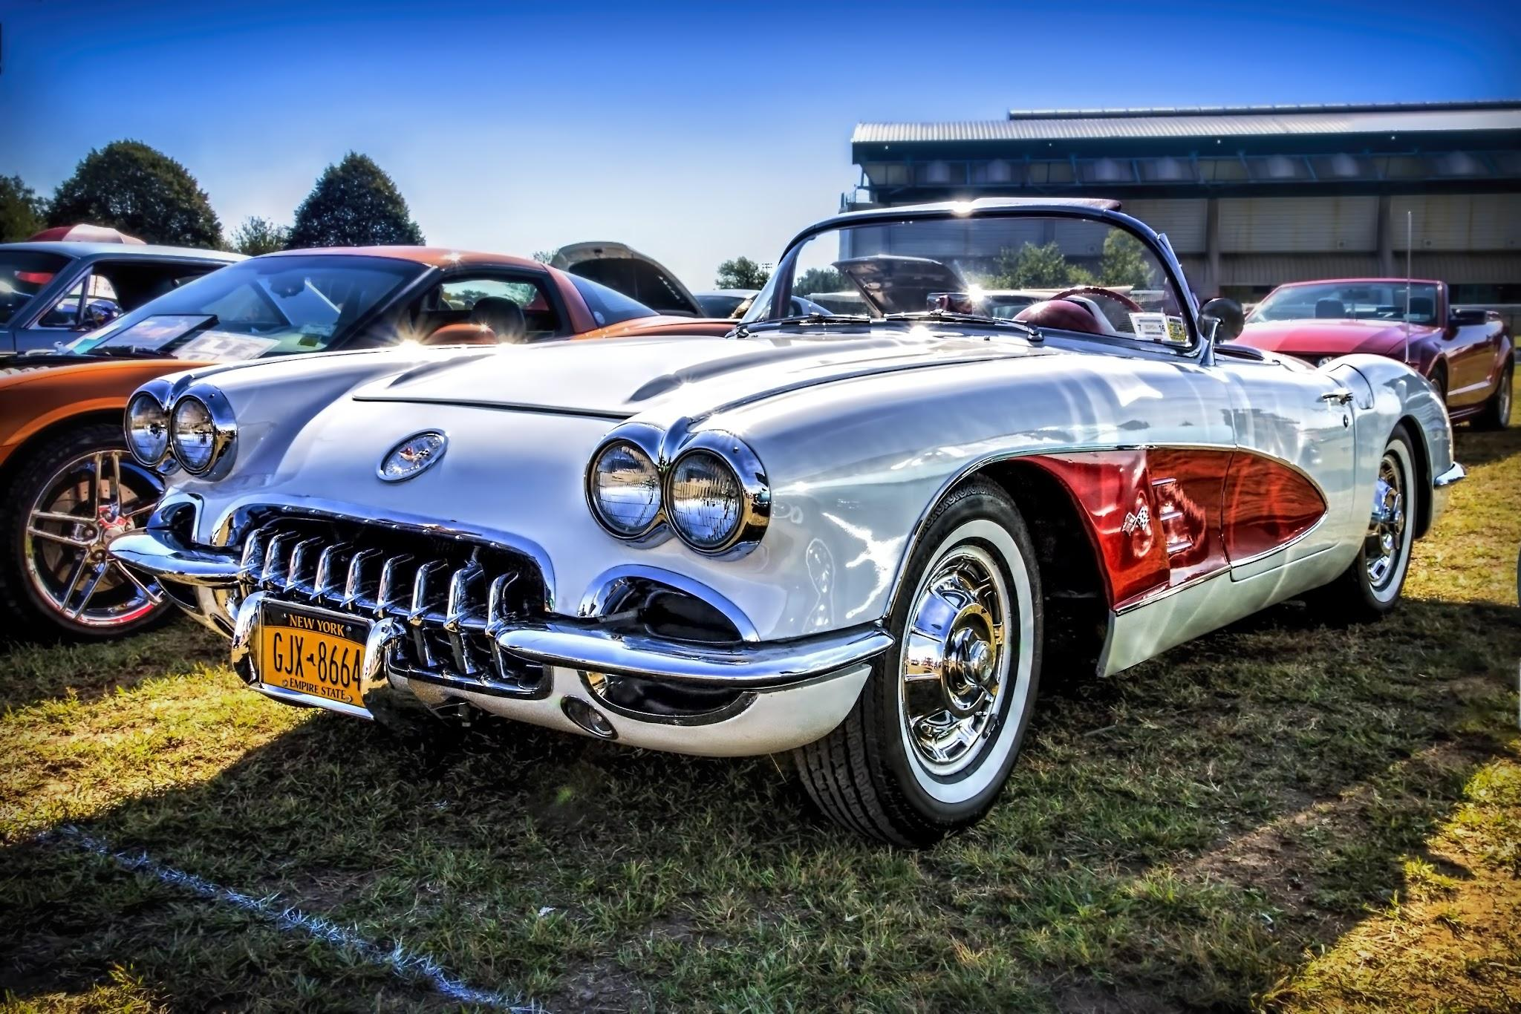
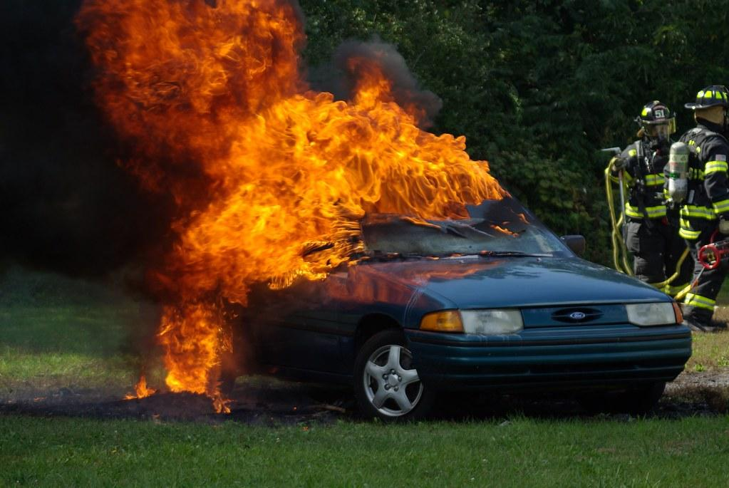
Research Question: Was 2018 a good time to buy a used car?
Our hypothesis: No, it was not a good time to buy a used car.

Slide 3

Research Question: Was 2018 a good time to buy a used car?
Sub questions:
Were interest rates (financing) going up or down?
How do car prices compare to household income?
Are there particular states where it’s better to buy a used car?
Will used car prices go up or down and what might you consider?

Slide 4
Main Findings
The annual interest rate for used car loans, the average loan amount, and the average loan term all increased from 2009 to 2018. In 2018, the average total cost (loan + interest over length of loan) of $30,868.03.
The average cost of a car compared to per capita income was 64.8%, meaning an average family in the US would spend more than half of the annual income on a used car
Still, if you had to buy a used car in 2018, it would make sense to travel to Washington D.C., where used car prices were the lowest.
Overall, used car prices were on the upswing.

Slide 5
Our Methodology, Assumptions, and Limitations
Our data came from Kaggle.com, the Federal Reserve Bank of St. Louis (FRED), and the Bureau of Labor Statistics. We mostly considered data from 2009 through 2018.
We assumed that the averages of our data would reflect an accurate picture of the used car market in 2018.
We adjusted the prices for inflation using 2018 as the benchmark.
The used car data was not normalized and was right-tailed due to some luxury cars (0.2% of all cars in our dataset) selling for very high prices (>$100,000). However, we took all data from all price points into account for our calculations.
The data did not break out cars by type (sedan, truck, etc.; gas, hybrid, electric), which would have allowed for more and better filtering and analysis.
We also did not take new car sales, new or used car inventories, or other externalities (gas prices, import tariffs, the cost of steel, etc.) into account. This data could help us further predict whether used car pricing would increase or decrease after 2018.

Slide 6
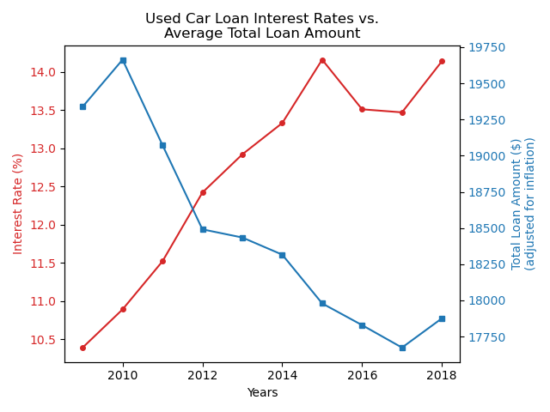
Were interest rates going up or down?
Average annual interest rates for used cars climbed steadily since 2009, despite a dip after a spike in 2015.
The trend of average total loan amounts was almost the opposite of interest rates.
The data suggest that interest rates will continue to rise in 2019.
While it would seem that the average loan amount would have decreased in 2018, it increased, indicating that despite the increased pain from a higher rate, a higher loan was necessary just to purchase an average car.

Slide 7
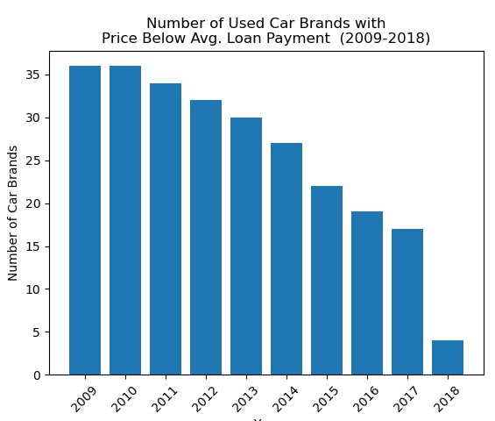
Will interest rates go up or down?
Looking at the average total payment price for ALL used cars by year, few brands had used cars that sold for less than or equal to that average total payment.
The number of brands with used cars meeting that criteria declined as the years went on.
In 2018, there were only 4 car brands whose used cars had a price (adjusted for inflation) that fell below the average payment price.

Slide 8
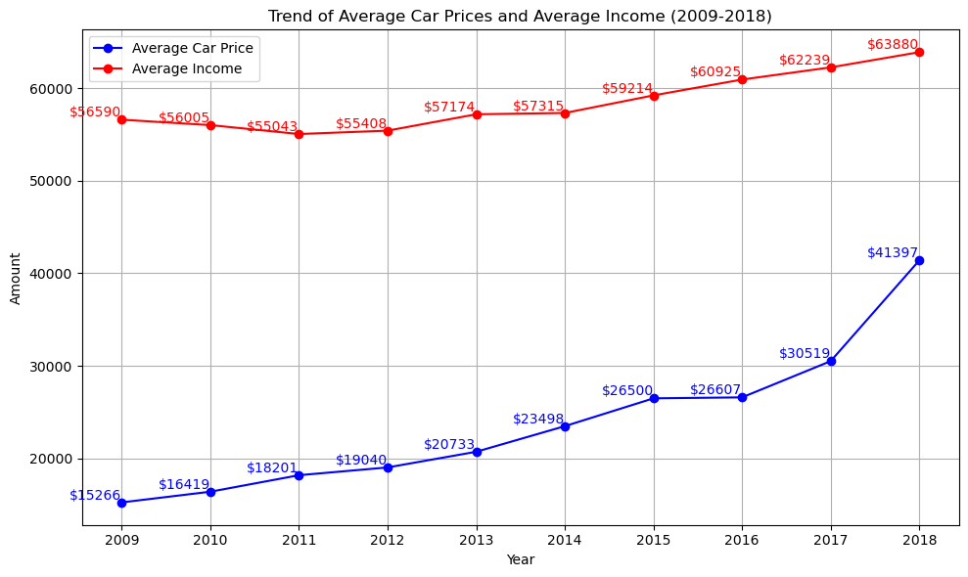
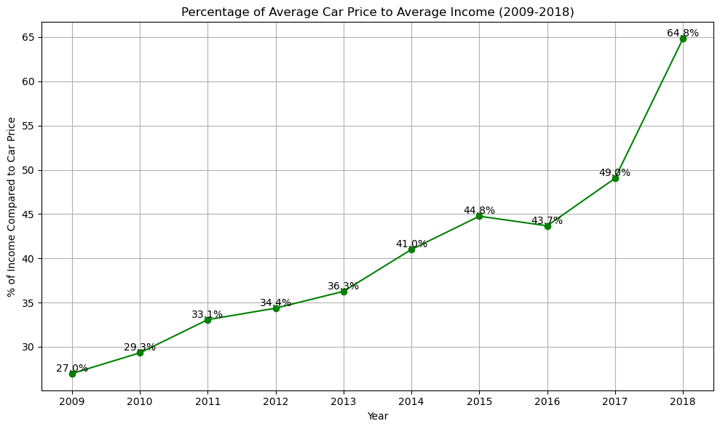
How do car prices compare to income?
In 2009, the average annual income was $56,590, with an average car price of $15,266, accounting for 27% of the income compared to 2018, the average annual income was $63,880, with an average car price of $41,397, representing a 64.8% of the income.
The percentage increase in average car prices has outpaced the percentage increase in average income, suggesting a potential challenge for affordability of vehicles over time. From 2009 to 2018 the average car price increased 171% compared to average income increasing only 12%.
As car prices continue to rise faster than income, consumers may adjust their preferences towards more economical transportation options.

Slide 9
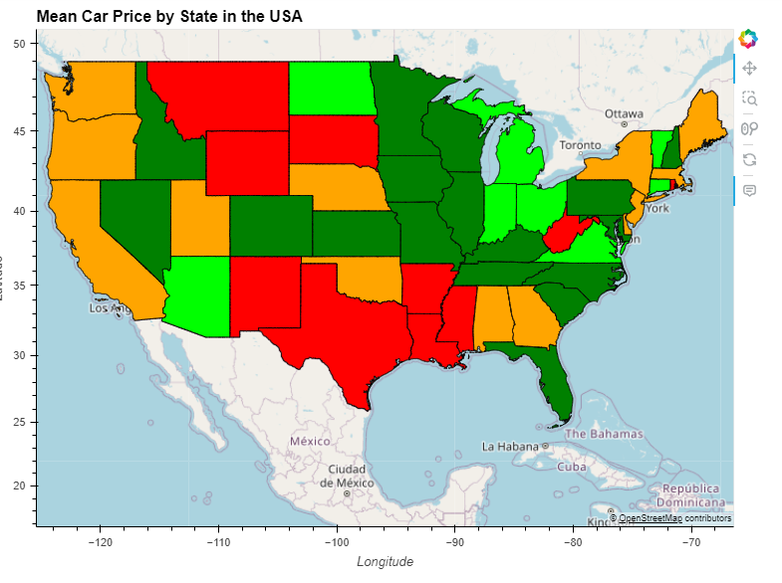
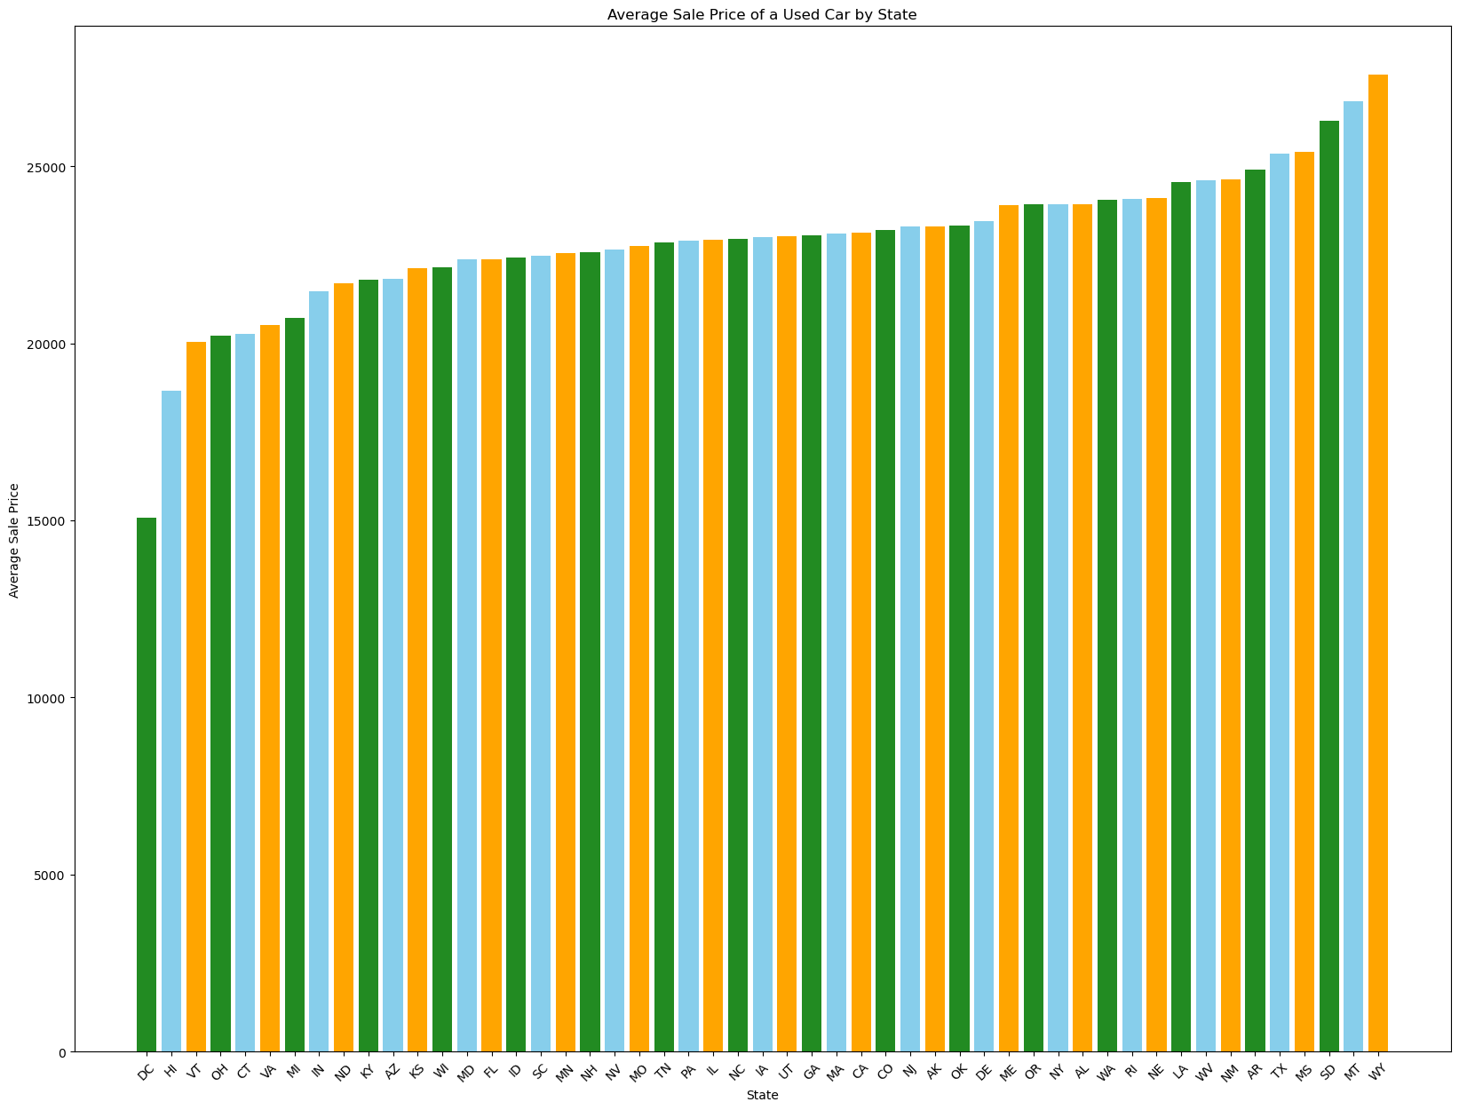
Regional Car Prices
Notes:
-Map shows car prices in relation to national mean
-Mean is 23,003
-Lowest prices are in DC, average 15085
-Highest prices are in WY, 27573 range 12488

Slide 10
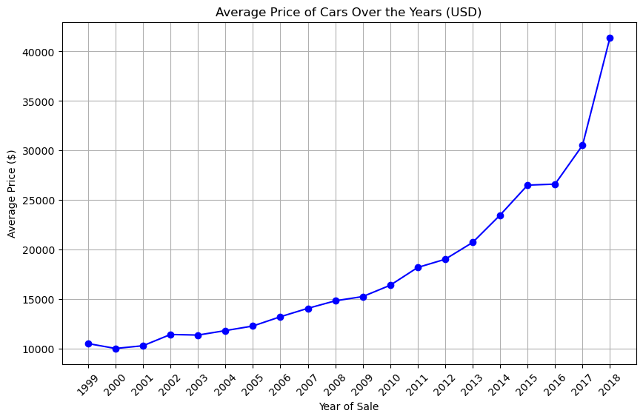
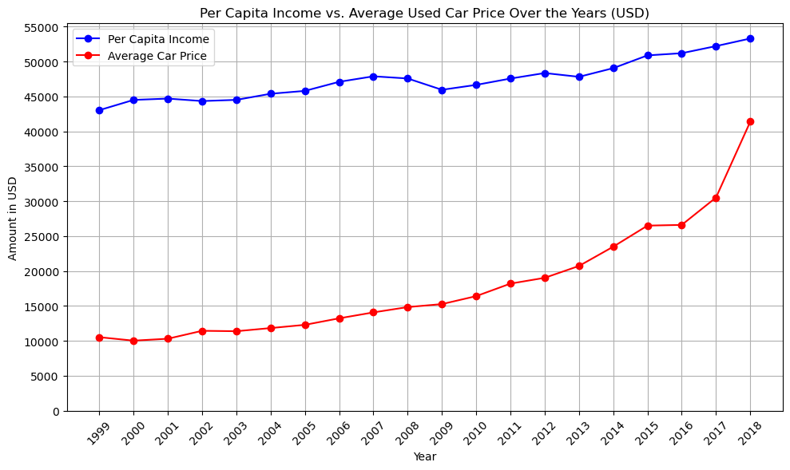
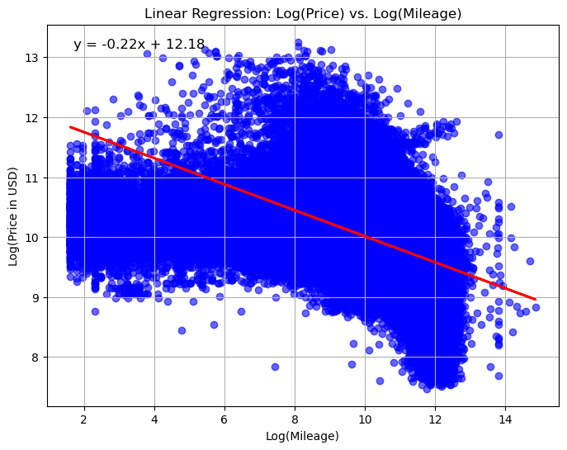
Are prices going up or down?
Over the past 20 years, there has been a steady climb in the average price of used cars peaking at ~$41,398 in 2018 with an average yearly increase of $2250.12. There is nothing to suggest that this trend will not continue in the coming years.
Additionally, the price of used cars is trending toward the average per capita income which is an alarming trend.
There is some correlation between the mileage of a used car and the average cost, however, based on the linear regression analysis and the coefficient of determination value of 0.201 only about 20% of the variability in used car prices is due to the mileage.

Slide 11
Conclusion
2018 was not a good year to buy a used car (but 2019 will probably be worse).
Data suggest that trends leading up to (and through) 2018 will continue to make buying a used car difficult. It is likely that:
Used car loan interest rates will continue to rise and the length of loans will increase, making purchasing a used car more expensive.
Used car prices will continue to rise and become a larger percent of per capita income, meaning households will have to spend more of their take-home pay on a used car.
Only a few regions or states have affordable used cars (affordable relative to all other used cars available)
On the whole there is nothing to suggest this trend is going to change and when buying a used car it might be worth considering one with more mileage in order to save money

