Slide 1
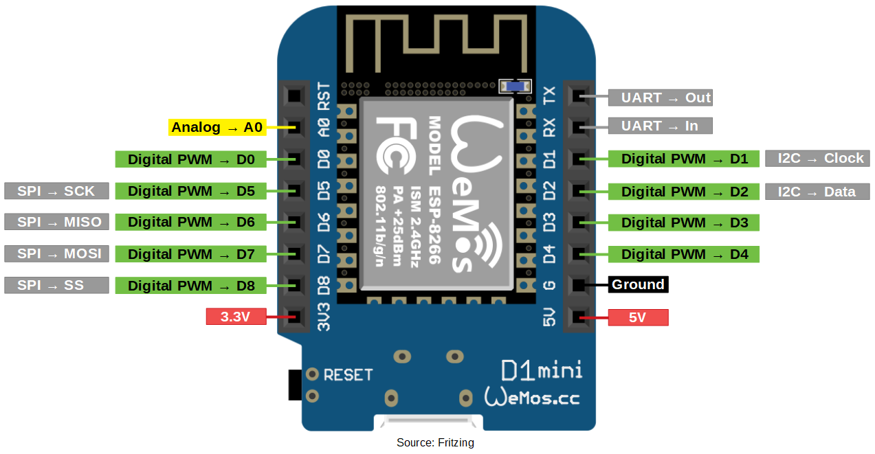
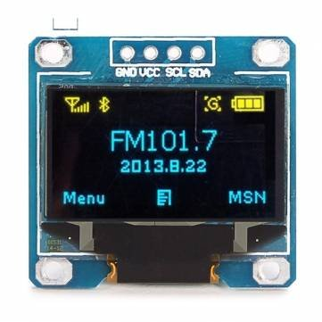
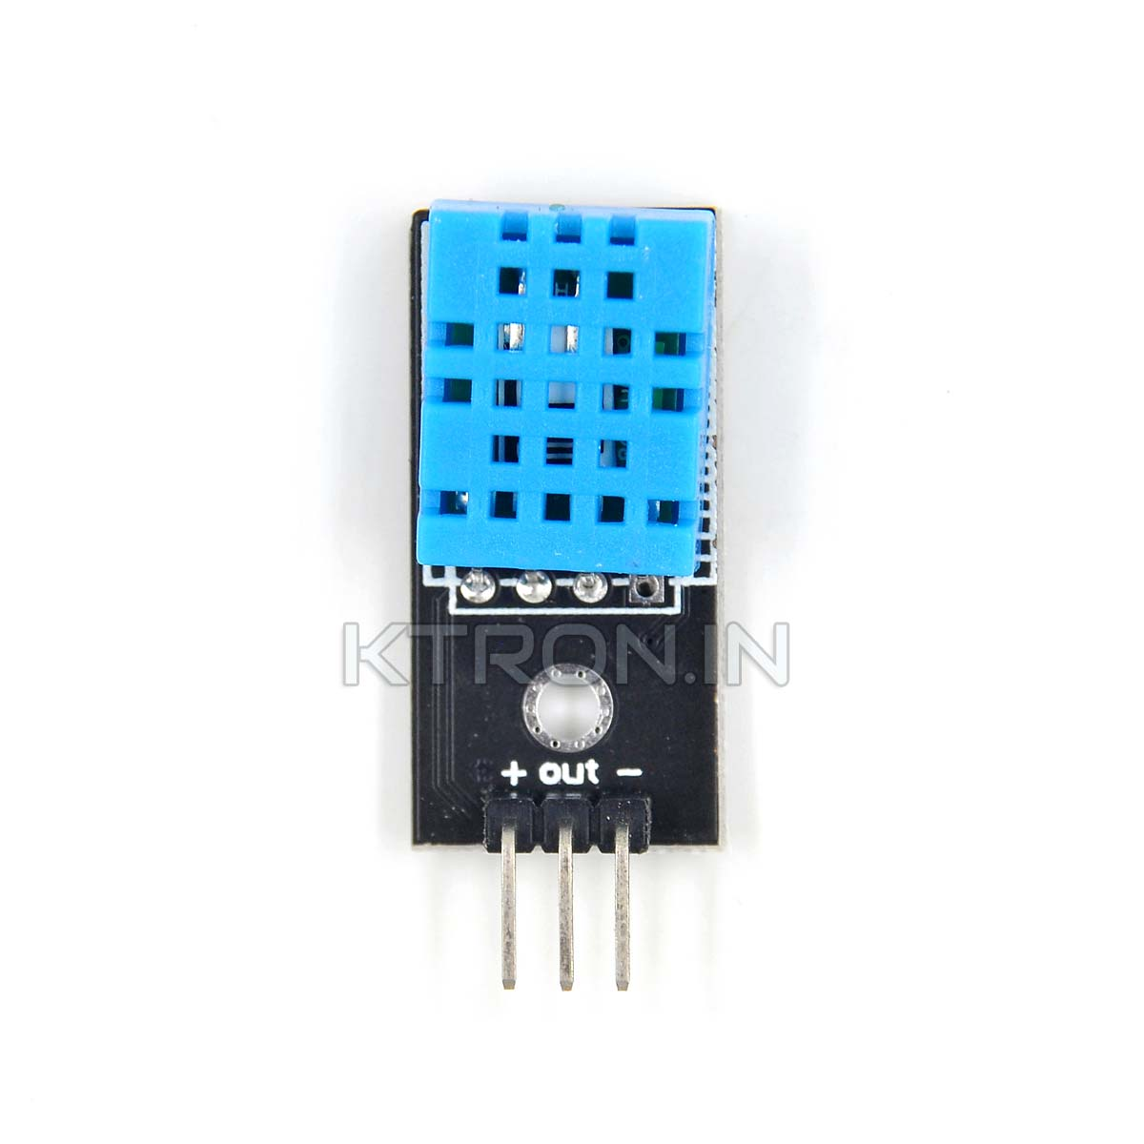

Slide 2
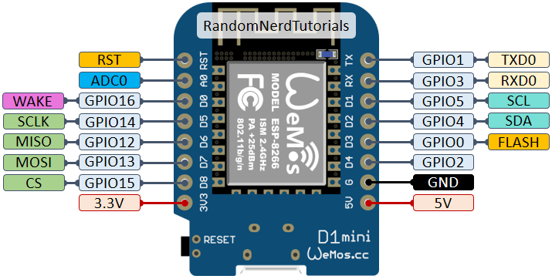

Slide 3
OLED Display Program (running with Putty)
import ssd1306 #( import OLED module)
from machine import I2C, Pin
i2c = I2C(scl=Pin(5),sda = Pin(4), freq=100000)
oled = ssd1306.SSD1306_I2C(128, 64, i2c)
oled.text('Evan',0,0)
oled.text('chen',50,30)
oled.show() #start showing
oled.fill(0) #clear setting
oled.show() #start showing

Slide 4
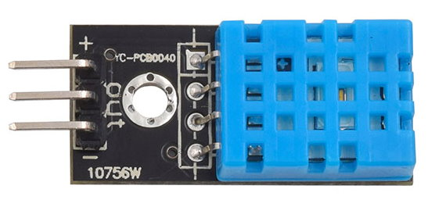

Slide 5
Temperature and humidity detection and display (running with Putty)
import dht
d = dht.DHT11(Pin(13))
def DHT11():
d.measure()
temp = d.temperature()
hum = d.humidity()
t = '{}c'.format(temp)
h = '{}%'.format(hum)
print('\u6eab\u5ea6:{}\u00b0C'.format(temp))
print('\u6fd5\u5ea6:{}%'.format(hum))
print('')
return (t, h)
temp, hum = DHT11()

