Slide 1

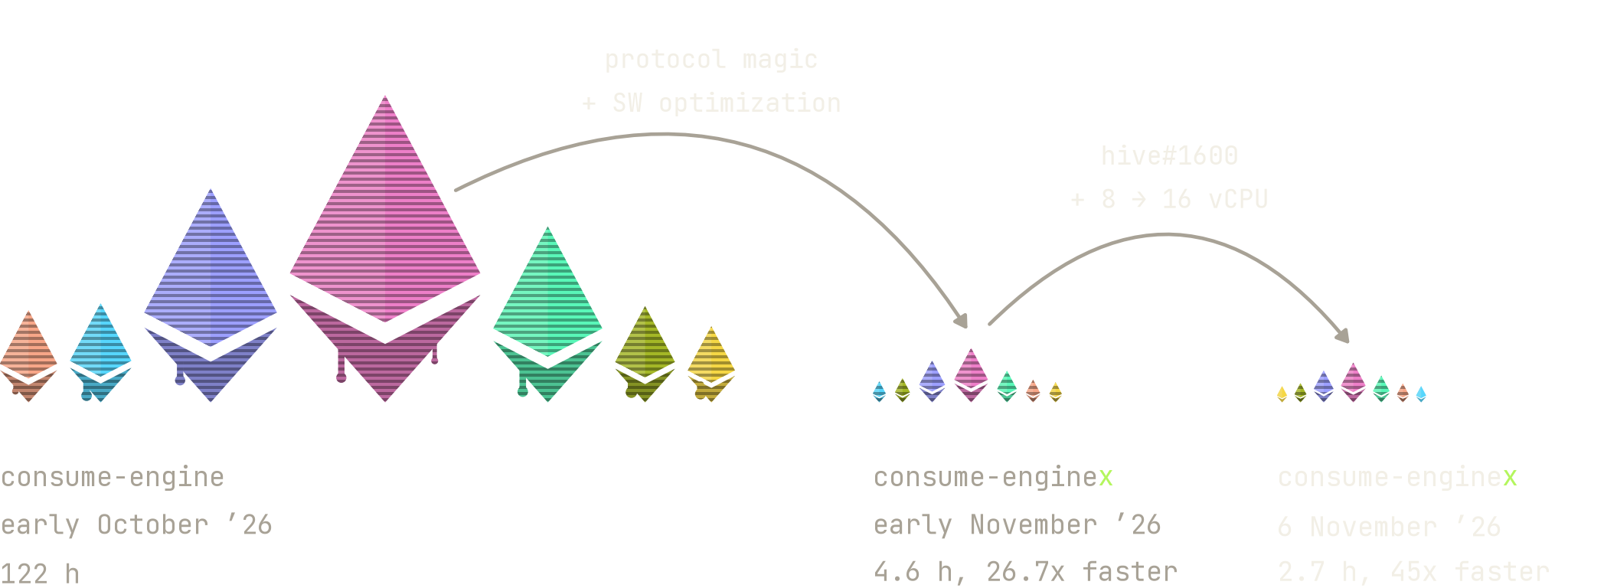
2026-11-06 // Devcon VIII, Mumbai
Honey, I Shrunk the Test Run
Protocol-native execution client system tests, 10-??x faster
Dan (danceratopz) // Specs @ Ethereum Foundation // ethereum/execution-specs

Slide 2
02 // what?
Take It for a (System) Test Drive
A system test checks the complete client, the way it runs on mainnet.
Until recently, EL clients had two main system test harnesses, both running on Hive:
2016-07-05
hive @karalabe ethereum/hive@82ff0ce
> Ethereum's test orchestrator: real clients in Docker, with an API for test harnesses.
2017-01-25
consensus (rlp) @holiman ethereum/hive#26
test method imports each test block's RLP from a file at startup
> The first system test. Hooks into the devp2p ImportChain path.
2023-03-15
pyspec (engine) @spencer-tb, @marioevz, @fjl ethereum/hive#732
test method sends each test block to the running client with engine_newPayload
> The Merge introduced the Engine API: a native interface to test blocks through.

Slide 3
02 // what?
Meet the Crew
Who does what on a (system) test drive.
> You've spec'd your car.
> You've tested each part on its own: the engine, the airbag, the handbrake.
> Now it's all assembled → time to take your Lambo prototype out on the track.
the test center // Hive // client and docker orchestration
client //
car
Lambo prototype
pre/txs/post-state //
checklist
actions & outcomes
test setup //
pit crew
sets up the car
test execution //
driver
drives the car
test assertions //
inspector
checks the outcome
system under test
tests
system test harness

Slide 4

02 // what?
Meet the Crew
Who does what on a (system) test drive.
> You've spec'd your car.
> You've tested each part on its own: the engine, the airbag, the handbrake.
> Now it's all assembled → time to take your Lambo prototype out on the track.
the test center // Hive // client and docker orchestration
client //
car
Lambo prototype
pre/txs/post-state //
checklist
actions & outcomes
test setup //
pit crew
sets up the car
test execution //
driver
drives the car
test assertions //
inspector
checks the outcome
system under test
tests
system test harness
Lambo photo: Alexander-93, Wikimedia Commons, CC BY-SA 4.0 (cropped, background removed)

Slide 5
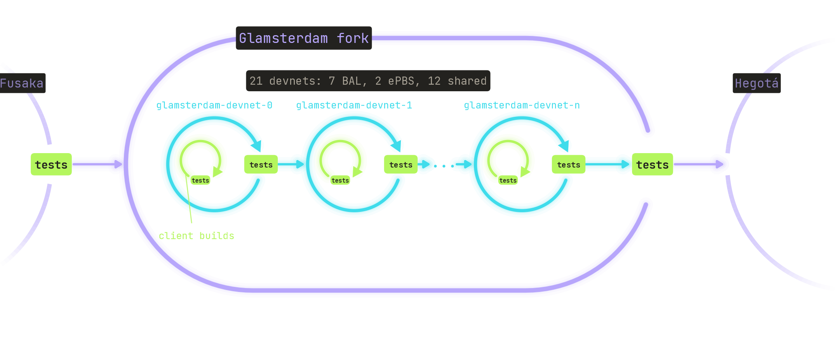
03 // why?
Tests gate every client build, devnet and fork
Faster feedback → faster forks

Slide 6
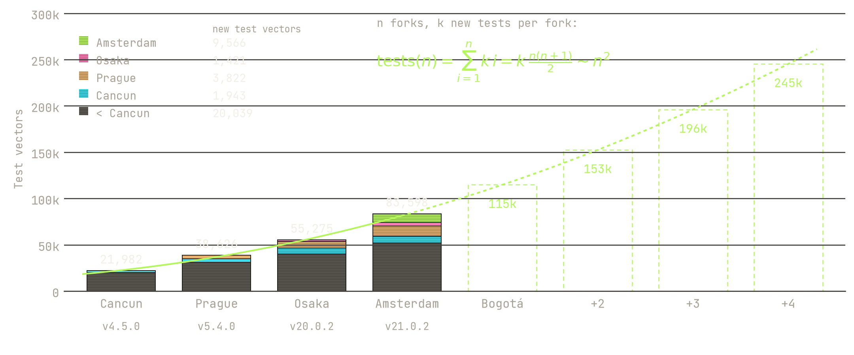

04 // problem
Honey, I Blew Up the Test Run
Blockchain Engine test vectors per fork release
ethereum/execution-spec-tests v4.5.0, v5.4.0
ethereum/execution-specs v20.0.2, v21.0.2

Slide 7
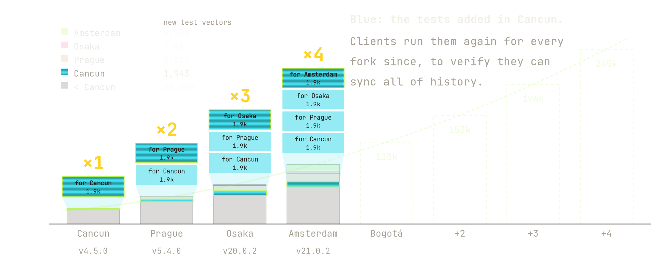
05 // problem
Honey, I Blew Up the Test Run
Blockchain Engine test vectors per fork release
ethereum/execution-spec-tests v4.5.0, v5.4.0
ethereum/execution-specs v20.0.2, v21.0.2

Slide 8
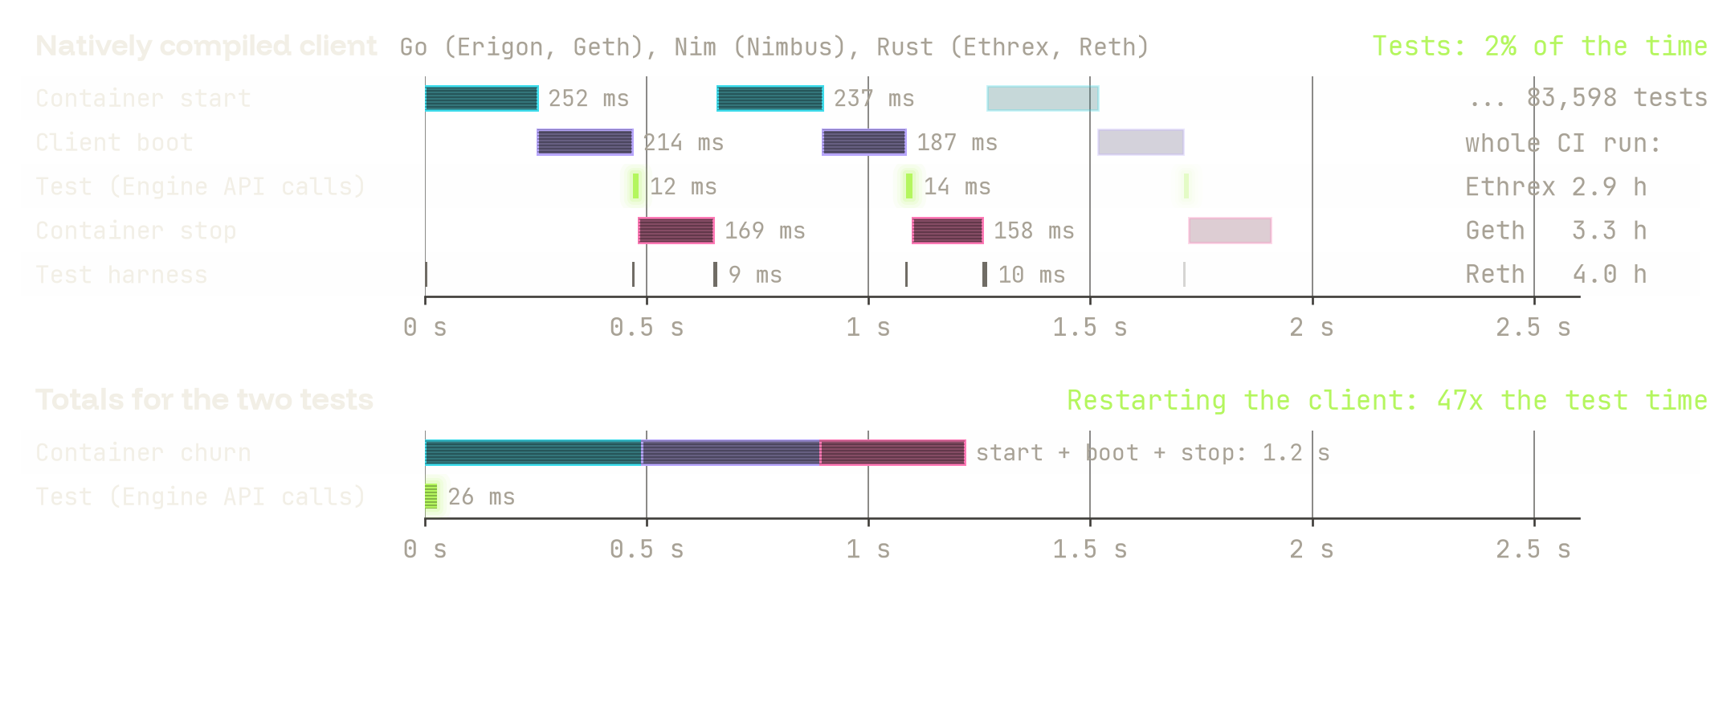
06 // optimization strategy
98% Pit Crew, 2% Driving
Where does the time go? consume-engine, one container per test

Slide 9
07 // reorging away startup
What if we just run all the tests on one client?
Reorg back to the genesis, then start the next test chain.
engine // one client per test
enginex // one client per genesis
Start client
Test 1
Stop
G → Test 1
Start client
Test 2
Stop
Start once
shared genesis G
G → Test 2
Start client
Test 3
Stop
G → Test 3
independent test chains from the same genesis
Clients already know how to reorg: no need to scrap the Lambo after one test.

Slide 10
08 // rewriting the checklists
Can it really be that easy?
The hard part: generating and rewriting the checklists.
generating // two sweeps
rewriting // the radio presets
Sweep 1: collect every test's accounts.
pre-state
tx → post-state
test A
P1: 87.4
2 mangoes in the glove box, AC on max
handbrake turn → the Lambo spins out
One genesis for all: its state root and hash.
test B
P1: 102.5
2 mangoes in the glove box, wipers on
reverse → the Lambo rolls back
Sweep 2: generate each test's blocks on that genesis hash.
Both want preset 1: one button can't hold two stations.
Chicken and egg: the genesis needs the tests, the tests need the genesis.
The fix: every checklist gets its own preset button.
Then one car runs every checklist. Easy, once they're generated and rewritten.

Slide 11
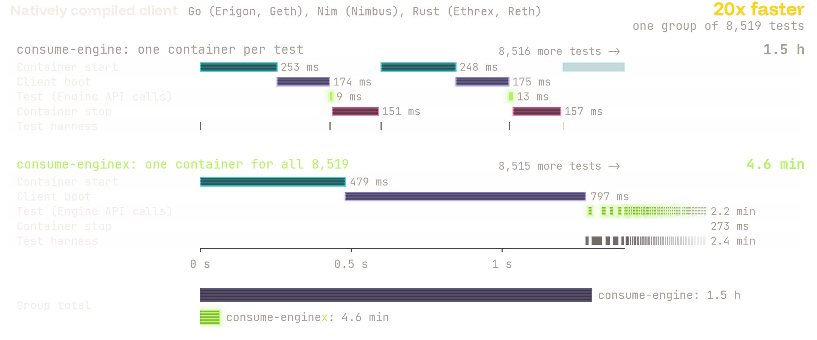
09 // reorging away startup
Now We're Driving
Where does the time go now? One big pre-alloc group, natively compiled client

Slide 12
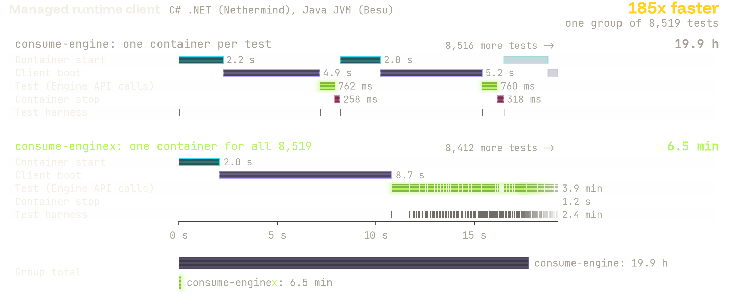
10 // reorging away startup
Now We're Driving
Where does the time go now? One big pre-alloc group, managed runtime client

Slide 13
11 // still shrinking
Can we shrink it further?
Fewer pre-alloc groups → faster runs, and it's still WIP.
pre-alloc groups, all forks // v21.0.1 → v21.0.2
client starts per client
v21.0.1
3,348 groups
−23%
v21.0.2
2,563 groups
consume-enginex, whole CI run (median) // v21.0.1 → v21.0.2
natively compiled (Geth, Reth, Ethrex, Nimbus)
v21.0.1
21.9 min
−11%
v21.0.2
19.6 min
Nethermind
v21.0.1
83.6 min
−21%
v21.0.2
66.1 min
Besu
v21.0.1
166.9 min
−20%
v21.0.2
133.1 min
We keep rewriting the tests ported from ethereum/tests (YAML) so they can share a genesis.
The checklists aren't all rewritten yet: that's the ?? in 10-??x.

Slide 14
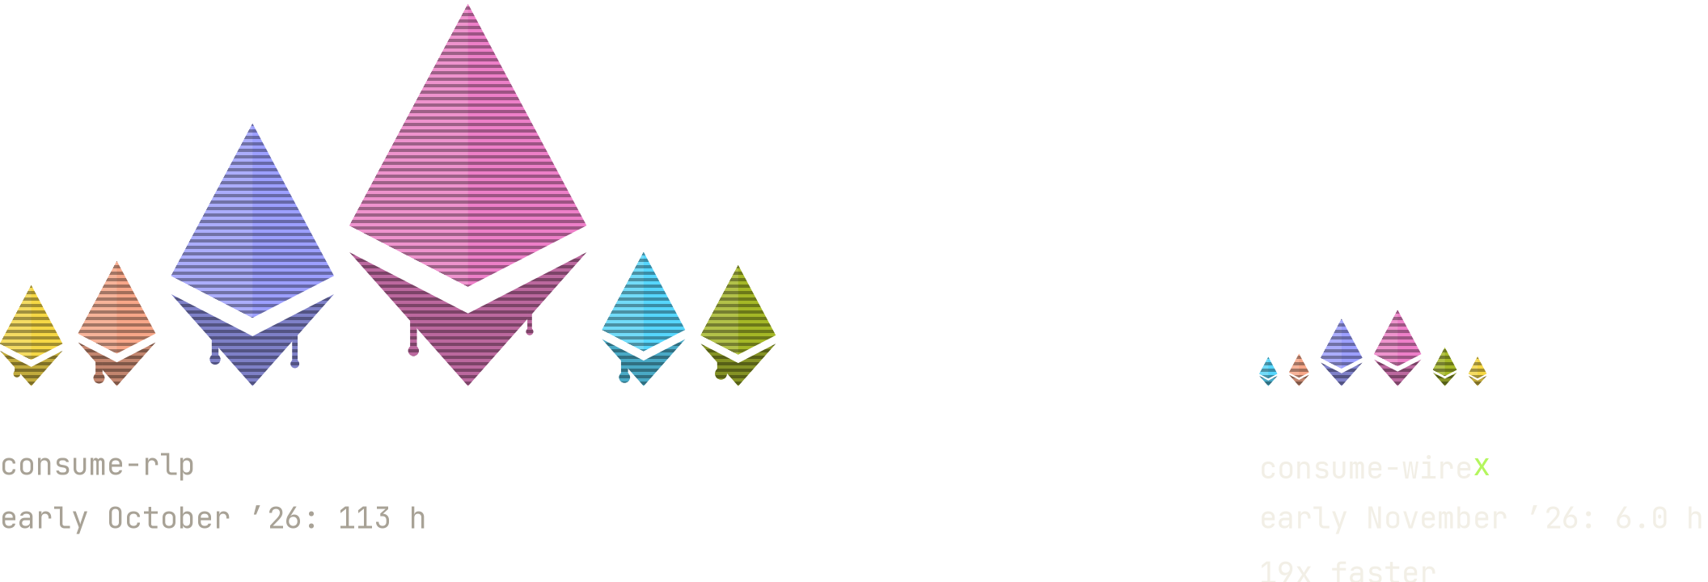
12 // wirex
WireX: same trick, over the wire
Faster, and blocks now arrive as on mainnet: over the wire.
consume-rlp
consume-wireX
how blocks arrive
read from a file at startup
from a mock devp2p peer, over the wire: protocol native
Engine API
not used
newPayload and forkchoiceUpdated start a sync
sync machinery
skipped
real full sync: fetchers, retries, timeouts
BALs (Amsterdam)
no peer to ask
eth/71: served or withheld, both paths tested

Slide 15
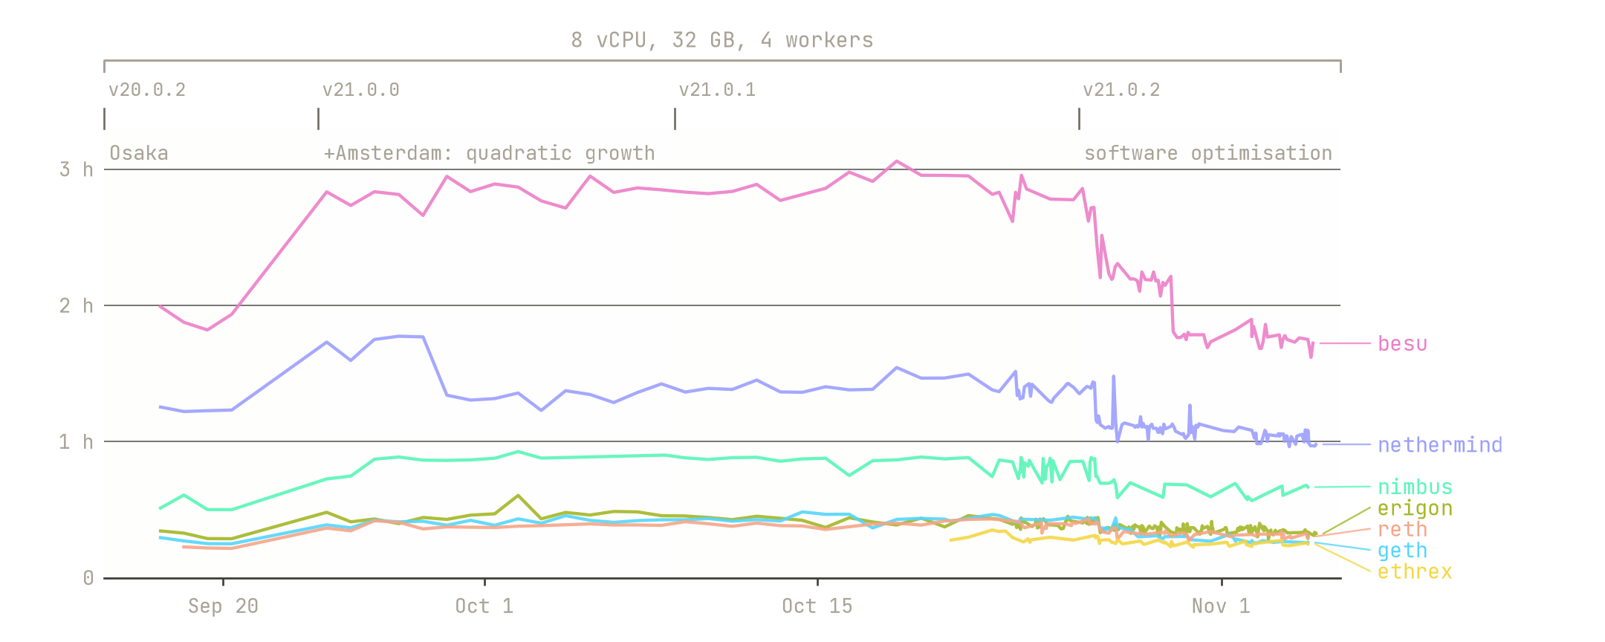
13 // every layer
Send it all to zero
consume-enginex wall time per client, September to 4 November.

Slide 16
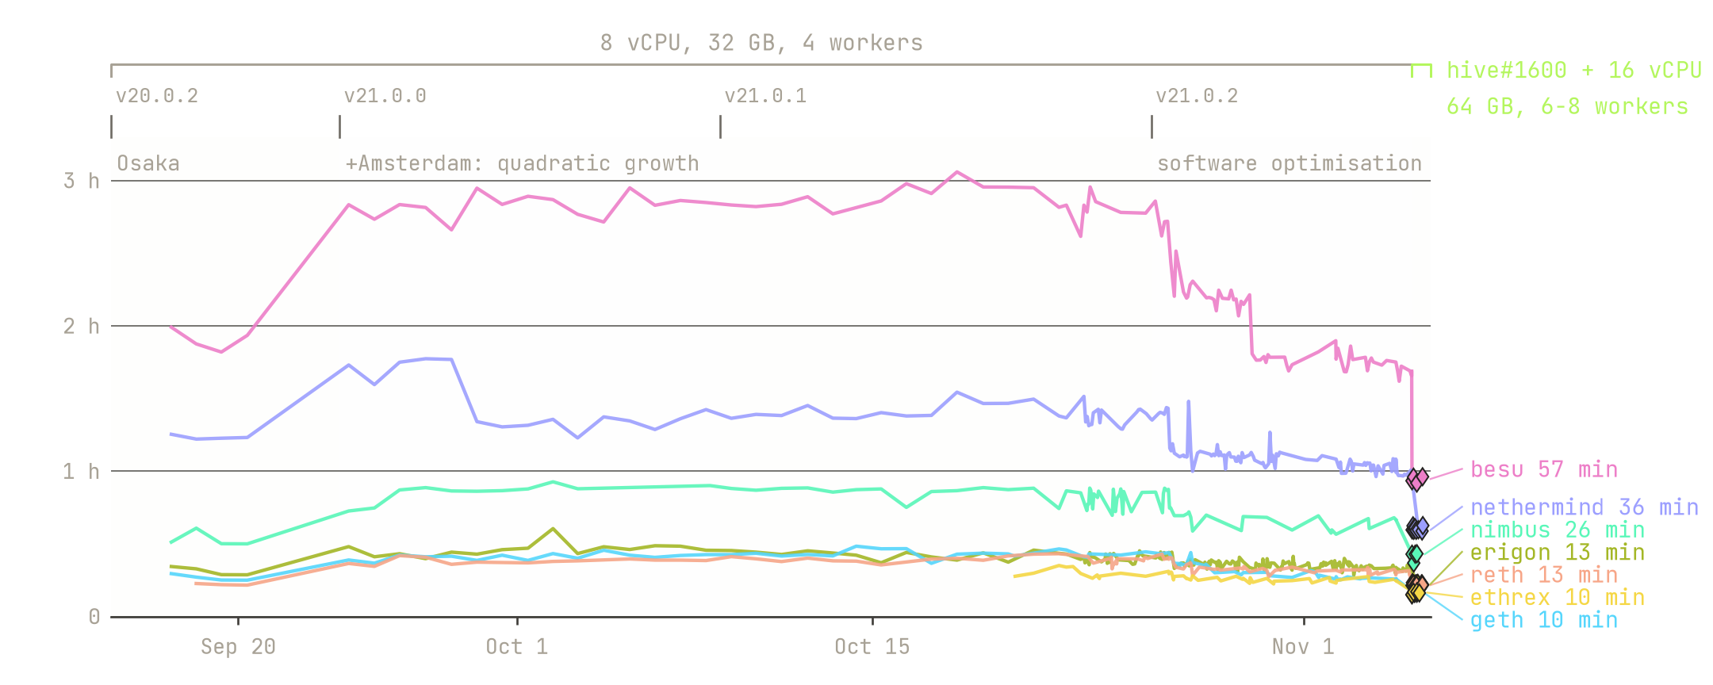
13 // every layer
Send it all to zero
consume-enginex wall time, September to 6 November: just in time for this talk.

Slide 17
14 // every layer
Every layer of the stack
Independent of EngineX: most of these help every simulator.
tests
execution-specs#3122 pre-alloc groups 5,458 → 3,279
v21.0.2 32% fewer pre-alloc groups
simulator
execution-specs#3914 fixture cache thrash fixed
execution-specs#3952 next group's client starts while this one runs
hive
hive#1600 teardown mutex fix: more workers pay off
hive#1627 client readiness probed faster
containers
hive-github-action#51 crun trial (open PR): client start 25-60 ms faster
client wrapper
hive#1644 besu: Java Flight Recorder off, -1 s per start
hive#1651 nimbus genesis mapping 19 s → 0.9 s
client
go-ethereum#36025 KZG on first use, -250 ms per start
besu#11813 KZG setup in the background, -1 s per start
runners
hive-tests#126 rerun on every client image: 6 → 58 jobs a day
hive-tests#153 8 → 16 vCPU runners

Slide 18
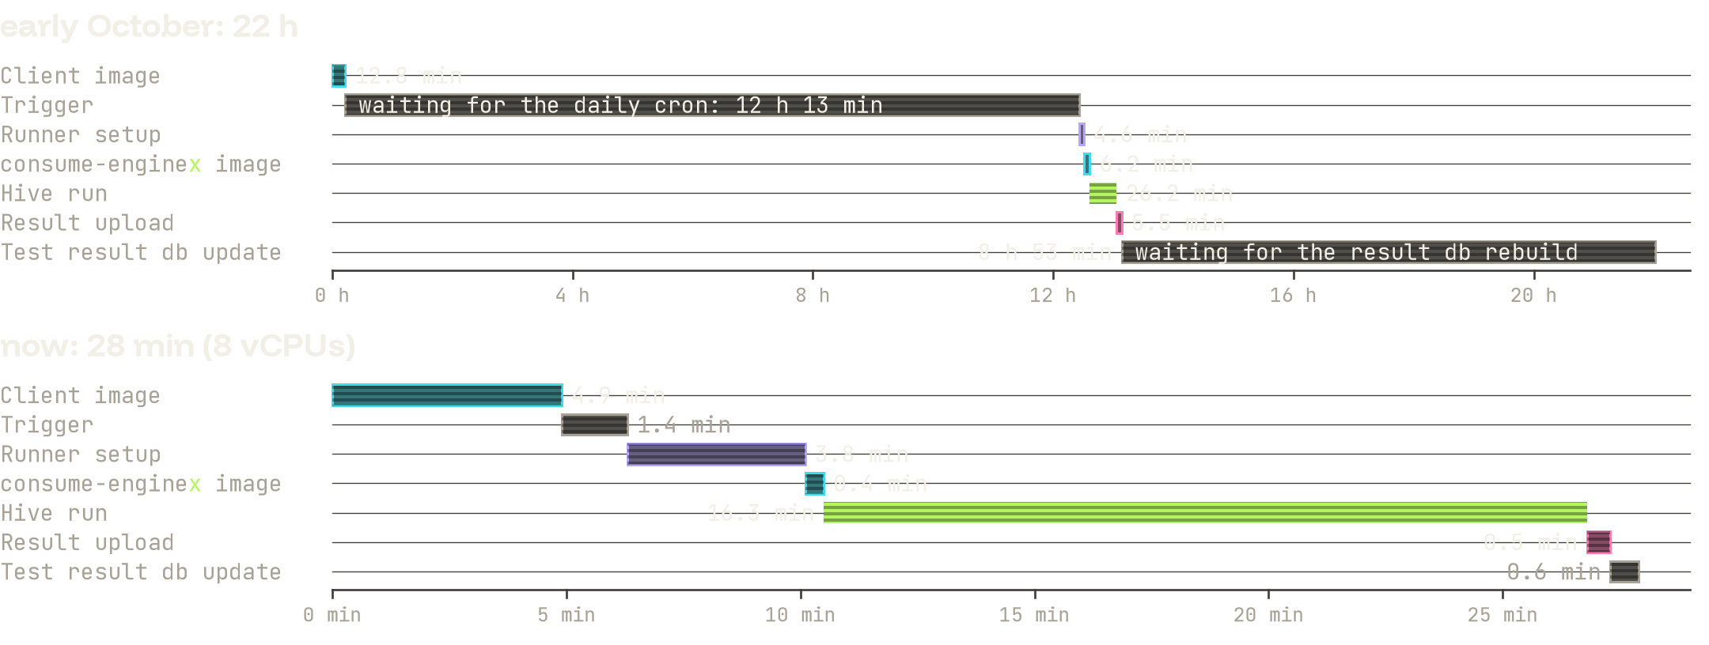
15 // feedback loop
From Push to Dashboard
From a geth commit to its consume-enginex result on the dashboard: 22 h, now 28 min.

Slide 19
What's next
16 // what's next
Complete and improve the tests ported from ethereum/tests.
Reduce the pre-alloc groups.
Don't system test when you can module test: better and standardized tooling.
Enable WireX for pre-merge forks → deprecate consume-rlp?

Slide 20

17 // takeaways
Takeaways
Faster system tests → happier devs & faster forks, so we made it fast.

Slide 21





Thank you!
Dan (danceratopz)
Special thanks to Spencer, Mario & all of Specs, the Pandas, esp. skylenet, and all
the amazing client teams: besu, geth, erigon, ethrex, nethermind, nimbus-eth1 and reth.
Docs: steel.ethereum.foundation/docs/execution-specs/running_tests/
Data: hive.ethpandaops.io/#/group/mainnet
Slides: danceratopz.github.io/devcon-8-test-talk, pinned at github.com/danceratopz

Slide 22
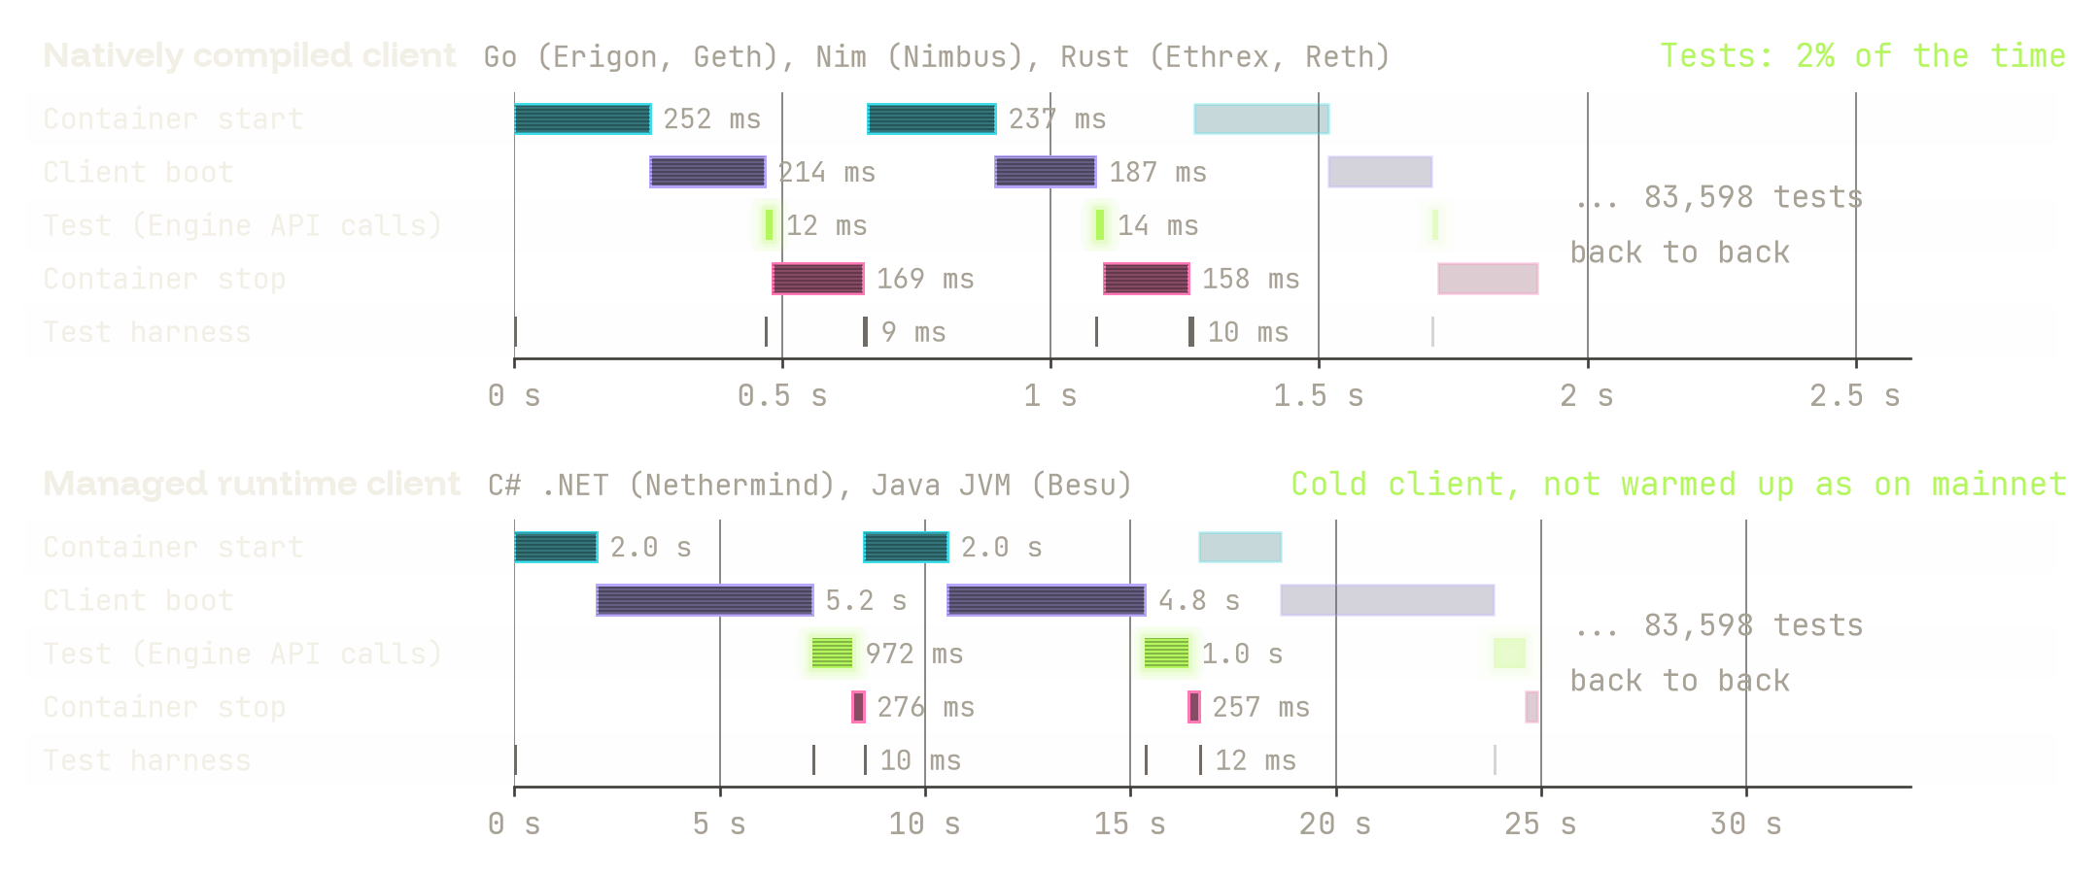
19 // backup
Where does the time go?
consume-engine, one container per test, on both kinds of client

