Slide 2
The sane approach for a home lab
Master-1
Worker-1
(local disk
binds)
Worker-2
(local disk
binds)
Notes:
Nice and simple. BUT:
1. What if I have to take the master down for mainenance.
2. Two worker/storage nodes means if a worker is down, I’m down to 1 replica
3. It seems like the master will have excess capacity – Normal is at least 4 cores now, right? (foreshadowing)
4. Probably most important, I wouldn’t learn about the HA end of things this way.

Slide 3
Crazy Uncle danch’s Home Lab
Shared VIP, courtesy keepalived
Internal etcd, redundant kubernetes control plane
Loadbalancer
Loadbalancer
Loadbalancer
Master-1
Master-2
Master-3
Application loads – Kafka, Kafka-streams, Custom Scala
Worker-1
Worker-2
Worker-3
Log aggregation and monitoring, courtesy of “the usual suspects”
Storage-1
Storage-2
Storage-3
Storage-layer fault tolerance and replication, courtesy Ceph
Notes:
So: “Hyperconverged” then.
Now, critical components are redundant. The number of replicas in this case was driven by the need for an odd number of etcd instances and > 2 ceph OSD failure domains. This adventure would be complex enough without managing an external etcd cluster, so I leveraged kubeadm’s ability to build the etcd cluster as a set of static pods withing kubernetes.

Slide 4
Why?
Why not?
Knowledge of how these components work helps in understanding the workings of their more conventional counterparts in the enterprise.

Slide 5
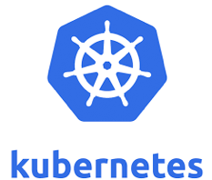
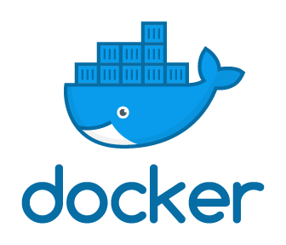
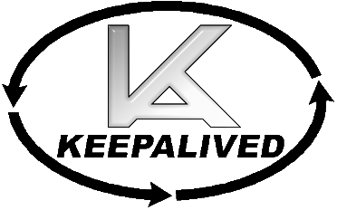











What’s Involved?

Slide 7
What is is and isn’t
Is:
  Educational
  A robust-ish lab environment (‘maintenance tolerant’)
Isn’t
  Anything like a production configuration
  Actually HA (a number of non-redundant features)
  Performant (colocation of Ceph with workloads leads to oversubscription)

Slide 8
Preparation
Install and update Linux on all hosts
Install ansible on maintenance workstation
Configure key-based ssh login for admin user from workstation to all hosts
(Optional) configure passwordless sudo on hosts
  I don’t – I specify –aks-become-pass on ansible commands

