Slide 1
MAC2000 Stage Calibration
Step-by-Step Guide
How to calibrate the Ludl MAC2000 motorized stage
for accurate die mapping and tile stitching
Stage: LEP (Ludl Electronic Products) | S/N: 060205
SemiAnalysis | 2026
SemiAnalysis | MAC2000 Stage Calibration Guide

Slide 2
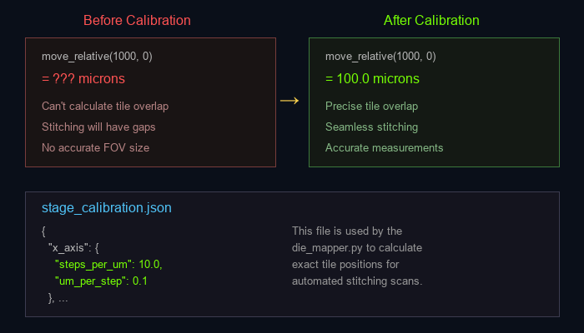
Why Calibrate the Stage?
The MAC2000 stage moves in motor steps, but we need to
know the physical distance per step (microns) to:
• Calculate field-of-view (FOV) in real units
• Set precise overlap between tiles for stitching
• Move to exact positions on the die
• Generate accurate measurement data
SemiAnalysis | MAC2000 Stage Calibration Guide

Slide 3
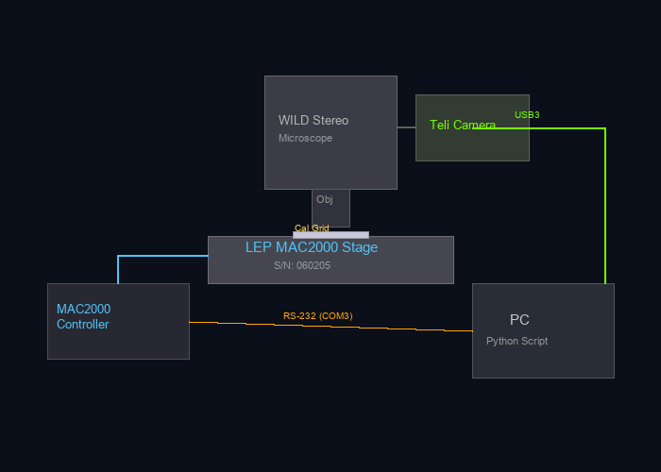
What You Need
Equipment:
• WILD stereo microscope with LEP MAC2000 stage
(S/N: 060205)
• Teli BU505MC camera (USB3) connected
• MAC2000 controller connected via RS-232 (COM3)
• MCS-0.1µm calibration standard
(S/N: CD-EA07-0801) — nested squares:
2.5mm, 1.0mm, 0.5mm, 0.25mm, 0.1mm
Software:
• Python 3.x with dependencies installed
• calibrate_stage.py (in MAC2000 folder)
Recommended magnification:
• WILD 32x or higher for best precision
(grid lines appear thicker = easier to align)
SemiAnalysis | MAC2000 Stage Calibration Guide

Slide 4
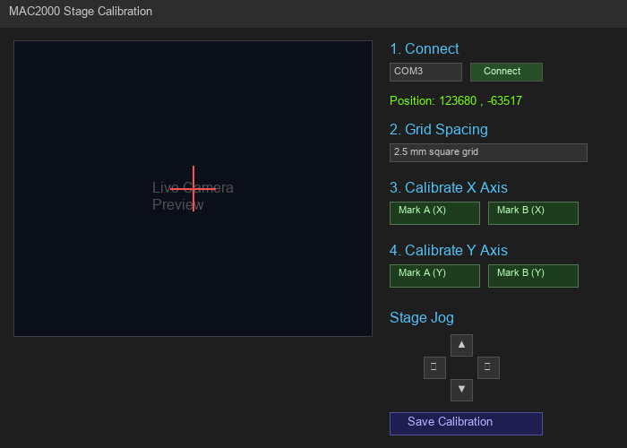
Step 1: Launch the Calibration Tool
1
Open a terminal and run:
python MAC2000/calibrate_stage.py
The calibration GUI will open with:
• Camera preview (left)
• Controls and calibration buttons (right)
• Stage jog arrows (bottom right)
SemiAnalysis | MAC2000 Stage Calibration Guide

Slide 5
Step 2: Connect Stage & Camera
2
1. Verify COM port is set to COM3 (or your port)
2. Click "Connect"
3. Status bar will show:
Stage: COM3 OK | Camera: BU505MC
4. Live position display will start updating
Troubleshooting:
• If COM3 access denied: close other programs
using the port (TeliViewer, PolyCameraPro, etc.)
• If camera fails: kill PolyCameraPro process first
SemiAnalysis | MAC2000 Stage Calibration Guide

Slide 6
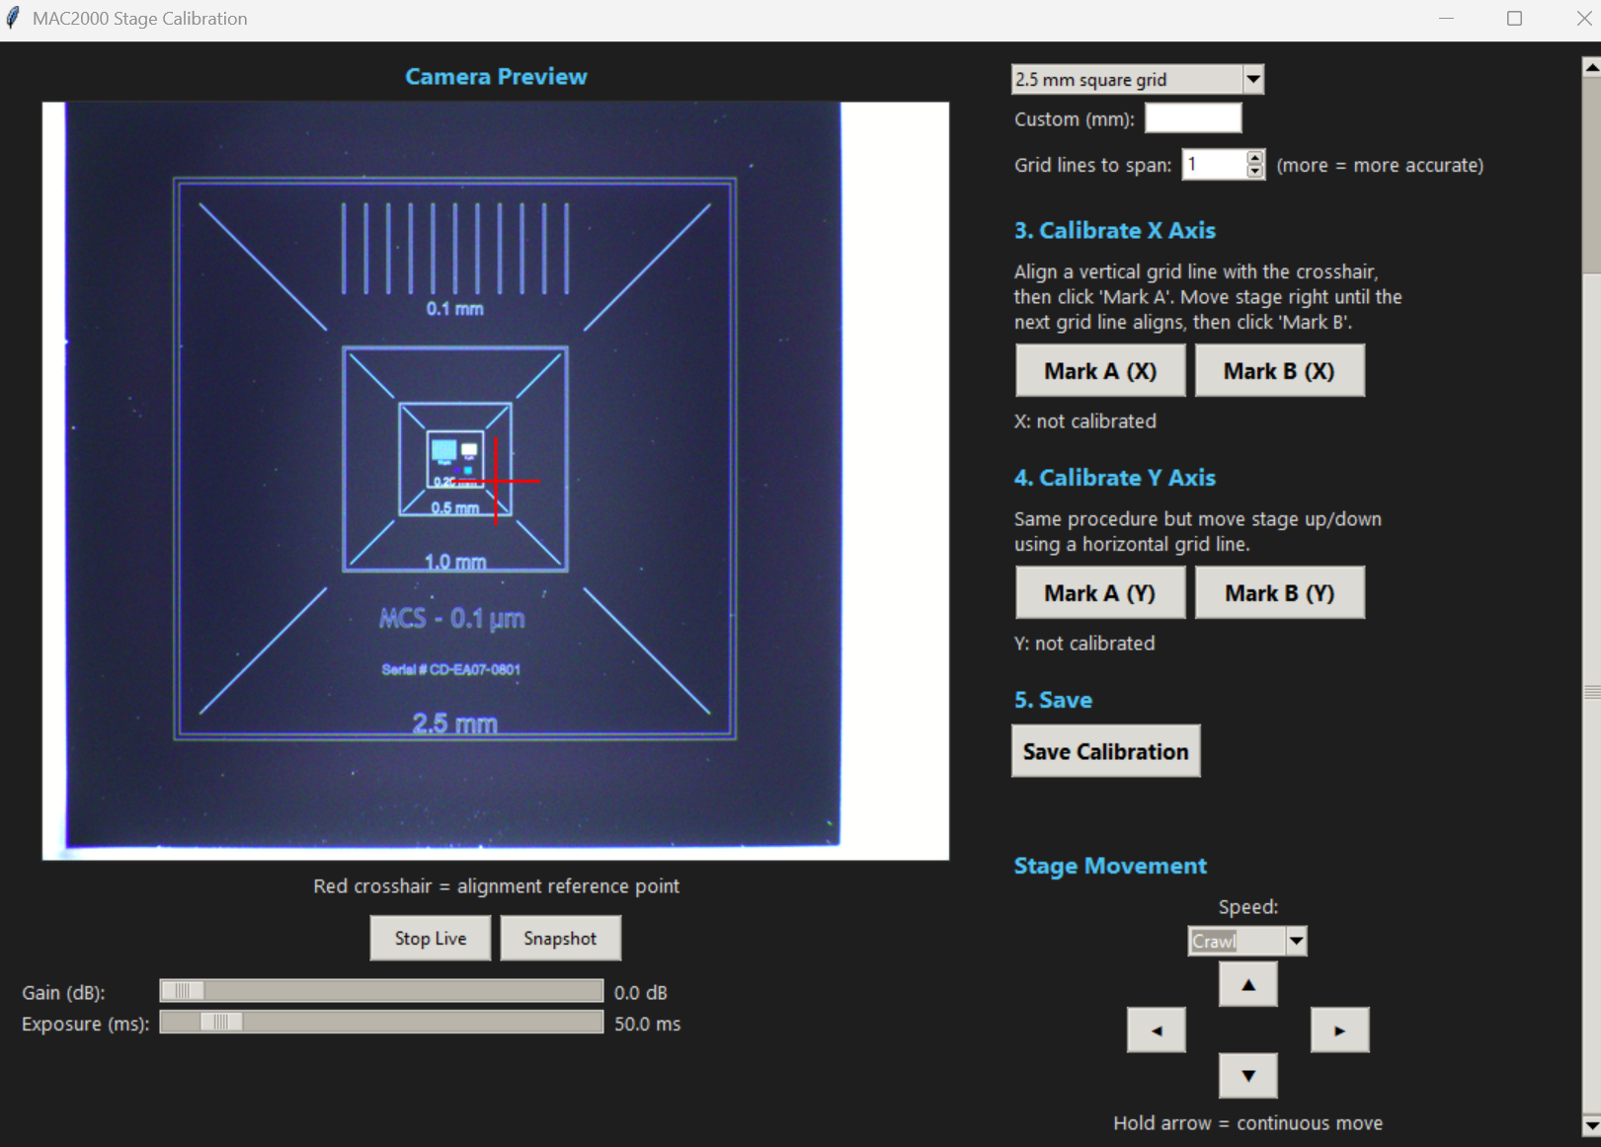
Step 3: Place Calibration Standard & Focus
3
1. Place the MCS-0.1µm calibration standard
on the stage (S/N: CD-EA07-0801)
2. Set the WILD microscope to 32x
• Grid lines appear thick = easy to align
• Magnification doesn't affect step count
3. Click "Start Live" to see the camera feed
4. Navigate to the 2.5 mm grid area
(outermost square on the standard)
5. Focus until grid lines are sharp
6. Adjust Gain/Exposure sliders if too
dark or bright
7. Select grid spacing: "2.5 mm square grid"
and set "Grid lines to span" = 1
SemiAnalysis | MAC2000 Stage Calibration Guide

Slide 7
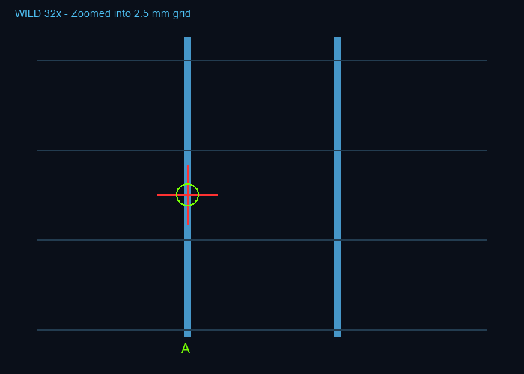
Step 4a: X-Axis — Mark Point A
4a
1. Use speed "Medium" to navigate until a
vertical grid line from the 2.5mm grid
is near the red crosshair
2. Switch to "Crawl" speed for fine alignment
3. Hold the LEFT/RIGHT arrows until the
vertical line is perfectly centered
on the crosshair
4. Click "Mark A (X)"
Status will show:
X: Point A = 123680 steps
SemiAnalysis | MAC2000 Stage Calibration Guide

Slide 8
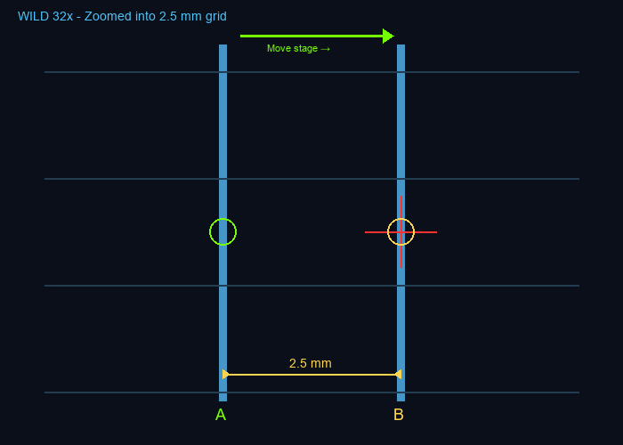
Step 4b: X-Axis — Move to Next Grid Line
4b
1. Switch to "Slow" or "Medium" speed
2. Hold the RIGHT arrow to move the stage
until the NEXT vertical grid line appears
3. Switch to "Crawl" for fine alignment
4. Align that line precisely on the crosshair
The distance between adjacent 2.5mm grid
lines = exactly 2.5 mm (2500 µm)
Take your time — precise alignment here
determines calibration accuracy!
SemiAnalysis | MAC2000 Stage Calibration Guide

Slide 9
Step 4c: X-Axis — Mark Point B
4c
1. With the next grid line aligned on the crosshair,
click "Mark B (X)"
2. The tool automatically calculates:
step_difference / grid_spacing = steps per um
3. Result appears immediately, for example:
X: 25000 steps / 2500 um =
10.0000 steps/um (0.1000 um/step)
If the number looks wrong, redo — click Mark A
again and repeat.
SemiAnalysis | MAC2000 Stage Calibration Guide

Slide 10
Step 5: Calibrate Y Axis
5
Same procedure, but for the Y axis:
1. Jog stage UP/DOWN until a HORIZONTAL grid line
aligns with the crosshair
2. Click "Mark A (Y)"
3. Jog stage DOWN until the NEXT horizontal
grid line aligns with the crosshair
4. Click "Mark B (Y)"
Result will show Y steps/um.
NOTE: X and Y may have slightly different values
if the stage has different gear ratios per axis.
SemiAnalysis | MAC2000 Stage Calibration Guide

Slide 11
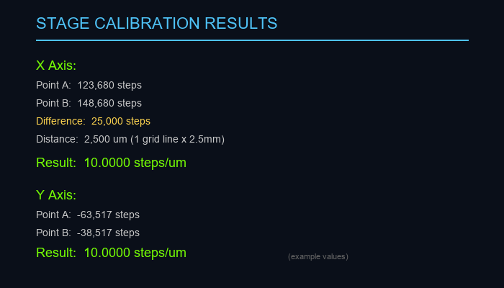
Step 6: Save Calibration
6
1. Click "Save Calibration"
2. This saves stage_calibration.json in the
MAC2000 folder containing:
• steps_per_um for X and Y
• um_per_step for X and Y
• Raw point A/B positions
• Grid spacing used
3. The die_mapper.py will automatically load
this file for tile scan calculations
SemiAnalysis | MAC2000 Stage Calibration Guide

Slide 12
Tips for Accurate Calibration
• Span multiple grid lines for better accuracy
(set "Grid lines to span" to 4 = 10mm travel)
• Use the smallest jog step size (100) for final
alignment to the crosshair
• Repeat the measurement 2-3 times and compare
results — they should be consistent within 1%
• The calibration only needs to be done ONCE per
stage (not per objective — stage steps are fixed)
• Recalibrate if the stage is serviced or if the
motor coupling is adjusted
• The Ludl MAC2000 typically has ~10 steps/um
(0.1 um resolution) but verify with your hardware
SemiAnalysis | MAC2000 Stage Calibration Guide

Slide 13
What's Next?
With the stage calibrated, you can now:
1. Run automated tile scans with die_mapper.py
• Specify die size in microns
• Set overlap percentage (typically 15%)
• Serpentine scan pattern minimizes travel
2. Stitch tiles with stitcher.py
• Phase correlation alignment
• Cosine-tapered blending
• Outputs high-res TIFF
3. Analyze in the DieAnalysisTool
• Select McBain or WILD microscope
• Choose objective for calibrated measurements
• Export to PPT or Excel
SemiAnalysis | MAC2000 Stage Calibration Guide

