Slide 1
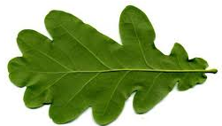
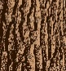




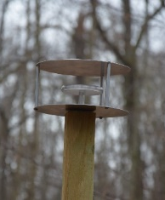
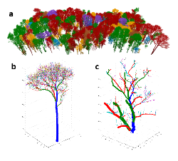
Experimental design
Molecular + Microbial Analyses
Sampling
samplers at open sites without canopy cover
Bacterial community composition and abundance (16S rRNA genes), functional analysis (PICRUSt)
throughfall sampler
Quercus robur
top
Chemical Analyses
mid
leaf, bark washings
bottom
POC, PN, DOC, DN, DP, DS, Ca, K, Mg, Na, Mn, Al, Si, Fe
Chlorophyll + sugar content (leaf washings)
Tilia cordata
stemflow sampler
Structural Analyses
microscale
macroscale
Fraxinus excelsior
airborne microbes (pollen traps)
SEM
TLS
Vegetation period 2021
Vegetation period 2022
10

