Slide 1
Functional microbiome research – bioinformatics section
Session 1 – intro to linux

Slide 2

First, thanks to de.NBI. They are amazing.

Slide 3
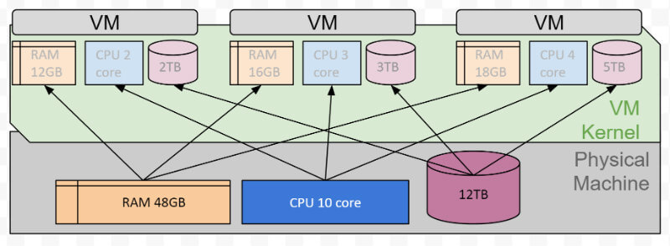
https://de.wikipedia.org/wiki/Universit%C3%A4t_Bielefeld#/media/Datei:Universit%C3%A4t_Bielefeld_Luftaufnahme_Juni_2022.jpg
Distributed computing and compute clusters are essential tools for scientists.
https://actusdigital.com/2018/01/08/virtual-machine-or-physical-server/
We use our local computers to talk to shared remote servers that have lots of high-powered processors, and storage and RAM.

Slide 4
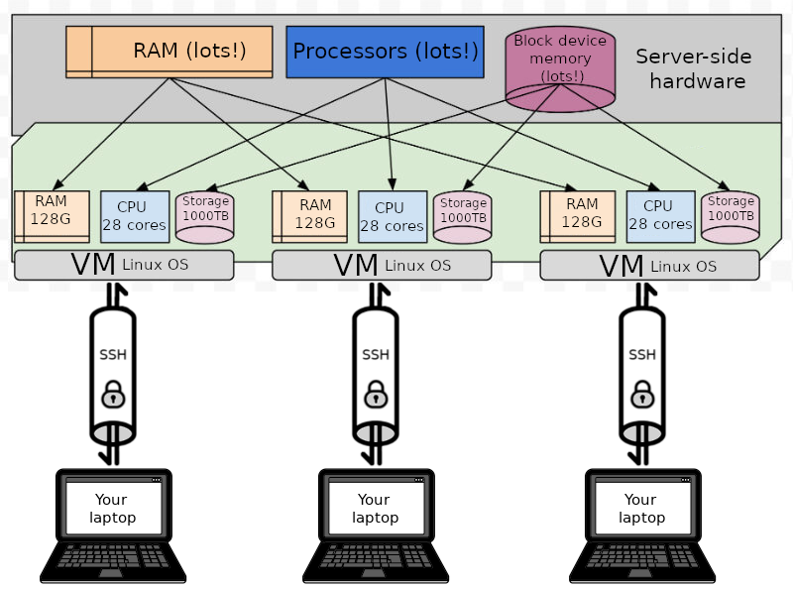
https://de.wikipedia.org/wiki/Universit%C3%A4t_Bielefeld#/media/Datei:Universit%C3%A4t_Bielefeld_Luftaufnahme_Juni_2022.jpg
de.NBI / Universität Bielefeld
https://actusdigital.com/2018/01/08/virtual-machine-or-physical-server/
Us.

Slide 5
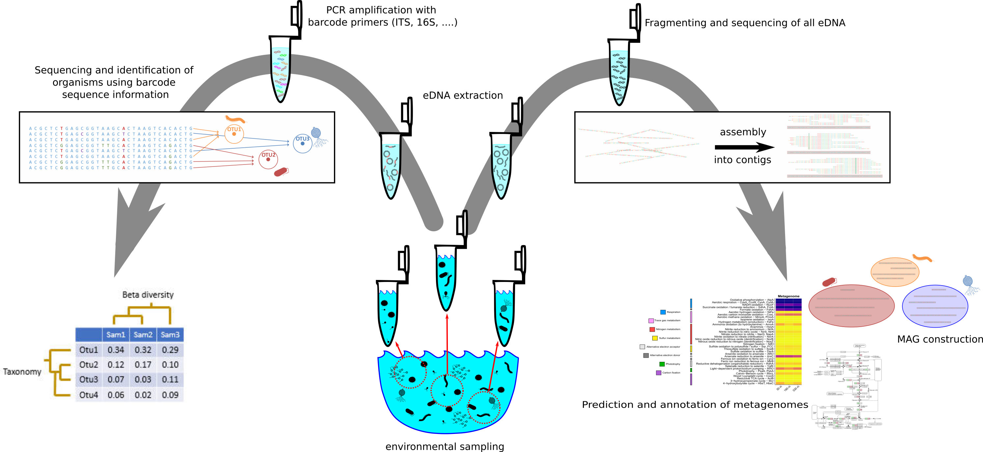
Review – what do we do with DNA sequence data?

Slide 6
Why do we need distributed computing to do this?

Slide 7
Because some steps take ~100 gig of RAM (or more!) and lots of processors.

Slide 8

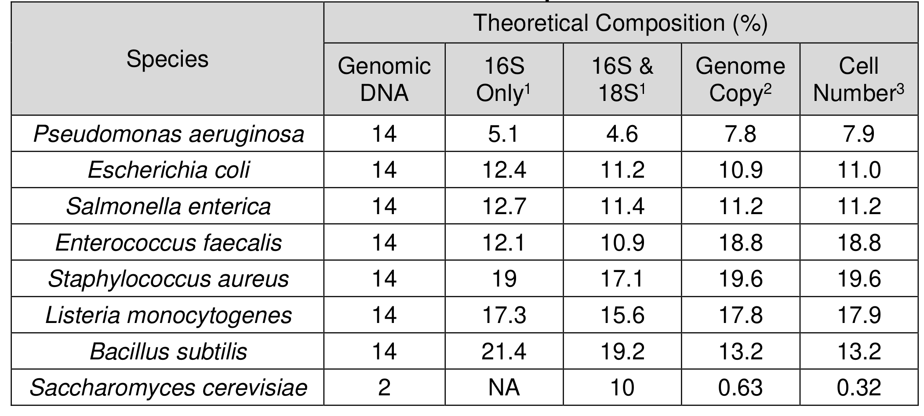
Dataset 1: ZymoBIOMICS HMW DNA Standard.

Slide 9

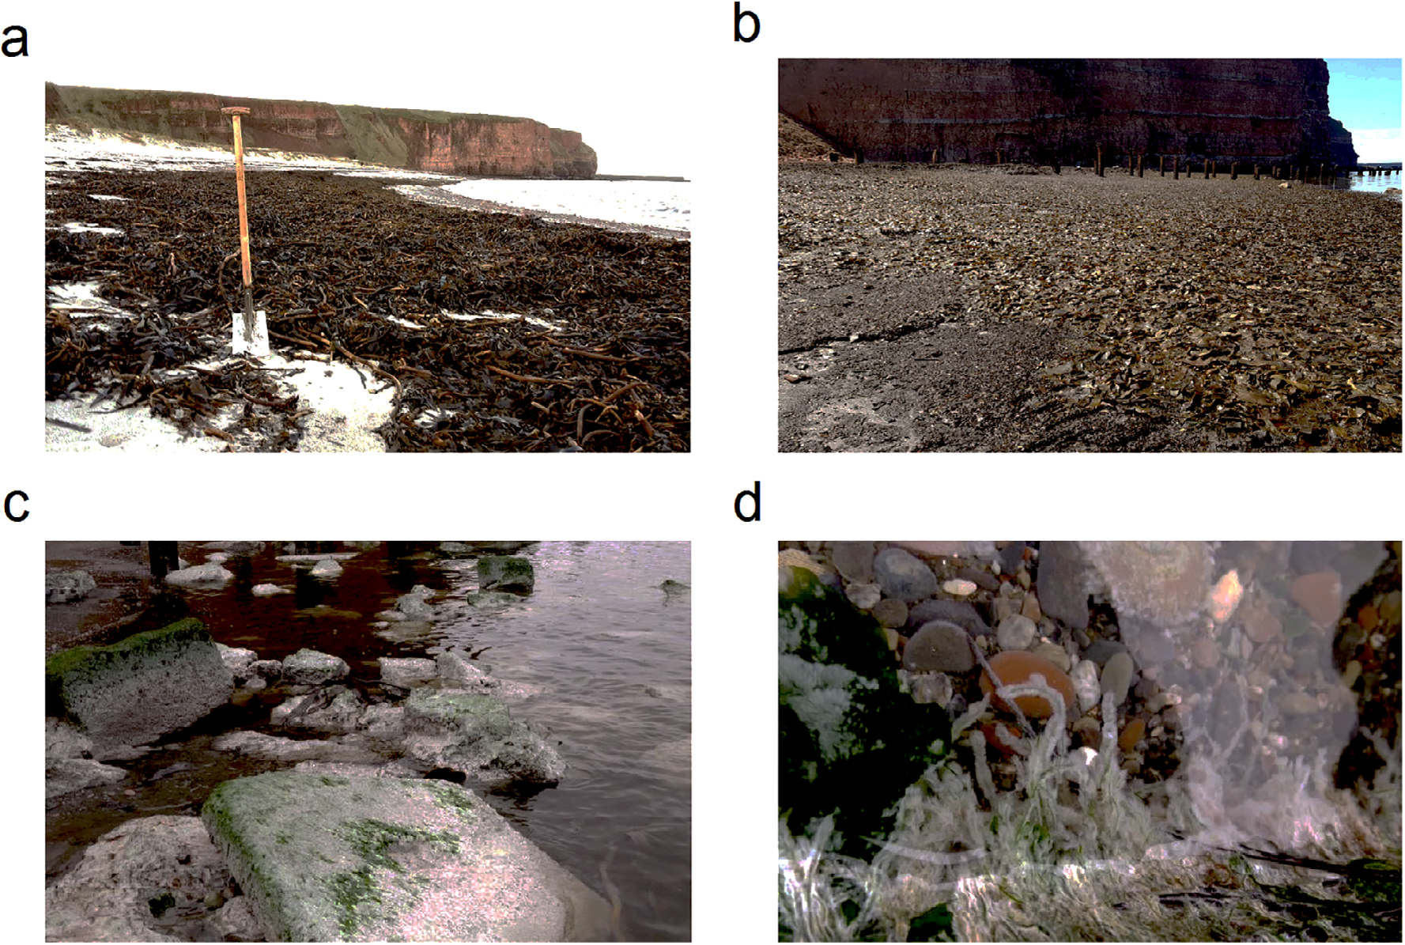
Dataset 2: Kelp decomposition

Slide 10
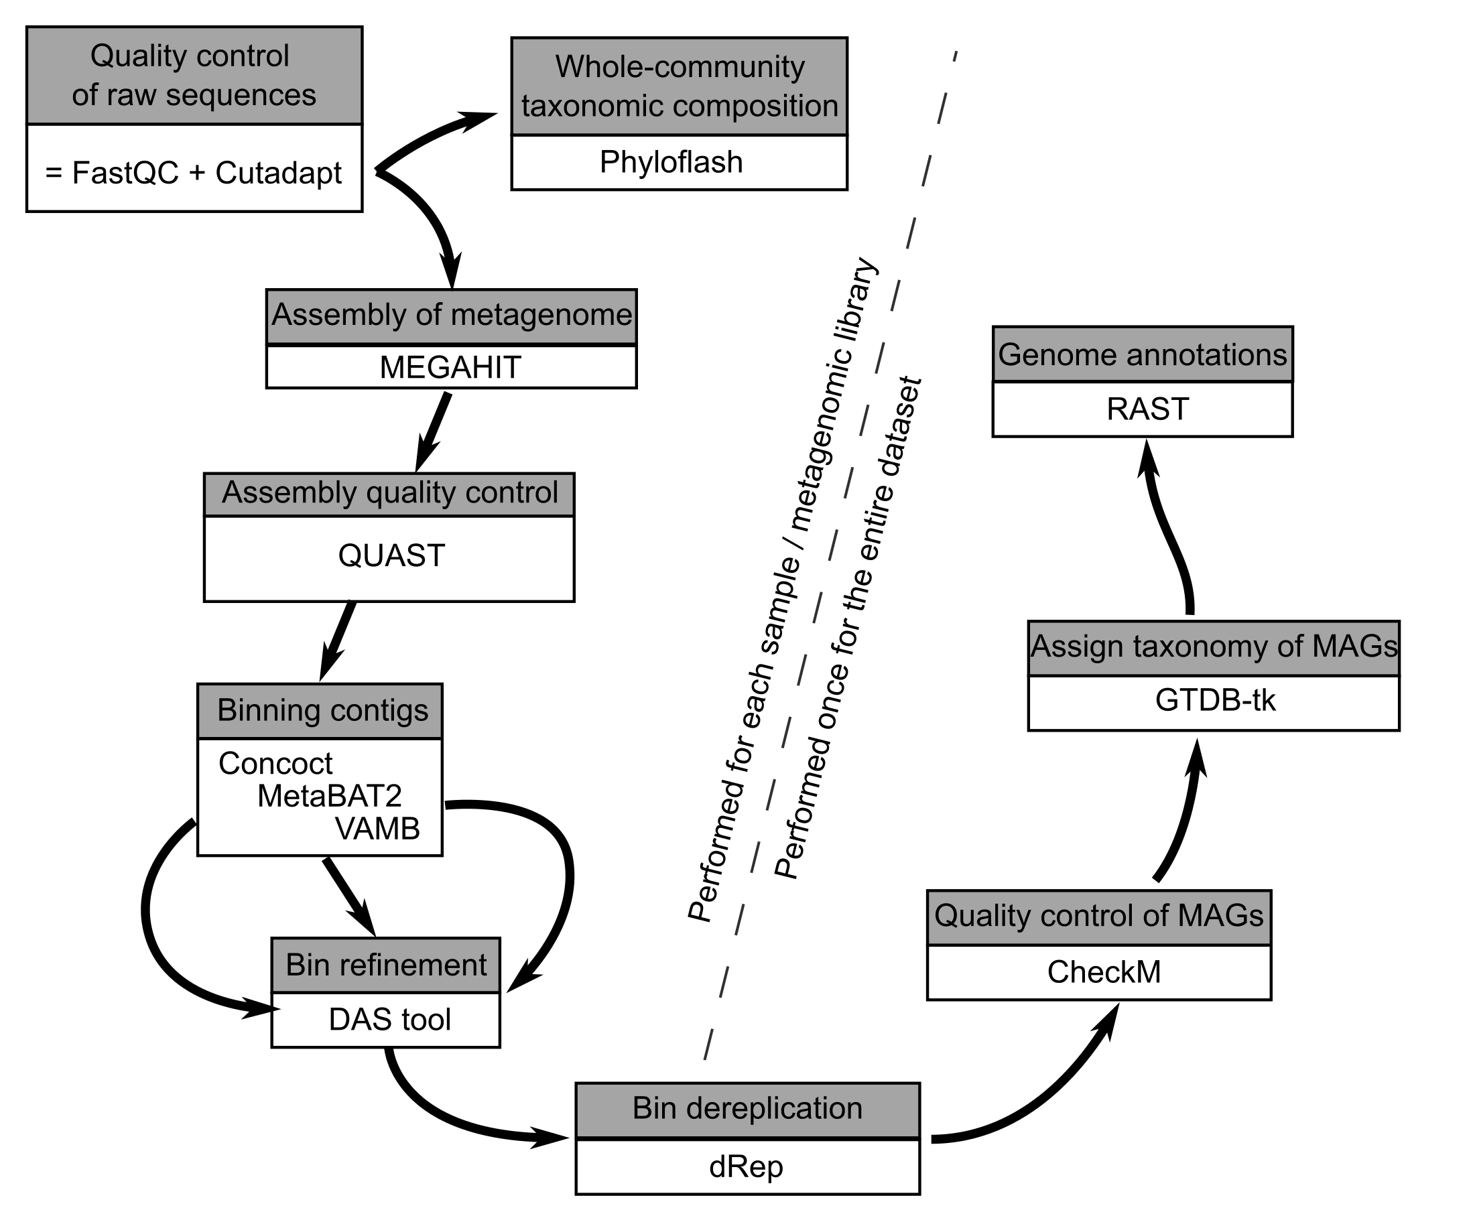
We will use various scientific software packages to assemble Metagenome-Assembled-Genomes (MAGs) from these sequence data.

Slide 11
First, we will do this with a simple mock community.

Slide 12
Then you will apply what you have learned to discover MAGs from the Kelp decomposition dataset.

Slide 13
We’ll keep track of what we do in scripts that will be kept in an online github repository.
1. Scientific computing and Linux (today!)
2. Metagenomic methods
3. Metabarcoding methods
Download using these links. Or use the links in the skript PDF on page 21.

Slide 14
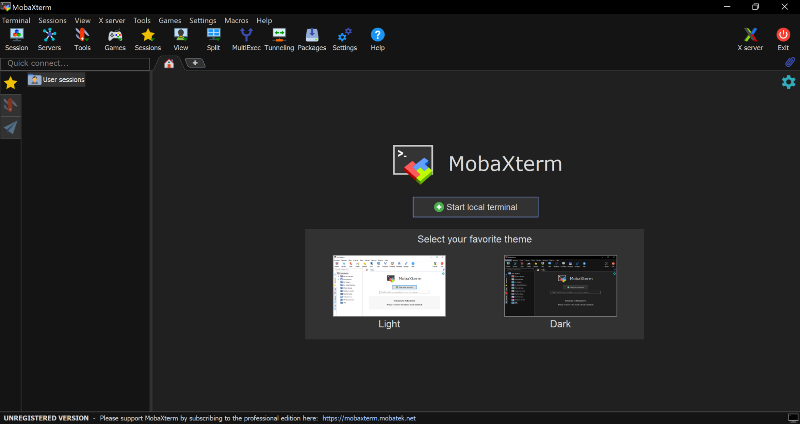
Try out MobaXterm on your computers.
Let’s check everyone’s installation. Try starting a local terminal.

Slide 15
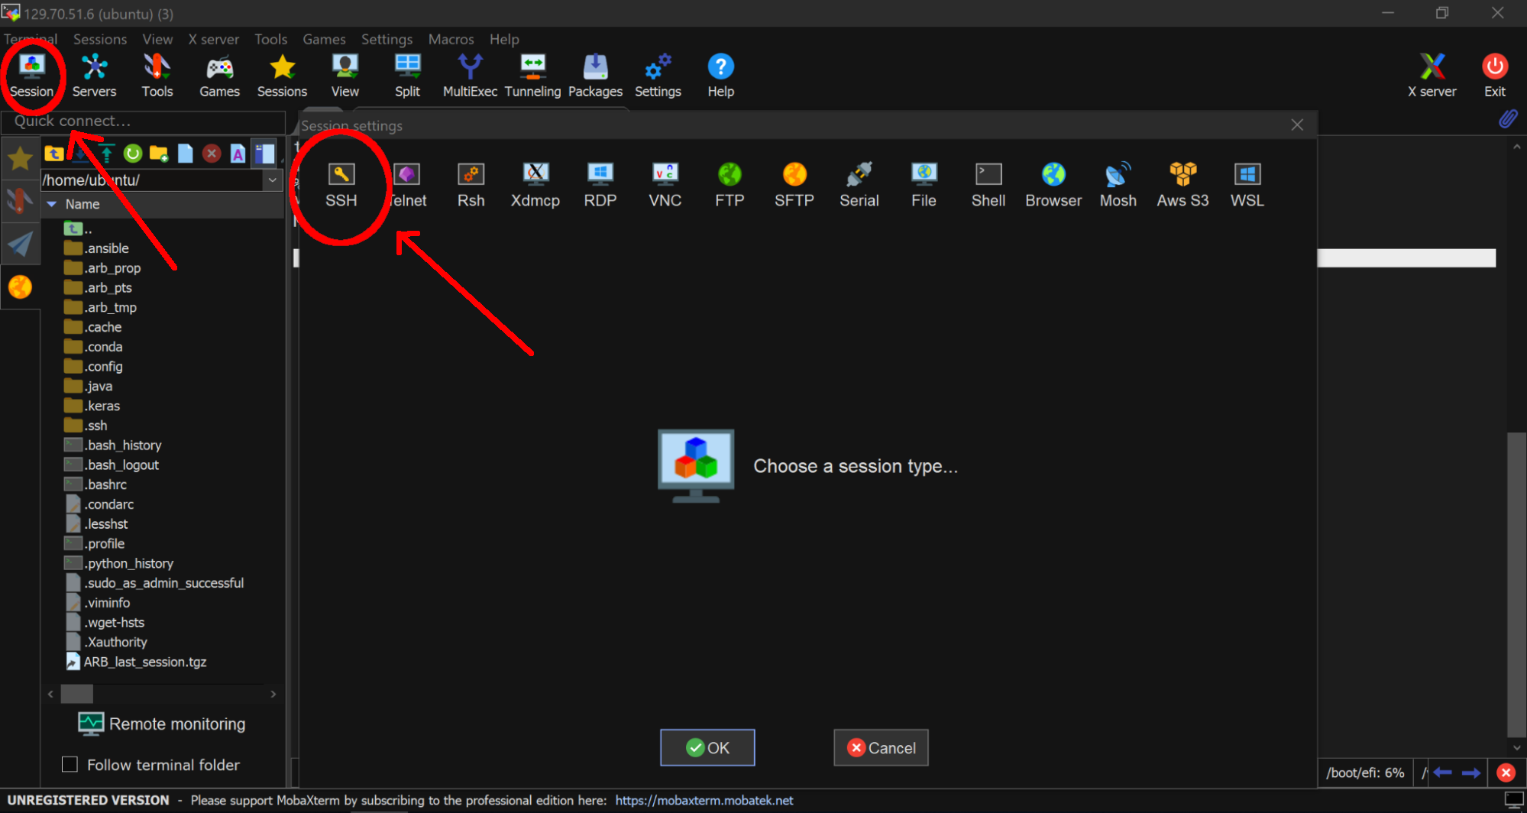
Now let’s try to connect to our de.NBI virtual machines.

Slide 16
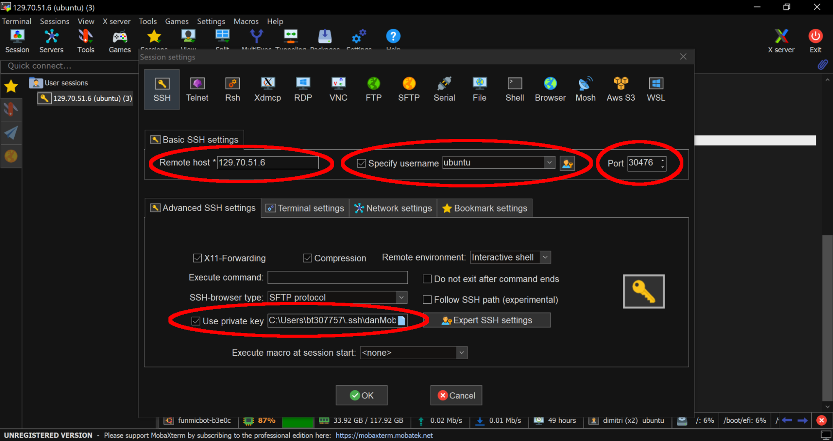
Now let’s try to connect to our de.NBI virtual machines.

Slide 17
First task: connect to VMs
Milan | ssh -p 30284 -i /path/to/your/privateKey ubuntu@129.70.51.6
Julia | ssh -p 30381 -i /path/to/your/privateKey ubuntu@129.70.51.6
Maria | ssh -p 30355 -i /path/to/your/privateKey ubuntu@129.70.51.6
Anja | ssh -p 30452 -i /path/to/your/privateKey ubuntu@129.70.51.6
Susanne | ssh -p 30461 -i /path/to/your/privateKey ubuntu@129.70.51.6
Rebekka | ssh -p 30372 -i /path/to/your/privateKey ubuntu@129.70.51.6
Or try with a shell variable: | key=/home/daniel/.ssh/funmic2023 ssh -p 30500 -i $key ubuntu@129.70.51.6

Slide 18
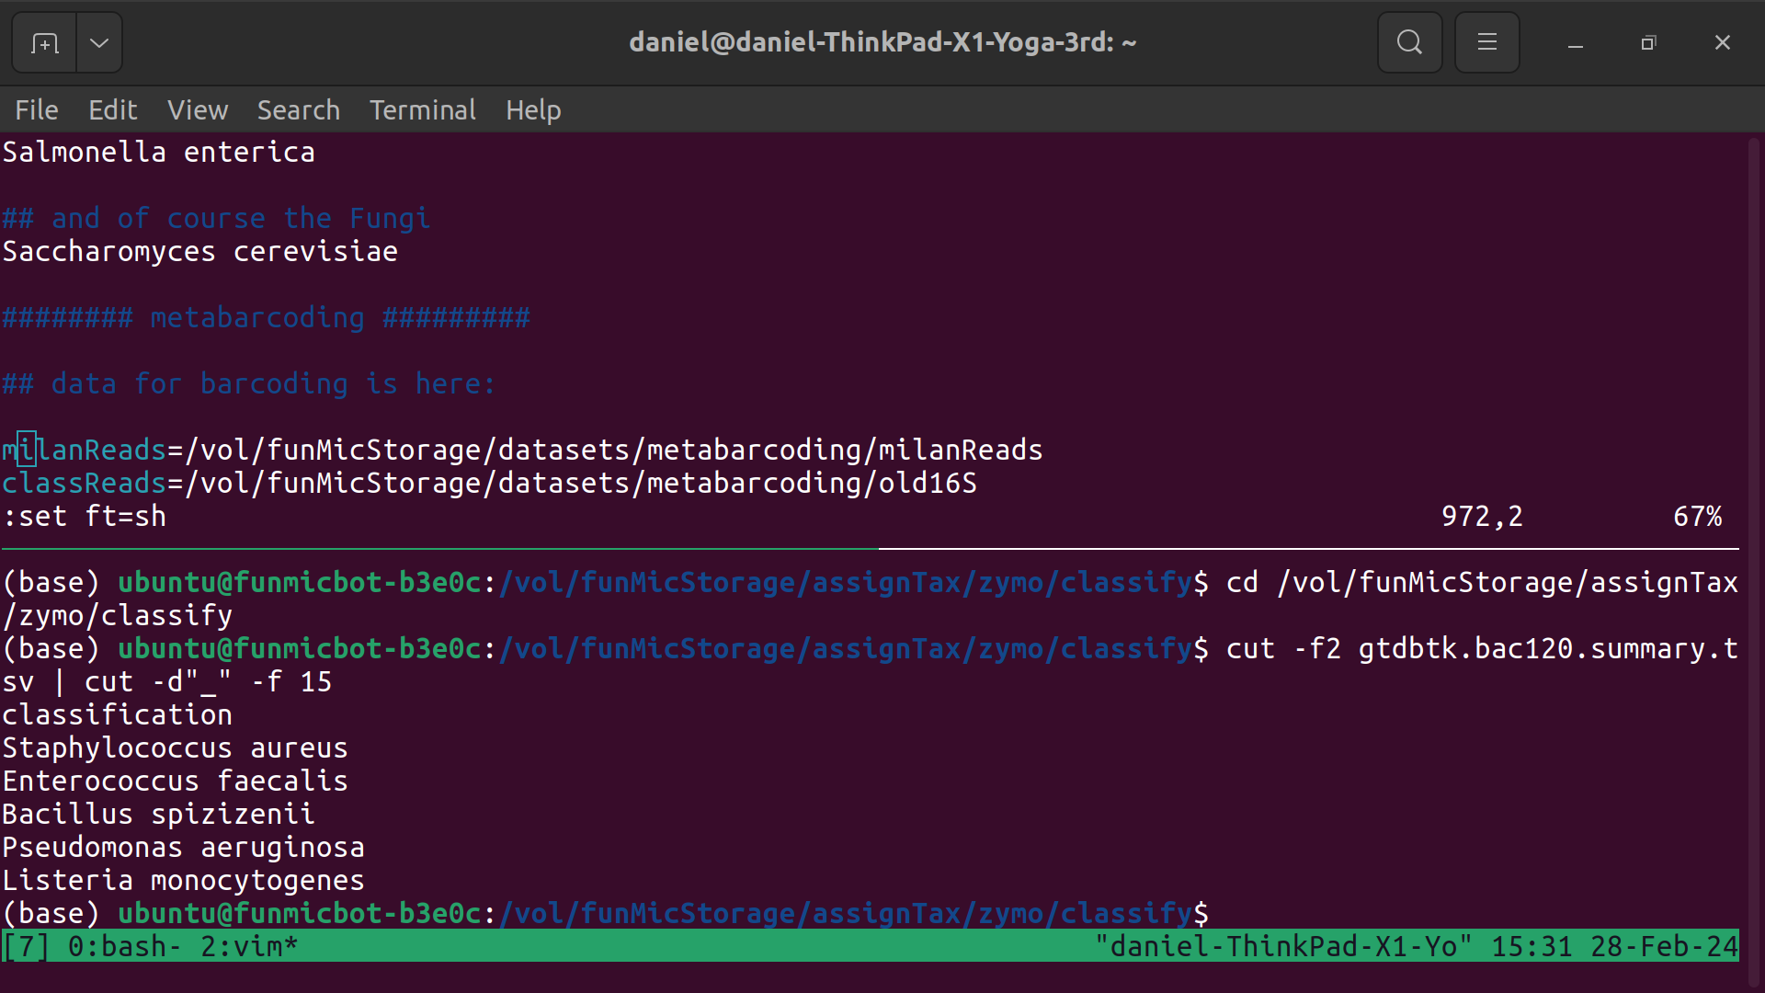
First task: connect to VMs
Second task: learn about linux terminals
Once you are in, open up the script for today, and let’s learn about linux.
(cut to terminal)

Slide 19
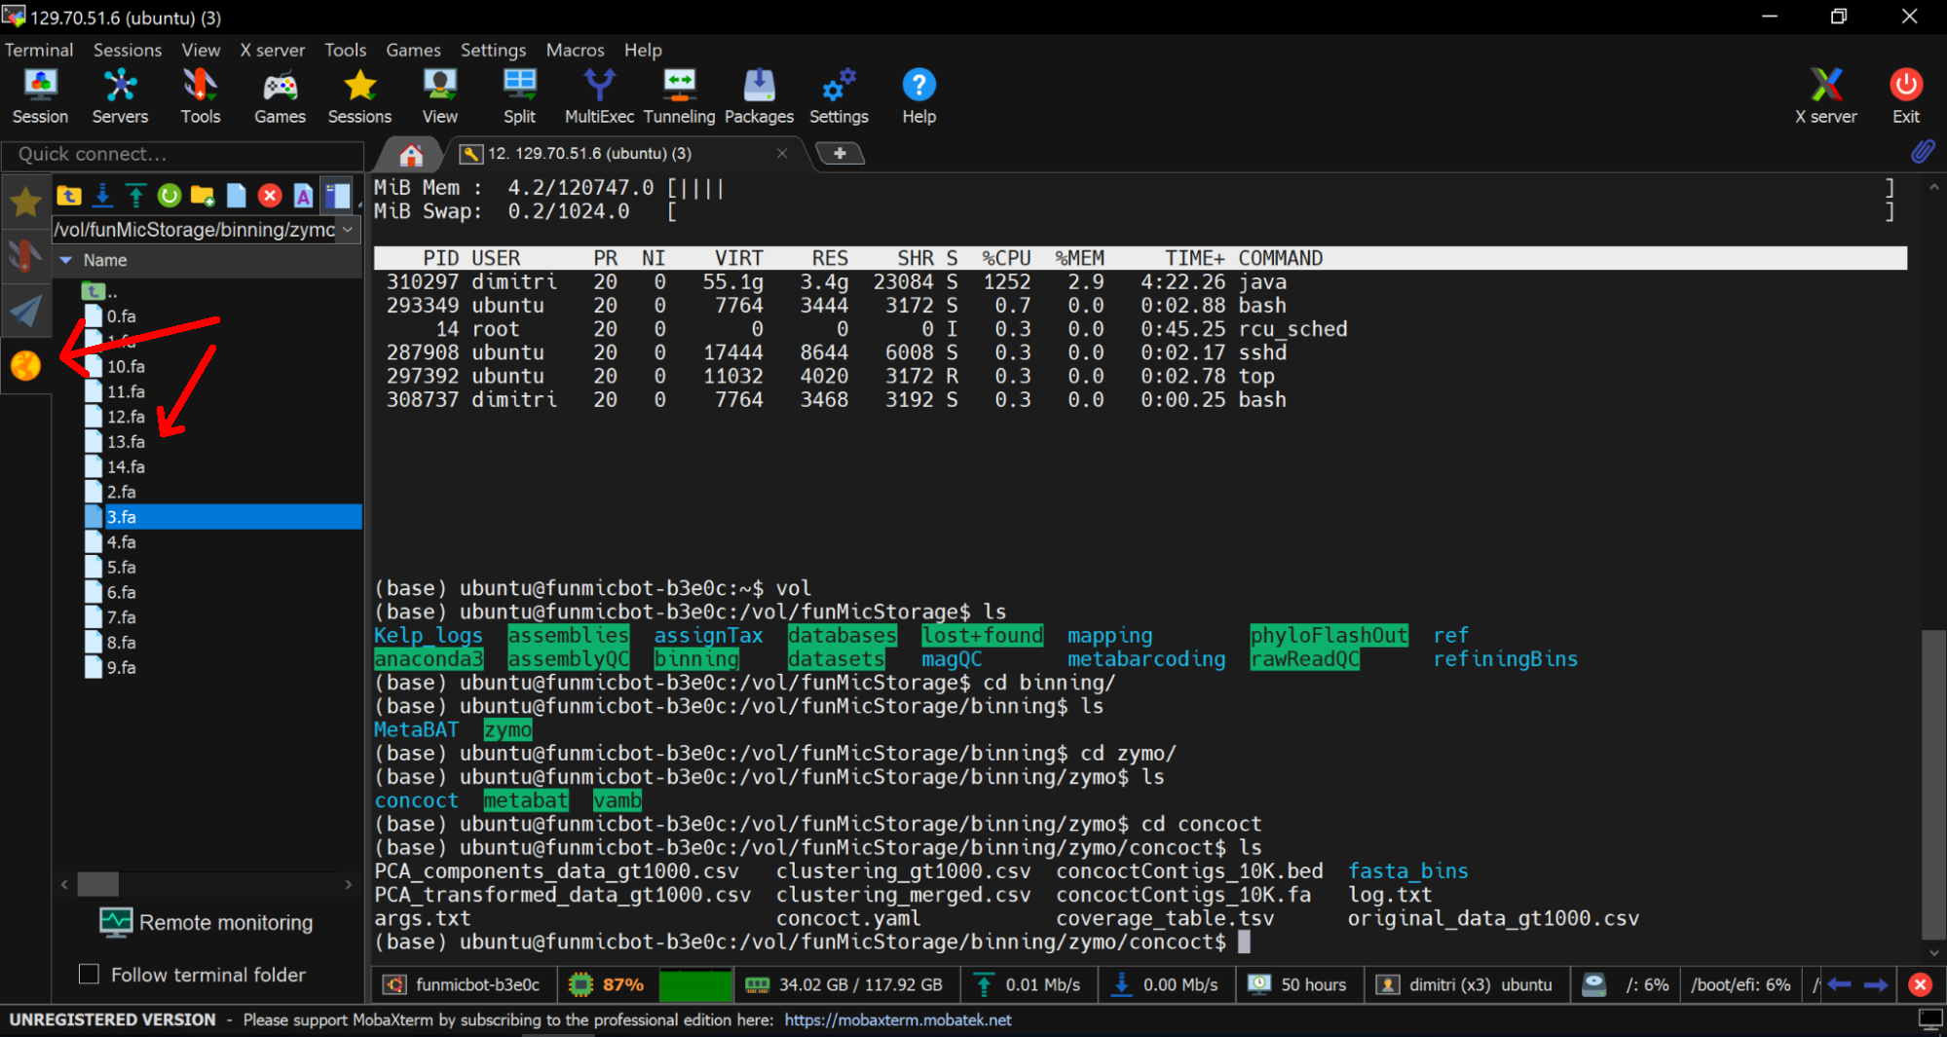
Second task: get a file from your VM to your computer
You will need to transfer files from your de.NBI virtual machine to your local computer often.

Slide 20
Second task: get a file from your VM to your computer
There are many ways to do this, but we’ll try MobaXterm’s builtin abilities.

Slide 21
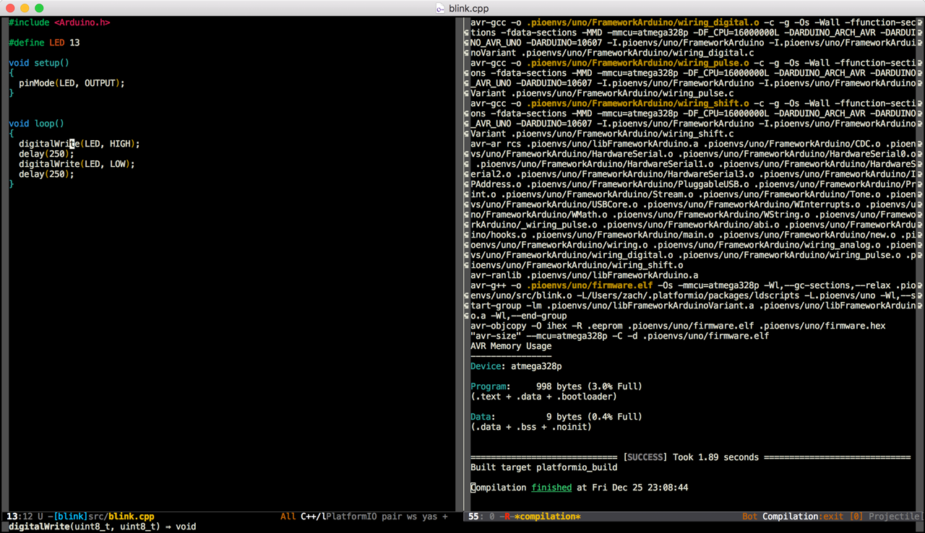
And final note: keep a script of what you do!!!
With scientific computing, it can sometimes take hours to build, debug, and successfully execute a single program, sometimes just one line of code.

Slide 22
And final note: keep a script of what you do!!!
You will often want to return to your commands days or months later. Other scientists will want to know precisely what commands and settings you used.

Slide 23



And final note: keep a script of what you do!!!
notepad-plus-plus.org
www.vim.org
www.gnu.org/software/emacs/tour/
Keep a running text-file script of all that you do. Comment it with your own mental notes so you can remember what you did and why in human language.
Pick a good text editor (not word processor!!) and learn to use it.

