Slide 1
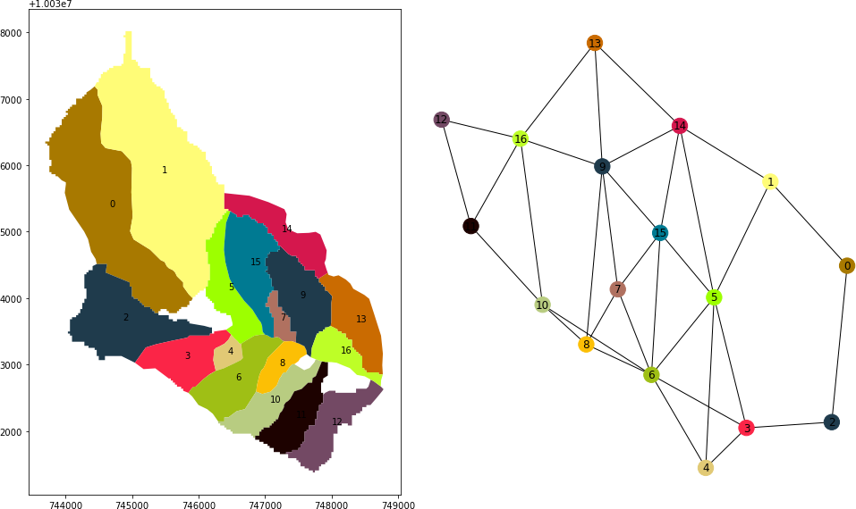
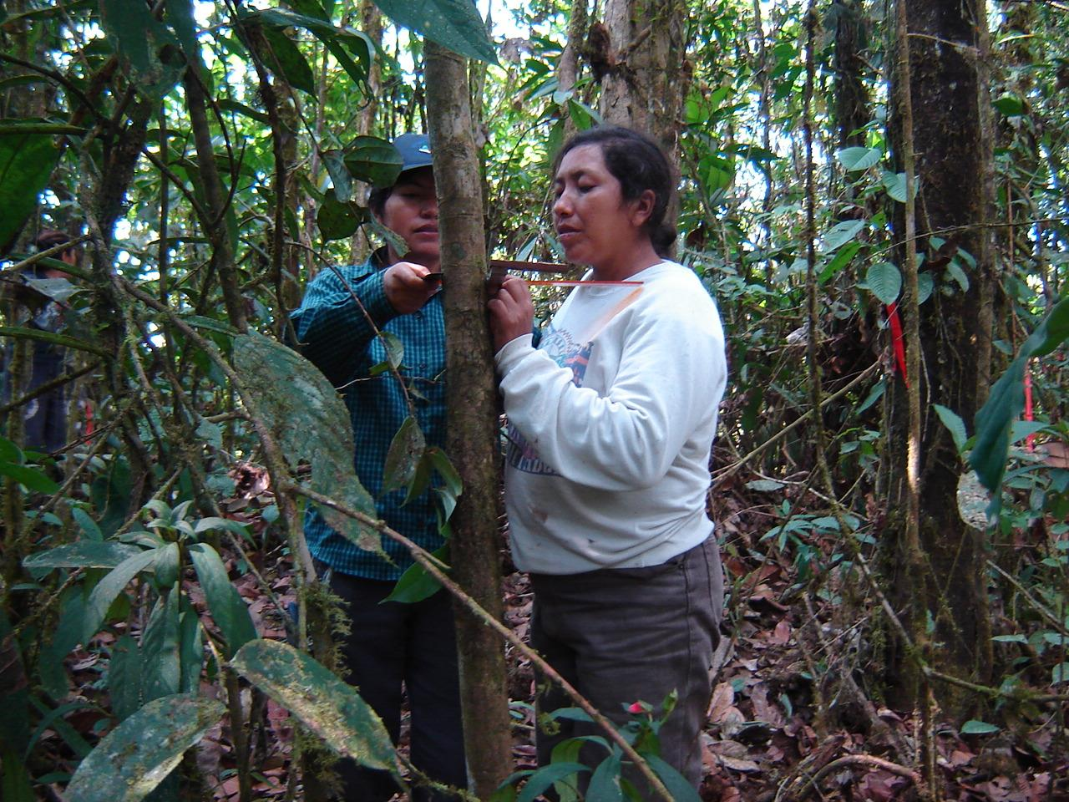
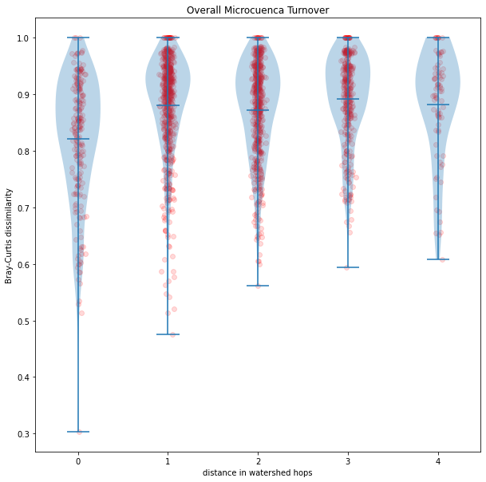
What has Dan been doing with the data?
And are we ready to start writing?

Slide 2
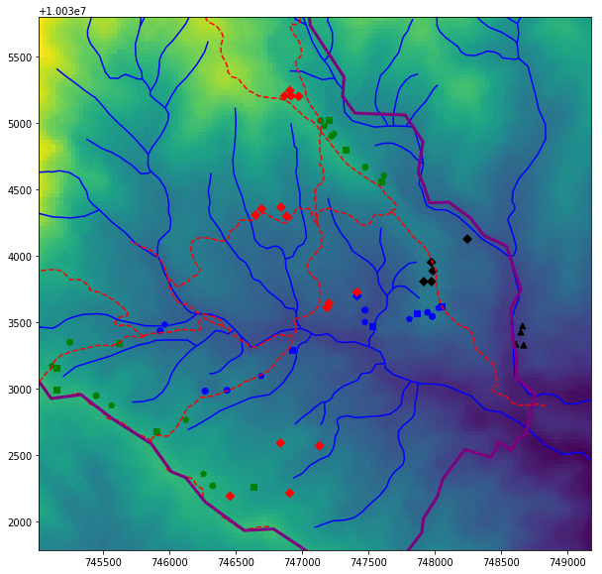
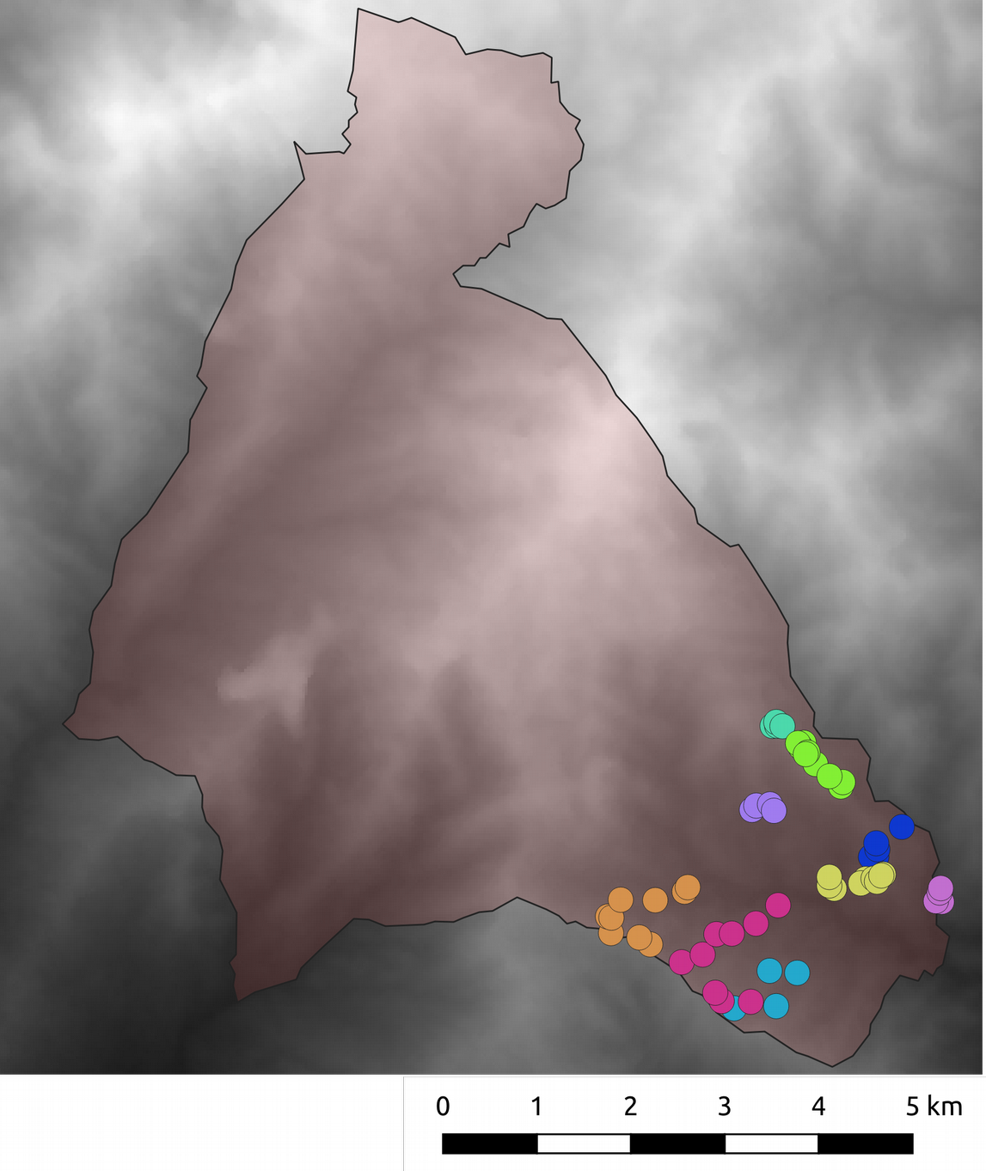
Old forest:
BC = circles
BS = pentagons
CLB = squares
Disturbed:
RCA = triangles
RG = diamonds

Slide 3
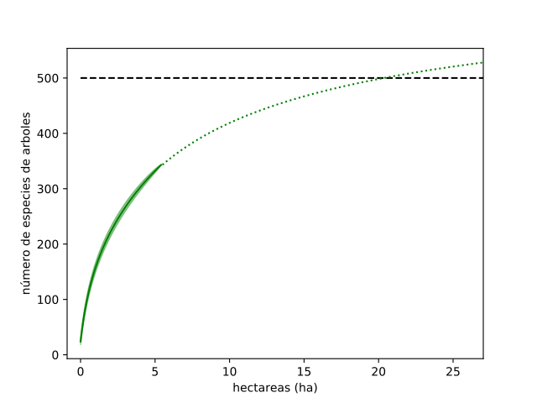
Lots of tree diversity. Among adults only, probably 500 species of tree in the southern third of Los Cedros.
 | Species | chao | chao.se | jack1 | jack1.se | jack2 | boot | boot.se | n
All sites | 343 | 516.3946 | 39.15056 | 483.6557 | 21.60728 | 566.8038 | 404.4403 | 10.54889 | 61

Slide 4
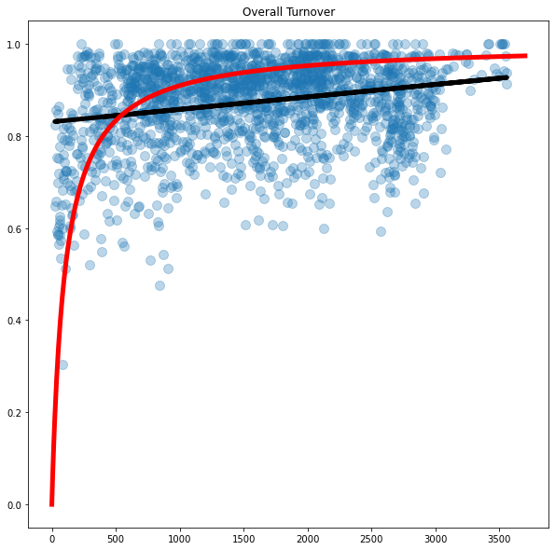
There is a spatial nature to this diversity. = Very high turnover, even sites very close to each other are very different. This tendency difference increases with distance.
Bray-Curtis dissimilarity among sites by distance (m) between sites.

Slide 5
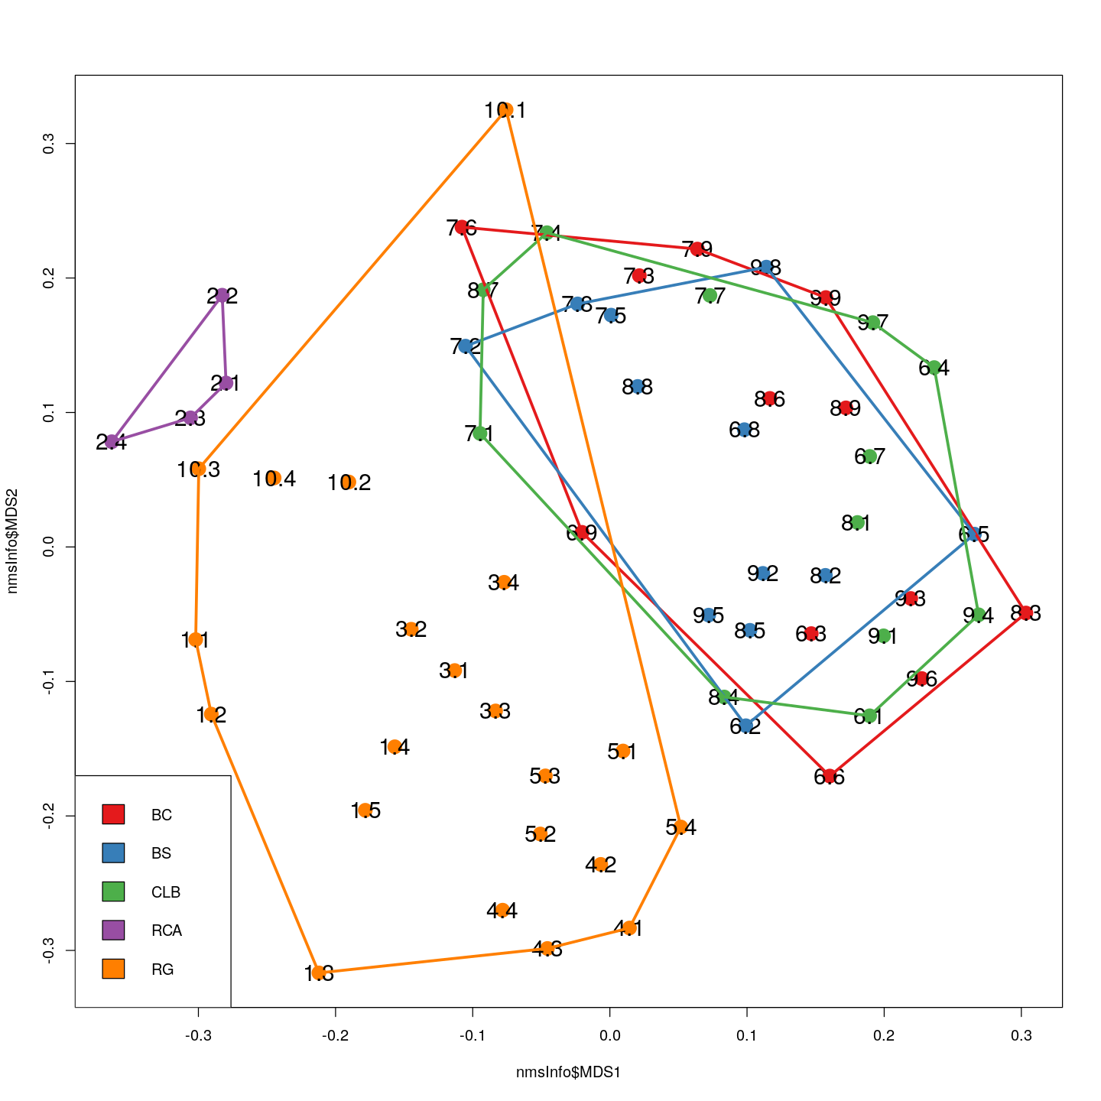
Ana’s team sampled sites with several different categories of land-use history.
“Natural” forest:
BC = bosque cerrado, undisturbed primary forest.
BS = bosque secondario, primary forest recovering from natural disturbance.
CLB = claro del bosque, natural gaps in primary forest.
Anthropogenic disturbance:
RCA = regeneración cañaveral, intensive agriculture
RG = regeneración, regenerating pastures.

Slide 6
These categories show that “natural forests” have very similar tree communities.
“Natural” forest:
BC = bosque cerrado, undisturbed primary forest.
BS = bosque secondario, primary forest recovering from natural disturbance.
CLB = claro del bosque, natural gaps in primary forest.
Anthropogenic disturbance:
RCA = regeneración cañaveral, intensive agriculture
RG = regeneración, regenerating pastures.

Slide 7
Intensive agriculture sites are very different, and regenerating pasture sites are intermediate between these two.
“Natural” forest:
BC = bosque cerrado, undisturbed primary forest.
BS = bosque secondario, primary forest recovering from natural disturbance.
CLB = claro del bosque, natural gaps in primary forest.
Anthropogenic disturbance:
RCA = regeneración cañaveral, intensive agriculture
RG = regeneración, regenerating pastures.

Slide 8
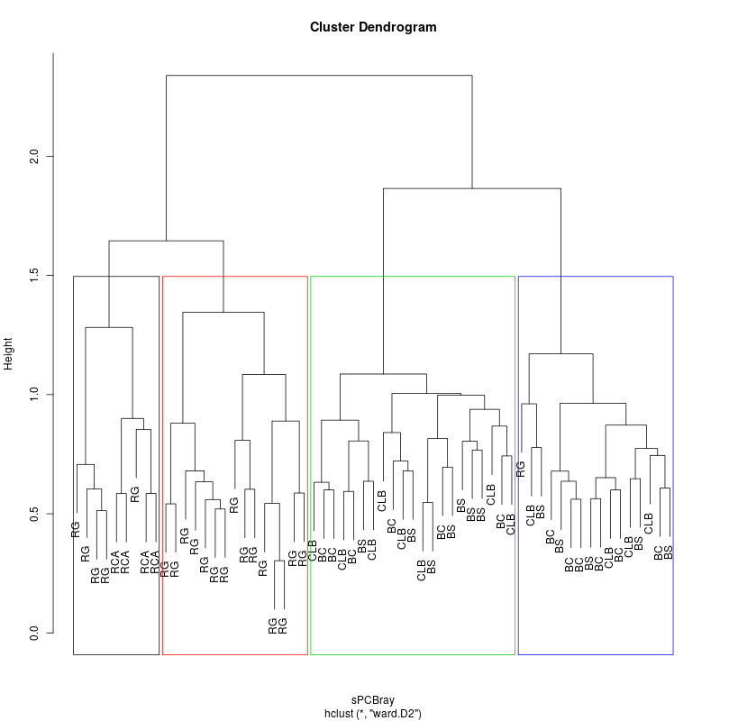
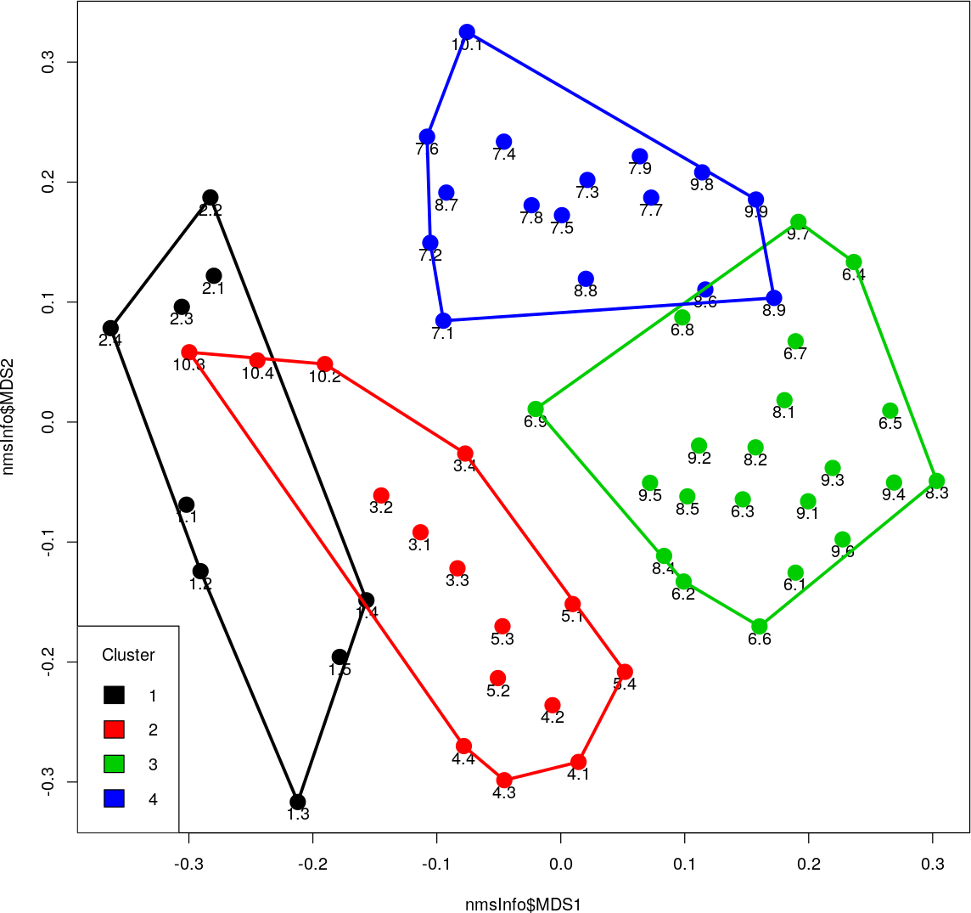
We can run an unsupervised clustering process on the sites, and 4 types of sites seem to emerge:

Slide 10
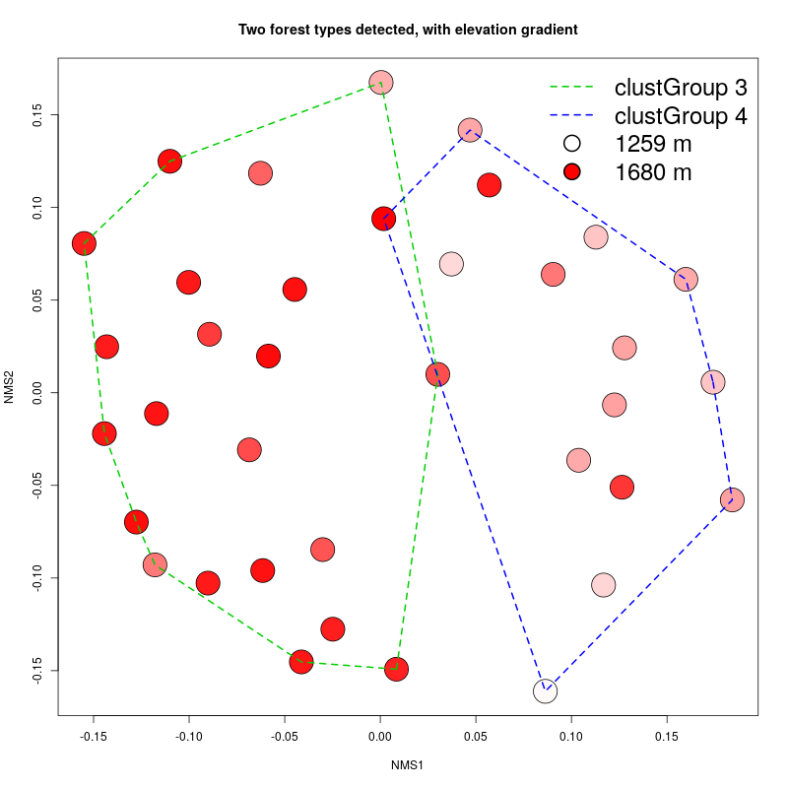
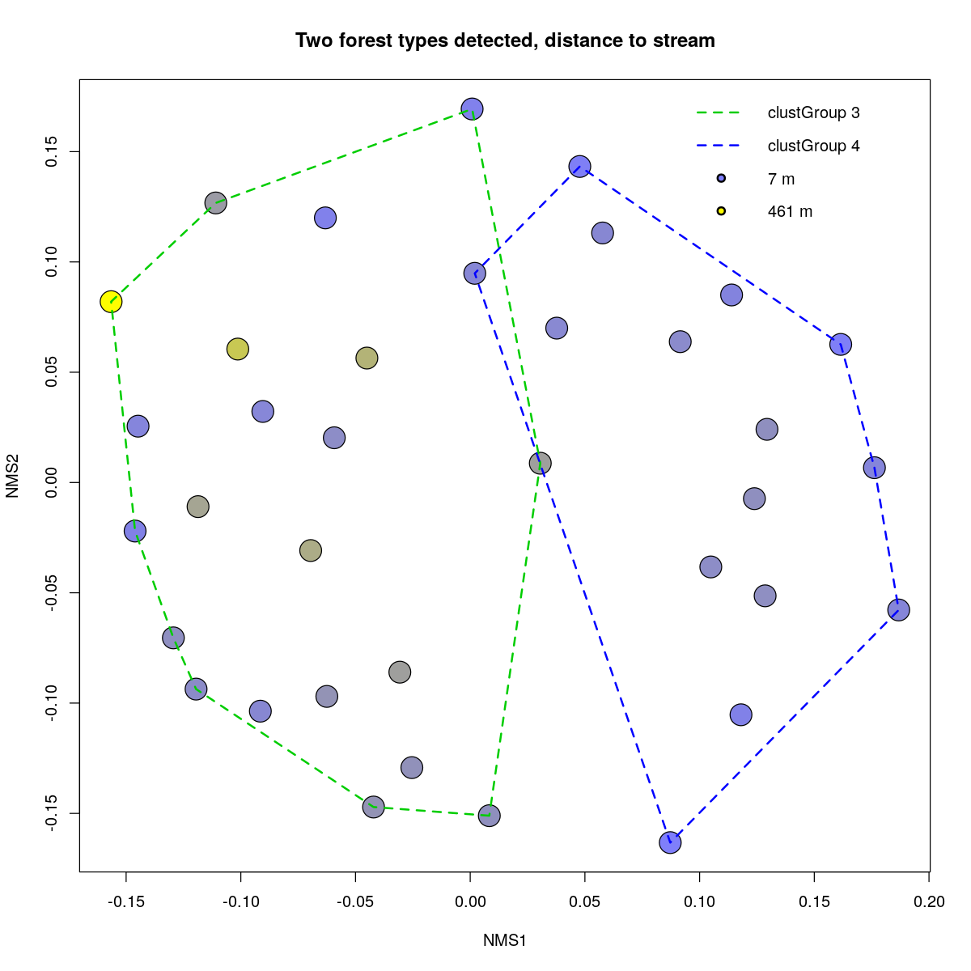
Old forests – two types. Why?

Slide 11
In each of these categories of mature trees, both land use history categories and among cluster groups, we can pick up indicator species.
This is not the case with the juvenile trees (these data are discussed below).

Slide 12
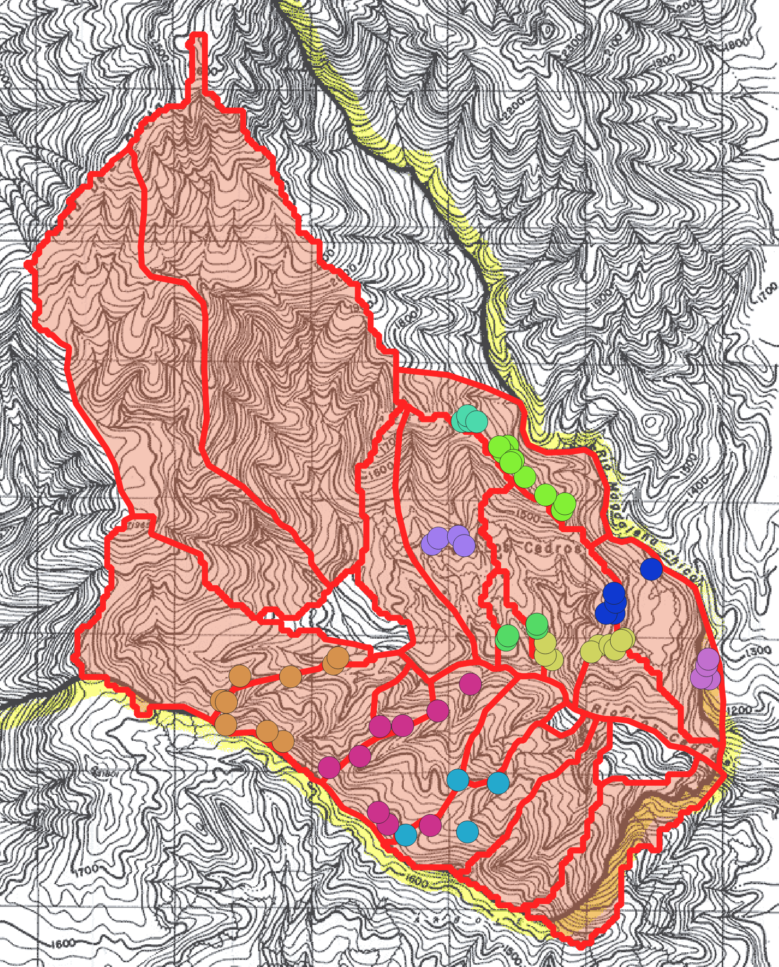
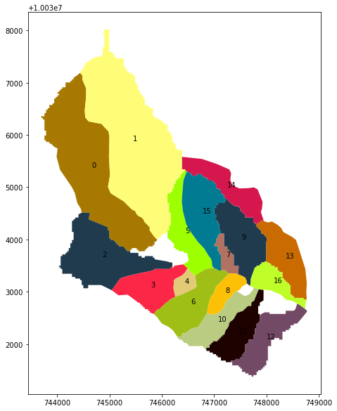
We can also view this ecological turnover in terms of watersheds.

Slide 15

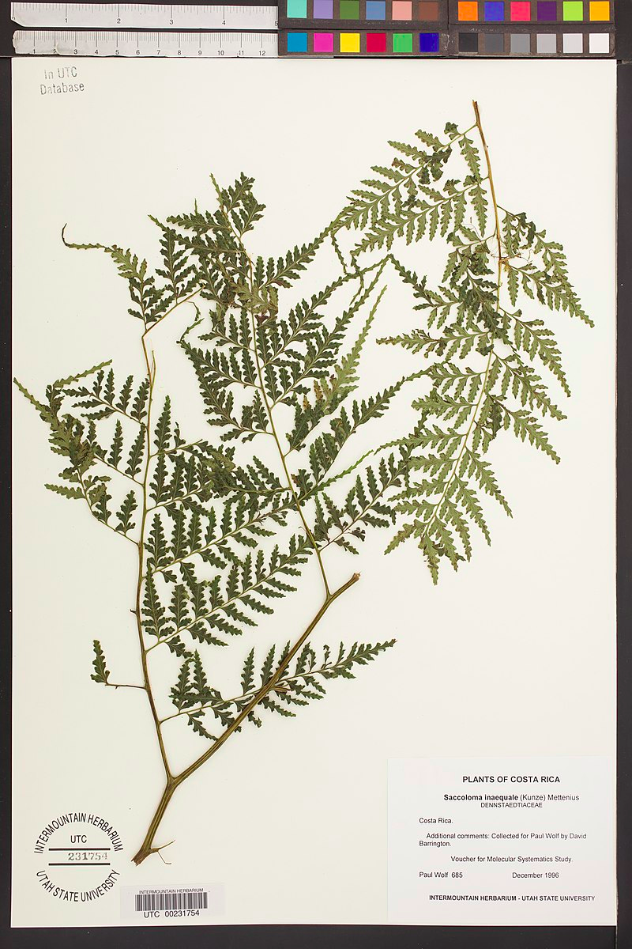

Juvenile data had to be cleaned up a bit, all data were checked against the growth form data in the TRY database, the STRI herbarium, and the Gentry manual. Had to throw out observations of plants that seemed unlikely to mature into a tree as defined in the other portion of the study (the mature tree observations).
Saccoloma sp.

Slide 16
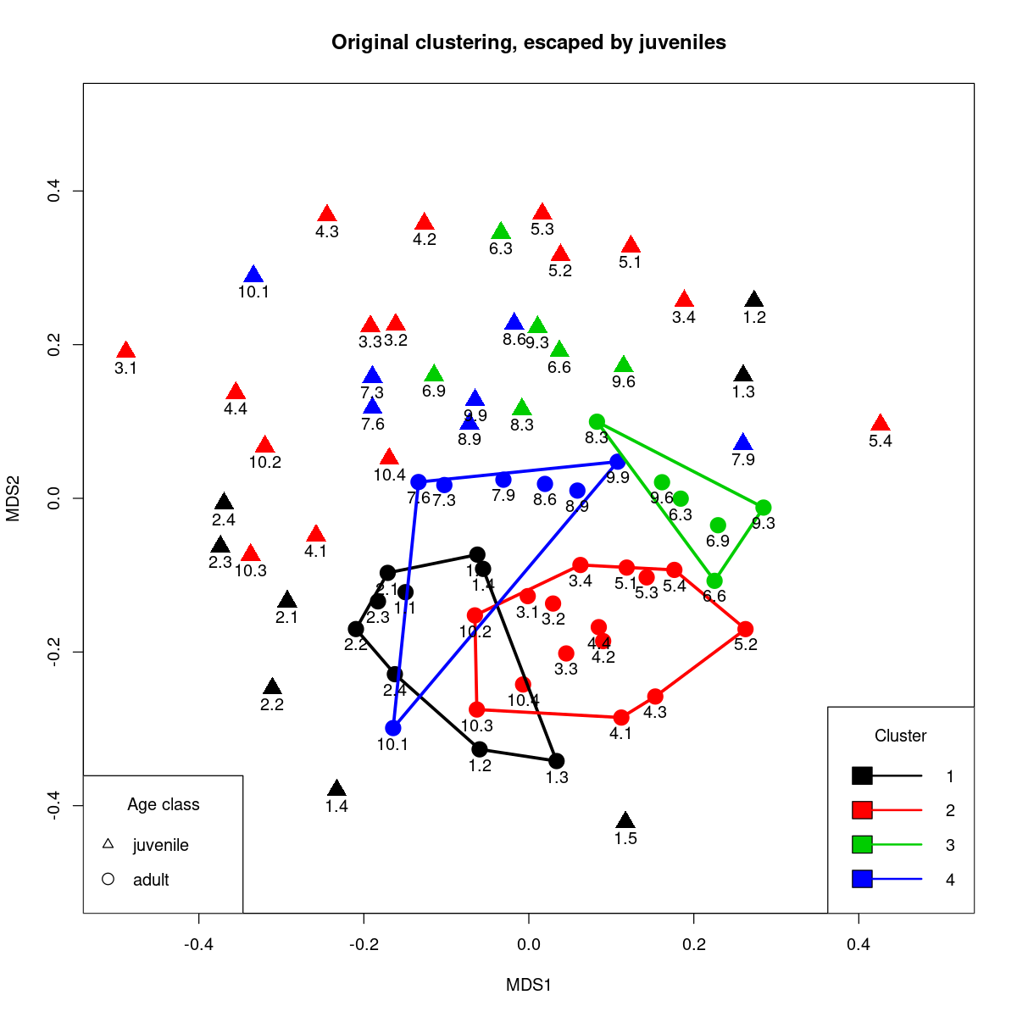
The juvenile tree communities don’t cluster simply, unlike the older trees.

Slide 17
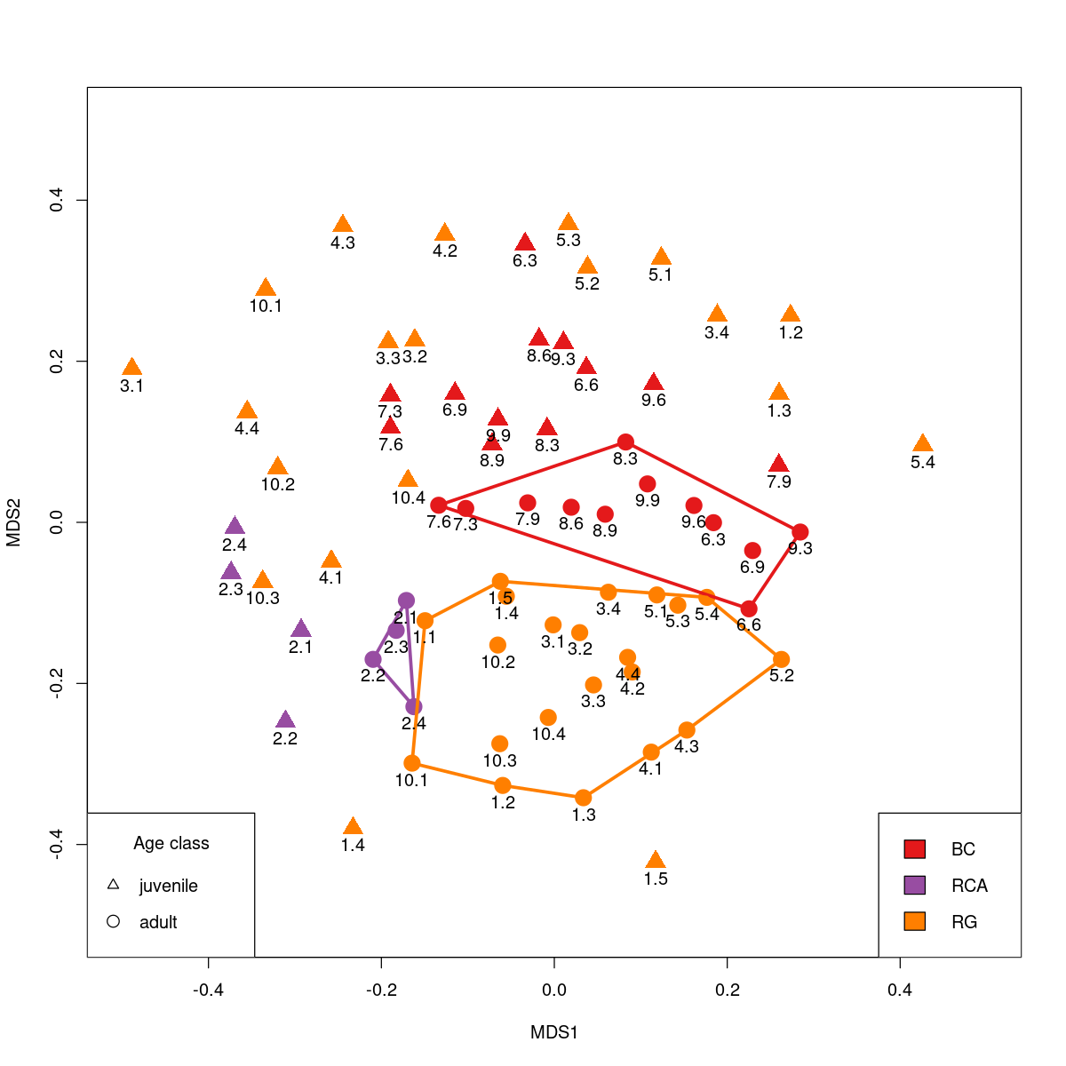
Disturbance regime does seem to predict two different poles of attraction for these dynamics. Heavily impacted sites seem to be progressing along a different successional trajectory than the more “natural sites”. But all sites, even old-forest sites, are changing.

Slide 18
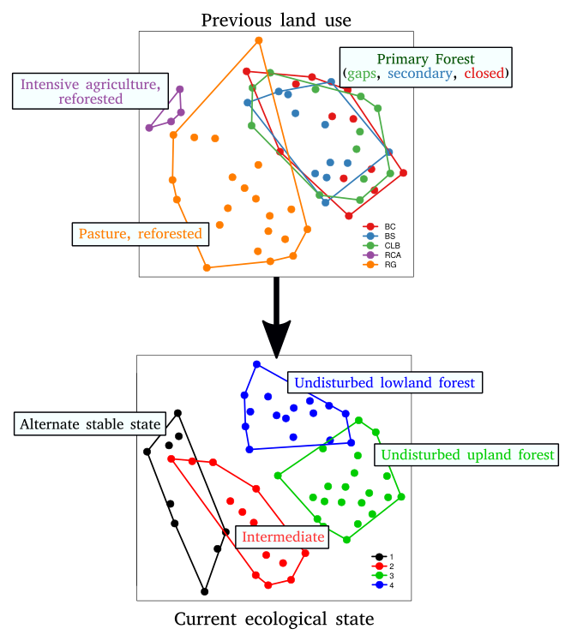
General story:
Forest seems to be following different successional trajectories based on their type of disturbance. All the classical ideas of forest succession seem to mostly apply to the “natural” disturbances, i.e. recreating the climax forest after disturbance.
Further complicating this, the next generation of tree communities of the entire forest seem to be changing, perhaps along two successional paths (anthropogenic vs. natural disturbance). But regardless, even primary forest sites are possibly changing into something very different than the historical forest. Climate change?

Slide 19
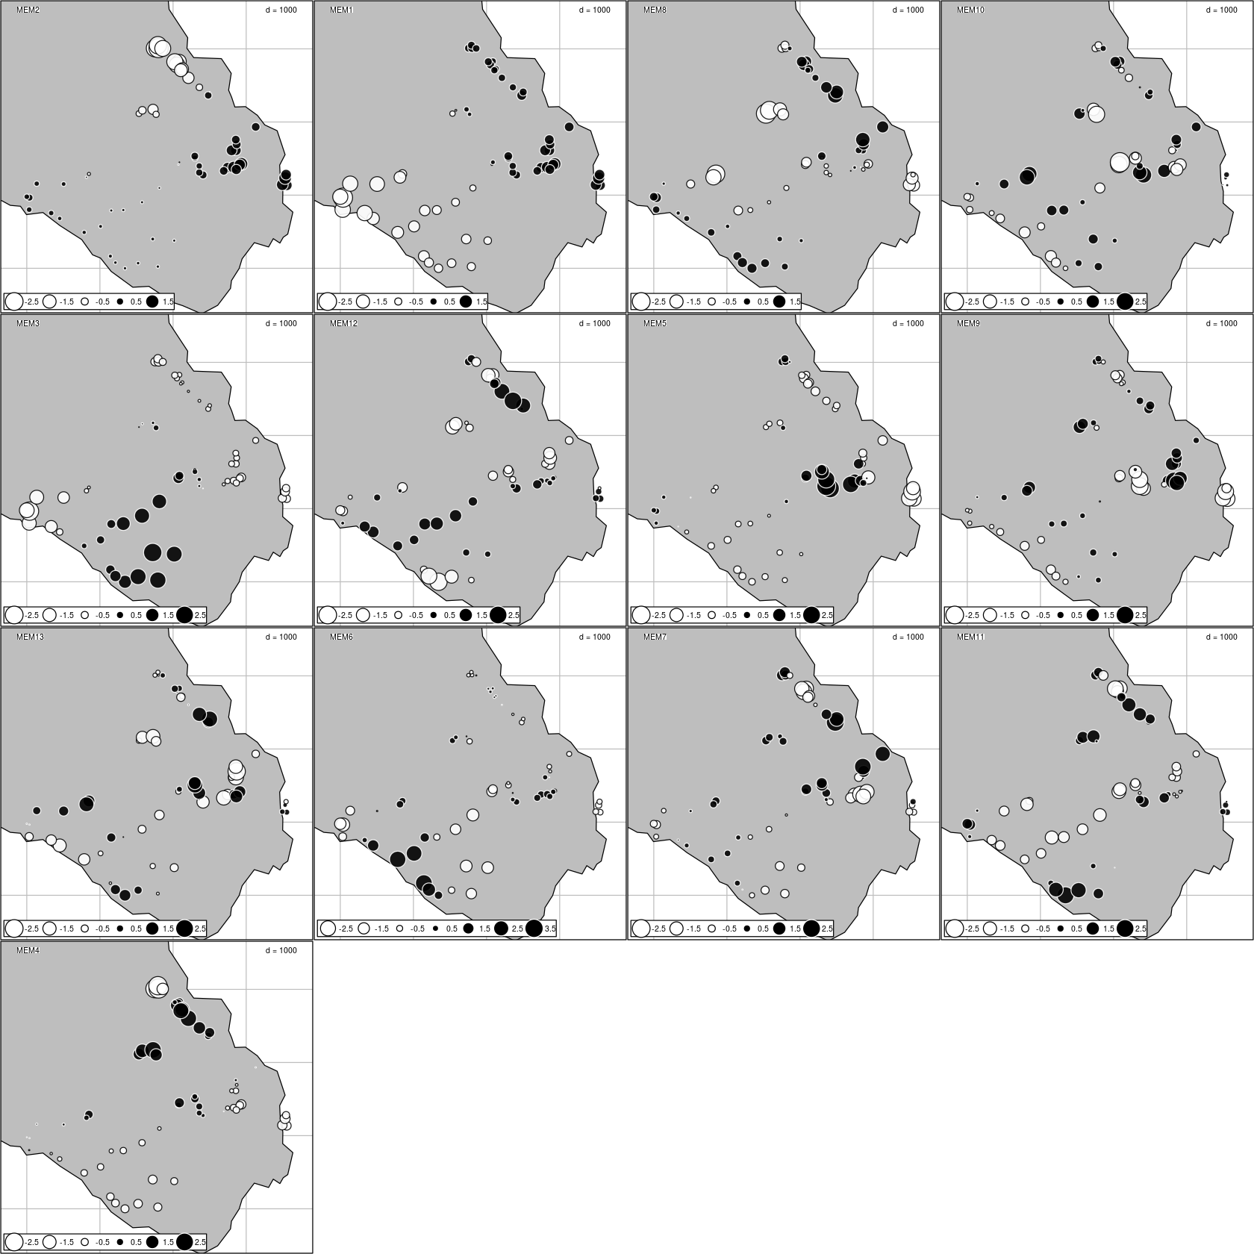
To do:
- finish MEM models
- fit a model to turnover
MEMs are spatial patterns in correlated with changes in plant community, that are detected by algorithms. The ones shown here are statistically significant, but I have not checked them for correlations with our environmental data or land use history. Needs to be done.

Slide 20
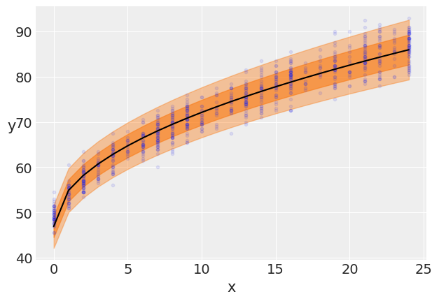
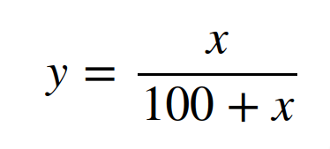
To do:
- finish MEM models
- fit a model to turnover

Slide 21
Can we start writing with this?

