Slide 1
Enhancing Your Processes and Flows with Apex

Slide 2
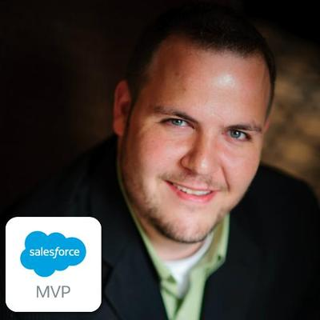
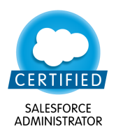
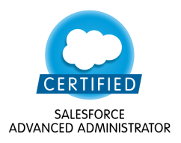
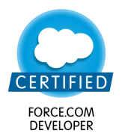

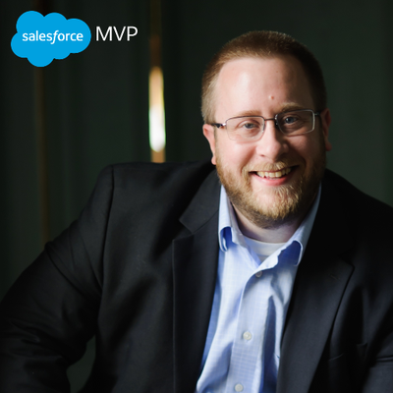
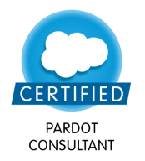
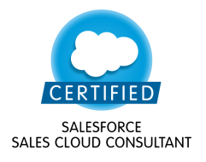


James Loghry
Principle Architect, EDL Consulting
Salesforce MVP
Andrew Boettcher
Chief Architect, Demand Chain Systems
Salesforce MVP

Slide 3
Safe Harbor Statement

Slide 4
Copyright

Slide 5
Introduction
What are Processes?
What are Flows?
When Declarative isn’t Enough
Introducing the @InvocableMethod
Hands-On Exercises

Slide 6
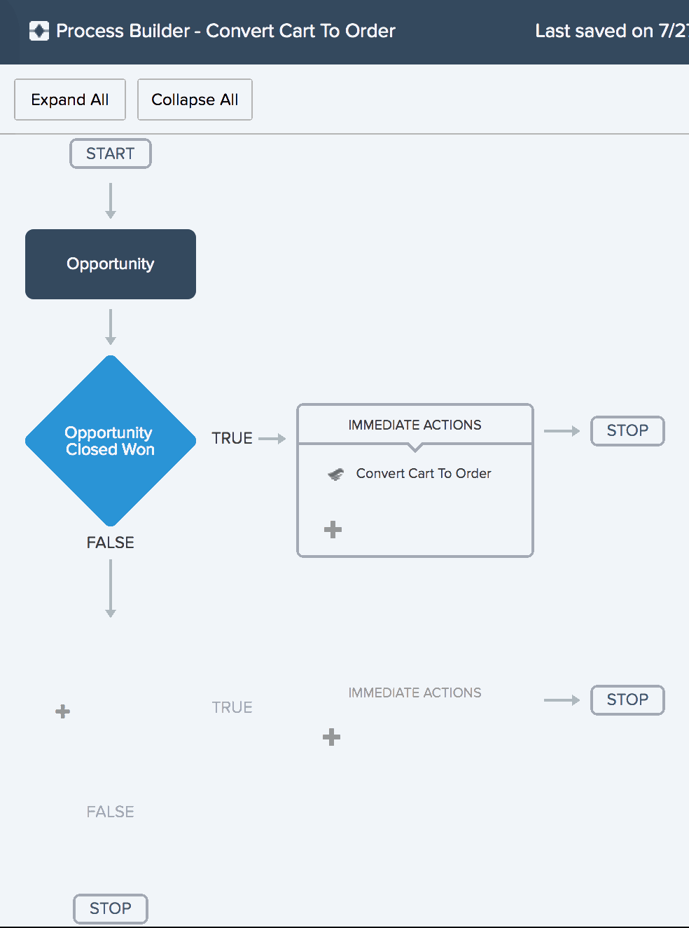
What are Processes?
Declarative workflow tool for automating business processes based on record creates and edits
“Workflow 2.0”
Ability to execute immediately or as scheduled action
Built using Process Builder
Processes can:
Create a record
Update related records
Execute quick actions
Post to Chatter
Submit records for approval
Send an email
Launch a Flow!
Notes:
Highlight that the exercises today will be highlighted around the Launching Flow capability.

Slide 7
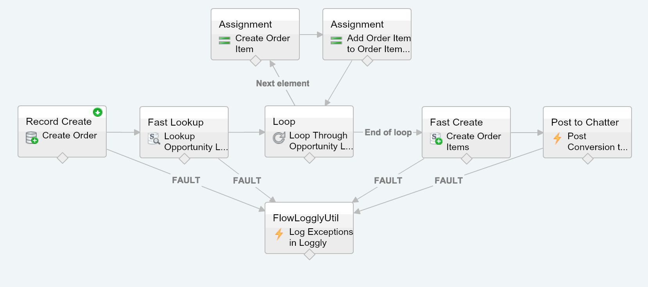
What are Flows?
Manage business processes declaratively
Flows executed from:
Visual Flow
Apex / Visualforce
Login Flow
User provisioning flow
Processes
Flows can:
Query single or multiple records
Create and Update single or multiple records
Loop over collections
Post to Chatter
Call Subflows
Handle faults!
Call Apex code!
Notes:
Highlight that the exercises today will be highlighted around the Launching Flow capability.

Slide 8
When Declarative isn’t Enough
Processes and Flows are very powerful, and give Awesome Admins super powers.
However, Processes don’t handle bulk data loads.
Processes nor Flows alone cannot handle:
Record deletes
Callouts to external systems
Upserts with External Ids
Describes
Other special use cases
Complicated logic is difficult to implement in Flows.
However, Flows can call Apex!

Slide 9
Introducing the @InvocableMethod
Adding the @InvocableMethod annotation to an Apex method enables it for Processes, Flows, and REST services.
Invocable methods must:
Be either public static or global static
Contain a list of primitives, sObjects, or user-defined types
Return a list of primitives, sObjects, or user-defined types
Global invocable methods can be used in Flows outside of a managed package
With user-defined types, use @InvocableVariable for variables
Like any Apex, invocable methods need unit tests and code coverage.
1
2
3
4
5
6
7
8
9
10
public class AccountQueryAction {
@InvocableMethod(label='Get Names' description='Returns names')
public static List<String> getAccountNames(List<ID> ids){
List<String> accountNames = new List<String>();
for (Account account : [SELECT Name FROM Account WHERE Id in :ids]){
accountNames.add(account.Name);
}
return accountNames;
}
}

Slide 10
Exercises

Slide 11


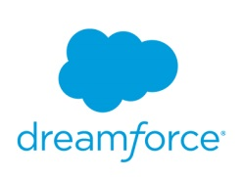

Training Org Login
Username: admin@df15functionsA###.com
Password: functions2015
Example:
Your computer number = 010
Your username = admin@df15functionsA010.com
For ###: use the 3-digit number located on your computer.
username
password
Username: admin@df15sessionname###.com
Password: password2015
Dreamforce ’15
Exercise Guide
Org will be active for 30 days post Dreamforce
Lab Files: download from documents tab in your org
010

Slide 12
1: Create an Apex method that can be called from Flows
EXERCISE
Scenario:
Mike, a developer with Universal Containers, needs to log exceptions that are resulting from his commerce Sales process. Mike wishes to utilize a third party system called Loggly for monitoring and tagging the logs. Because the system requires a callout, Mike must integrate Apex into his Sales process, which is implemented through a Process and a Flow.
Time: 15 minutes
Goal:
Learn how to define an Apex class and method for use in a Flow.
Tasks:
Sign up for a Loggly Account.
Configure Loggly for Salesforce.
Update the FlowLogglyUtil class for use in Flows.
Notes:
If you’re not using exercises, you can ignore this.

Slide 13
2: Update a flow to handle faults using Apex
EXERCISE
Scenario:
Mike, the developer at Universal Containers, would like to use a combination of declarative and custom functionality for implementing a simple business process where Opportunities, which are marked as Closed Won, are converted into Order records. To implement this requirement, Mike is designing a solution that utilizes Flow, Processes, and Apex and using a mixture of both clicks and code.
Time: 10 minutes
Goal:
Learn how Apex can be used for extending the capability of a Flow.
Tasks:
Open the Order Processing Flow.
Connect the fault paths to the FlowLogglyUtil element.
Save and activate the flow.
Notes:
If you’re not using exercises, you can ignore this.

Slide 14
3: Create a Process to call the Order Processing Flow
EXERCISE
Scenario:
When Opportunities are Closed / Won, Universal containers would like to convert the Opportunities into Orders for invoicing and tracking.
Time: 10 minutes
Goal:
In this exercise you will learn how to execute Apex in processes as well as learn how flows can be used in conjunction with processes to implement complex logic.
Tasks:
Create a Process that executes when an Opportunity is updated to Closed / Won.
Add an Apex action to the process for logging the Opportunity in Loggly.
Save and activate the process.
Notes:
If you’re not using exercises, you can ignore this.

Slide 15
4: Test the Process, Flow, and Invocable Method
EXERCISE
Scenario:
Sarah, a sales rep in Universal Containers has just closed a big deal. Universal’s process converts the Opportunities to Orders. When Sarah marks the Opportunity record as Closed, Won, the Opportunity and its line items will be converted to Orders and Order Item records and linked back to the Opportunity.
If the sales rep closes a deal where a customer has purchased more than 10 of a particular product, then a validation rule prevents that product from being recorded in Salesforce and the exception is logged in Loggly.
Time: 15 minutes
Goal:
Test that the Apex, Flow, and Process work as expected.
Tasks:
Create an Opportunity, update its Stage to “Closed/Won” and verify the Flow and Process copy the Opportunity record details to a new Order record.
Omit the Opportunity’s Account, testing that a Flow Fault occurs and logs the Fault in Loggly
Notes:
If you’re not using exercises, you can ignore this.

Slide 17

What’s Next?
Thank you for attending!
Your satisfaction is very important to us. Click on the Course Survey link located on the Home Page of your training org to give us your feedback.
Get certified! Go to www.webassessor.com/salesforce to register.
Take the next step! Register for the next course! Go to www.salesforce.com/training.

Slide 18


Salesforce University
Training and Certification Resources
Training Webpage: www.salesforce.com/training
Certification Webpage: certification.salesforce.com
Follow us on Twitter: @SalesforceU
Salesforce Success Community:
Log in to Salesforce → Help & Training → Collaboration
© Copyright 2015 salesforce.com, inc. All rights reserved. Various trademarks held by their respective owners.

