Slide 2
Agenten und Simulation von AL
Exkurs: Hierarchical Temporal Memory
Simulation von Anwendungslandschaften
Problem Statement
Roadmap

Slide 3
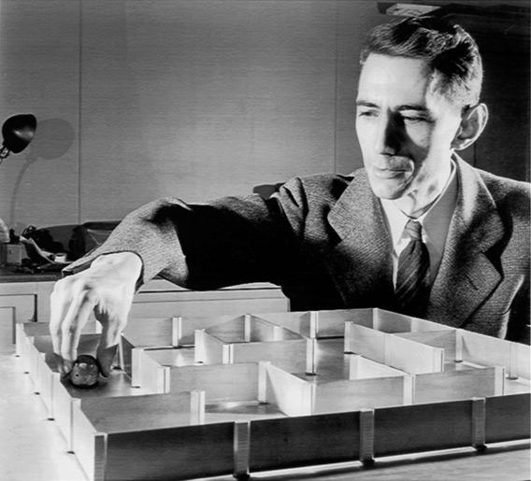

Slide 4
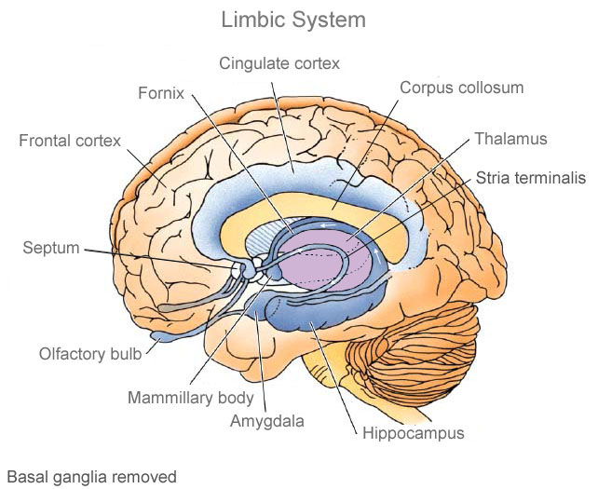

Slide 5
„Alle“ Tiere

Slide 6
Säugetiere
„Alle“ Tiere

Slide 7
Neocortex
Hippocampus
Motorsignale +
Sinnessignale
Thalamus
Motorsignale
Motorsignale
Sinnessignale

Slide 8
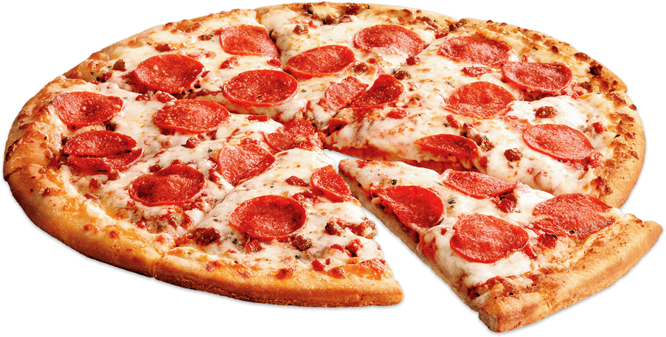
Neocortex
Hippocampus
Motorsignale +
Sinnessignale
Thalamus
Motorsignale
Motorsignale
Sinnessignale

Slide 9
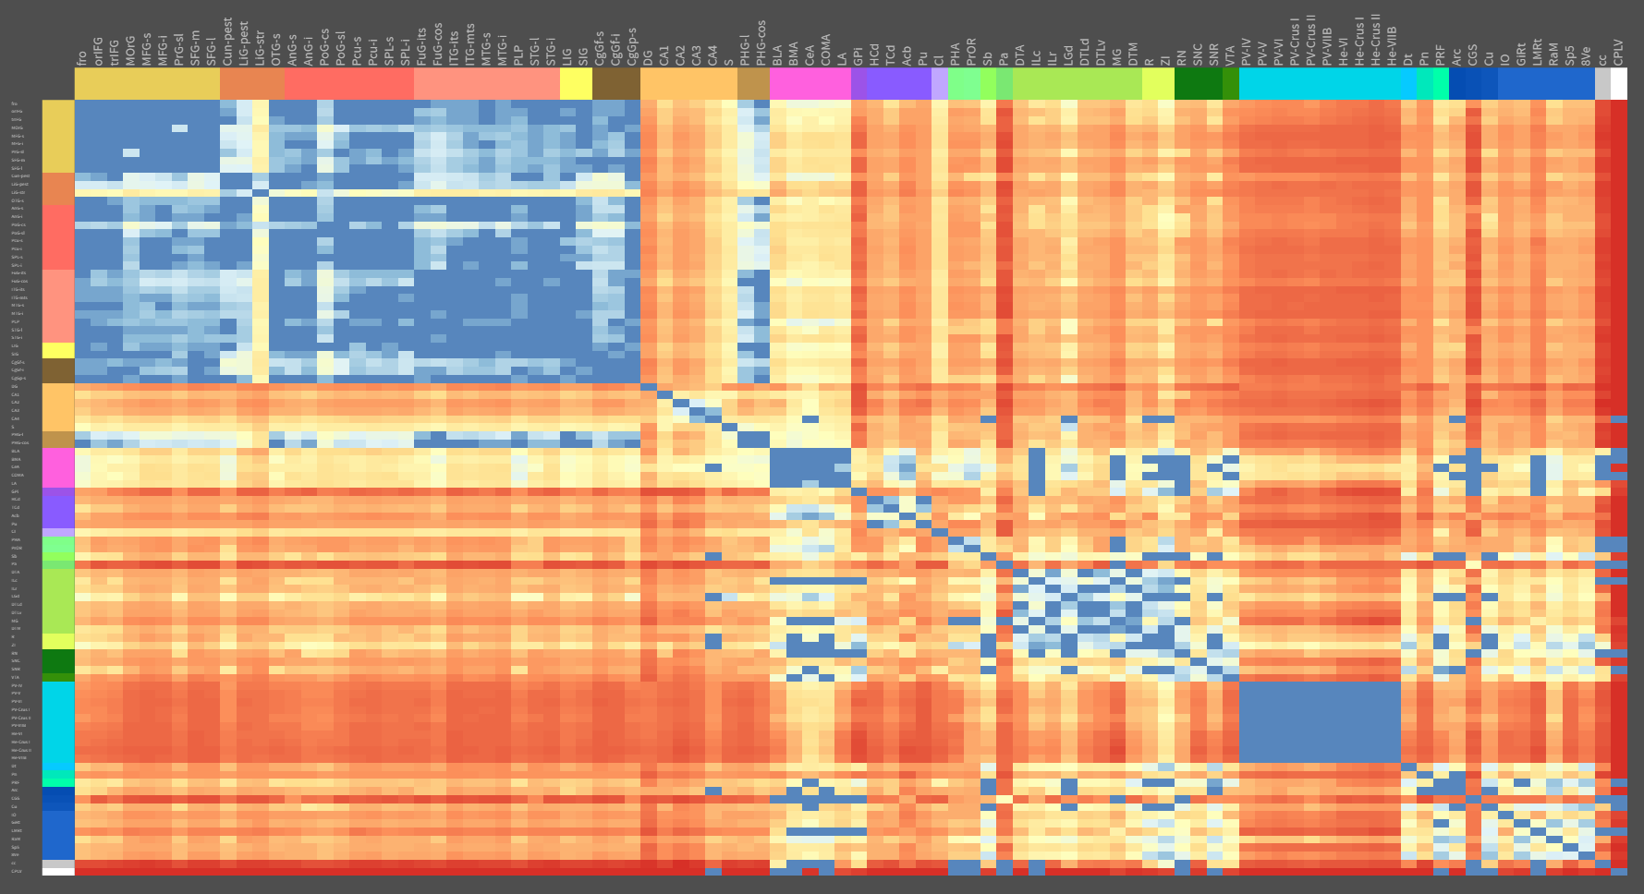

Slide 10
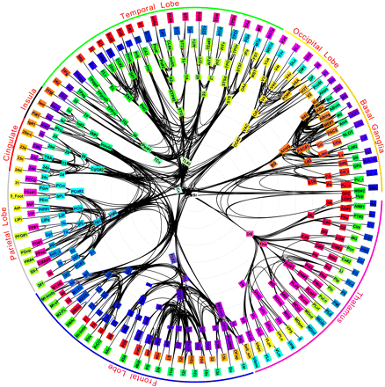

Slide 11
Unser Neocortex-Modell bisher
Region
Region
Region
Region
Region
Region
Region
Region
Region

Slide 12
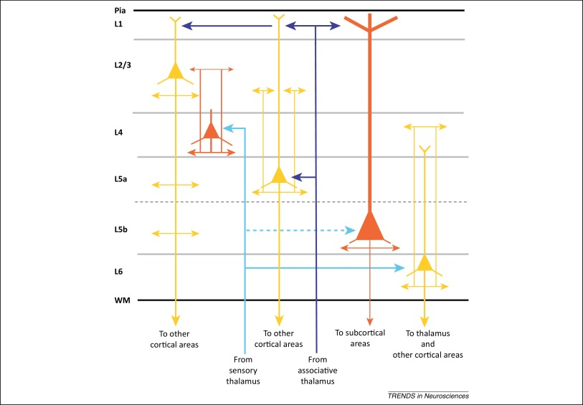
Schichten im Neocortex
Region

Slide 13
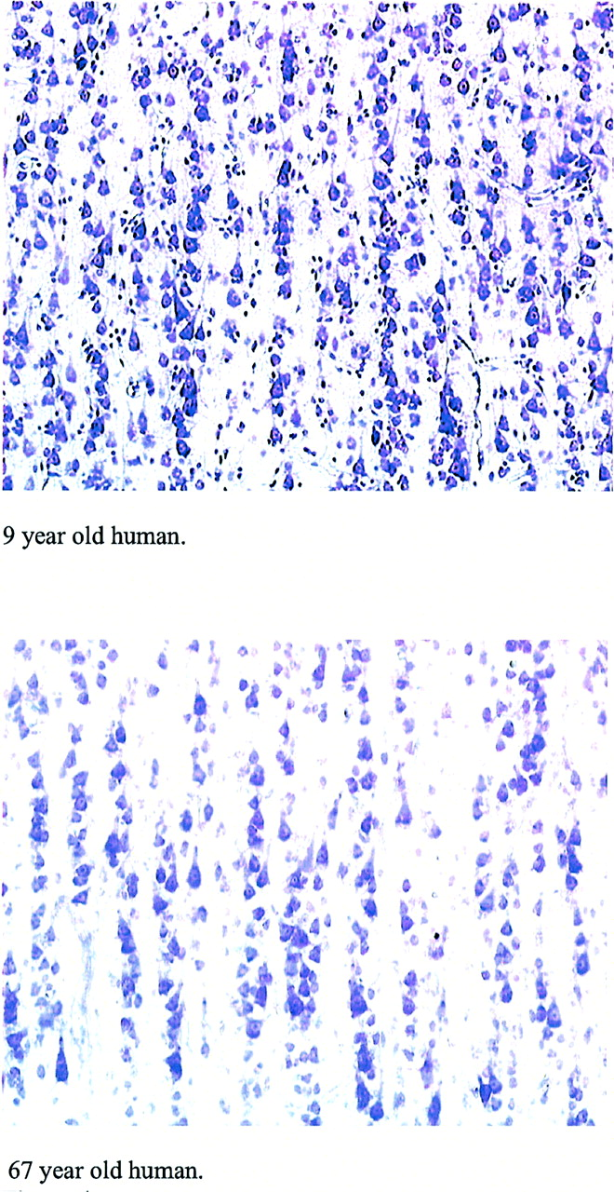
Minicolumns im Neocortex

Slide 14
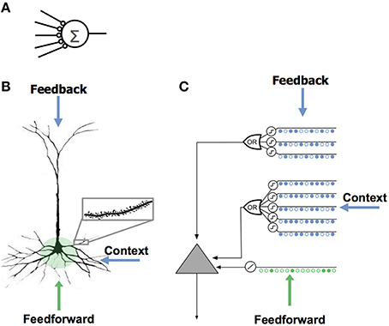
Neuronenmodelle
Hawkins, Ahmad (2016)

Slide 15
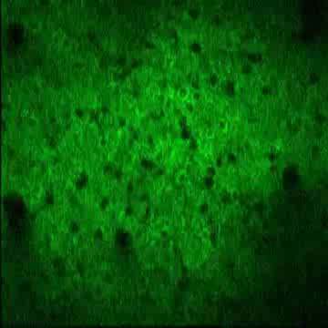
Sparse Distributed Representations

Slide 16
Firing
 | A | B | C | D | E | F | G | H | I | J | K | L
A | 0 | 0 | 0 | 0 | 0 | 0 | 0 | 0 | 0 | 0 | 0 | 0
B | 0 | 0 | 0 | 0 | 0 | 0 | 0 | 0 | 0 | 0 | 0 | 0
C | 0 | 0 | 0 | 0 | 0 | 0 | 0 | 0 | 0 | 0 | 0 | 0
D | 0 | 0 | 0 | 0 | 0 | 0 | 0 | 0 | 0 | 0 | 0 | 0
E | 0 | 0 | 0 | 0 | 0 | 0 | 0 | 0 | 0 | 0 | 0 | 0
F | 0 | 0 | 0 | 0 | 0 | 0 | 0 | 0 | 0 | 0 | 0 | 0
G | 0 | 0 | 0 | 0 | 0 | 0 | 0 | 0 | 0 | 0 | 0 | 0
H | 0 | 0 | 0 | 0 | 0 | 0 | 0 | 0 | 0 | 0 | 0 | 0
I | 0 | 0 | 0 | 0 | 0 | 0 | 0 | 0 | 0 | 0 | 0 | 0
J | 0 | 0 | 0 | 0 | 0 | 0 | 0 | 0 | 0 | 0 | 0 | 0
K | 0 | 0 | 0 | 0 | 0 | 0 | 0 | 0 | 0 | 0 | 0 | 0
L | 0 | 0 | 0 | 0 | 0 | 0 | 0 | 0 | 0 | 0 | 0 | 0
Predictive
Inactive
A
B
C
D
E
F
G
H
I
J
K
L

Slide 17
Firing
 | A | B | C | D | E | F | G | H | I | J | K | L
A | 0 | 0 | 0 | 0 | 0 | 0 | 0 | 0 | 0 | 0 | 0 | 0
B | 0 | 0 | 0 | 0 | 0 | 0 | 0 | 0 | 0 | 0 | 0 | 0
C | 0 | 0 | 0 | 0 | 0 | 0 | 0 | 0 | 0 | 0 | 0 | 0
D | 0 | 0 | 0 | 0 | 0 | 0 | 0 | 0 | 0 | 0 | 0 | 0
E | 0 | 0 | 0 | 0 | 0 | 0 | 0 | 0 | 0 | 0 | 0 | 0
F | 0 | 0 | 0 | 0 | 0 | 0 | 0 | 0 | 0 | 0 | 0 | 0
G | 0 | 0 | 0 | 0 | 0 | 0 | 0 | 0 | 0 | 0 | 0 | 0
H | 0 | 0 | 0 | 0 | 0 | 0 | 0 | 0 | 0 | 0 | 0 | 0
I | 0 | 0 | 0 | 0 | 0 | 0 | 0 | 0 | 0 | 0 | 0 | 0
J | 0 | 0 | 0 | 0 | 0 | 0 | 0 | 0 | 0 | 0 | 0 | 0
K | 0 | 0 | 0 | 0 | 0 | 0 | 0 | 0 | 0 | 0 | 0 | 0
L | 0 | 0 | 0 | 0 | 0 | 0 | 0 | 0 | 0 | 0 | 0 | 0
Predictive
Parameter
Bonus: 1.0
Malus: 0.1
Threshold: 0.5
Inactive
A
B
C
D
E
F
G
H
I
J
K
L

Slide 18
Firing
 | A | B | C | D | E | F | G | H | I | J | K | L
A | 0 | 0 | 0 | 0 | 0 | 0 | 0 | 0 | 0 | 0 | 0 | 0
B | 0 | 0 | 0 | 0 | 0 | 0 | 0 | 0 | 0 | 0 | 0 | 0
C | 0 | 0 | 0 | 0 | 0 | 0 | 0 | 0 | 0 | 0 | 0 | 0
D | 0 | 0 | 0 | 0 | 0 | 0 | 0 | 0 | 0 | 0 | 0 | 0
E | 0 | 0 | 0 | 0 | 0 | 0 | 0 | 0 | 0 | 0 | 0 | 0
F | 0 | 0 | 0 | 0 | 0 | 0 | 0 | 0 | 0 | 0 | 0 | 0
G | 0 | 0 | 0 | 0 | 0 | 0 | 0 | 0 | 0 | 0 | 0 | 0
H | 0 | 0 | 0 | 0 | 0 | 0 | 0 | 0 | 0 | 0 | 0 | 0
I | 0 | 0 | 0 | 0 | 0 | 0 | 0 | 0 | 0 | 0 | 0 | 0
J | 0 | 0 | 0 | 0 | 0 | 0 | 0 | 0 | 0 | 0 | 0 | 0
K | 0 | 0 | 0 | 0 | 0 | 0 | 0 | 0 | 0 | 0 | 0 | 0
L | 0 | 0 | 0 | 0 | 0 | 0 | 0 | 0 | 0 | 0 | 0 | 0
Predictive
Inactive
A
B
C
D
E
F
G
H
I
J
K
L

Slide 19
Firing
 | A | B | C | D | E | F | G | H | I | J | K | L
A | 0 | 0 | 0 | 0 | 0 | 0 | 0 | 0 | 0 | 0 | 0 | 0
B | 0 | 0 | 1 | 0 | 0 | 0 | 1 | 0 | 0 | 0 | 1 | 0
C | 0 | 0 | 0 | 0 | 0 | 0 | 0 | 0 | 0 | 0 | 0 | 0
D | 0 | 0 | 0 | 0 | 0 | 0 | 0 | 0 | 0 | 0 | 0 | 0
E | 0 | 0 | 0 | 0 | 0 | 0 | 0 | 0 | 0 | 0 | 0 | 0
F | 0 | 0 | 1 | 0 | 0 | 0 | 1 | 0 | 0 | 0 | 1 | 0
G | 0 | 0 | 0 | 0 | 0 | 0 | 0 | 0 | 0 | 0 | 0 | 0
H | 0 | 0 | 0 | 0 | 0 | 0 | 0 | 0 | 0 | 0 | 0 | 0
I | 0 | 0 | 0 | 0 | 0 | 0 | 0 | 0 | 0 | 0 | 0 | 0
J | 0 | 0 | 1 | 0 | 0 | 0 | 1 | 0 | 0 | 0 | 1 | 0
K | 0 | 0 | 0 | 0 | 0 | 0 | 0 | 0 | 0 | 0 | 0 | 0
L | 0 | 0 | 0 | 0 | 0 | 0 | 0 | 0 | 0 | 0 | 0 | 0
Predictive
Inactive
A
B
C
D
E
F
G
H
I
J
K
L

Slide 20
Firing
 | A | B | C | D | E | F | G | H | I | J | K | L
A | 0 | 0 | 0 | 0 | 0 | 0 | 0 | 0 | 0 | 0 | 0 | 0
B | 0 | 0 | 0.9 | 0 | 0 | 0 | 0.9 | 0 | 0 | 0 | 0.9 | 0
C | 0 | 1 | 0 | 0 | 0 | 1 | 0 | 0 | 0 | 1 | 0 | 0
D | 0 | 0 | 0 | 0 | 0 | 0 | 0 | 0 | 0 | 0 | 0 | 0
E | 0 | 0 | 0 | 0 | 0 | 0 | 0 | 0 | 0 | 0 | 0 | 0
F | 0 | 0 | 0.9 | 0 | 0 | 0 | 0.9 | 0 | 0 | 0 | 0.9 | 0
G | 0 | 1 | 0 | 0 | 0 | 1 | 0 | 0 | 0 | 1 | 0 | 0
H | 0 | 0 | 0 | 0 | 0 | 0 | 0 | 0 | 0 | 0 | 0 | 0
I | 0 | 0 | 0 | 0 | 0 | 0 | 0 | 0 | 0 | 0 | 0 | 0
J | 0 | 0 | 0.9 | 0 | 0 | 0 | 0.9 | 0 | 0 | 0 | 0.9 | 0
K | 0 | 1 | 0 | 0 | 0 | 1 | 0 | 0 | 0 | 0 | 1 | 0
L | 0 | 0 | 0 | 0 | 0 | 0 | 0 | 0 | 0 | 0 | 0 | 0
Predictive
Inactive
A
B
C
D
E
F
G
H
I
J
K
L

Slide 21
Firing
 | A | B | C | D | E | F | G | H | I | J | K | L
A | 0 | 0 | 0 | 0 | 0 | 0 | 0 | 0 | 0 | 0 | 0 | 0
B | 0 | 0 | 0.8 | 0 | 0 | 0 | 1.8 | 0 | 0 | 0 | 0.8 | 0
C | 0 | 0.9 | 0 | 0 | 0 | 0.9 | 0 | 0 | 0 | 0.9 | 0 | 0
D | 0 | 0 | 0 | 0 | 0 | 0 | 0 | 0 | 0 | 0 | 0 | 0
E | 0 | 0 | 0 | 0 | 0 | 0 | 0 | 0 | 0 | 0 | 0 | 0
F | 0 | 0 | 0.8 | 0 | 0 | 0 | 1.8 | 0 | 0 | 0 | 0.8 | 0
G | 0 | 0.9 | 0 | 0 | 0 | 0.9 | 0 | 0 | 0 | 0.9 | 0 | 0
H | 0 | 0 | 0 | 0 | 0 | 0 | 0 | 0 | 0 | 0 | 0 | 0
I | 0 | 0 | 0 | 0 | 0 | 0 | 0 | 0 | 0 | 0 | 0 | 0
J | 0 | 0 | 0.8 | 0 | 0 | 0 | 1.8 | 0 | 0 | 0 | 0.8 | 0
K | 0 | 0.9 | 0 | 0 | 0 | 0.9 | 0 | 0 | 0 | 0.9 | 0 | 0
L | 0 | 0 | 0 | 0 | 0 | 0 | 0 | 0 | 0 | 0 | 0 | 0
Predictive
Inactive
A
B
C
D
E
F
G
H
I
J
K
L

Slide 22
Firing
 | A | B | C | D | E | F | G | H | I | J | K | L
A | 0 | 0 | 0 | 0 | 0 | 0 | 0 | 0 | 0 | 0 | 0 | 0
B | 0 | 0 | 0.7 | 0 | 0 | 0 | 1.7 | 0 | 0 | 0 | 0.7 | 0
C | 0 | 0.8 | 0 | 0 | 0 | 0.8 | 0 | 0 | 0 | 0.8 | 0 | 0
D | 0 | 0 | 0 | 0 | 0 | 0 | 0 | 0 | 0 | 0 | 0 | 0
E | 0 | 0 | 0 | 0 | 0 | 0 | 0 | 0 | 0 | 0 | 0 | 0
F | 0 | 0 | 0.7 | 0 | 0 | 0 | 1.7 | 0 | 0 | 0 | 0.7 | 0
G | 1 | 0.8 | 0 | 0 | 1 | 0.8 | 0 | 0 | 1 | 0.8 | 0 | 0
H | 0 | 0 | 0 | 0 | 0 | 0 | 0 | 0 | 0 | 0 | 0 | 0
I | 0 | 0 | 0 | 0 | 0 | 0 | 0 | 0 | 0 | 0 | 0 | 0
J | 0 | 0 | 0.7 | 0 | 0 | 0 | 1.7 | 0 | 0 | 0 | 0.7 | 0
K | 0 | 0.8 | 0 | 0 | 0 | 0.8 | 0 | 0 | 0 | 0.8 | 0 | 0
L | 0 | 0 | 0 | 0 | 0 | 0 | 0 | 0 | 0 | 0 | 0 | 0
Predictive
Inactive
A
B
C
D
E
F
G
H
I
J
K
L

Slide 23
Firing
 | A | B | C | D | E | F | G | H | I | J | K | L
A | 0 | 0 | 1 | 0 | 0 | 0 | 1 | 0 | 0 | 0 | 1 | 0
B | 0 | 0 | 0.6 | 0 | 0 | 0 | 1.6 | 0 | 0 | 0 | 0.6 | 0
C | 0 | 0.7 | 0 | 0 | 0 | 0.7 | 0 | 0 | 0 | 0.7 | 0 | 0
D | 0 | 0 | 0 | 0 | 0 | 0 | 0 | 0 | 0 | 0 | 0 | 0
E | 0 | 0 | 1 | 0 | 0 | 0 | 1 | 0 | 0 | 0 | 1 | 0
F | 0 | 0 | 0.6 | 0 | 0 | 0 | 1.6 | 0 | 0 | 0 | 0.6 | 0
G | 0.9 | 0.7 | 0 | 0 | 0.9 | 0.7 | 0 | 0 | 0.9 | 0.7 | 0 | 0
H | 0 | 0 | 0 | 0 | 0 | 0 | 0 | 0 | 0 | 0 | 0 | 0
I | 0 | 0 | 1 | 0 | 0 | 0 | 1 | 0 | 0 | 0 | 1 | 0
J | 0 | 0 | 0.6 | 0 | 0 | 0 | 1.6 | 0 | 0 | 0 | 0.6 | 0
K | 0 | 0.7 | 0 | 0 | 0 | 0.7 | 0 | 0 | 0 | 0.7 | 0 | 0
L | 0 | 0 | 0 | 0 | 0 | 0 | 0 | 0 | 0 | 0 | 0 | 0
Predictive
Inactive
A
B
C
D
E
F
G
H
I
J
K
L

Slide 25
Quellen:

Slide 26
Weiterführende Informationen:

