Slide 2
Agenten und Simulation von AL
Exkurs: Hierarchical Temporal Memory (HTM)
Simulation von Anwendungslandschaften
Problem Statement
Roadmap

Slide 3
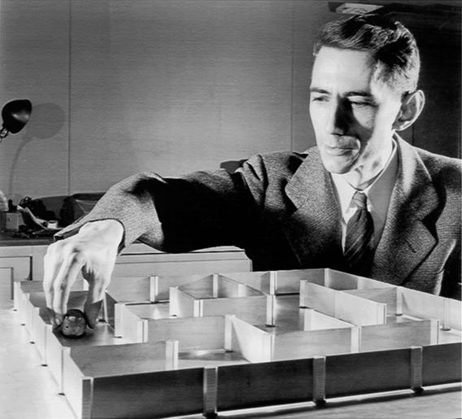
http://www.slate.com/articles/health_and_science/the_mouse_trap/2011/11/rat_mazes_and_mouse_mazes_a_history_.html

Slide 4
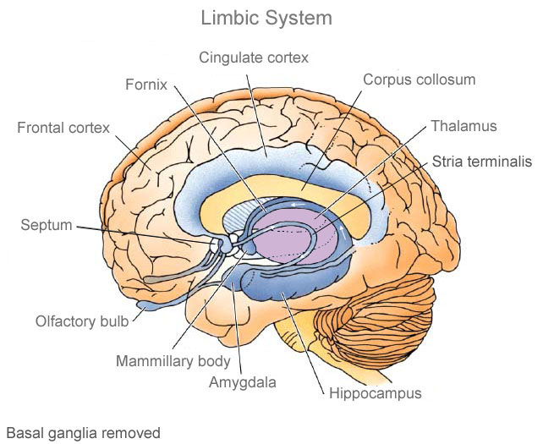
http://www.weallhaveuniquebrains.com/brain_anatomy/amygdala_and_hippocampus/

Slide 5
„Alle“ Tiere
http://www.weallhaveuniquebrains.com/brain_anatomy/amygdala_and_hippocampus/

Slide 6
Säugetiere
„Alle“ Tiere
http://www.weallhaveuniquebrains.com/brain_anatomy/amygdala_and_hippocampus/

Slide 7
Neocortex
Hippocampus
Motorsignale +
Sinnessignale
Thalamus
Motorsignale
Motorsignale
Sinnessignale

Slide 8
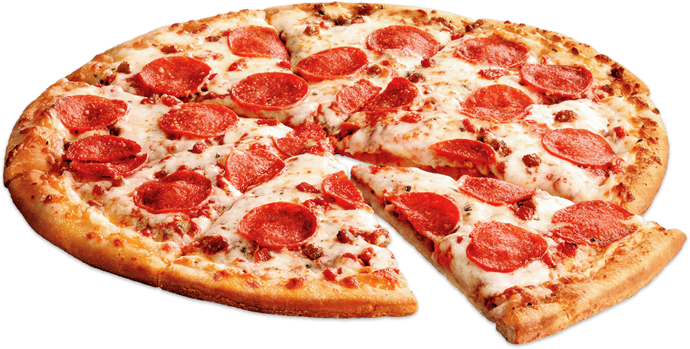
Neocortex
Hippocampus
Motorsignale +
Sinnessignale
Thalamus
Motorsignale
Motorsignale
Sinnessignale

Slide 9
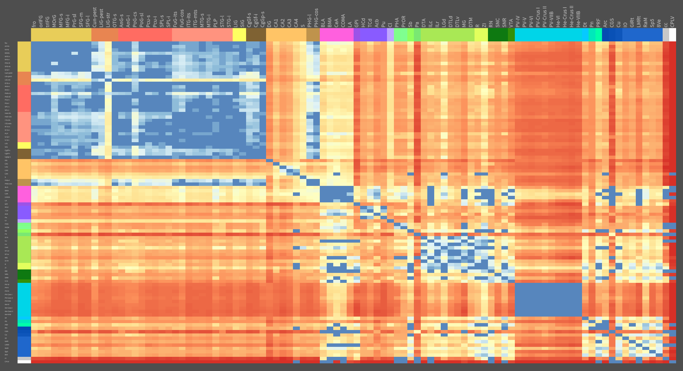
Allen Institute for Neuroscience, 2016, http://casestudies.brain-map.org/ggb

Slide 10
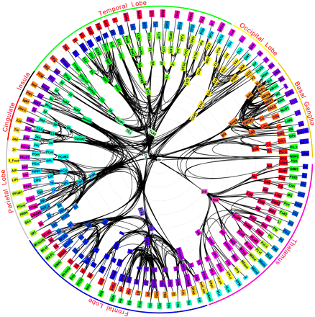
Modha und Singh, 2010

Slide 11
Unser Neocortex-Modell bisher
Region
Region
Region
Region
Region
Region
Region
Region
Region

Slide 12
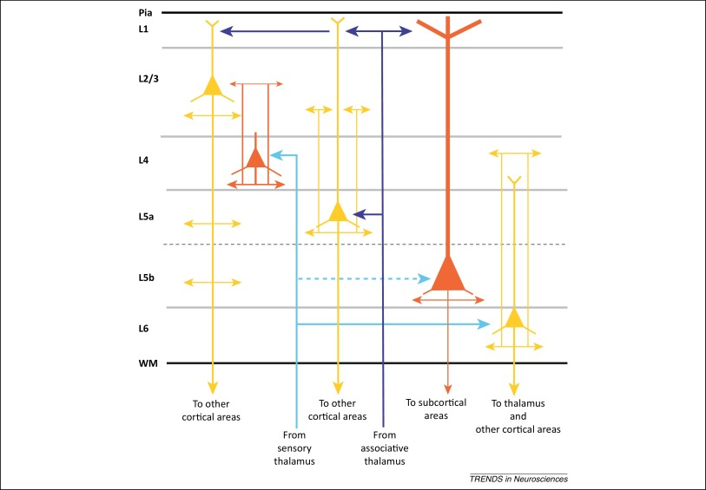
Schichten im Neocortex
Region
Allene et Al. 2015

Slide 13
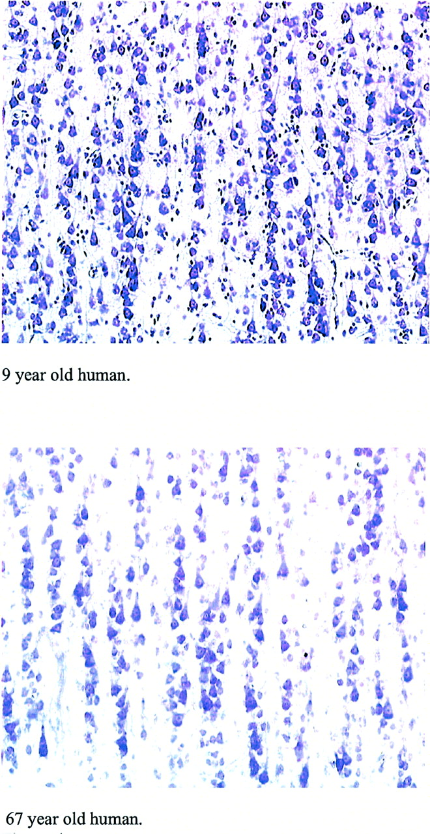
Buxhoeveden & Casanova 2002
Minicolumns im Neocortex
Allene et Al. 2015

Slide 14
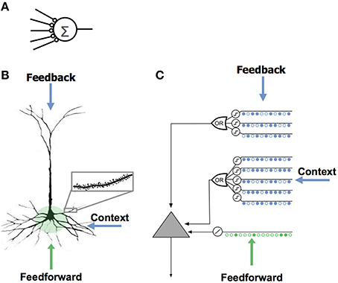
Neuronenmodelle
Hawkins, Ahmad (2016)

Slide 15
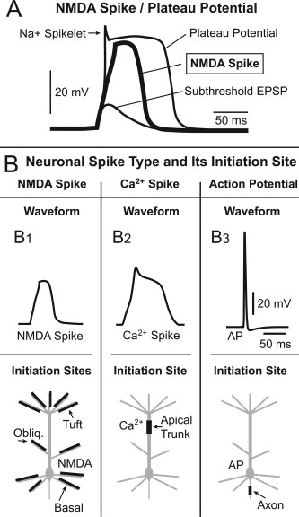
Neuronenmodelle
Hawkins, Ahmad (2016)

Slide 16
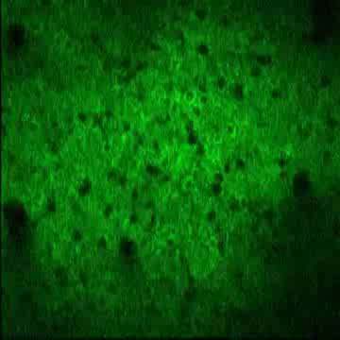
Sparse Distributed Representations (SDRs)
https://www.youtube.com/watch?v=kQxsTyNKtqg

Slide 17
Firing
 | A | B | C | D | E | F | G | H | I | J | K | L
A | 0 | 0 | 0 | 0 | 0 | 0 | 0 | 0 | 0 | 0 | 0 | 0
B | 0 | 0 | 0 | 0 | 0 | 0 | 0 | 0 | 0 | 0 | 0 | 0
C | 0 | 0 | 0 | 0 | 0 | 0 | 0 | 0 | 0 | 0 | 0 | 0
D | 0 | 0 | 0 | 0 | 0 | 0 | 0 | 0 | 0 | 0 | 0 | 0
E | 0 | 0 | 0 | 0 | 0 | 0 | 0 | 0 | 0 | 0 | 0 | 0
F | 0 | 0 | 0 | 0 | 0 | 0 | 0 | 0 | 0 | 0 | 0 | 0
G | 0 | 0 | 0 | 0 | 0 | 0 | 0 | 0 | 0 | 0 | 0 | 0
H | 0 | 0 | 0 | 0 | 0 | 0 | 0 | 0 | 0 | 0 | 0 | 0
I | 0 | 0 | 0 | 0 | 0 | 0 | 0 | 0 | 0 | 0 | 0 | 0
J | 0 | 0 | 0 | 0 | 0 | 0 | 0 | 0 | 0 | 0 | 0 | 0
K | 0 | 0 | 0 | 0 | 0 | 0 | 0 | 0 | 0 | 0 | 0 | 0
L | 0 | 0 | 0 | 0 | 0 | 0 | 0 | 0 | 0 | 0 | 0 | 0
Predictive
Inactive
A
B
C
D
E
F
G
H
I
J
K
L

Slide 18
Firing
 | A | B | C | D | E | F | G | H | I | J | K | L
A | 0 | 0 | 0 | 0 | 0 | 0 | 0 | 0 | 0 | 0 | 0 | 0
B | 0 | 0 | 0 | 0 | 0 | 0 | 0 | 0 | 0 | 0 | 0 | 0
C | 0 | 0 | 0 | 0 | 0 | 0 | 0 | 0 | 0 | 0 | 0 | 0
D | 0 | 0 | 0 | 0 | 0 | 0 | 0 | 0 | 0 | 0 | 0 | 0
E | 0 | 0 | 0 | 0 | 0 | 0 | 0 | 0 | 0 | 0 | 0 | 0
F | 0 | 0 | 0 | 0 | 0 | 0 | 0 | 0 | 0 | 0 | 0 | 0
G | 0 | 0 | 0 | 0 | 0 | 0 | 0 | 0 | 0 | 0 | 0 | 0
H | 0 | 0 | 0 | 0 | 0 | 0 | 0 | 0 | 0 | 0 | 0 | 0
I | 0 | 0 | 0 | 0 | 0 | 0 | 0 | 0 | 0 | 0 | 0 | 0
J | 0 | 0 | 0 | 0 | 0 | 0 | 0 | 0 | 0 | 0 | 0 | 0
K | 0 | 0 | 0 | 0 | 0 | 0 | 0 | 0 | 0 | 0 | 0 | 0
L | 0 | 0 | 0 | 0 | 0 | 0 | 0 | 0 | 0 | 0 | 0 | 0
Predictive
Parameter
Bonus: 1.0
Malus: 0.1
Threshold: 0.5
Inactive
A
B
C
D
E
F
G
H
I
J
K
L

Slide 19
Firing
 | A | B | C | D | E | F | G | H | I | J | K | L
A | 0 | 0 | 0 | 0 | 0 | 0 | 0 | 0 | 0 | 0 | 0 | 0
B | 0 | 0 | 0 | 0 | 0 | 0 | 0 | 0 | 0 | 0 | 0 | 0
C | 0 | 0 | 0 | 0 | 0 | 0 | 0 | 0 | 0 | 0 | 0 | 0
D | 0 | 0 | 0 | 0 | 0 | 0 | 0 | 0 | 0 | 0 | 0 | 0
E | 0 | 0 | 0 | 0 | 0 | 0 | 0 | 0 | 0 | 0 | 0 | 0
F | 0 | 0 | 0 | 0 | 0 | 0 | 0 | 0 | 0 | 0 | 0 | 0
G | 0 | 0 | 0 | 0 | 0 | 0 | 0 | 0 | 0 | 0 | 0 | 0
H | 0 | 0 | 0 | 0 | 0 | 0 | 0 | 0 | 0 | 0 | 0 | 0
I | 0 | 0 | 0 | 0 | 0 | 0 | 0 | 0 | 0 | 0 | 0 | 0
J | 0 | 0 | 0 | 0 | 0 | 0 | 0 | 0 | 0 | 0 | 0 | 0
K | 0 | 0 | 0 | 0 | 0 | 0 | 0 | 0 | 0 | 0 | 0 | 0
L | 0 | 0 | 0 | 0 | 0 | 0 | 0 | 0 | 0 | 0 | 0 | 0
Predictive
Inactive
A
B
C
D
E
F
G
H
I
J
K
L

Slide 20
Firing
 | A | B | C | D | E | F | G | H | I | J | K | L
A | 0 | 0 | 0 | 0 | 0 | 0 | 0 | 0 | 0 | 0 | 0 | 0
B | 0 | 0 | 1 | 0 | 0 | 0 | 1 | 0 | 0 | 0 | 1 | 0
C | 0 | 0 | 0 | 0 | 0 | 0 | 0 | 0 | 0 | 0 | 0 | 0
D | 0 | 0 | 0 | 0 | 0 | 0 | 0 | 0 | 0 | 0 | 0 | 0
E | 0 | 0 | 0 | 0 | 0 | 0 | 0 | 0 | 0 | 0 | 0 | 0
F | 0 | 0 | 1 | 0 | 0 | 0 | 1 | 0 | 0 | 0 | 1 | 0
G | 0 | 0 | 0 | 0 | 0 | 0 | 0 | 0 | 0 | 0 | 0 | 0
H | 0 | 0 | 0 | 0 | 0 | 0 | 0 | 0 | 0 | 0 | 0 | 0
I | 0 | 0 | 0 | 0 | 0 | 0 | 0 | 0 | 0 | 0 | 0 | 0
J | 0 | 0 | 1 | 0 | 0 | 0 | 1 | 0 | 0 | 0 | 1 | 0
K | 0 | 0 | 0 | 0 | 0 | 0 | 0 | 0 | 0 | 0 | 0 | 0
L | 0 | 0 | 0 | 0 | 0 | 0 | 0 | 0 | 0 | 0 | 0 | 0
Predictive
Inactive
A
B
C
D
E
F
G
H
I
J
K
L

Slide 21
Firing
 | A | B | C | D | E | F | G | H | I | J | K | L
A | 0 | 0 | 0 | 0 | 0 | 0 | 0 | 0 | 0 | 0 | 0 | 0
B | 0 | 0 | 0.9 | 0 | 0 | 0 | 0.9 | 0 | 0 | 0 | 0.9 | 0
C | 0 | 1 | 0 | 0 | 0 | 1 | 0 | 0 | 0 | 1 | 0 | 0
D | 0 | 0 | 0 | 0 | 0 | 0 | 0 | 0 | 0 | 0 | 0 | 0
E | 0 | 0 | 0 | 0 | 0 | 0 | 0 | 0 | 0 | 0 | 0 | 0
F | 0 | 0 | 0.9 | 0 | 0 | 0 | 0.9 | 0 | 0 | 0 | 0.9 | 0
G | 0 | 1 | 0 | 0 | 0 | 1 | 0 | 0 | 0 | 1 | 0 | 0
H | 0 | 0 | 0 | 0 | 0 | 0 | 0 | 0 | 0 | 0 | 0 | 0
I | 0 | 0 | 0 | 0 | 0 | 0 | 0 | 0 | 0 | 0 | 0 | 0
J | 0 | 0 | 0.9 | 0 | 0 | 0 | 0.9 | 0 | 0 | 0 | 0.9 | 0
K | 0 | 1 | 0 | 0 | 0 | 1 | 0 | 0 | 0 | 0 | 1 | 0
L | 0 | 0 | 0 | 0 | 0 | 0 | 0 | 0 | 0 | 0 | 0 | 0
Predictive
Inactive
A
B
C
D
E
F
G
H
I
J
K
L

Slide 22
Firing
 | A | B | C | D | E | F | G | H | I | J | K | L
A | 0 | 0 | 0 | 0 | 0 | 0 | 0 | 0 | 0 | 0 | 0 | 0
B | 0 | 0 | 0.8 | 0 | 0 | 0 | 1.8 | 0 | 0 | 0 | 0.8 | 0
C | 0 | 0.9 | 0 | 0 | 0 | 0.9 | 0 | 0 | 0 | 0.9 | 0 | 0
D | 0 | 0 | 0 | 0 | 0 | 0 | 0 | 0 | 0 | 0 | 0 | 0
E | 0 | 0 | 0 | 0 | 0 | 0 | 0 | 0 | 0 | 0 | 0 | 0
F | 0 | 0 | 0.8 | 0 | 0 | 0 | 1.8 | 0 | 0 | 0 | 0.8 | 0
G | 0 | 0.9 | 0 | 0 | 0 | 0.9 | 0 | 0 | 0 | 0.9 | 0 | 0
H | 0 | 0 | 0 | 0 | 0 | 0 | 0 | 0 | 0 | 0 | 0 | 0
I | 0 | 0 | 0 | 0 | 0 | 0 | 0 | 0 | 0 | 0 | 0 | 0
J | 0 | 0 | 0.8 | 0 | 0 | 0 | 1.8 | 0 | 0 | 0 | 0.8 | 0
K | 0 | 0.9 | 0 | 0 | 0 | 0.9 | 0 | 0 | 0 | 0.9 | 0 | 0
L | 0 | 0 | 0 | 0 | 0 | 0 | 0 | 0 | 0 | 0 | 0 | 0
Predictive
Inactive
A
B
C
D
E
F
G
H
I
J
K
L

Slide 23
Firing
 | A | B | C | D | E | F | G | H | I | J | K | L
A | 0 | 0 | 0 | 0 | 0 | 0 | 0 | 0 | 0 | 0 | 0 | 0
B | 0 | 0 | 0.7 | 0 | 0 | 0 | 1.7 | 0 | 0 | 0 | 0.7 | 0
C | 0 | 0.8 | 0 | 0 | 0 | 0.8 | 0 | 0 | 0 | 0.8 | 0 | 0
D | 0 | 0 | 0 | 0 | 0 | 0 | 0 | 0 | 0 | 0 | 0 | 0
E | 0 | 0 | 0 | 0 | 0 | 0 | 0 | 0 | 0 | 0 | 0 | 0
F | 0 | 0 | 0.7 | 0 | 0 | 0 | 1.7 | 0 | 0 | 0 | 0.7 | 0
G | 1 | 0.8 | 0 | 0 | 1 | 0.8 | 0 | 0 | 1 | 0.8 | 0 | 0
H | 0 | 0 | 0 | 0 | 0 | 0 | 0 | 0 | 0 | 0 | 0 | 0
I | 0 | 0 | 0 | 0 | 0 | 0 | 0 | 0 | 0 | 0 | 0 | 0
J | 0 | 0 | 0.7 | 0 | 0 | 0 | 1.7 | 0 | 0 | 0 | 0.7 | 0
K | 0 | 0.8 | 0 | 0 | 0 | 0.8 | 0 | 0 | 0 | 0.8 | 0 | 0
L | 0 | 0 | 0 | 0 | 0 | 0 | 0 | 0 | 0 | 0 | 0 | 0
Predictive
Inactive
A
B
C
D
E
F
G
H
I
J
K
L

Slide 24
Firing
 | A | B | C | D | E | F | G | H | I | J | K | L
A | 0 | 0 | 1 | 0 | 0 | 0 | 1 | 0 | 0 | 0 | 1 | 0
B | 0 | 0 | 0.6 | 0 | 0 | 0 | 1.6 | 0 | 0 | 0 | 0.6 | 0
C | 0 | 0.7 | 0 | 0 | 0 | 0.7 | 0 | 0 | 0 | 0.7 | 0 | 0
D | 0 | 0 | 0 | 0 | 0 | 0 | 0 | 0 | 0 | 0 | 0 | 0
E | 0 | 0 | 1 | 0 | 0 | 0 | 1 | 0 | 0 | 0 | 1 | 0
F | 0 | 0 | 0.6 | 0 | 0 | 0 | 1.6 | 0 | 0 | 0 | 0.6 | 0
G | 0.9 | 0.7 | 0 | 0 | 0.9 | 0.7 | 0 | 0 | 0.9 | 0.7 | 0 | 0
H | 0 | 0 | 0 | 0 | 0 | 0 | 0 | 0 | 0 | 0 | 0 | 0
I | 0 | 0 | 1 | 0 | 0 | 0 | 1 | 0 | 0 | 0 | 1 | 0
J | 0 | 0 | 0.6 | 0 | 0 | 0 | 1.6 | 0 | 0 | 0 | 0.6 | 0
K | 0 | 0.7 | 0 | 0 | 0 | 0.7 | 0 | 0 | 0 | 0.7 | 0 | 0
L | 0 | 0 | 0 | 0 | 0 | 0 | 0 | 0 | 0 | 0 | 0 | 0
Predictive
Inactive
A
B
C
D
E
F
G
H
I
J
K
L

Slide 26
Kapazität von SDRs

Slide 27
Kapazität von SDRs
2048 Minicolumns á 10 Neuronen
2% Aktivierungsquote („40 Einsen im Eingangsvektor“)

Slide 28
Kapazität von SDRs
2048 Minicolumns á 10 Neuronen
2% Aktivierungsquote („40 Einsen im Eingangsvektor“)
Jeder einzelne Eingangsvektor kann in bis zu 10^40 verschiedenen Kontexten repräsentiert werden.

Slide 29
Kapazität von SDRs
2048 Minicolumns á 10 Neuronen
2% Aktivierungsquote („40 Einsen im Eingangsvektor“)
Jeder einzelne Eingangsvektor kann in bis zu 10^40 verschiedenen Kontexten repräsentiert werden (Einschränkungen in der Praxis).
Durch „Sparsity“ braucht man keine vollständige Adjazenzmatrix, sondern nur einen Bruchteil an Verbindungen.
Biologisch sind etwa 1000-3000 Synapsen pro Neuron bei 10-30 Synapsen pro aktivem dendritischem Segment.

Slide 30
Fehlertoleranz von SDRs
Eingangssignale bilden keine klassische Codierung (etwa ASCII), sondern repräsentieren semantische Features.
Dadurch bleibt trotz einzelner Fehler immer eine semantische Ähnlichkeit erhalten.

Slide 31
Simulation von Anwendungslandschaften

Slide 32
Simulation von Anwendungslandschaften
Agent
Anwendungslandschaft
Agent
Agent

Slide 33
State Machine Agent
Agent
Anwendungs- landschaft
State Machine
Connectors
Log in
Lege Kunde an
Lege Auftrag an
Geh Facebook
Log out
Kontext
(SLAs, Emotionsmodell)

Slide 34
State Machine Agent
Prüft Geschäftsprozesse und SLAs
Agent handelt gezielt im Rahmen der Zustandsmaschine
Kontextbezogene Reaktion möglich (z.B. durch Emotionsmodell)

Slide 35
HTM Agent
Agent
Anwendungs- landschaft
Action Pool
SDR
Encoder/Decoder
Connectors
Lege Auftrag an
Lege Kunde an
Log in
HTM Anomaly Detection
Log out
Geh Facebook

Slide 36
HTM Agent
Agiert vollständig nicht-deterministisch innerhalb eines Action Pools
Der Agent „lernt“ typische Reaktionen auf Sequenzen von Aktionen
Durch Anomaly Detection des Agenten können subtile Unterschiede im Verhalten von Anwendungslandschaften gefunden werden

Slide 37
Roadmap
Infrastruktur für „reale“ Anwendungslandschaft schaffen
Dort Anwendungen ergänzen und Geschäftsprozesse implementieren
Prototyp eines State Machine Agenten entwickeln
Reproduzierbare ALs ermöglichen (Meta-Repository)
Effiziente HTM Implementation abschließen (notfalls existieren bereits Referenzimplementationen)
Agenten Modularisieren und SDR Encoder/Decoder entwerfen

Slide 38
Quellen:
Hawkins & Ahmad 2016, Why Neurons Have Thousands of Synapses, a Theory of Sequence Memory in Neocortex
(http://journal.frontiersin.org/article/10.3389/fncir.2016.00023/full)
Modha & Singh 2010, Network architecture of the long-distance pathways in the macaque brain
(http://www.pnas.org/content/107/30/13485.full)
Zhou et Al. 2010, The Decade of the NMDA Spike
(https://www.researchgate.net/publication/44670091_The_decade_of_the_dendritic_NMDA_spike)
Buxhoeveden & Casanova 2002, The Minicolumn Hypothesis in Neuroscience,
(http://brain.oxfordjournals.org/content/125/5/935)
Allene et Al. 2015, The Neuronal Identity Bias behind Necortical GABAergic plasticity,
(http://dx.doi.org/10.1016/j.tins.2015.07.008)

Slide 39
Weiterführende Informationen:
Numenta HTM Learning Center
http://numenta.com/learn/
IBM Research: Jeff Hawkins on Machine Intelligence
https://www.youtube.com/watch?v=0SroCjwkSFc
UC Berkeley NICE Workshop
https://www.youtube.com/watch?v=LalFsN2XZtA&list=PLOyuQaVrp4qqkSep0TP20Gw9mzFyp-GH9

