Slide 2
Agenten und Simulation von AL
Exkurs: Hierarchical Temporal Memory
Simulation von Anwendungslandschaften
Problem Statement
Roadmap

Slide 3
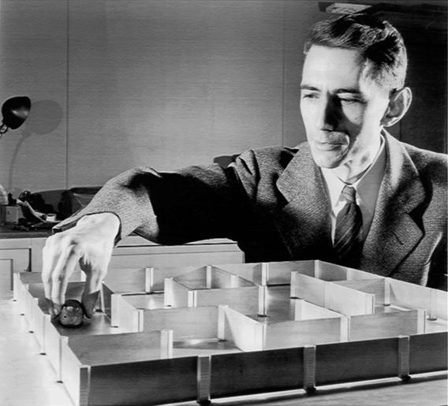

Slide 4
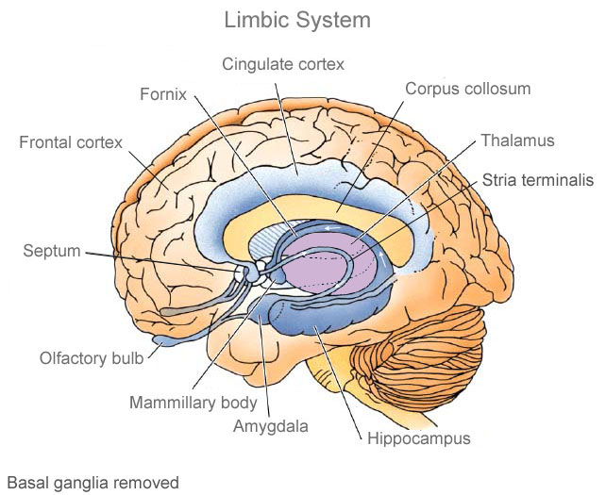

Slide 5
„Alle“ Tiere

Slide 6
Säugetiere
„Alle“ Tiere

Slide 7
Neocortex
Hippocampus
Motorsignale +
Sinnessignale
Thalamus
Motorsignale
Motorsignale
Sinnessignale

Slide 8
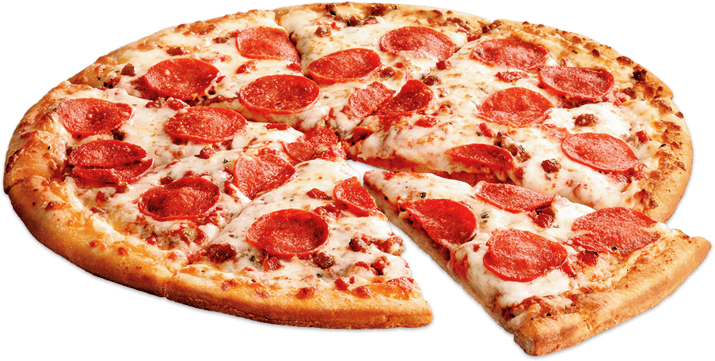
Neocortex
Hippocampus
Motorsignale +
Sinnessignale
Thalamus
Motorsignale
Motorsignale
Sinnessignale

Slide 9
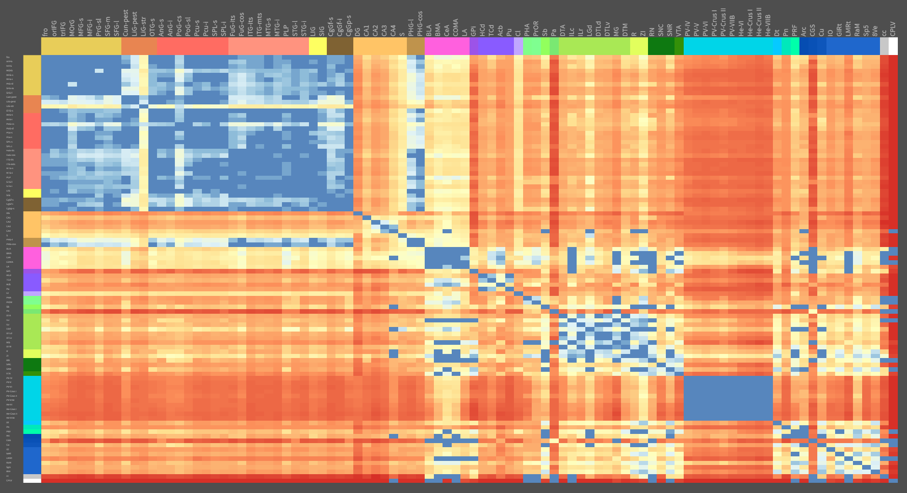

Slide 10
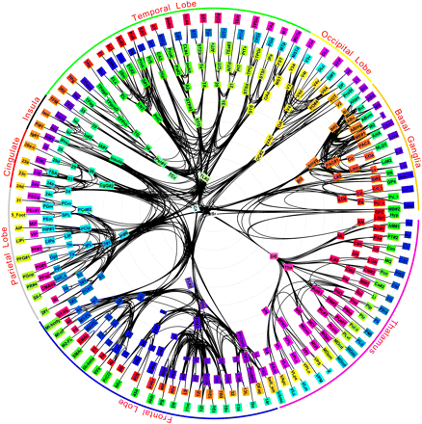

Slide 11
Unser Neocortex-Modell bisher
Region
Region
Region
Region
Region
Region
Region
Region
Region

Slide 12
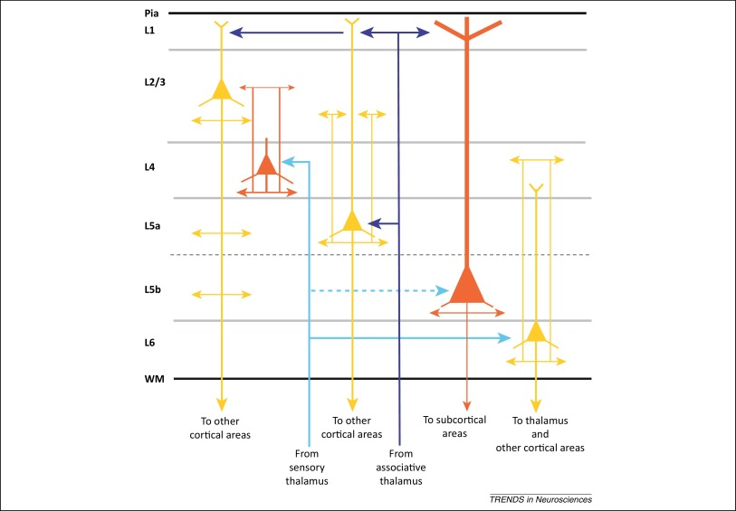
Schichten im Neocortex
Region

Slide 13
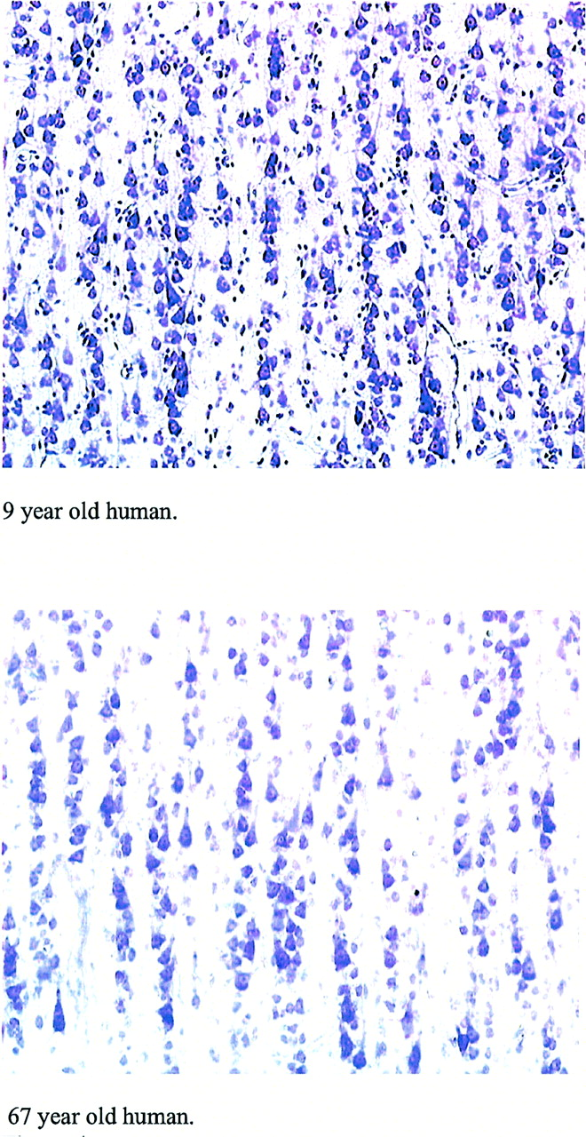
Minicolumns im Neocortex

Slide 14
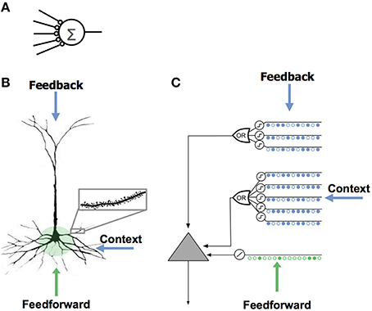
Neuronenmodelle
Hawkins, Ahmad (2016)

Slide 15
 | A | B | C | D | E | F | G | H | I | J | K | L
A | 0 | 0 | 0 | 0 | 0 | 0 | 0 | 0 | 0 | 0 | 0 | 0
B | 0 | 0 | 0 | 0 | 0 | 0 | 0 | 0 | 0 | 0 | 0 | 0
C | 0 | 0 | 0 | 0 | 0 | 0 | 0 | 0 | 0 | 0 | 0 | 0
D | 0 | 0 | 0 | 0 | 0 | 0 | 0 | 0 | 0 | 0 | 0 | 0
E | 0 | 0 | 0 | 0 | 0 | 0 | 0 | 0 | 0 | 0 | 0 | 0
F | 0 | 0 | 0 | 0 | 0 | 0 | 0 | 0 | 0 | 0 | 0 | 0
G | 0 | 0 | 0 | 0 | 0 | 0 | 0 | 0 | 0 | 0 | 0 | 0
H | 0 | 0 | 0 | 0 | 0 | 0 | 0 | 0 | 0 | 0 | 0 | 0
I | 0 | 0 | 0 | 0 | 0 | 0 | 0 | 0 | 0 | 0 | 0 | 0
J | 0 | 0 | 0 | 0 | 0 | 0 | 0 | 0 | 0 | 0 | 0 | 0
K | 0 | 0 | 0 | 0 | 0 | 0 | 0 | 0 | 0 | 0 | 0 | 0
L | 0 | 0 | 0 | 0 | 0 | 0 | 0 | 0 | 0 | 0 | 0 | 0
Firing
Predictive
A
B
C
D
E
F
G
H
I
J
K
L

Slide 16
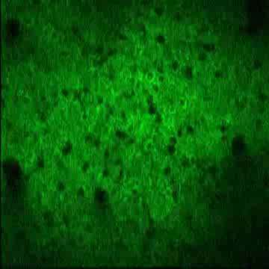
Repräsentation von Ereignissen

Slide 17
Quellen:
Weiterführende Informationen:

