Slide 1
Racial Disparities in Mortgage Lending
DSC-500 Final Project By Dan Clayton

Slide 2
Question
Are there differences in the outcomes of mortgage applications by race?

Slide 3
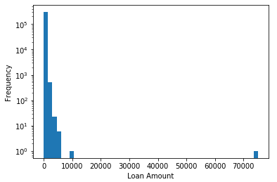
5 Variables from the dataset
loan_amount_000s--The amount the applicant wants to borrow (in thousands)
Many outliers exist—will limit the working dataset to loans <$417K*
*Loans above $417K are considered “Jumbo loans” in the state of IL and have different risk categorization that “standard” loans

Slide 4
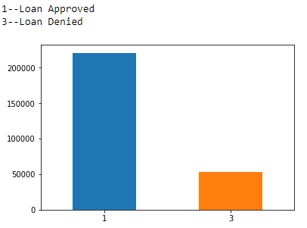
5 Variables from the dataset
action_taken--What became of the loan:

Slide 5
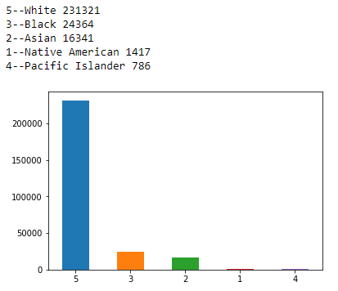
5 Variables from the dataset
applicant_race_1--The applicant's self reported race

Slide 6
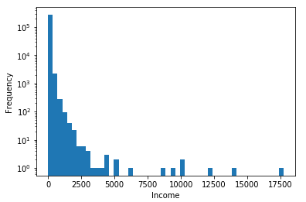
5 Variables from the dataset
applicant_income_000s--The applicant's annual income
Many outliers exist—will limit the working dataset to incomes <$200K

Slide 7
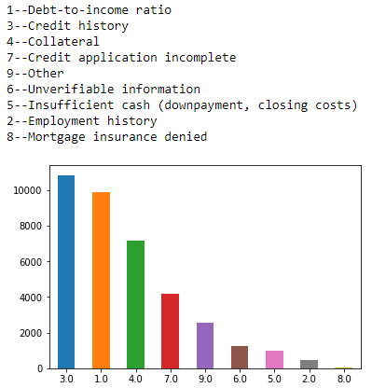
5 Variables from the dataset
denial_reason_1--why the loan was denied

Slide 8
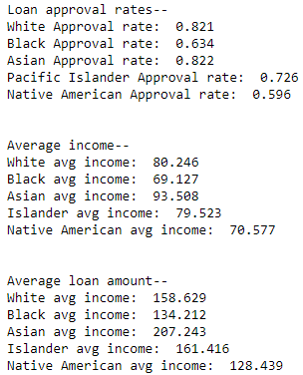
Summary Statistics by Race

Slide 9
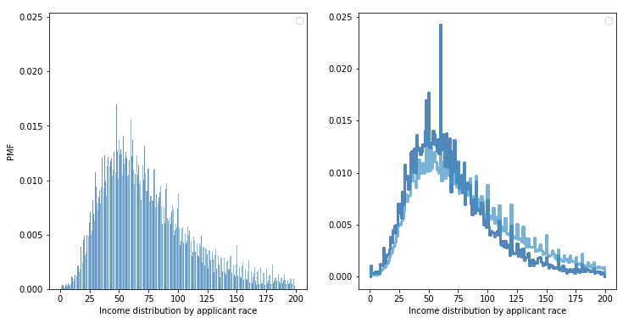
PMF
Income distribution by applicant race
(black vs white)

Slide 10
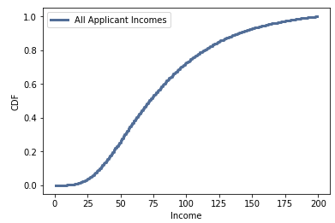
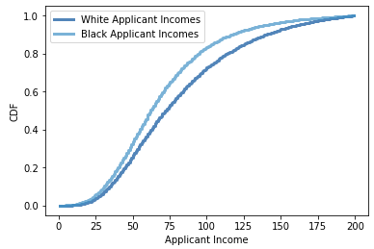
CDF
The greatest spread between black and white income CDFs occurs between $75-$125K annual incomes, implying that a black applicant had to be higher up in the earning percentile to achieve this income than a white applicant (it is more unusual for black applicants to achieve these incomes than white applicants.

Slide 11
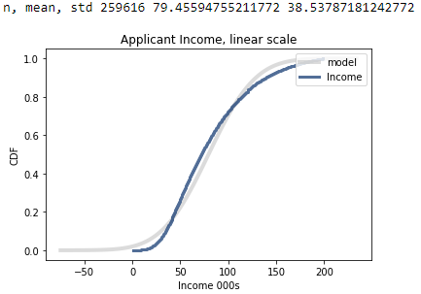
Analytical Distribution
Analysis: The model is a reasonably good fit for predicting applicant income, particularly in the $50-$125K income range

Slide 12
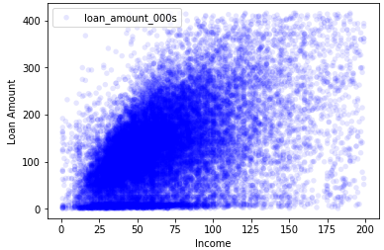
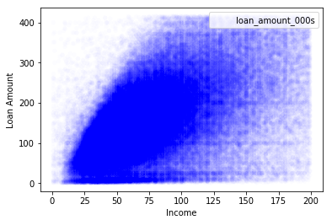
Scatter Plots
Income to loan amount by race
White applicants (left) Black Applicants (Right)
Analysis: The alpha was adjusted on the black applicant chart to make it more comparable to the white applicant chart (fewer data points made the pattern harder to see) The same linear pattern is observed for black applicants as for white

Slide 13
Hypothesis Test
#Testing correlation
class CorrelationPermute(thinkstats2.HypothesisTest):
def TestStatistic(self, data):
xs, ys = data
test_stat = abs(thinkstats2.Corr(xs, ys))
return test_stat
def RunModel(self):
xs, ys = self.data
xs = np.random.permutation(xs)
return xs, ys
data = clean_df.applicant_income_000s.values, clean_df.loan_amount_000s.values
ht = CorrelationPermute(data)
pvalue = ht.PValue()
pvalue
Pvalue result (all applicants): 0
Pvalue result (white applicants): 0
Pvalue result (black applicants): 0
Analysis--for all applicants there appears to be no correlation (p-value = 0) between loan amount and applicant income
Repeating the same test for black and white applicant subsets yields the same result
This is surprising—from the graphs above there appears to be a linear relationship between income and loan amount, but that is not supported by this hypothesis test

Slide 14
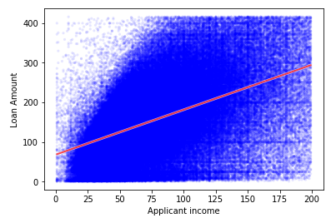
Regression Analysis
Analysis: Regression analysis confirms the linear relationship between income and loan amount for all races

