Slide 1
Good Morning
We will start at 10:00 ET
Instructor: Dan Costello, MCT

Slide 2
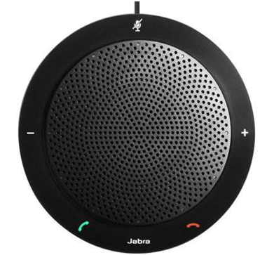
Course Title Here
Instructor: Dan Costello Email: danc@onlc.com
Class begins at 10 Eastern time
For Class Audio Connection:
ONLC Office Locations – Audio is connected over Jabra™ speaker
Home or Office – Call: xxx-xxx-xxxx Access Code: xxx xxx xxx# Enter the audio pin shown in the GoToMeeting panel
If you need assistance, call 800-288-8221

Slide 3
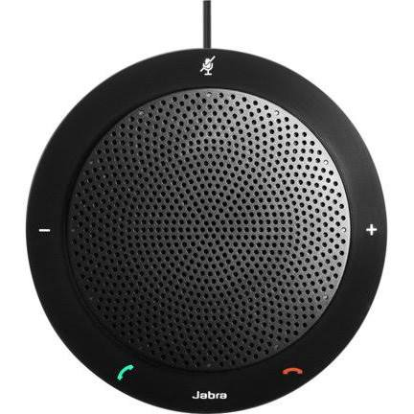
The Jabra Speaker
Mute Button – A ring of red lights appears around the speaker when the phone is muted. A single white light appears above the Jabra logo when the phone is not muted.
Volume Down
Volume Up
The On/Off Hook buttons have no function when connected to GoToMeeting audio.

Slide 4

A.M. Break: 11:00-11:15 ET
Questions? Comments?
Dan’s e-mail: danc@onlc.com
Dan’s cell #: ‪(617) 863-2310‬

Slide 5
Lunch: 12:00-13:00
Lab: 13:00-13:45
Questions? Comments?
Dan’s e-mail: danc@onlc.com
Dan’s cell #: ‪(617) 863-2310‬

Slide 6
Lab: 11:30-12:00
Lunch: 12:00-13:00
Questions? Comments?
Dan’s e-mail: danc@onlc.com
Dan’s cell #: ‪(617) 863-2310‬

Slide 7
Lunch: 12:30-13:30
Lab: 13:30-14:30
P.M. Break: 14:30-14:45
Questions? Comments?
Dan’s e-mail: danc@onlc.com
Dan’s cell #: ‪(617) 863-2310‬

Slide 8
A.M. Break: 11:30-11:45
Lab: 11:45-12:45
Lunch: 12:45-13:45
Questions? Comments?
Dan’s e-mail: danc@onlc.com
Dan’s cell #: ‪(617) 863-2310‬

Slide 9
A.M. Break: 11:15-11:30
Lab: 11:30-12:15
Questions? Comments?
Dan’s e-mail: danc@onlc.com
Dan’s cell #: ‪(617) 863-2310‬

Slide 10
Lab: 14:30-15:00
P.M. Break: 15:00-15:15
Questions? Comments?
Dan’s e-mail: danc@onlc.com
Dan’s cell #: ‪(617) 863-2310‬

Slide 11
Good Morning
Lab:
10:00-10:45
Questions? Comments?
Dan’s e-mail: danc@onlc.com
Dan’s cell #: ‪(617) 863-2310‬

Slide 12
Lab:
15:45-Done
Lab will continue tomorrow a.m. starting at 10:00 ET.
Have a great night!
Questions? Comments?
Dan’s e-mail: danc@onlc.com
Dan’s cell #: ‪(617) 863-2310‬

Slide 13
Good Morning
We will start at 10:00 ET
Questions? Comments?
Dan’s e-mail: danc@onlc.com
Dan’s cell #: ‪(617) 863-2310‬

Slide 14
Thank You
Have a great night!
Questions? Comments?
Dan’s e-mail: danc@onlc.com
Dan’s cell #: ‪(617) 863-2310‬

Slide 15
Thank You
http://www.onlc.com/eval
Have a great weekend!
Questions? Comments?
Dan’s e-mail: danc@onlc.com
Dan’s cell #: ‪(617) 863-2310‬

Slide 16
NOTES:
ONLC Azure Database Connection
Server: onlcdb.database.windows.net
DB: AdventureWorksLT
User: student
Password: Pa55w.rd

