Slide 1
Piezoelectric Noise measurement (update 3)
Ari Pedersen, Danny Vander-Hyde

Slide 2
Electrode design v2
Using cylindrical Laplace solver in Matlab I modified the code to correct my statements in the first version (done in cartesian and was not correct assuming disk electrodes).
To finalize the electrode design I wanted to optimize three features of the electrodes:
The size of the disk
The size of the hole in the disk
Disk separation

Slide 3
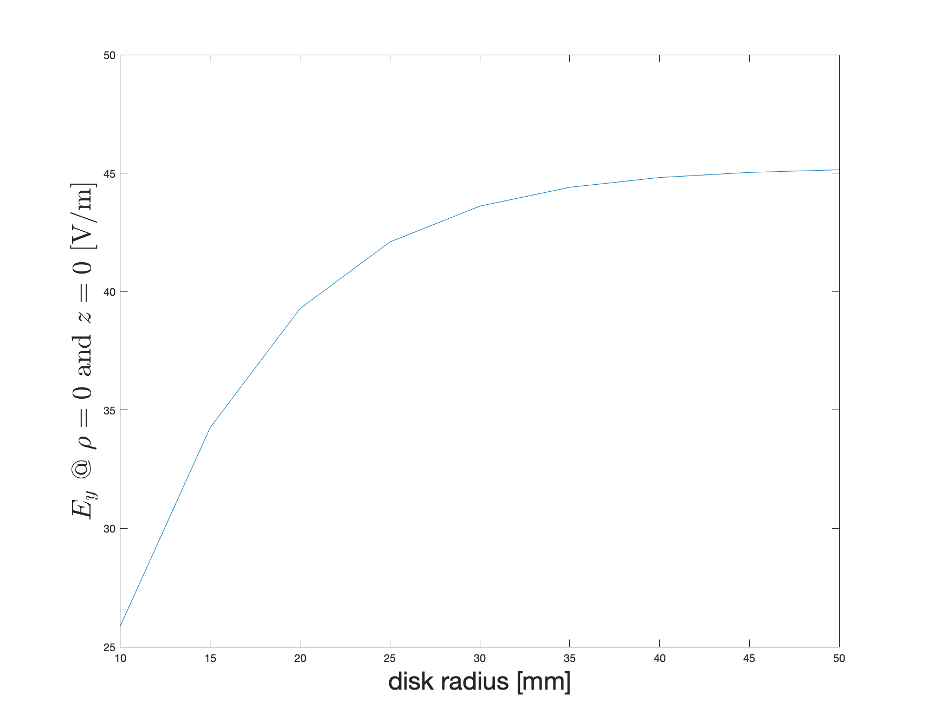
Electrode disk size

Slide 4
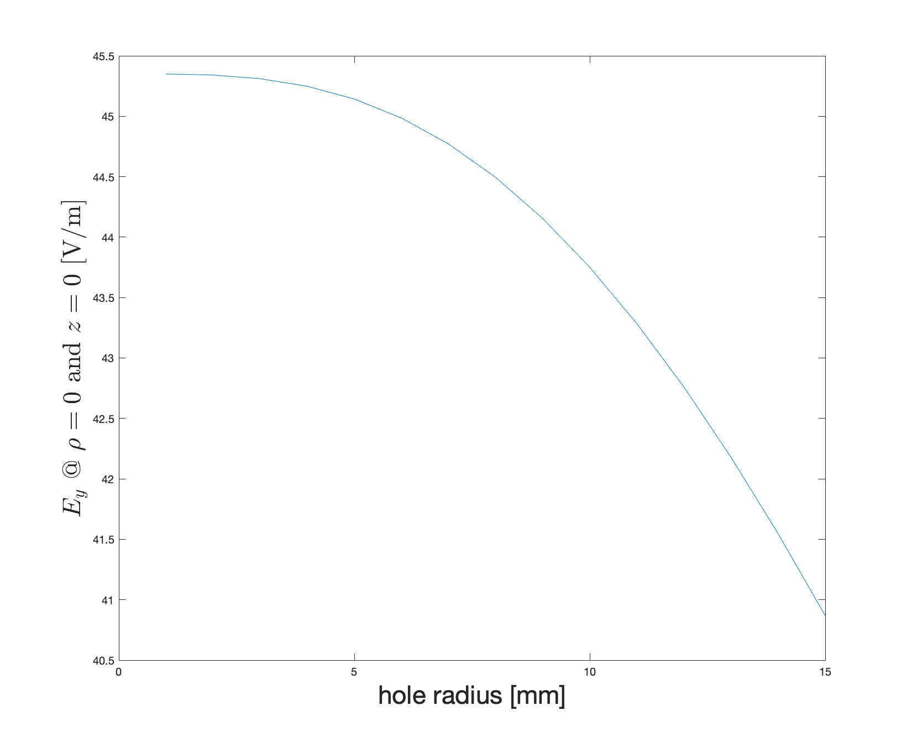
Electrode hole size

Slide 5
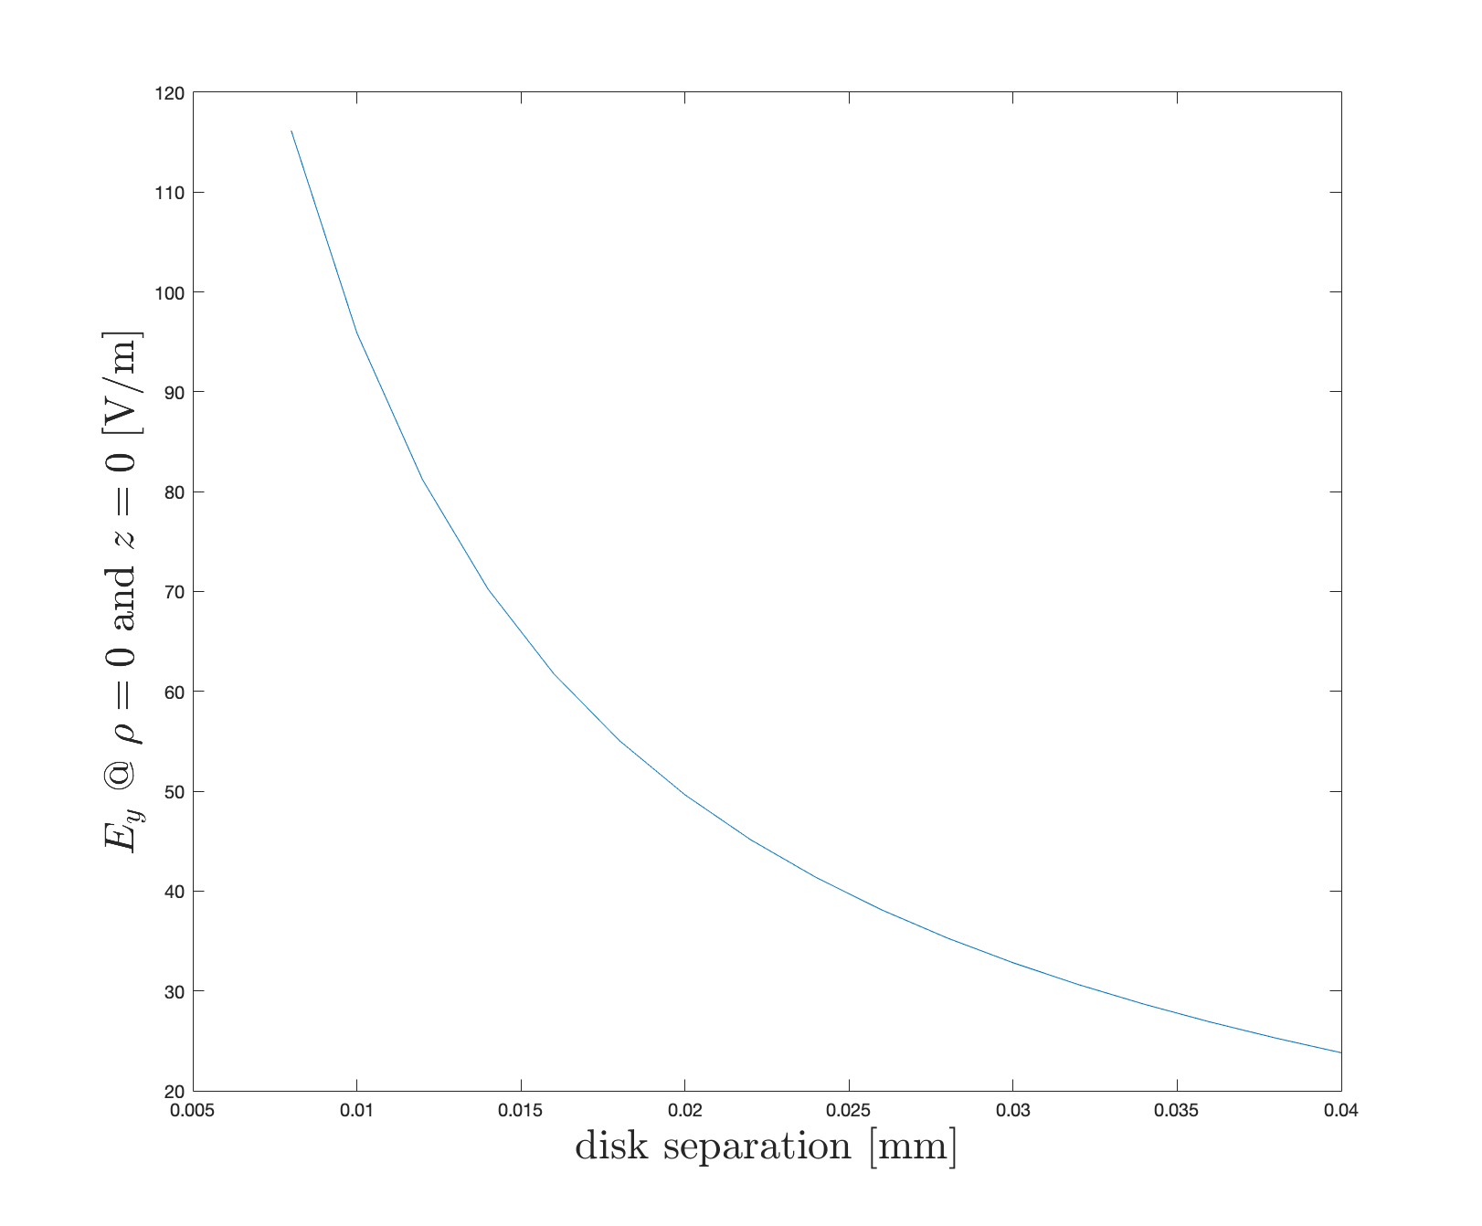
Electrode disk separation

Slide 6
Disk size and separation
.
.2 "
5mm

Slide 7
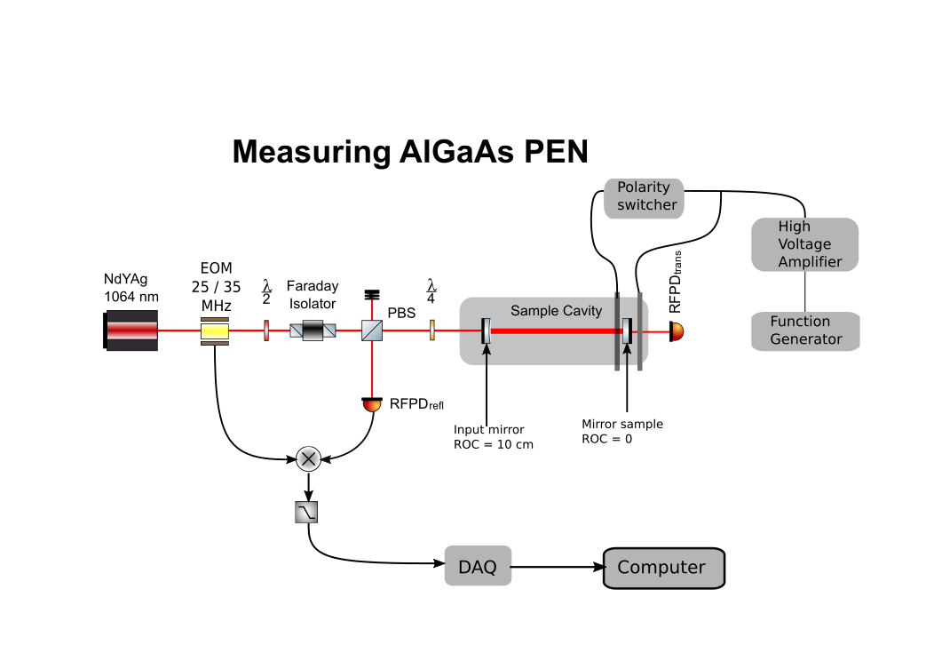
Optical layout V0

Slide 8
Next steps
COMSOL modelling comparison
Further iterations of enclosure

Slide 9
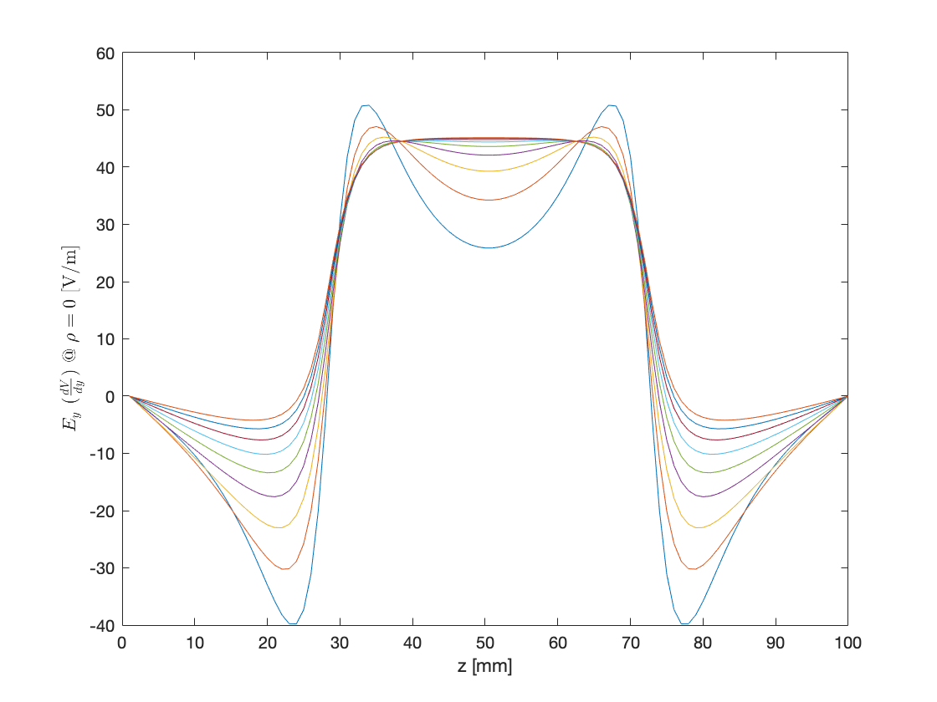
Some cool pictures (vary plate size \rho = 0)

Slide 10
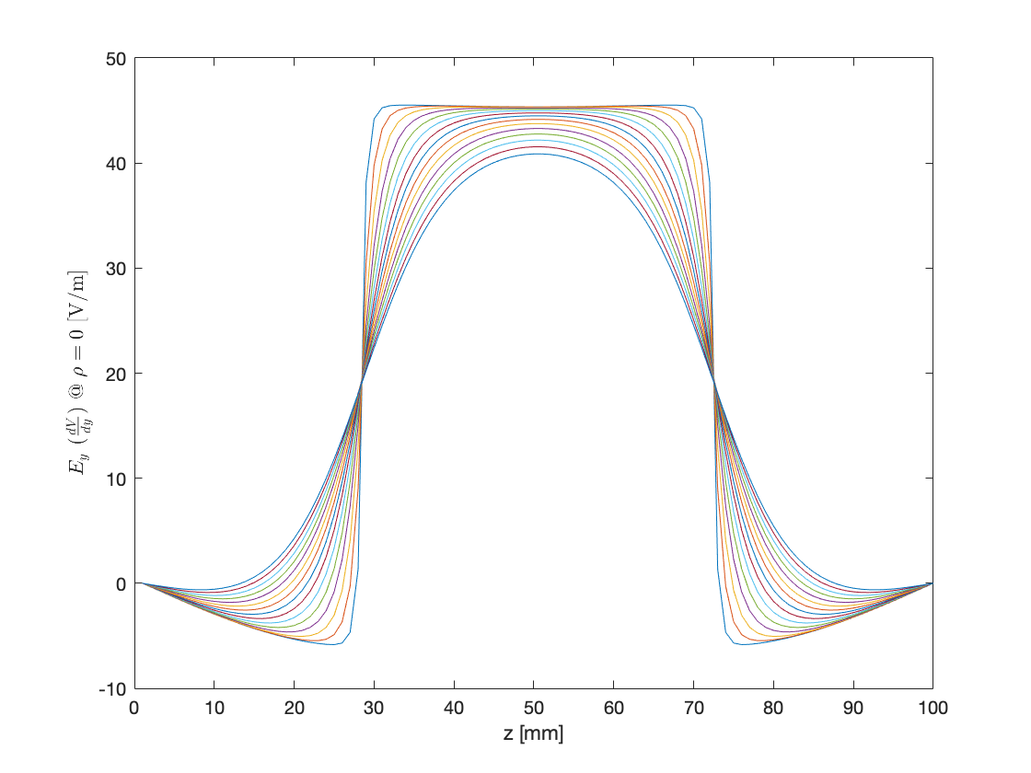
Some cool pictures (varying hole size \rho = 0)

Slide 11
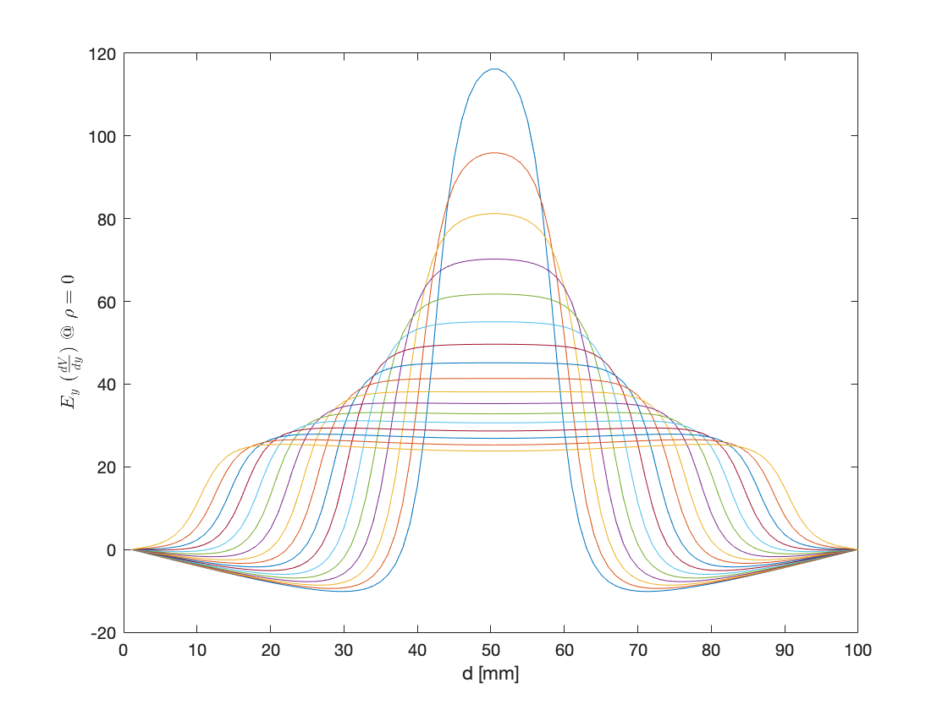
Some cool pictures (vary plate separation \rho = 0)

