Slide 1
Measuring electro-optic noise of AlGaAs (electrode design and schema v1)
Ari Pedersen, Danny Vander-Hyde

Slide 2
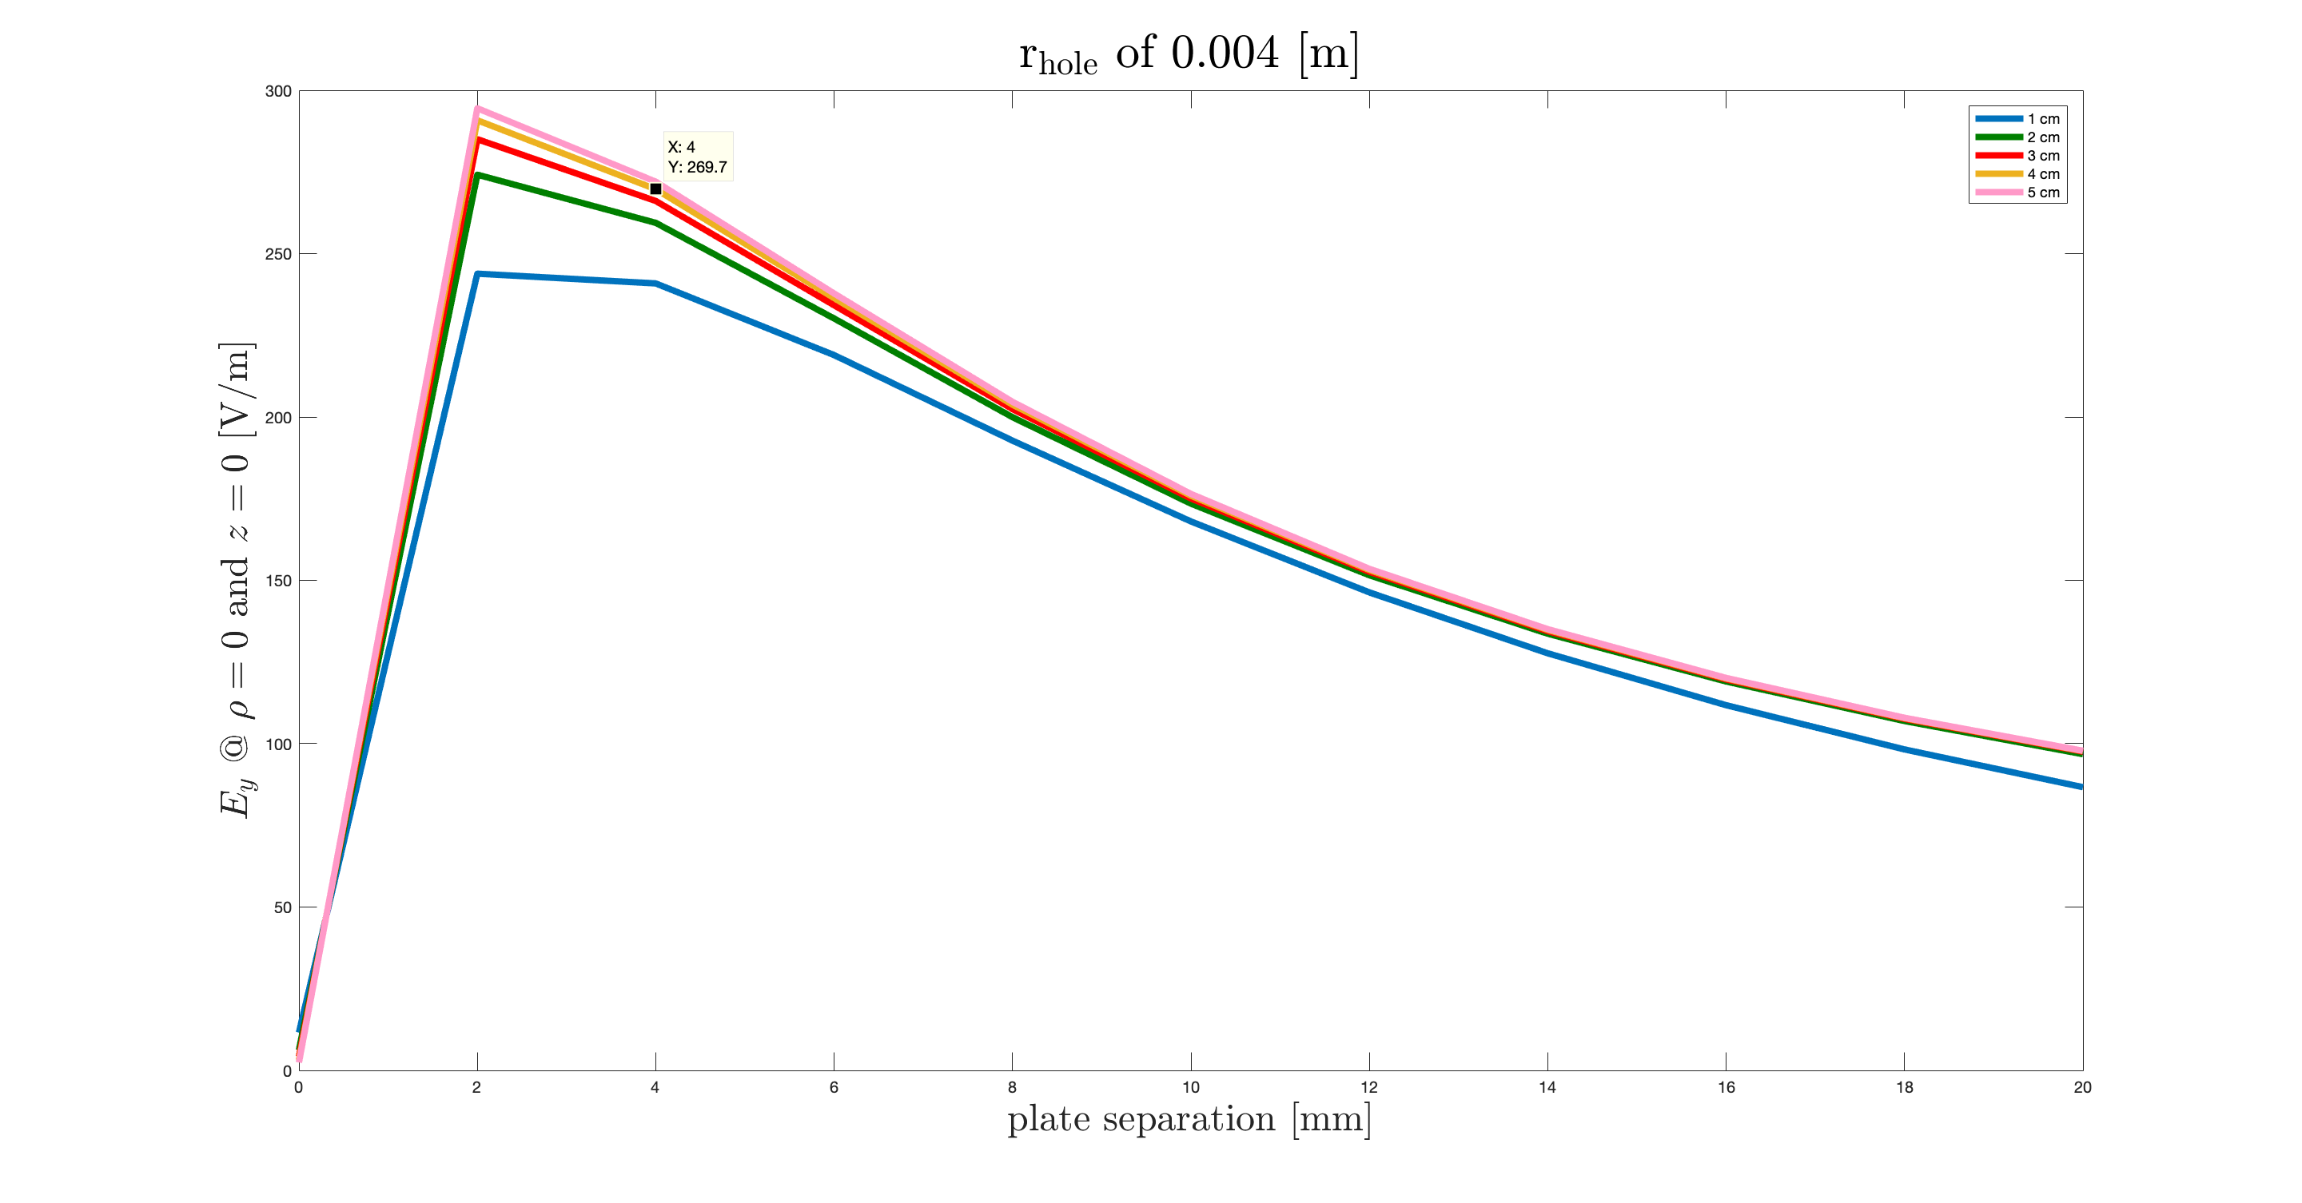
Electrode disk size
Comparing 4 and 5 cm the difference is no larger than .5% in field strength between 10-20 mm of disk separation
Comparing 3 and 4 cm the difference is no larger than .6% between 10-20 mm of disk separation
Comparing 3 and 2 cm the difference is no larger than .82% between 10-20 mm of disk separation
Comparing 2 and 1 cm the difference is no larger than 11.7% between 10-20 mm of disk separation
* Note: 2 [V] potential difference set between the plates

Slide 3
Electrode disk size (cont.)
For a 4 mm electrode hole radius (conservative estimate for optical considerations), we have some freedom to choose between a 2.5 inch to 4 inch disk without much loss of field strength at the origin
Note: not flux of some region, just a point at the origin.

Slide 4
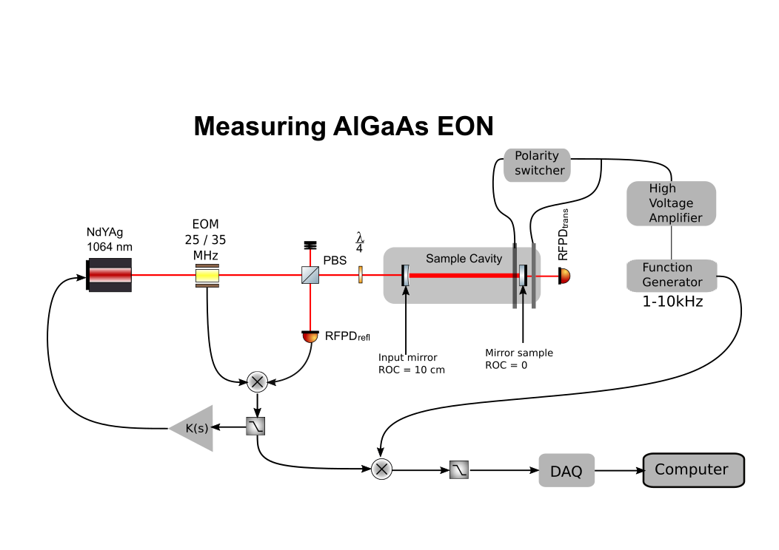
Optical layout V1

Slide 5
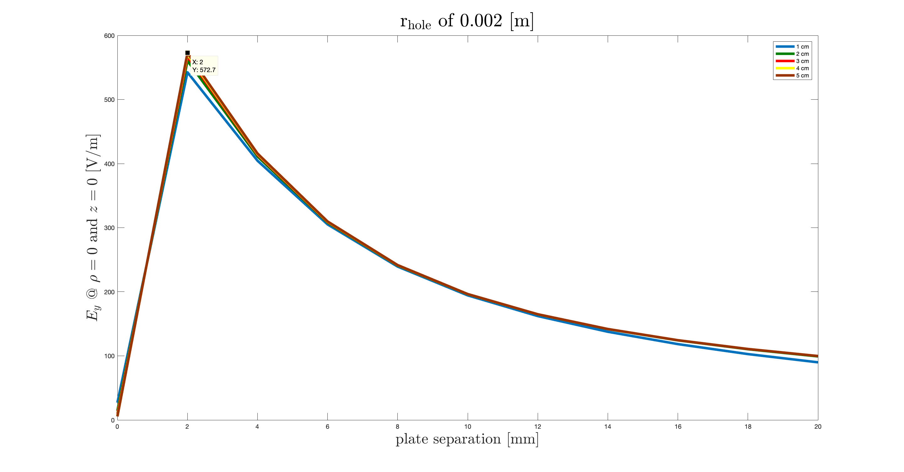
Electrode disk size (extra)
Comparing 4 and 5 cm the difference is no larger than .08% in field strength between 10-20 mm of disk separation
Comparing 3 and 4 cm the difference is no larger than .08% between 8-20 mm of disk separation
Comparing 3 and 2 cm the difference is no larger than .54% between 8-20 mm of disk separation
Comparing 2 and 1 cm the difference is no larger than 10.3% between 8-20 mm of disk separation
* Note: 2 [V] potential difference set between the plates

