Slide 1
Electro-optic effects in a HR AlGaAs coated mirror
Danny Vander-Hyde

Slide 2

The Pockel’s effect $dn/dE$
The Pockel’s effect, put quite simply is birefringence induced by an external Electric field across a material
The effect, predominantly in crystalline materials is caused by the

Slide 3
Pockel’s effect for stratified media

Slide 4
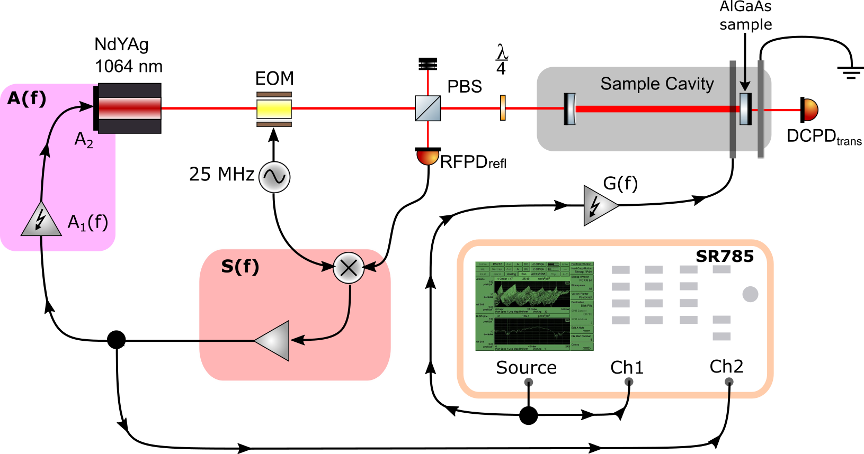
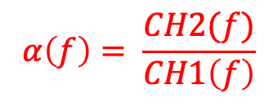
Measurement schema
$$α\left(f\right)= \frac{CH2(f)}{CH1\left(f\right)}$$

Slide 6
EXTRA SLIDES

Slide 7
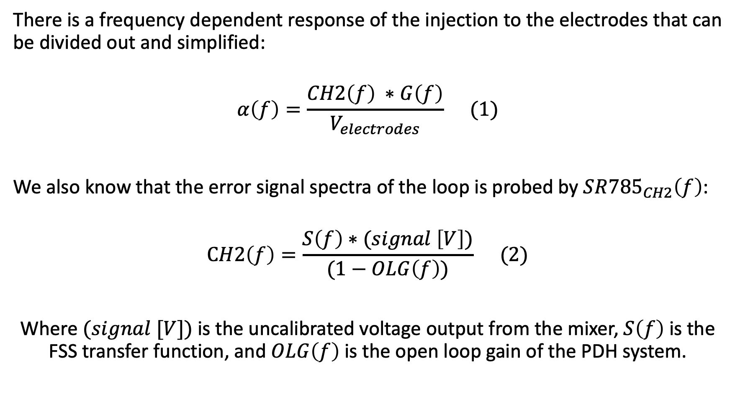
Calibration (cont.)
There is a frequency dependent response of the injection to the electrodes that can be divided out and simplified:
$$α\left(f\right)=\frac{CH2\left(f\right) ∗G\left(f\right)}{V_{electrodes}} (1)$$
We also know that the error signal spectra of the loop is probed by $SR{785}_{CH2}\left(f\right)$:
$$CH2\left(f\right)=\frac{S\left(f\right)∗(signal \left[V\right])}{(1−OLG\left(f\right))} (2)$$
Where $(signal [V])$is the uncalibrated voltage output from the mixer, $S\left(f\right)$ is the FSS transfer function, and $OLG\left(f\right)$ is the open loop gain of the PDH system.

Slide 8
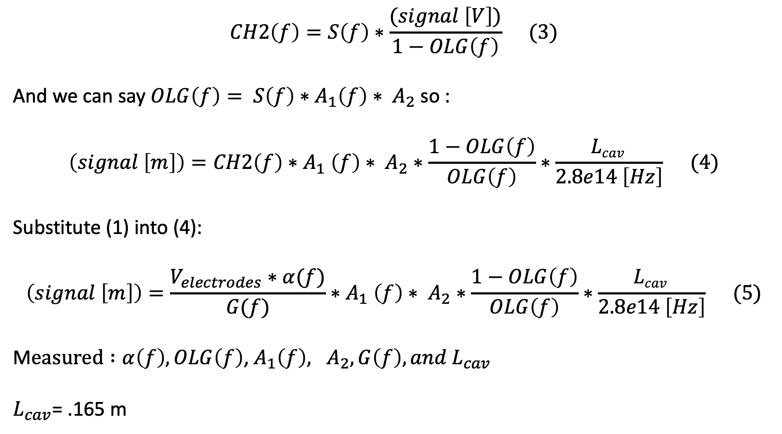
Calibration (cont.)
$$CH2\left(f\right)=S\left(f\right)∗\frac{(signal \left[V\right])}{1−OLG\left(f\right)} (3)$$
And we can say $OLG\left(f\right)= S\left(f\right)∗A_{1}\left(f\right)∗ A_{2}$ so :
$$\left(signal \left[m\right]\right)=CH2\left(f\right){∗A}_{1}\left(f\right)∗ A_{2}∗\frac{1−OLG\left(f\right)}{OLG\left(f\right)}∗\frac{Lcav }{2.8e14 \left[Hz\right]} (4)$$
Substitute (1) into (4):
$$\left(signal \left[m\right]\right)=\frac{V_{electrodes}∗α(f)}{G(f)}{∗A}_{1}\left(f\right)∗ A_{2}∗\frac{1−OLG\left(f\right)}{OLG\left(f\right)}∗\frac{Lcav }{2.8e14 \left[Hz\right]} (5)$$
M$easured :α\left(f\right), OLG\left(f\right)$, $A_{1}\left(f\right), A_{2}, G\left(f\right), and L_{cav}$
$L_{cav}$= .165 m
Notes:
Rearrange equation 2 to solve for (signal) (replacement)

