Slide 1
Piezoelectric field in HR AlGaAs coating (split electrode design)
Danny Vander-Hyde

Slide 2
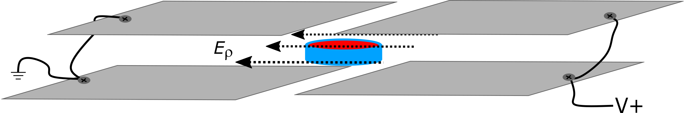
Electric field injection
Plate dimensions: 66mm x 38mm
Plate separation along z-axis: 9mm
Slit size: 3mm
V+ = 0-300V

Slide 3
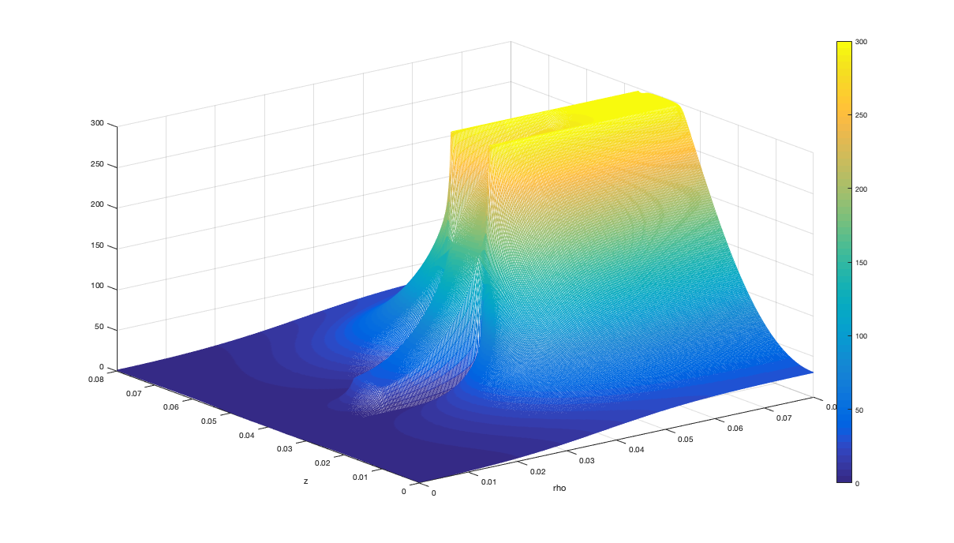
Potential map

Slide 4
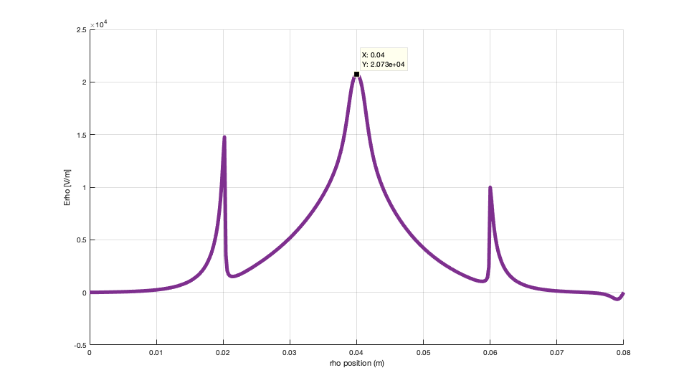
Electric field estimate (transverse field)

Slide 5
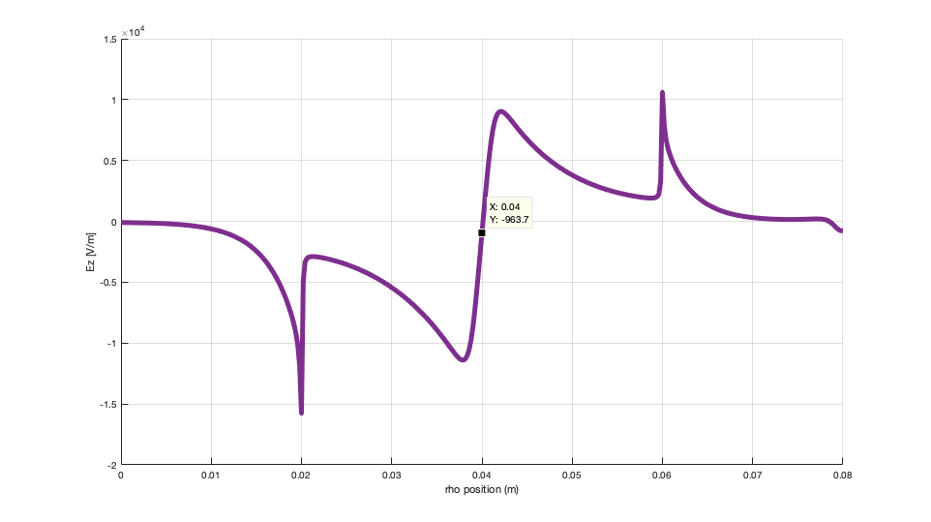
Electric field estimate (transverse field)

Slide 6
Model Estimate

