Slide 1
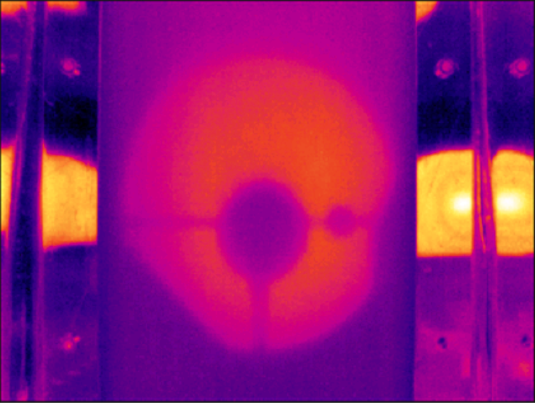
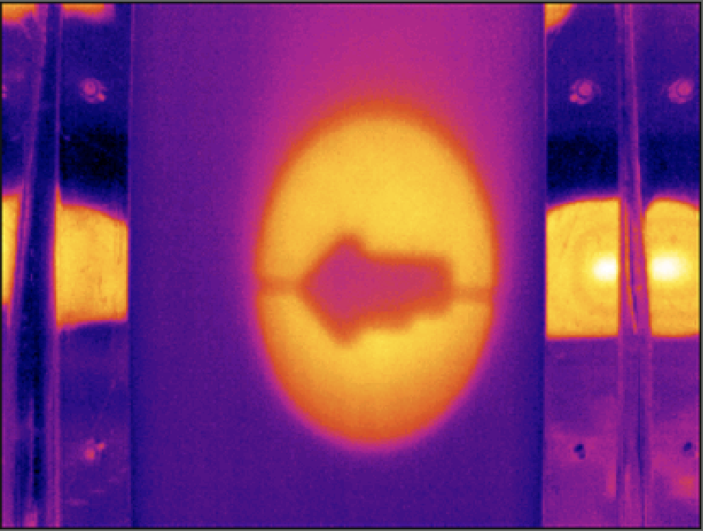
FLIR camera vertical centering (after translating)
CO2Y mask 1
CO2Y mask 2
Mask 2 previous center
Mask 1 center

