Slide 1
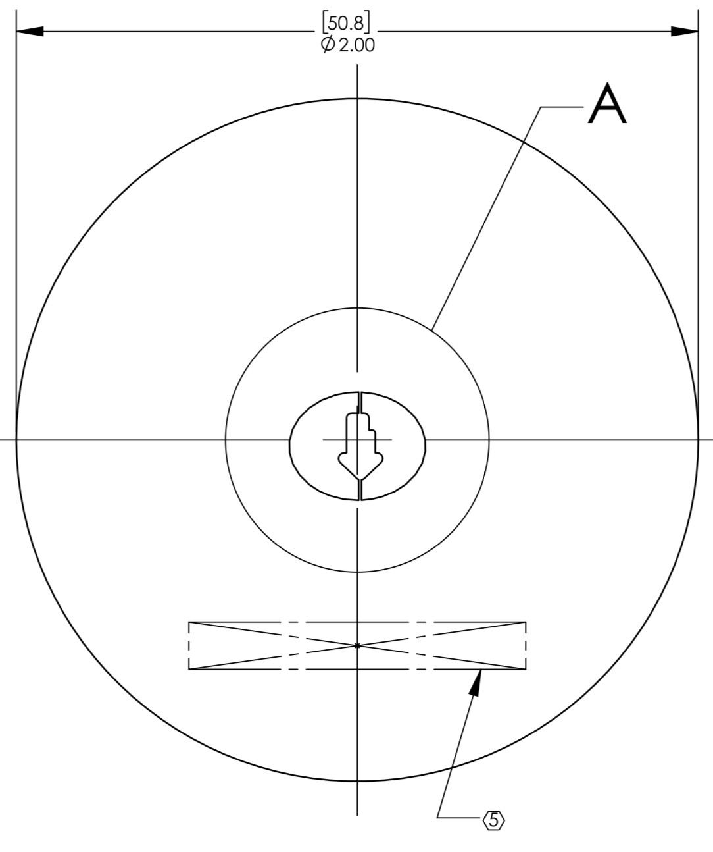
HWS orientation
Orientation in flipper
FLIR camera orientation

