Slide 1

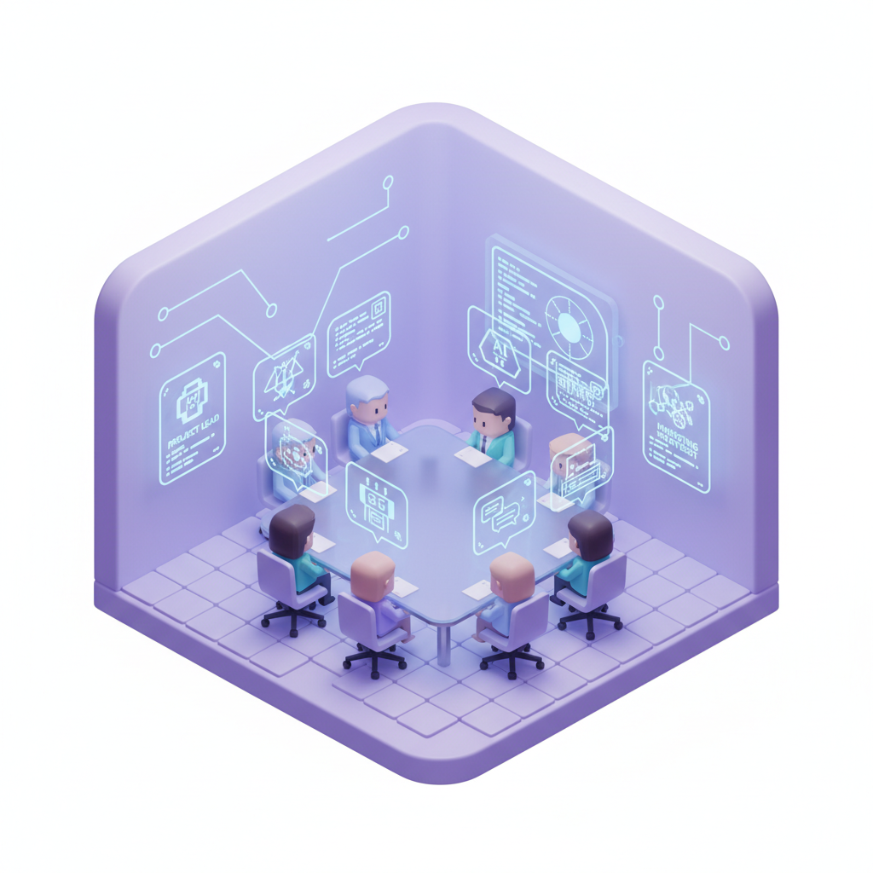
NPC Persona & Meeting System
DeskRPG | AI-Driven NPC Conversation Architecture
3-File Persona Injection
IDENTITY.md | SOUL.md | AGENTS.md
IDENTITY - Role, personality, expertise, communication style
SOUL - Core values, methodology, decision patterns
AGENTS - Meeting protocol: SPEAK/PASS, memory, group rules
Meeting Orchestration (meeting-broker.js)
1. Poll all agents in parallel (SPEAK / PASS)
2. Fairness-based speaker selection (longest silence first)
3. Grant floor with 10-turn context + participant info
DeskRPG: Virtual Office with AI NPCs
4. Stream response in real-time via OpenClaw Gateway
5. Repeat until maxTurns or consecutive PASS termination
20 Office Presets | OpenClaw + OpenRouter (fallback) | Auto / Manual / Directed modes

