Slide 1

TrafficFlowBench 2026
Traffic State Reconstruction
STAEformer, ImputeFormer and an ensemble
Model comparison
Experiments 003–006
3 new Kaggle submissions
21 October 2026
2026 IEEE Big Data Traffic Flow Bench
Notes:
PRESENTATION SCRIPT
This presentation summarizes our latest TrafficFlowBench experiments. We started from a five-epoch STAEformer residual model, improved that model, trained an ImputeFormer residual model, and combined the two. We made three new Kaggle submissions. The ensemble achieved the best Public score, improving the previous result from 0.76826 to 0.78255. I will first explain the data and pipeline, then the evaluation setup and the results.
SOURCES
docs/task1-upgrade-004-006.md; submissions/003_multitask/result.json; submissions/004_staeformer/result.json; submissions/005_imputeformer/result.json; submissions/006_ensemble/result.json.

Slide 2
Data and reconstruction pipeline
Synthetic highway observations · Task 1 reconstructs missing speed and flow.
Dataset
Masked observations
10
directional corridors
Observed speed / flow
+ visibility mask
Interpolation
from visible values
1,583
mainline links
5 min
sampling interval
Residual model → Δspeed, Δflow
One day: 288 × N × C
N = links in one corridor
C = input channels; flow is per lane
Prediction = interpolation + residual
Train with 20%, 30% or 50% random masking; compute loss only on hidden eligible cells.
Evaluate only the official Task 1 target coordinates. A blank cell is not automatically a target.
02 | Data & method
Notes:
PRESENTATION SCRIPT
The dataset contains synthetic observations from ten directional corridors, with 1,583 mainline links sampled every five minutes. For each corridor, one day forms a 288-by-links array. We first interpolate the visible observations. A residual model then uses the observations, mask and interpolated values to predict a correction. The final estimate is the interpolation plus that correction. During training, we randomly hide eligible observations at rates of 20, 30 or 50 percent and compute the reconstruction loss only there. Evaluation uses the official target coordinates, because not every blank is a prediction target.
SOURCES
docs/staeformer-residual.md; docs/task1-upgrade-004-006.md; src/task1/upgrade.py; src/task1/staeformer_data.py.
DETAILS FOR QUESTIONS
The basic five channels are observed speed, observed flow per lane, visibility, interpolated speed and interpolated flow per lane. Interpolation uses visible values from the full day, including later observations. This is offline Task 1 reconstruction, not causal Task 2 forecasting. Submitted flow is converted back to vehicles per hour.

Slide 3
Models and evaluation setup
Two residual models, one common reconstruction pipeline.
Setting
Previous STAEformer
Improved STAEformer
ImputeFormer
Input window
24 steps / 2 h
48 steps / 4 h
24 steps / 2 h
Data channels
5
8
5
Training
5 epochs
5 + 15 epochs
20 epochs (from scratch)
Key difference
Reference model
Quality + time-gap inputs
Low-rank attention
New models: 50% overlapping windows · residual weight 1.0 · seed 42 · physical GPU 9
LOCAL FIT
SELECT MODEL / BLEND
REPORT RESULTS
Jun–Dec 2030
Jan 2031
Feb 2031
Final models: refit on all nine training months → predict the March / April inputs.
03 | Experiment design
Notes:
PRESENTATION SCRIPT
The improved STAEformer uses a four-hour window and eight input channels. It adds observation quality and the distance to the previous and next visible observation. It continues a five-epoch checkpoint for fifteen more epochs, giving twenty cumulative epochs. ImputeFormer uses a two-hour window and five data channels, with low-rank attention, and trains for twenty epochs from scratch. For local experiments, we fit on June through December, choose the model and blend using January, then report February results. Submission models are separately refit on all nine training months before predicting the official March and April inputs.
SOURCES
configs/task1_upgrade_004_006.json; docs/task1-upgrade-004-006.md; runs/staeformer_upgrade_004/local/history.json; runs/imputeformer_upgrade_005/local/history.json.
DETAILS FOR QUESTIONS
STAEformer has temporal/spatial attention; ImputeFormer has projected temporal attention and factorized embedded spatial attention, plus Fourier regularization of 0.01. Both are residual-reconstruction adaptations, not direct reproductions of published benchmark scores. Both use AdamW, BF16, and half-window inference strides. Early stopping was allowed; both selected epoch 20. STAEformer's local warm-start checkpoint was trained only on June–December. The final nine-month checkpoint was used only for submission refitting. Original model code: https://github.com/XDZhelheim/STAEformer and https://github.com/tongnie/ImputeFormer (commit 1c3868cf499951ac43b4fc7280593fbb745f58c7).

Slide 4
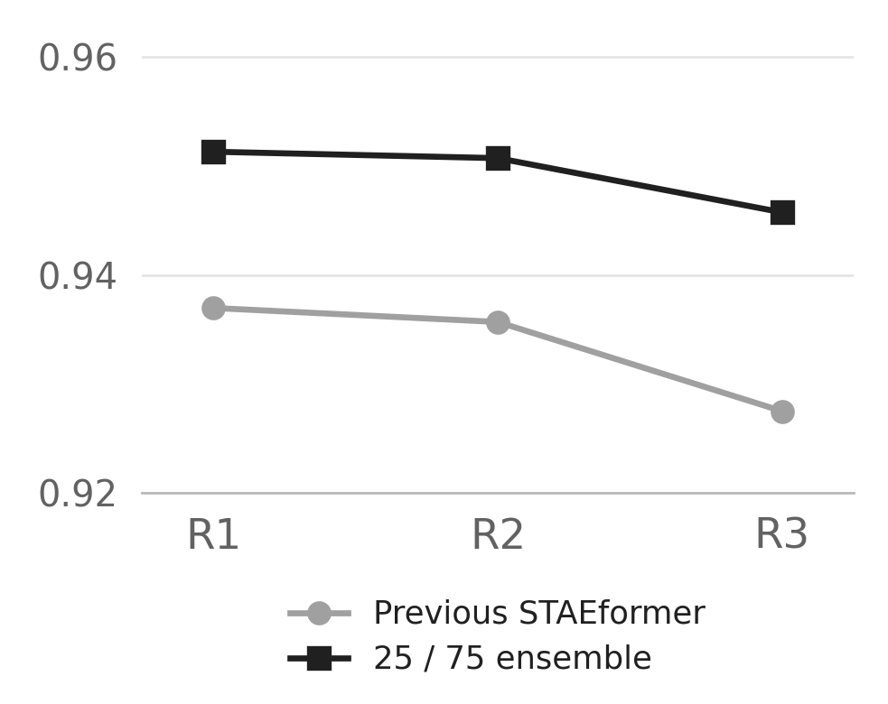
Local Task 1 results
S_state · higher is better · models trained on Jun–Dec 2030
Model
January
selection
February
report
February by mask regime
Previous STAEformer
0.931830
0.933377
Improved STAEformer
0.943123
0.944272
ImputeFormer
0.947440
0.948697
25 / 75 ensemble
0.948117
0.949252
Panel-average S_state
25% STAEformer + 75% ImputeFormer
Blend selected on January · all 3,443,944 February targets evaluated
February was also evaluated in earlier experiments; this experiment used January for selection.
04 | Local evaluation
Notes:
PRESENTATION SCRIPT
These are local Task 1 scores, rather than the overall Kaggle score. The improved STAEformer scored 0.944272 on February, while ImputeFormer scored 0.948697. The ensemble was highest at 0.949252, compared with 0.933377 for the previous model. The graph also shows that the ensemble improved over the previous model in all three masking regimes. We chose one common blend using January: 25 percent STAEformer and 75 percent ImputeFormer. We then evaluated all 3,443,944 official February target cells using that fixed blend.
SOURCES
runs/ensemble_006/comparison_with_kaggle.json; runs/ensemble_006/selection_best.json; runs/staeformer_residual_001/test_result.json.
DETAILS FOR QUESTIONS
January has 3,645,345 official targets. February has been evaluated in earlier experiments, so it is not a newly untouched independent benchmark. Selection for this experiment used January only. These local results come from June–December fits, not from final submission models refit on all nine months. The regime chart is an equal average over directional panels. Task 1 uses normalized speed and flow-per-lane RMSE; local and Kaggle aggregate scores are different metrics.

Slide 5
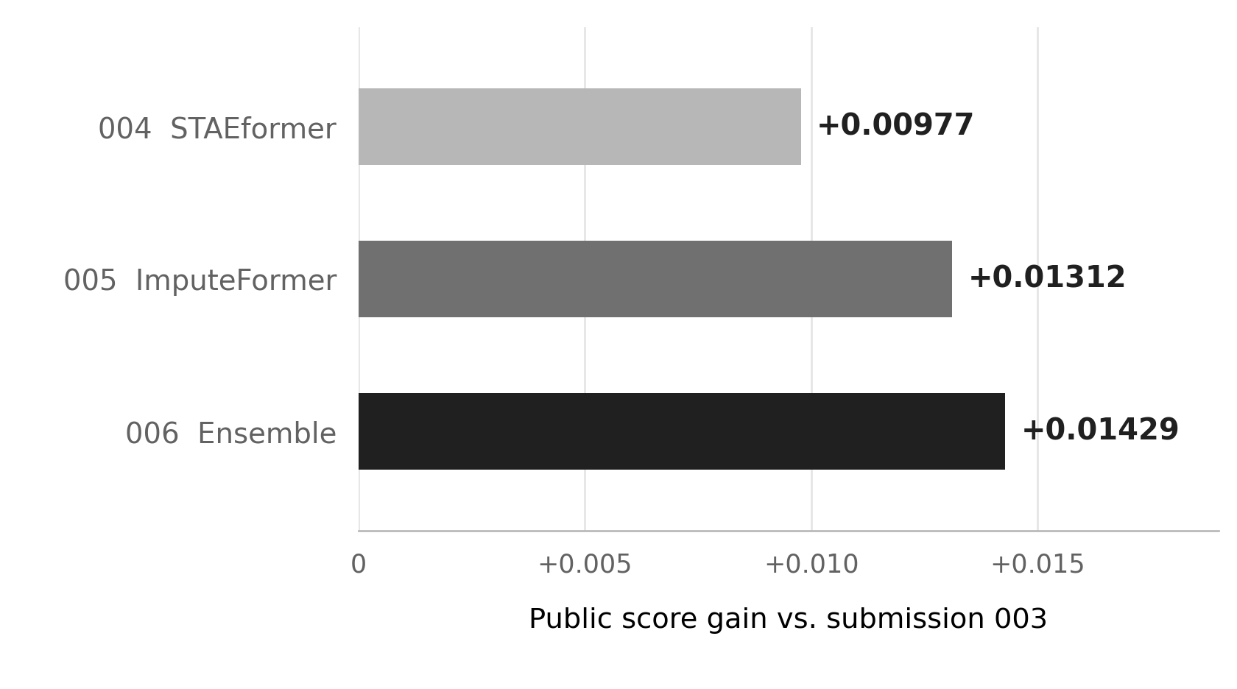
Kaggle Public results
Three new submissions completed · Task 2 (queue) and Task 4 (path flow) held fixed
Improvement over submission 003
Submission
Public score
003 Previous
0.76826
004 STAEformer
0.77803
005 ImputeFormer
0.78138
006 Ensemble
0.78255
+0.01429
Best gain over the previous submission
The Public gain reflects Task 1 reconstruction + Task 3 physical consistency.
05 | Official submission results
Notes:
PRESENTATION SCRIPT
All three new submissions were scored successfully on Kaggle. The previous Public score was 0.76826. Improved STAEformer reached 0.77803, ImputeFormer reached 0.78138, and the ensemble reached 0.78255. The best absolute improvement is 0.01429. We kept every Task 2 and Task 4 prediction identical to the previous submission. The score change therefore reflects the combined effect of Task 1 reconstruction and Task 3 physical consistency, since both use the same speed and flow predictions. The Public total does not let us separate those two contributions.
SOURCES
submissions/003_multitask/result.json (57461328); submissions/004_staeformer/result.json (57468104); submissions/005_imputeformer/result.json (57468122); submissions/006_ensemble/result.json (57468140); runs/ensemble_006/completion_audit.json.
DETAILS FOR QUESTIONS
All three new receipts are COMPLETE as checked on 21 October 2026. Each CSV contains 6,980,503 rows: 6,735,795 state, 174,000 queue, and 70,708 ODME. All 244,708 queue/ODME rows match submission 003. Target coverage, uniqueness, finite/nonnegative values, row order, and CSV round-trip checks passed. The three files were frozen before the first upload; the blend was not tuned to Kaggle feedback. Overall scoring weights: 0.35 state + 0.30 queue + 0.15 physics + 0.20 ODME. Private scores have not been released.

Slide 6
Conclusion and next experiment
25% STAEformer
+ 75% ImputeFormer
0.78255
Best Kaggle Public score
Best of the four configurations tested.
+0.01429 over submission 003
01
ImputeFormer was the strongest single model.
02
The ensemble added +0.00117 on the Public leaderboard.
03
Next: train with time-block and spatial masks.
Then test window length, extra features and training duration one at a time.
Private leaderboard results are not yet available.
06 | Conclusion
Notes:
PRESENTATION SCRIPT
The best configuration was the 25 percent STAEformer and 75 percent ImputeFormer ensemble, with a Public score of 0.78255. ImputeFormer was the strongest single model, and combining it with STAEformer added another 0.00117. Our next experiment should make the training masks more similar to the official missingness patterns, including gaps across time and neighboring links. After that, we should change window length, extra features and training duration one at a time to understand which changes are responsible for the gains. The private results are not available yet.
SOURCES
runs/ensemble_006/comparison_with_kaggle.json; docs/task1-upgrade-004-006.md; submissions/006_ensemble/result.json.
DETAILS FOR QUESTIONS
The STAEformer upgrade changed window length, features, training duration and inference overlap together. The results establish a configuration comparison, not an architecture-only ablation. Independent random training masks differ from the official masking regimes. The proposed next experiments have not been run. All training for the completed experiments used physical GPU 9; creating these slides uses CPU only.

