Slide 1
Corporate Governance Reform and the Korea Discount
Lessons from Japan's Reform Experience
Setting: Monthly index P/B ratios: KOSPI · TOPIX · S&P 500 · MSCI EM | Jan 2004 – Dec 2024 | 1,008 obs.
Finding: KOSPI P/B averages –0.177× below TOPIX (t = –3.23) and –0.601× below MSCI EM (t = –10.30)
Approach: Japan's three governance reforms as policy benchmarks; event-window, panel OLS, synthetic control
Caveat: N = 4 country clusters; saturated event-window design — descriptive, not causally identified

Slide 2
The Korea Discount
KOSPI equities have persistently underperformed comparable benchmarks for over two decades
Magnitude of the discount — 2004–2024 average P/B ratios
Three structural channels
• Chaebol opacity & agency costs — control-to-cash-flow ratio ≈ 2:1; tunneling; 60% inheritance tax incentive to suppress share prices
• Minority-shareholder recourse deficit — civil-law tradition, weak derivative suit rights, incomplete Stewardship Code
• Geopolitical risk premium — six North Korean nuclear tests; priced as a structural level discount, not event spikes
Benchmark
Mean gap
t-stat
95% CI
KOSPI sub-period
vs. TOPIX
–0.177×
–3.23
[–0.284×, –0.069×]
vs. MSCI EM
–0.601×
–10.30
[–0.716×, –0.486×]
vs. S&P 500
–1.90×
—
—
KOSPI trajectory: 1.36× (2004–2013) → 1.02× (2014–2022) → 0.93× (2023–2024) | TOPIX rebounded to 1.36× post-2023 TSE reform

Slide 3
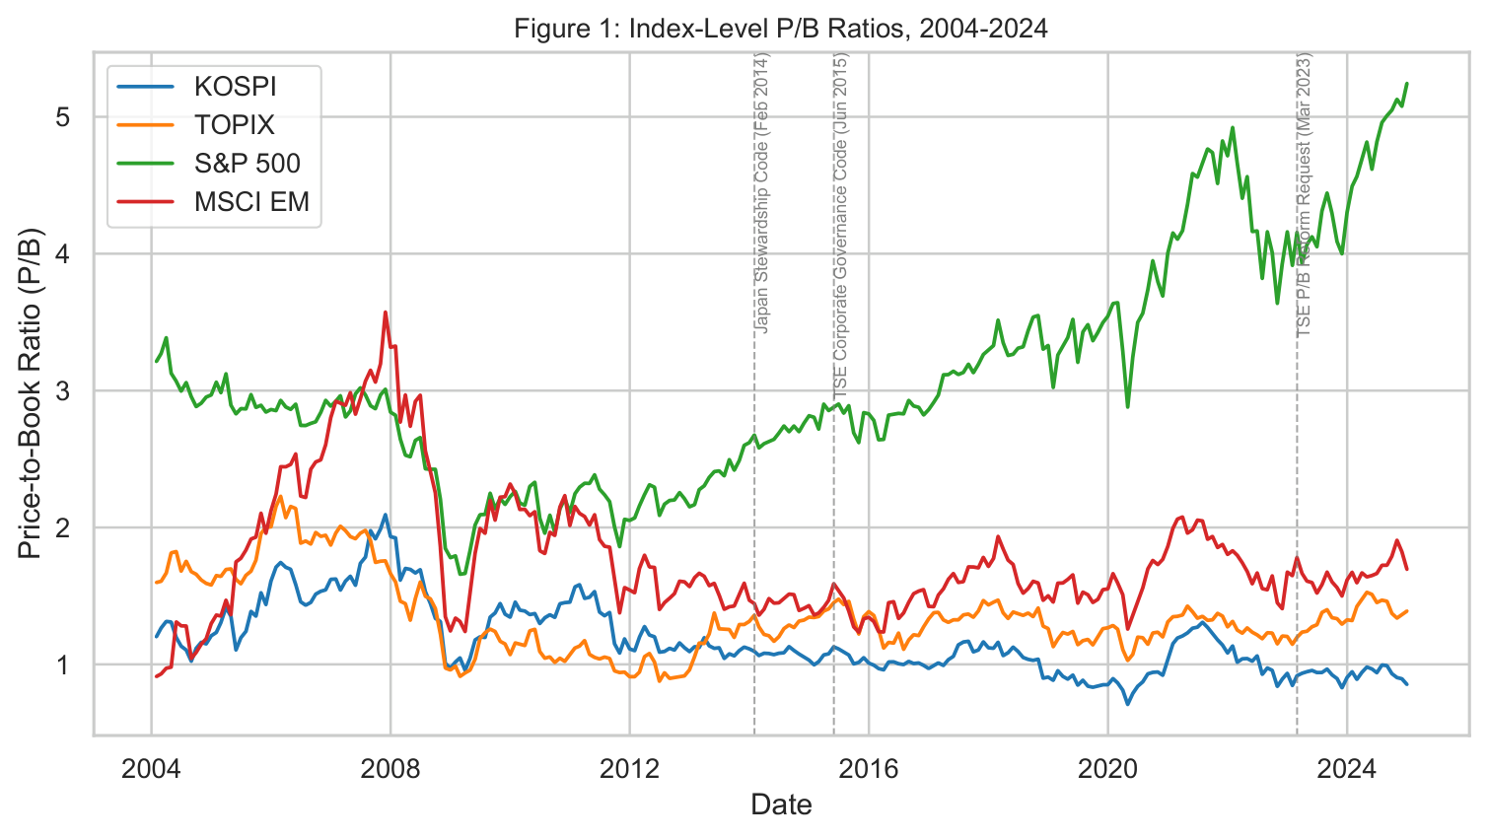
Figure 1: Index-Level P/B Ratios, 2004–2024
Dashed verticals mark Japan's three reform dates; Korea discount persists and widens post-2023

Slide 4
Japan's Governance Reform Program
Three staged interventions — used as policy benchmarks, not clean natural experiments
Feb 2014
Stewardship Code
Required institutional investors to adopt engagement policies and disclose voting records. Accelerated keiretsu cross-shareholding unwinding (Miyajima 2023). High compliance under comply-or-explain.
Jun 2015
Corporate Governance Code
Required all TSE-listed firms to comply or explain against governance principles. Mandated ≥ 2 independent directors. By 2017, >90% of JPX-Nikkei 400 complied.
Mar 2023
TSE P/B Reform
Firms below 1.0× book value required to disclose capital efficiency plans. TOPIX P/B rose from ≈1.0× to ≈1.36×. KOSPI remained at ≈0.93× — gap widened. Korea's Value-Up Program (2024) mirrors this but remains voluntary.
Korea comparison: adopted Stewardship Code Dec 2016 (weaker enforcement) and Value-Up Program 2024 (voluntary) — a partial, not strictly never-treated, comparison unit. All reform dates locked in config.py before any data transformation.

Slide 5
Data & Empirical Strategy
Data
• Bloomberg PX_TO_BOOK_RATIO: monthly index P/B
• KOSPI · TOPIX · S&P 500 · MSCI EM
• Jan 2004 – Dec 2024 (1,008 country-months)
• P/B preferred to P/E: less cyclically volatile; no sign-change in recessions; directly targeted by TSE reform
• GPR index (Caldara–Iacoviello) + GPRNK sub-index for North Korea escalation
• No missing data across all four series
Three Empirical Designs
Event-window analysis [primary]
Linear pre-event trend extracted over [–36, –1] months; CAR = cumulative abnormal KOSPI–TOPIX spread over [–12, +24]. Saturated design → no SEs. Results are descriptive only.
Panel OLS [corroborating]
Two-way FE (country + time); reform × Japan interaction terms. Wild-bootstrap p-values (999 Rademacher draws, N = 4 clusters). Results: p = 0.625 / 0.375 / 0.500 — no robust causal evidence.
Synthetic control [2023 only]
Convex combination of regional EM donor markets on demeaned P/B. Full weight to MSCI EM Asia (w = 1.0); pre-treatment RMSPE = 0.1451. Post-reform gap fades rather than widens — no sustained idiosyncratic premium.

Slide 6
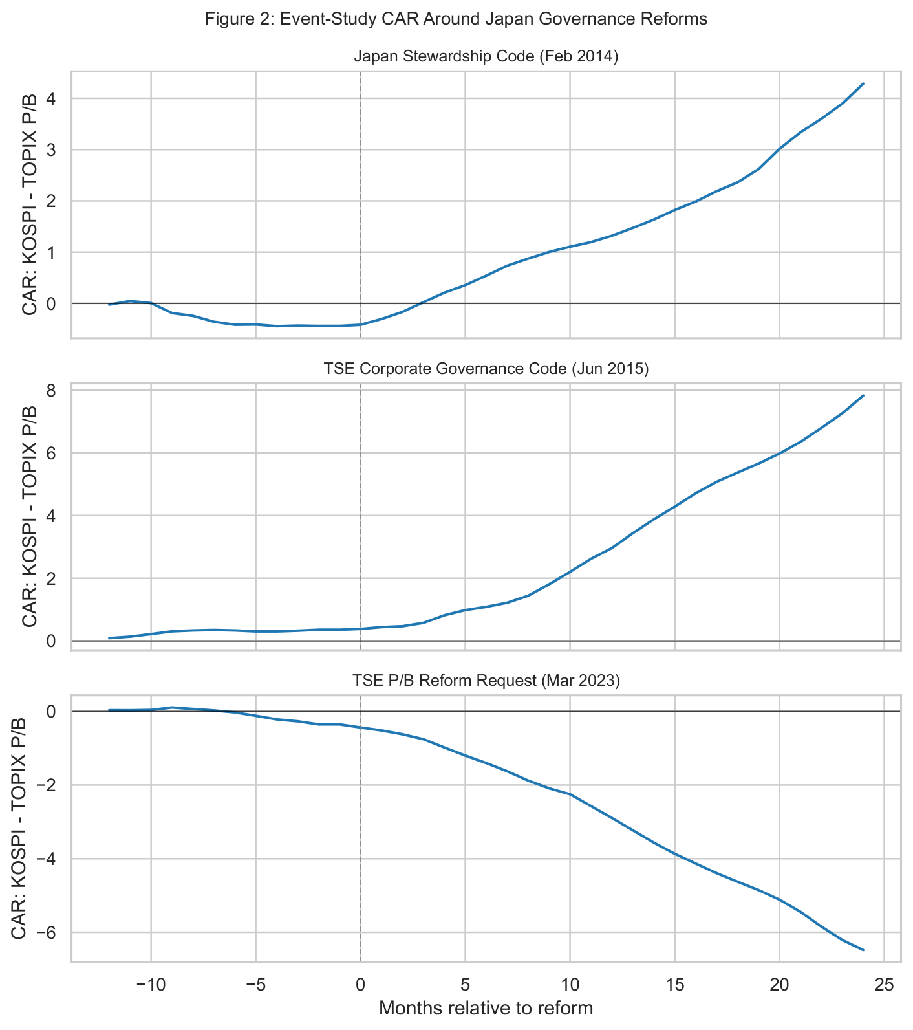
Results: Event-Window Analysis
Cumulative abnormal KOSPI–TOPIX P/B spread; positive = discount narrowed vs. pre-event trend
Three cohort CARs at τ = +24
2014 Stewardship Code | CAR ≈ +4.29
Spread rose vs. pre-event trend. Overlaps 2015 window — not independent.
2015 Corp. Governance Code | CAR ≈ +7.83
Largest cumulative movement. Overlaps 2014 window.
2023 TSE P/B Reform | CAR ≈ –6.48
Korea–Japan gap deepened relative to pre-event trend after reform. Clearest and most policy-relevant cohort.
Critical caveat: design is saturated; no confidence intervals; 2014 and 2015 cohorts overlap. These are descriptive spread movements, not causal treatment effects.

Slide 7
Results: Panel OLS & Synthetic Control
Panel OLS — two-way FE + reform × Japan
Wild-bootstrap p-values (999 Rademacher draws, N = 4 clusters)
2 of 3 point estimates are negative. None reaches p < 0.05 under wild bootstrap. N = 4 clusters → severely limited power. Interpret as: no robust causal evidence.
Synthetic Control — 2023 TSE P/B Reform
Donor pool: MSCI EM Asia, MSCI HK, MSCI Taiwan, MSCI China, MSCI India, MSCI Indonesia
Donor weight: MSCI EM Asia = 1.0 (single-donor solution)
Pre-treatment RMSPE: 0.1451 (below 0.15 threshold)
Post-reform gap: Modestly positive, fading (avg. change ≈ –0.0028/month)
Interpretation: Japan's P/B lift broadly matched its synthetic EM Asia peer. No sustained idiosyncratic governance premium after 2023.
Caveat: TOPIX absolute P/B did rise, but may reflect yen depreciation and regional EM momentum rather than a purely idiosyncratic governance premium.
Interaction term
Coef.
p-value
Stewardship Code × Japan
+0.09
0.625
Corp. Governance Code × Japan
–0.32
0.375
TSE P/B Reform × Japan
–0.23
0.500

Slide 8
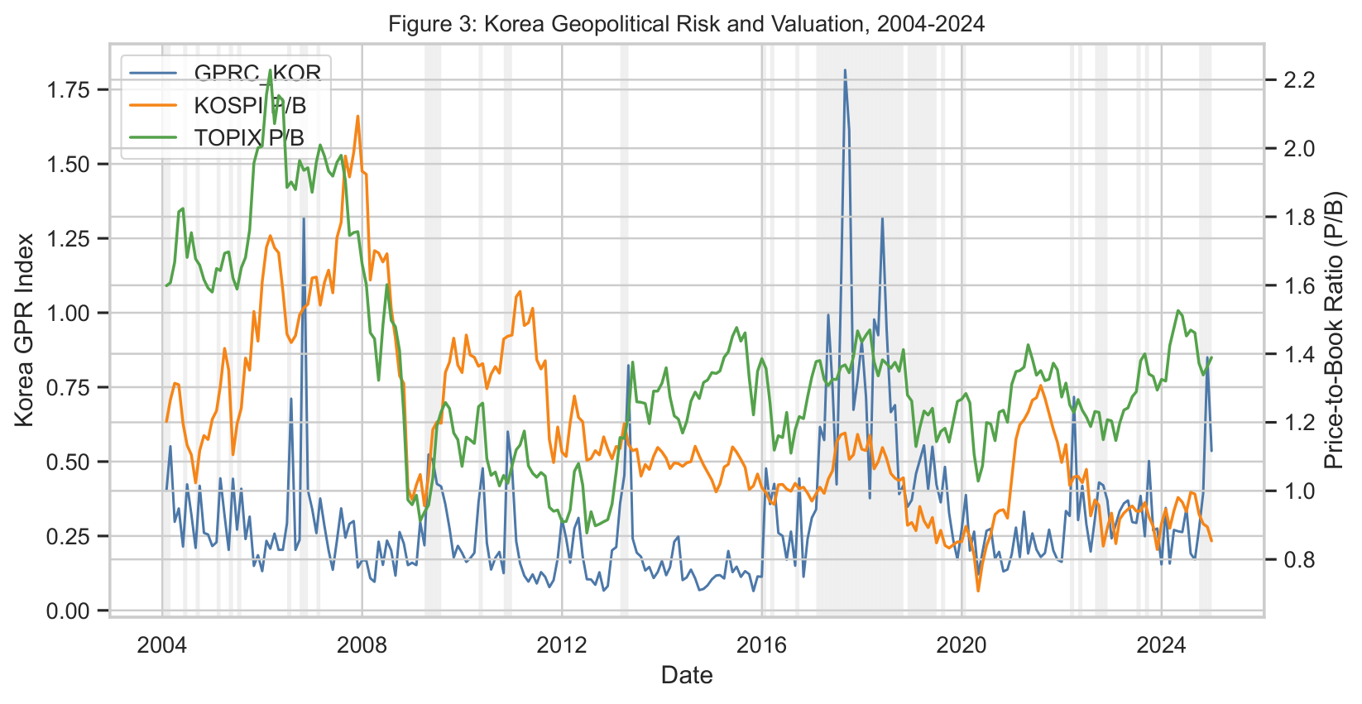
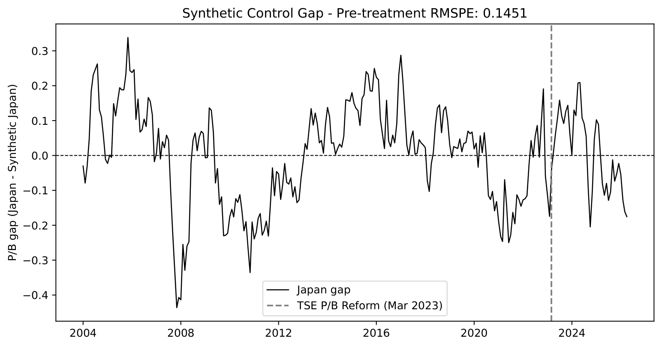
Preliminary Results: Additional Figures
Left: GPR escalation insignificant (p = 0.40) — risk priced as level discount | Right: Synthetic control gap fades post-2023

Slide 9
Conclusion
What we document
• KOSPI P/B averages –0.177× below TOPIX (t = –3.23) and –0.601× below MSCI EM (t = –10.30)
• Discount widened post-2023: KOSPI ≈ 0.93× vs. TOPIX ≈ 1.36×
• Three channels: chaebol opacity · minority recourse deficit · geopolitical risk premium
Empirical findings
• Event-window CARs: large spread movements around reform dates, but no valid inference (saturated design, overlapping cohorts)
• Panel OLS: p-values 0.625 / 0.375 / 0.500 — no robust causal evidence of a Japan governance re-rating
• Synthetic control: full weight to MSCI EM Asia (RMSPE 0.1451); post-reform gap fades, not widens
• Geopolitical risk coefficient: –0.02 (p = 0.40) is not significant, priced as a structural level discount
Bottom line
• The Korea Discount is persistent and statistically significant
• Japan's experience provides useful policy benchmarks but does not identify the valuation gain Korea would realize from adopting Japan-style reforms
• Future work: firm-level chaebol governance panel; Korea Value-Up Program event study (2024–2026+)

Slide 10
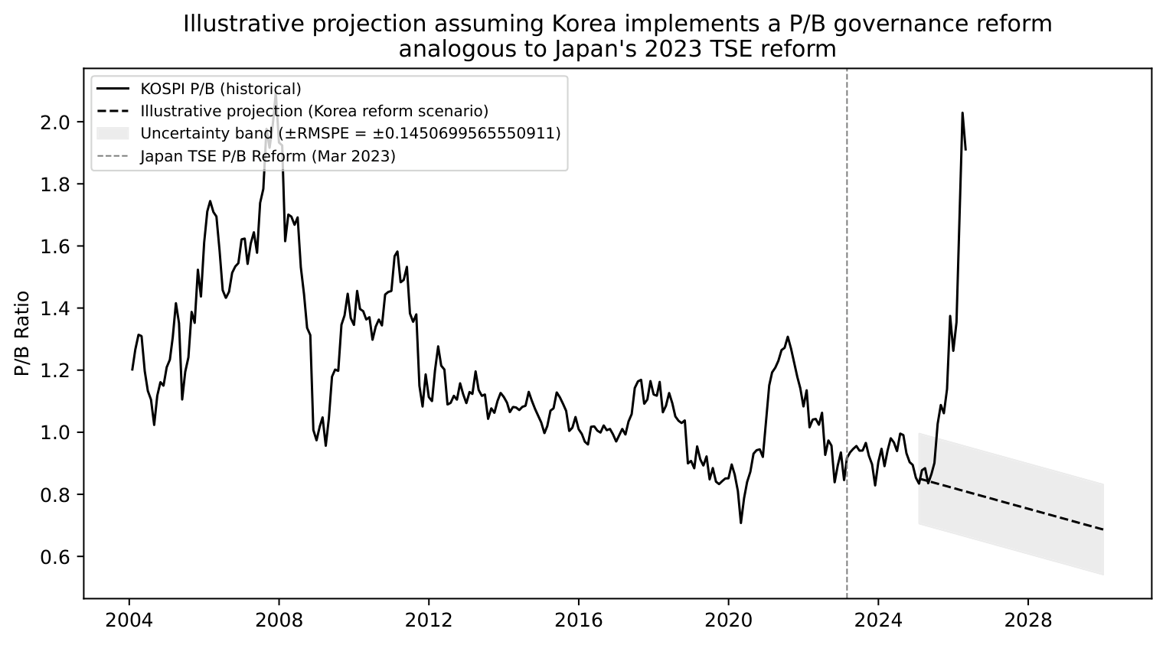
Appendix A: Illustrative Counterfactual Projection
KOSPI P/B under a Korea governance reform scenario — stress test, not a forecast
Construction
• Base: KOSPI P/B ≈ 0.93× (Dec 2024)
• Applied rate: avg. monthly change in Japan's synthetic-control gap over first 18 post-reform months (–0.0028/month)
• Uncertainty band: ± RMSPE = ± 0.1451
Result
Because the Japan post-2023 relative gap change is negative, the mechanical projection does not close the Korea Discount. This is a stress test, not a prediction of policy success.
Policy levers (if reforms are implemented)
• FSC mandatory P/B disclosure (comply-or-explain, not voluntary)
• KRX ≥ 50% independent board composition for large-cap issuers
• Korean Stewardship Code: mandatory voting records + NPS engagement division

