Slide 1
IO Lab
Lec 1 - Introduction
August 24 2016
Notes:
Carlo

Slide 2
Today
Course Goals
Course Structure
Logistics
IOLab 2016 Immersion
Questions
Notes:
Carlo

Slide 3
Instructors
Bob Glushko (Professor - UC Berkeley School of Information)
Daniel Chen (2nd Year MIMS)
Data Science, Information Architect, Data Engineering
Carlo Liquido (2nd Year MIMS)
Data Visualization, Data Science, Frontend Dev GSR
Parv Sondhi (2nd Year MIMS)
Product Management and UX Research, Backend Dev GSR
Notes:
Everybody

Slide 4
Course Goals
What is IO Lab?
Notes:
{speaker: “Carlo”}

Slide 5
Background
Previously offered in Spring 2016, Fall 2014, Fall 2013, Fall 2012
Building information systems: Full Stack Development
Hands-on approach to implementing 202 concepts
Not just code - but architect
Notes:
Carlo

Slide 6
Our Objective
To help you design and develop information systems
Applying principles from Info 202: Information Organization and Retrieval
By leveraging current web technologies and tools
Our focus is on how you can implement these principles in your web application, not teaching the principles themselves
Notes:
Carlo

Slide 7
Past Projects

Slide 8
Learning principles
Not about talking/demos - more about practice
Not just read, dive in!
Design, plan before you code
Walk, run, and fall. Repeat
Deliberate Practice : Pair Programming
Notes:
Carlo

Slide 9
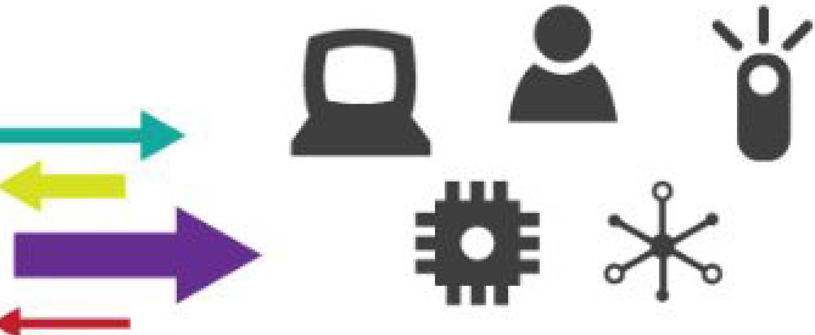

They a re a ll ''Organizing Systems"
Arranged Collection of Resources
• •
Supported Interactions
A collection of resources intentionally arranged to enable some set of interactions
Notes:
Parv

Slide 10
202 Concepts | Delivered through Module | Topic
Architectural Thinking/Controlled Vocabulary | Front End | HTML/CSS/Javascript
Architectural Thinking | Front End | Systems Architecture Planning
Relationships, Taxonomies and Ontologies | Back End | Modelling DBs
Classification System, Granularity and Abstraction | Back End | ORMs
Organizing Interactions | Advanced topics | Using APIs/API Design
Document Type Spectrum | Advanced topics | Web Scraping
Info 202 principles in practice
Notes:
Parv

Slide 11
Course Structure
Notes:
Parv

Slide 12




Getting Started
Course Structure
Front End
Back End
Advanced Topics
Introduction | HTML | Web Frameworks | APIs
Fundamentals | CSS | Architecture | Visualization
Git | Responsive Design | Database Design | Security
Command Line | JavaScript & jQuery |  | Deployment
Notes:
Parv

Slide 13
Logistics
Course Websites
BCourses: Assignments, Grades, Reading material, Syllabus
Github: Code, Resources, Templates etc
Grading policies
40% final project deliverable
40% weekly submissions (assignments + project milestones + responses)
20% participation (attendance and class work)
Notes:
Parv

Slide 14
Logistics
Final project
Functional system - not a prototype
Mobile or Web App or hybrid with working and deployed components
Team size 2 - 4 People
Periodic milestones and then final deliverable
Ideas - pitch your own
Notes:
Parv

Slide 15
Connecting everything together
Immersion
IOLab 2016
Notes:
Parv

Slide 16
Immersion
What is a front-end & back-end?
What are different technologies that support them?
How do they work together in the application architecture?
Know your tech
HTML , CSS
JavaScript Vs jQuery
Frameworks
Databases
Notes:
Parv

Slide 17
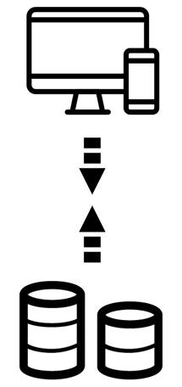
Class exercise
Split into groups of 4-6
Draw how you think LinkedIn is architected (client-server model)
Detail one specific user interaction ( endorsements or connection requests)
Notes:
Parv

Slide 18
Refresher - how the web works
Traditionally a 2-tiered approach
Client-Server
Client sends request, server processes and responds
Multi-tiered paradigm
Encapsulation of application services
Scalability
Examples - web server, load balancers, services (message queues, file servers)
Mobile apps enablement
API Layer on top of web apps
Notes:
Daniel
Layer 7 — Application Layer: The application layer is the OSI layer closest to the end user, which means that both the OSI application layer and the user interact directly with the software application. This layer interacts with software applications that implement a communicating component. Such application programs fall outside the scope of the OSI model. Application layer functions typically include identifying communication partners, determining resource availability, and synchronizing communication. Examples of application layer implementations include Telnet, Hypertext Transfer Protocol (HTTP), File Transfer Protocol (FTP), NFS and Simple Mail Transfer Protocol (SMTP).
Layer 6 — Presentation Layer: The presentation layer provides a variety of coding and conversion functions that are applied to application layer data. These functions ensure that information sent from the application layer of one system would be readable by the application layer of another system. Some examples of presentation layer coding and conversion schemes include common data representation formats, conversion of character representation formats, common data compression schemes, and common data encryption schemes, for example, eXternal Data Representation (XDR) used by Network File System (NFS).
Layer 5 — Session Layer: The session layer establishes, manages, and terminates communication sessions. Communication sessions consist of service requests and service responses that occur between applications located in different network devices. These requests and responses are coordinated by protocols implemented at the session layer. Examples of session layer protocols include NetBIOS, PPTP, RPC and SSH etc.
Layer 4 — Transport Layer: The transport layer accepts data from the session layer and segments the data for transport across the network. Generally, the transport layer is responsible for making sure that the data is delivered error-free and in the proper sequence. Flow control generally occurs at the transport layer. Transmission Control Protocol (TCP) and User Datagram Protocol (UDP) are popular transport layer protocols.
Layer 3 — Network Layer: The network layer defines the network address, which differs from the MAC address. Some network layer implementations, such as the Internet Protocol (IP), define network addresses in a way that route selection can be determined systematically by comparing the source network address with the destination network address and applying the subnet mask. Because this layer defines the logical network layout, routers can use this layer to determine how to forward packets. Because of this, much of the design and configuration work for inter-networks happens at Layer 3, the network layer. The Internet Protocol (IP) and related protocols like ICMP, BGP etc are commonly used layer 3 protocols.
Layer 2 — Data link Layer: The data link layer provides reliable transit of data across a physical network link. Different data link layer specifications define different network and protocol characteristics, including physical addressing, network topology, error notification, sequencing of frames, and flow control. Physical addressing (as opposed to network addressing) defines how devices are addressed at the data link layer. Asynchronous Transfer Mode (ATM) and Point-to-Point Protocol (PPP) are common examples of layer 2 protocols.
Layer1 — Physical Layer: The physical layer defines the electrical, mechanical, procedural, and functional specifications for activating, maintaining, and deactivating the physical link between communicating network systems. Physical layer specifications define characteristics such as voltage levels, timing of voltage changes, physical data rates, maximum transmission distances, and physical connectors. Popular physical layer protocols include RS232, X.21, Firewire and SONET.

Slide 19
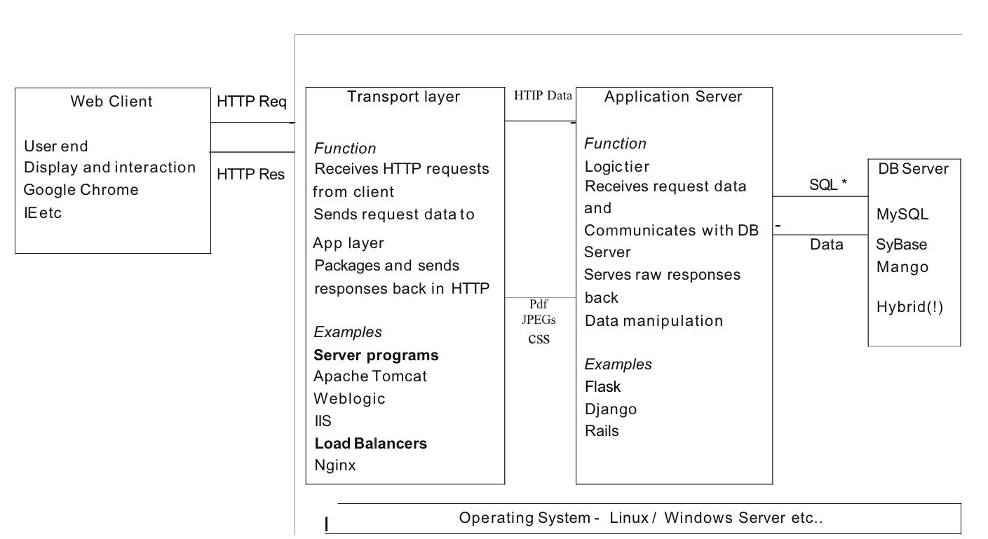
Notes:
Daniel
The TCP/IP stack has four layers: Application, Transport, Internet, and Network. At each layer there are different protocols that are used to standardize the flow of information, and each one is a computer program (running on your computer) that's used to format the information into a packet as it's moving down the TCP/IP stack. A packet is a combination of the Application Layer data, the Transport Layer header (TCP or UDP), and the IP layer header (the Network Layer takes the packet and turns it into a frame).
the user specifies a URL in their browser (either from a bookmark or by typing) the browser initiates a TCP connection to the Web server (or server pool) via its IP address as published in DNS. (Web servers by default use TCP port 80 to service incoming requests.). As part of this process, the browser also makes DNS lookup requests to convert the URL to an IP address after the server completes acknowledgement of its side of the TCP connection, the browser sends HTTP requests to the server to retrieve content for the URL. after the server replies with content for the Web page, the browser retrieves the content from the HTTP packets and display it accordingly. Content can include embedded URLs for advertising banners or other third-party content, that in turn triggers the browser to issue new TCP connection requests to those locations. The browser may also save temporary information about its connections to local files on the client computer called cookies.

Slide 20
Step #1 - Language
Tons of options
Python, Java, PHP, Ruby, Javascript,
Similar principles;different syntax
Language choices
Support (Tools, Libraries), Platform, Problem domain
Go deep, not broad
Instagram (Python), LinkedIn (Java), Twitter (Ruby)
Change - foundational versus scaling up
Notes:
Daniel
Focus on your problem/goal first

Slide 21
Step #2 - Frameworks
Web apps have similar underlying tasks
Dealing with different requests
Choosing pages to display + what content
Frameworks help abstract these tasks
Each language has popular frameworks
Python : Flask, Django
Ruby : Rails
Build your own..
Simple [build from scratch] vs Complex [All-inclusive]
More in Module 3
Notes:
Daniel
Popularity, Support, Philosophy, Security, Documentation, Learning curve, Compatibility
I think it is ionic framework and MEAN stack. Here is why I think so. Future is about building mobile first and cloud first. The future applications should be rapidly adaptable to change, they should scale easily and its better to use to similar software technologies for various mobile devices.

Slide 22
Step #3 - Data & Infrastructure
Information persistence
Server Side: Database, Text Files, Spreadsheets
Client Side: Local storage via HTML 5
Databases
SQL RDBMS: Structured; NoSQL: Unstructured
Cloud Storage via API
Firebase. Google Docs
Module 3
Designing a relational DB, NoSQL - MongoDB etc..
Notes:
Daniel
Size of data
Purposes of data
How much you going to use them
Security
Money

Slide 23
Step #4 - Add Magic
API Layer
Interact with other services, set up your own
Deploy your stuff
Domain name, Server space, hosting etc.
Security and Scaling
Common attacks and how to secure your app
Load balancing, etc…
Module 4
Advanced tools will help you run with your app
Notes:
Daniel

Slide 24
Summary
Module 1 & 2 : Intro/Front-End
HTML, CSS , best practices for good design
JavaScript breathes life
jQuery simplifies in-page interactions
Module 3 : Back-End
Choose a language you’re comfortable with: Python
A web-framework that allows you to build up rapidly: Flask
Give you a flavour of other frameworks: Meteor, Django
Databases!
Module 4 :
Deployment and other tools
Notes:
Daniel

Slide 25
Quick Poll
Linux
Windows
Mac
Notes:
Daniel

