Slide 1
BY DANDAVENI GANESH
WIPRO NGA - .Net React (MS Dynamics) - FY26 - C3
Instructor Name : Parth Shukla
Customer Engagement &
Service Analytics
A comprehensive platform for managing support operations, tracking tickets, and analyzing performance.

Slide 2
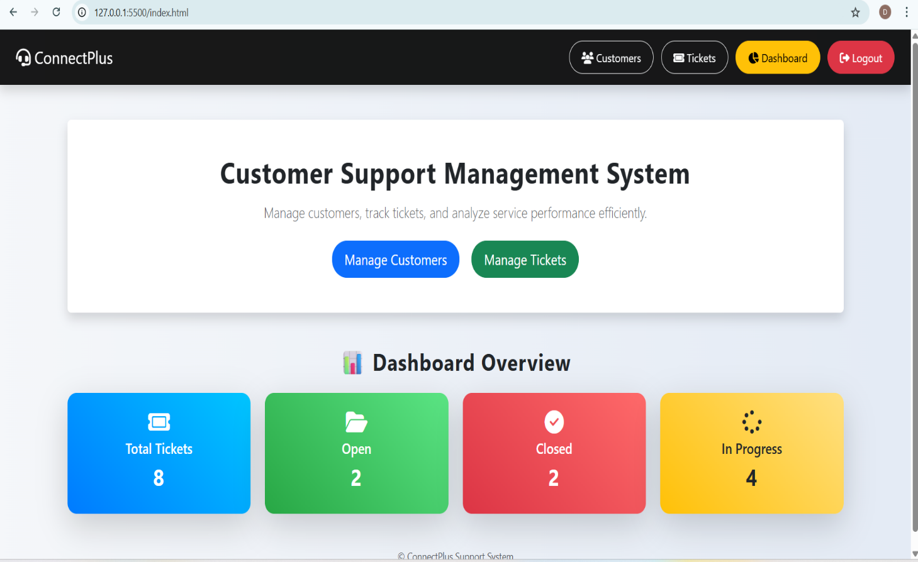
Platform Overview
This centralized web-based platform is meticulously designed to streamline modern customer service operations.
It serves as a unified hub where support teams can efficiently handle inquiries, assign service tickets, and monitor resolution timelines in real-time.
By replacing manual tracking with an automated, data-driven system, organizations can dramatically improve response times, minimize human errors, and greatly elevate overall customer satisfaction.

Slide 3
Core Objectives
Centralized Management: Design a unified system to handle end-to-end customer support workflows efficiently.
Robust Architecture: Develop a secure, high-performance backend API for processing tickets and validating business rules.
Data Integrity: Implement a highly structured, normalized relational database to securely persist customer and operational data.
Actionable Analytics: Generate real-time insights using integrated Power BI dashboards to track KPIs like open and closed tickets.
Responsive Experience: Build an intuitive, seamless frontend interface that empowers agents to manage workloads without friction.

Slide 4
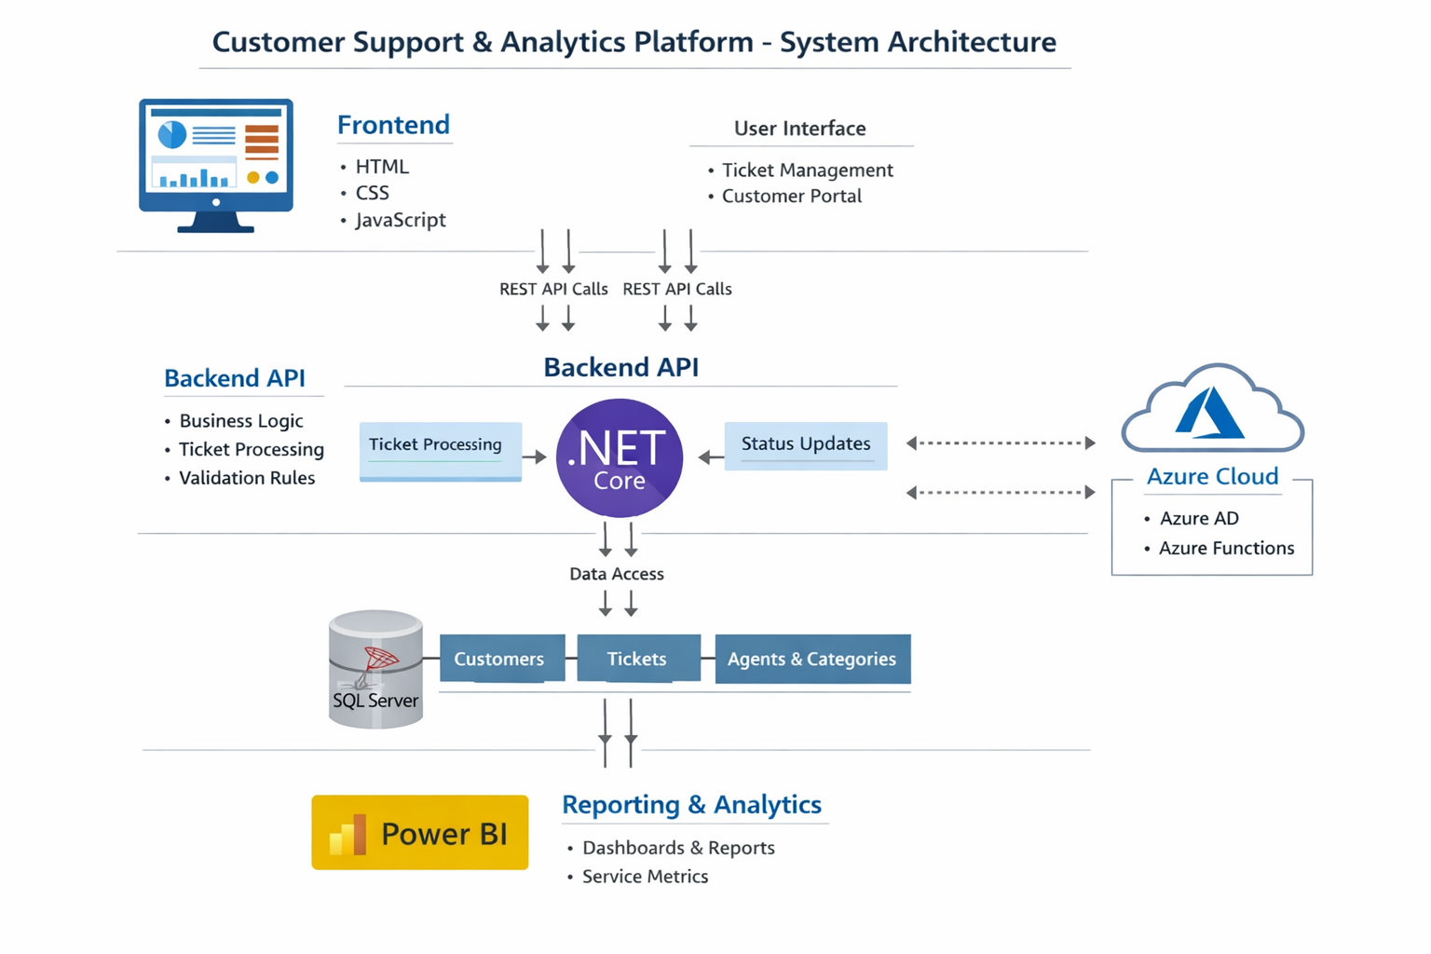
3-Tier Architecture
Scalable & Modular
The platform is engineered on a highly resilient three-tier architecture, ensuring strict separation of concerns and maintainability.
Frontend: A dynamic UI built with HTML, CSS, and JavaScript, providing instant access to ticket management functionalities.
Backend API: A robust .NET Core application responsible for orchestrating complex business logic and request validation.
Database: A reliable SQL Server deployment ensuring transactional consistency and long-term data security.

Slide 5
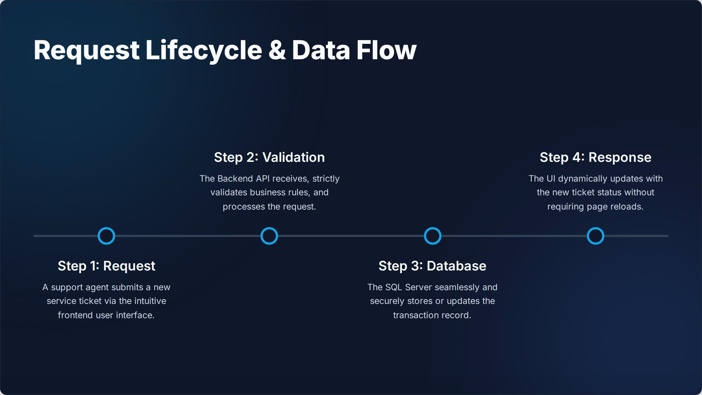
Slide Title
Add your content here...

Slide 6
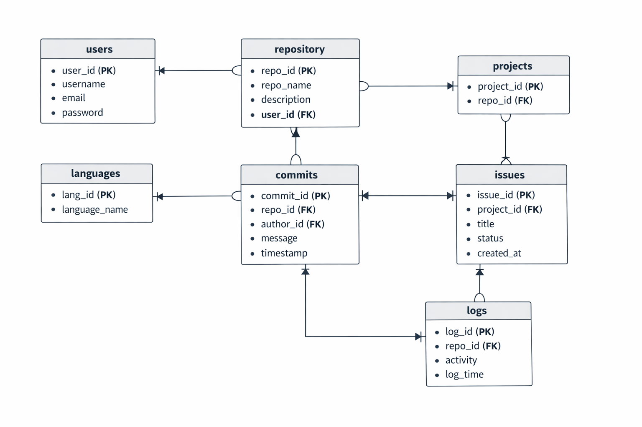
Database Design
The database employs a normalized relational schema to eliminate redundancy and maintain strict data integrity.
Customers: Core table storing client identity and contact information.
Agents: Tracks internal support staff responsible for resolving issues.
Categories: Classifies issues (e.g., Billing, Technical, Account Access).
Tickets: The central transactional table securely mapping customers to agents and categories.

Slide 7
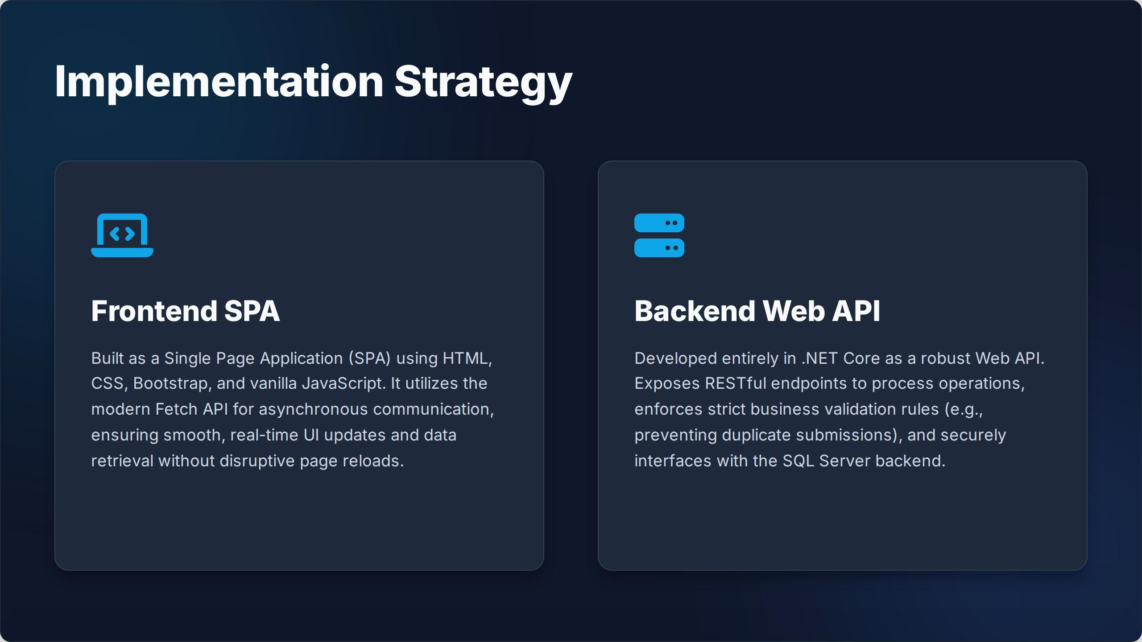
Slide Title
Add your content here...

Slide 8
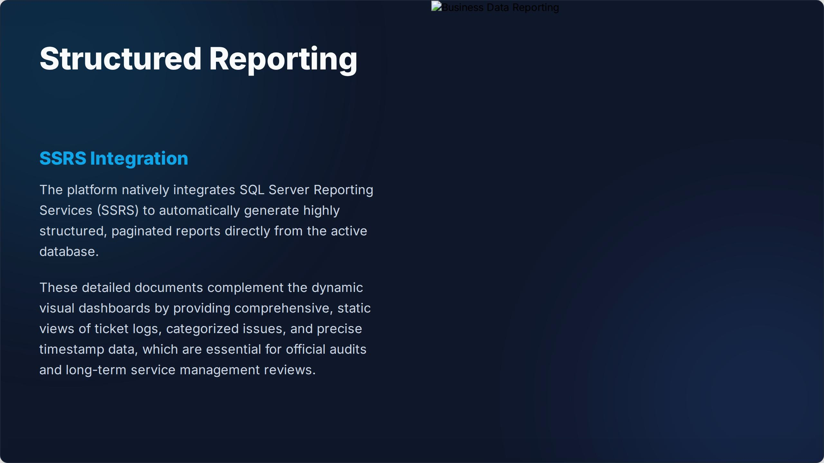
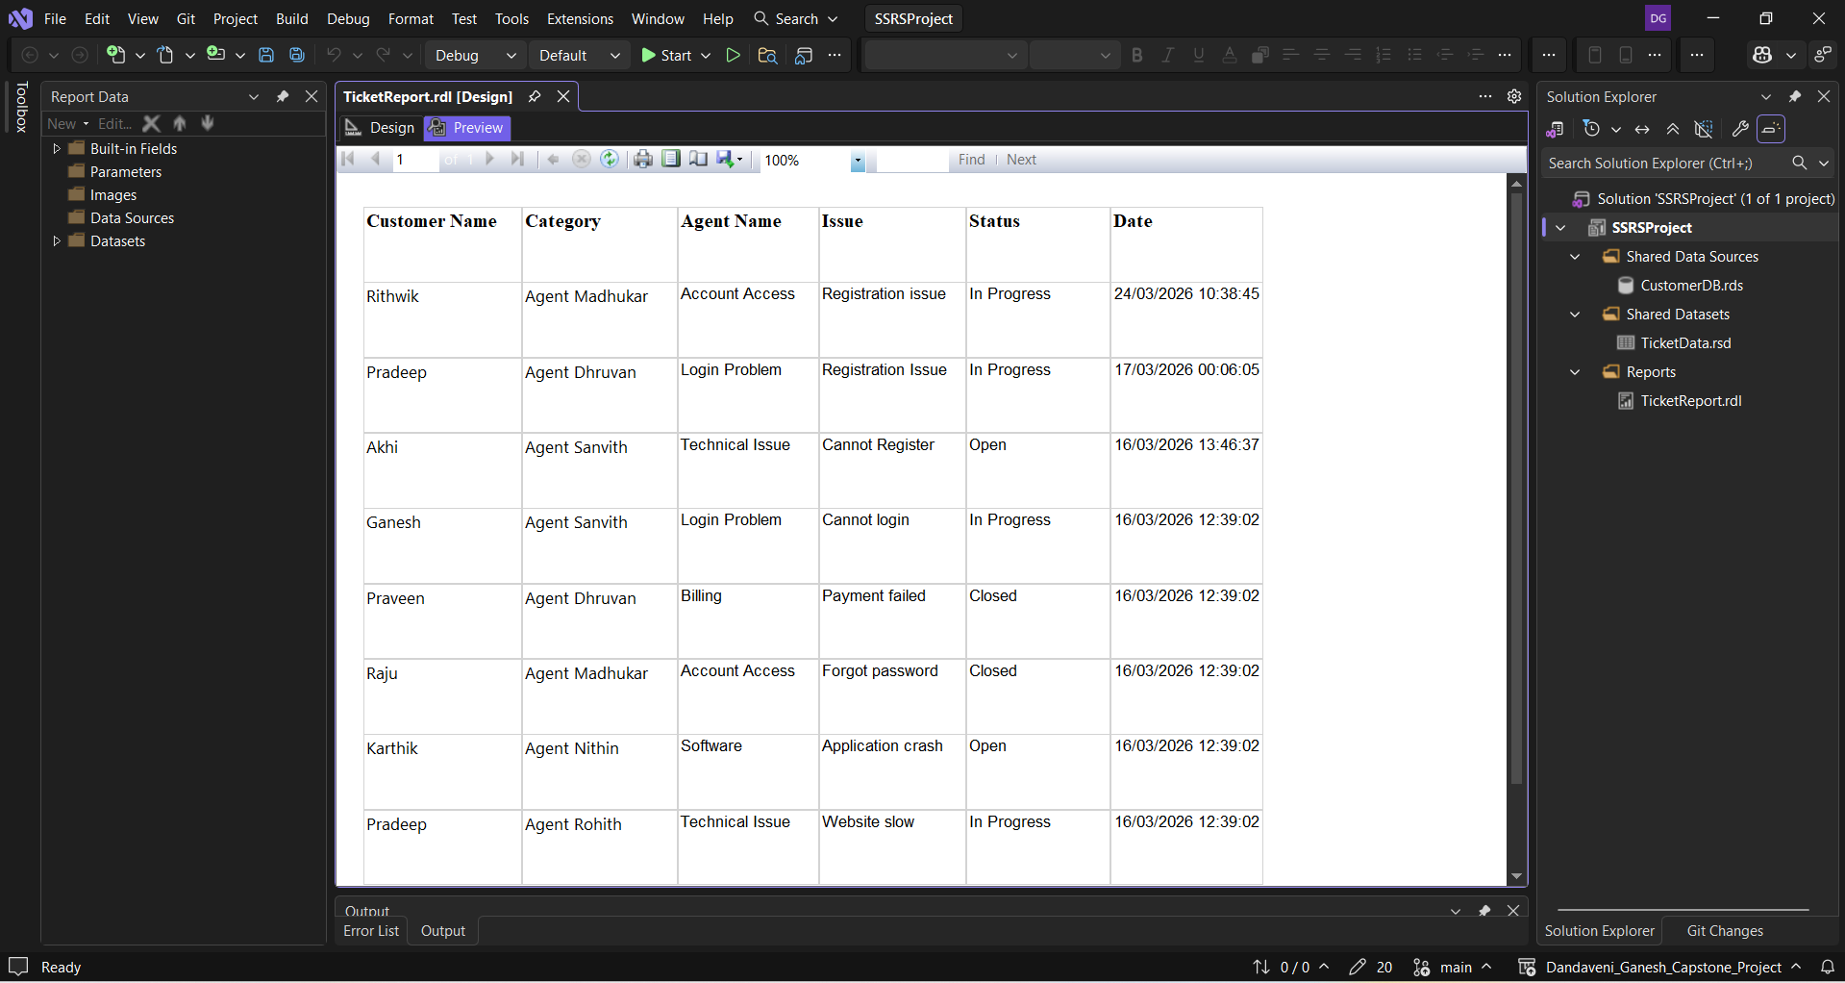
Slide Title
Add your content here...

Slide 9
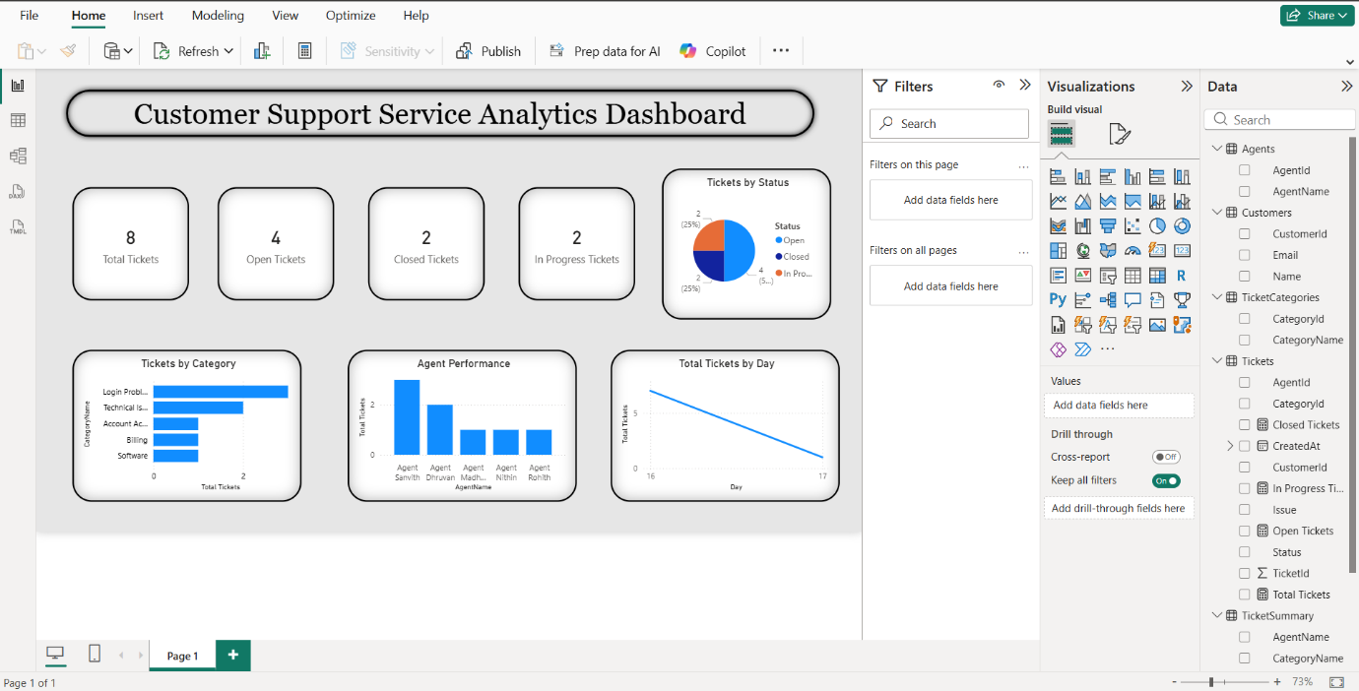
Power BI Dashboard:
Displays real-time ticket statistics
Total, Open, Closed, In Progress
Total, Open, Closed, In Progress

Slide 10
Conclusion
The Customer Engagement & Service Analytics platform successfully streamlines support operations through a centralized and scalable system.
It enables efficient ticket management, ensures data integrity, and provides real-time insights for better decision-making.
With its 3-tier architecture and modern web technologies, the system delivers high performance, flexibility, and a seamless user experience.
Overall, the platform enhances customer satisfaction, improves operational efficiency, and provides a strong foundation for future scalability.

