Slide 1
MUSIK
To discover regional music
To know which music is popular in a particular place
To entertain by listening music
GROUP 7
Borschneck Amélie – Poirot Charles-Henri - Vo Huynh Dan – Shriman Narayan Tiwari

Slide 2
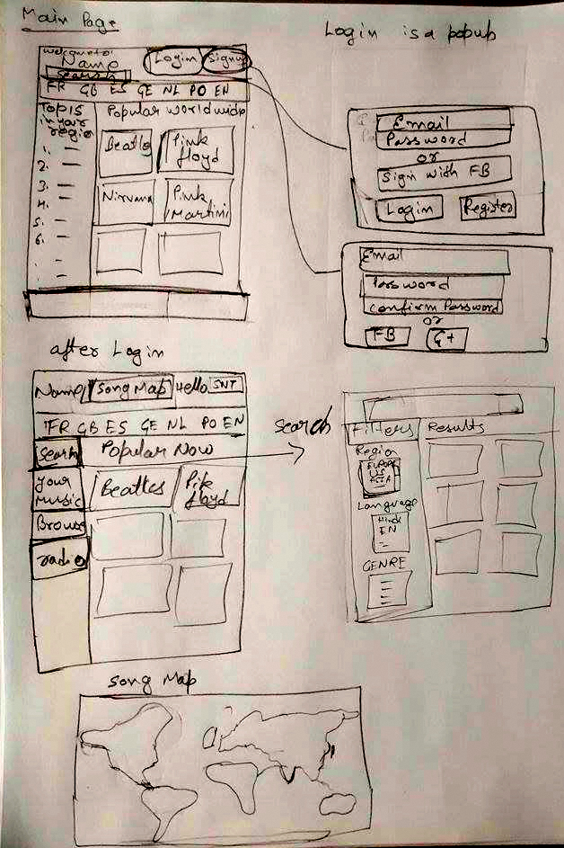
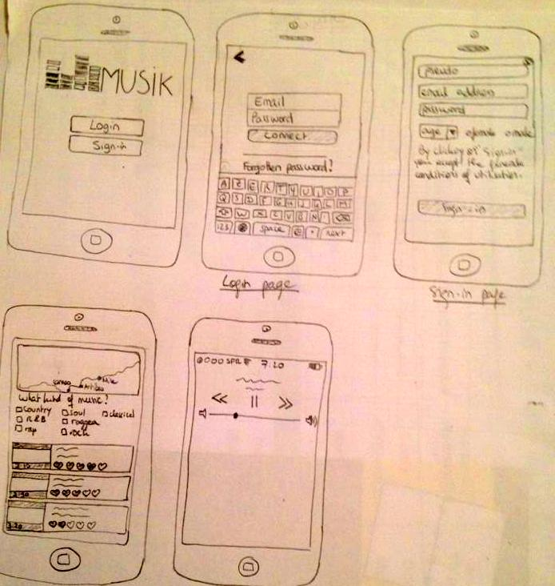
Our sketches...

Slide 3
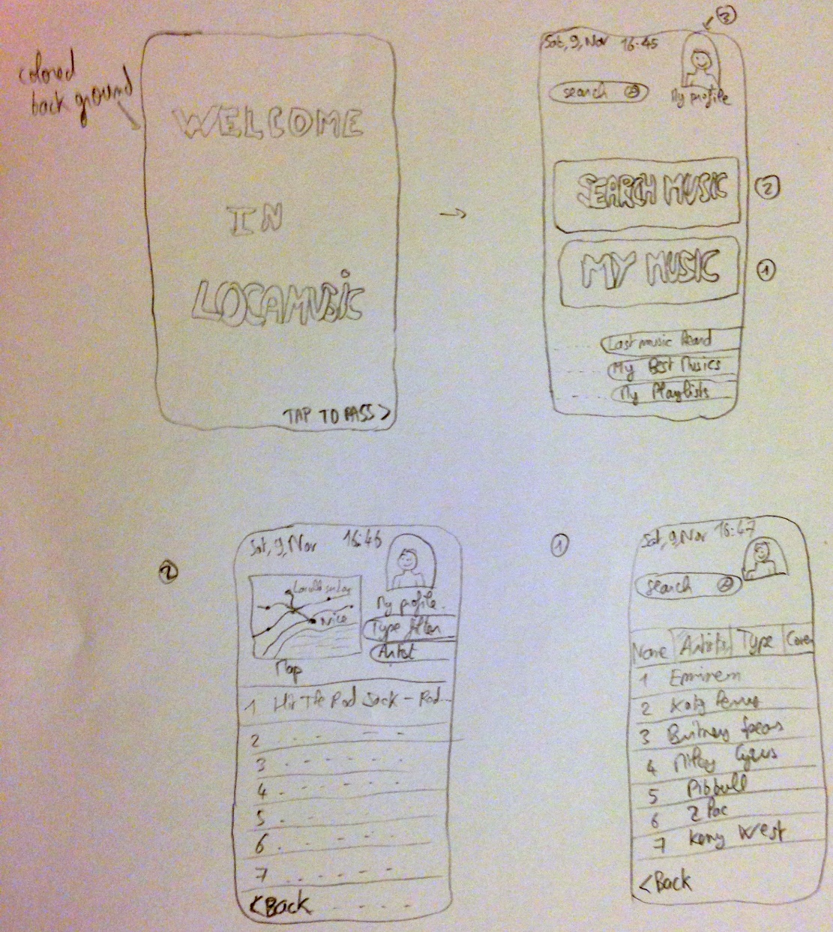
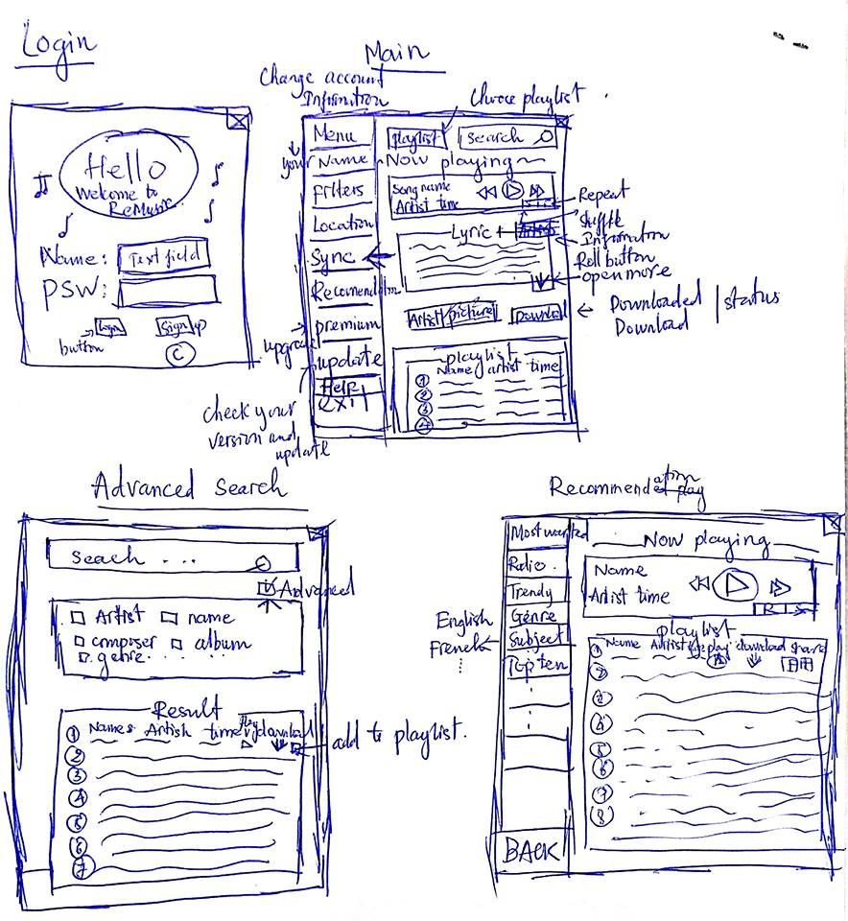

Slide 4
About our experience ...
Entertain
Explore
Regional music
Spread
The local cultural music
Popular music

