Slide 1

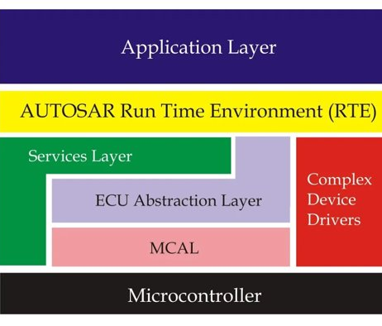
AUTOSAR
AUTomotive Open System ARchitecture

Slide 2
BSW = Basic SoftWare
CAN = Controller Area Network
RTE = RunTime Environment
MCU = MicroController Unit
ECU = Electronic Control Unit
MCAL = Microcontroller Abstraction Layer
EEPROM = electrically erasable and reprogrammable ROM ( read only mem )
DTC = Diagnostic Trouble Code
ASIC = Application specific integrated circuit

Slide 3

Definitions
Development partnership which creates an open and standardized software architecture for automotive ECUs.
Partners : BMW Group, BOSCH, Continental, Daimler, Ford, General Motors, PSA Group, Toyota, and VOLKSWAGEN.
Layered software architecture which can be used in applications based on microcontrollers reducing expenditures of research and development

Slide 4
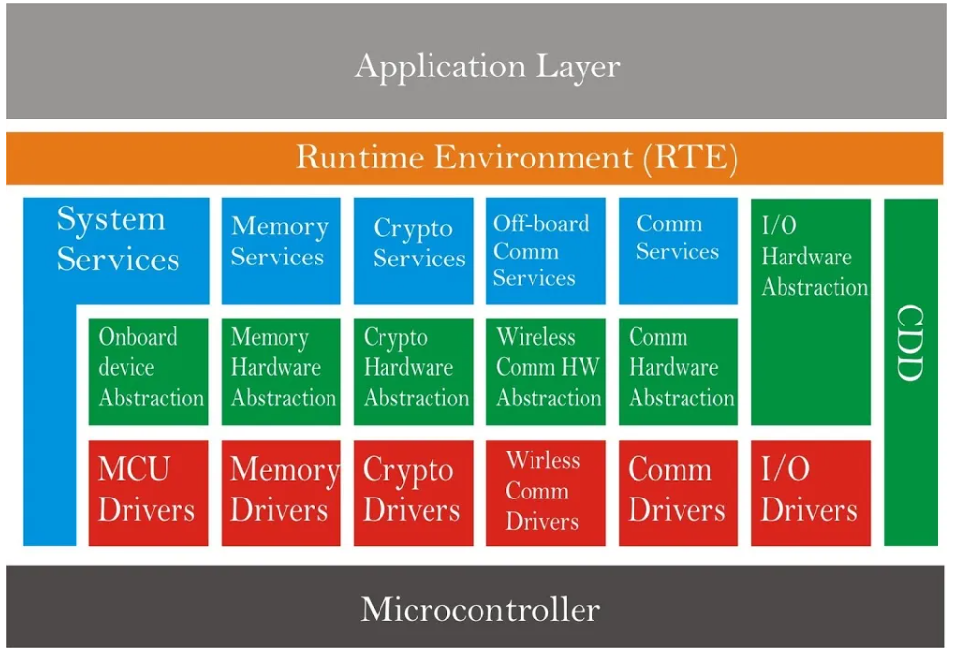

Slide 5

Goals
Scalability (to different platforms)
Transferability (of software)
Availability
Safety requirements
Sustainable use of natural resources
maintainability

Slide 6
Software Architecture (3 Layers)
Microcontroller (Basic Software)
Runtime environment (RTE)
Application layer
- Can have multiple software components (SWC)
- Application code
- App layer uses this layer while communicating with other layers below using ports.
- Provides communication between SWCs and between ECUs
- Is the layer on which the AUTOSAR would work
Microcontroller Abstraction Layer (MCAL)
Electronic Control Unit (ECU) Abstraction Layer
Services Layer
Complex Device Drivers

Slide 7
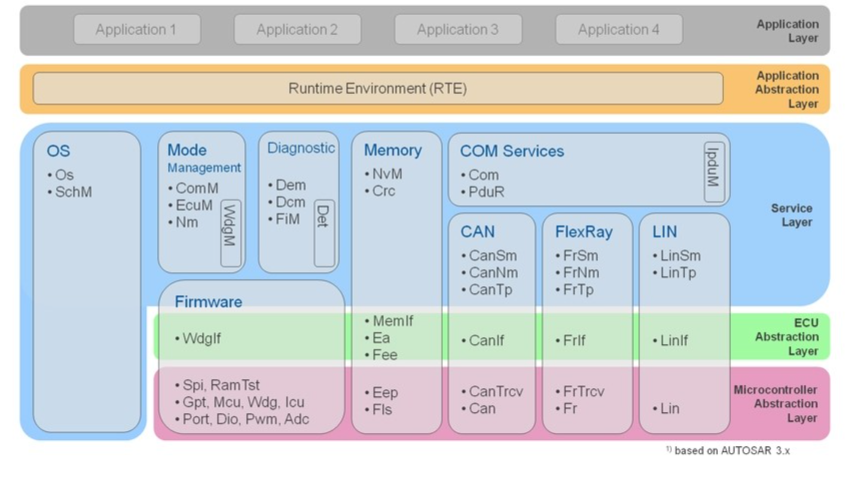
RTE
Memory stack
Communication stack
Diagnosis stack
OS
Crypto stack

Slide 8
Servies Layer :
Different services for app use
System, Memory, Crypto, Offboard com and Com Services
ECU Abstraction Layer
ECU related abstractions.
Hardware, on Board devie, Memory hardware, Crypto hardware Abstractions to make applications hardware independent
MCAL
Has drivers through which the above layers communicate with MC hardware peripherals

Slide 9
AUTOSAR RTE
Heart of Autosar ECU architecture
All Ports and Interfaces – way of allowing SWCs to communicate with one another or access BSW modules
Inter ECU communication realized by using undelying communication bus like CAN or FlexRay through COM stack
RTE maps the runnables to OS tasks
RTE handles :
Communication between SWCs
Scheduling of SWCs
RTE is separately generated for each ECU
There is a configuration phase – cannot be reconfigured to add more connections

Slide 10
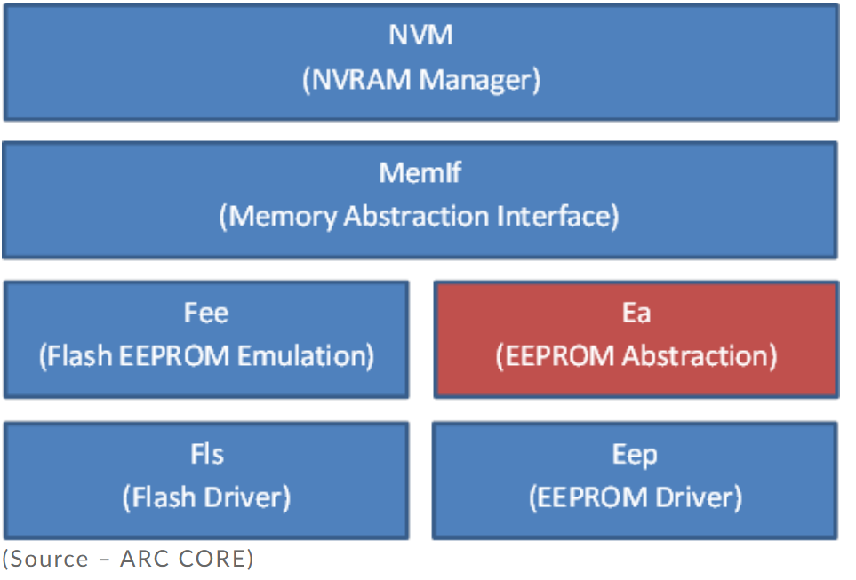
Memory stack
Basic memory management services to upper Application Layer and BSW modules
Access to memory cluster from the device functions
R/W data on Flash or EEPROM

Slide 11

Communication Stack
Facilitates vehicle network communication
Modules in 3 sublayers : Services, ECU Abstraction and MCAL
BUS drivers and Bus specific interface modules

Slide 12
Diagnosis stack
Any issue encountered on the automotive ECU is stored as Diagnostics Trouble Code (DTC) in EEPROM which can be retrieved using a diagnostic tool
DCM : read and write fault codes
DEM : store and process diagnostic errors
FIM : control mechanism for AUTOSAR BSW components

Slide 13

Operating system
Task management - schedules tasks
Manages system resources
RTOS – Real time operating system is often used in autosar applications to meet timing requirements

Slide 14

Crypto Stack
Cryptographic algorithms for secure on-board communication
Handles secure key generation, distribution, revocation
Crypto interfaces

Slide 15

Complex device driver
Software component used to model a function outside normal BSW, for complex or resource critical sensor evaluation or actuator control
Ex : for project specific ASIC
Can access directly the MC

