Slide 1
Automotive Communication Protocols
LIN, CAN, Automotive Ethernet
SPI, I2C and UART

Slide 2
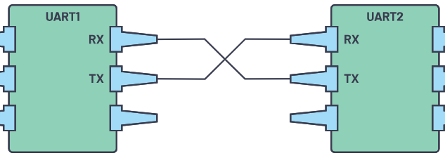
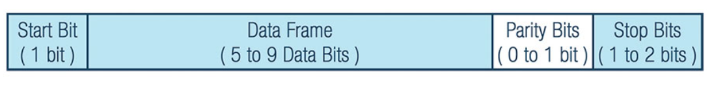
UART – Universal Asynchronous Receiver-Transmitter
Hardware communication protocol
Serial communication with two wires
Most used especially in embedded systems, MCs and computers
Dedicated pins RX – TX
Maximum 1 master and slave
Length of msg: 1 + 9 + 1+ 3 = 14 bits

Slide 3
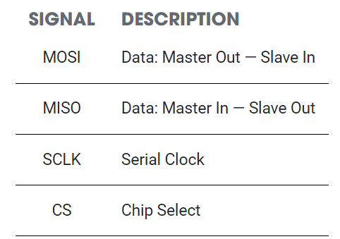
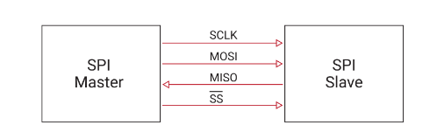
SPI - Serial Peripheral Interface
Synchronous
One of the fastest, the downside is that it has 4 wires
Is advantageous when we have 1 master to multiple slaves communication ( but not a rule )
High data transfer rates – exceeding bandwidth of 10 MHz
Length 3 to 16 bits

Slide 4
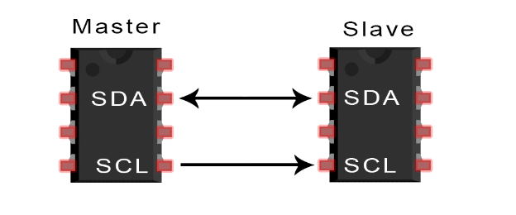
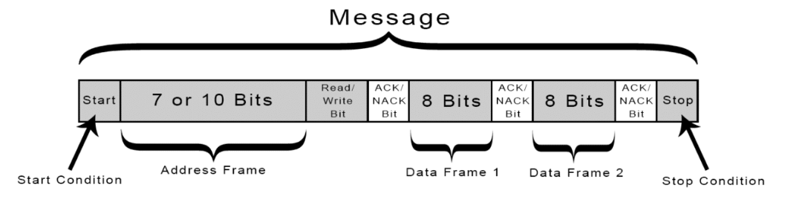
I²C : Inter-Integrated Circuit
Combines best features of SPI and UARTs
Connect multiple slaves to 1 master ( like SPI )
Synchronous
Multiple masters controlling one or more salves
Only 2 wires ( like UART )
SDA(Serial Data) : send data between master and slave
SCL(Serial Clock) : clock signal
100kbps
30 bits length
Project

Slide 5
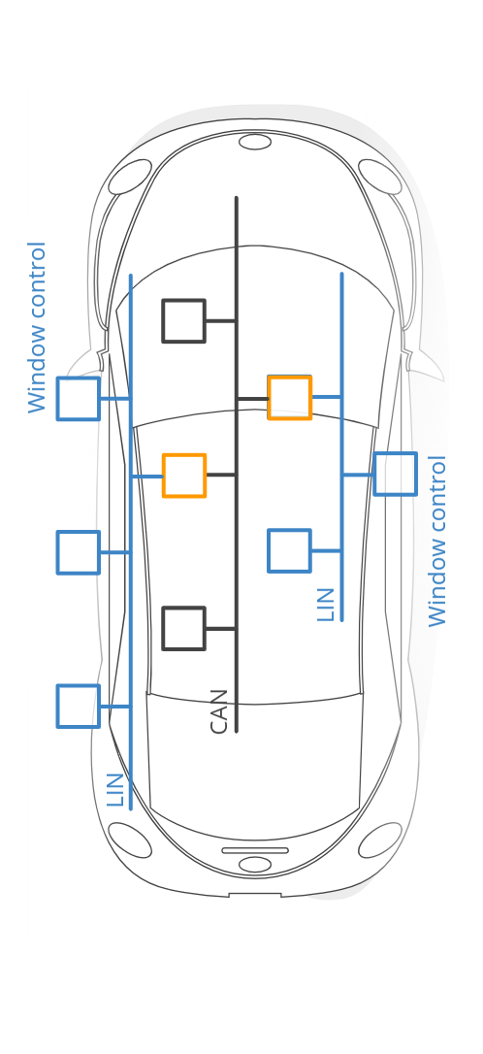
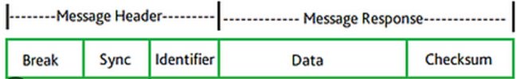
LIN – Local Interconnect Network
Single wire - serial network protocol (up to 19 kbps -> 40 meters) in
distributed automotive applications
Cheaper, lower performance and reliability than CAN, but used together. LIN complements CAN
1 master, up to 15 slaves ( 16 nodes)
Collision detection necessary – all comms initiated by master
[break, 13+1][sync, 8][ident, 6+2][data, 8bytes][checksum, 8bit] = aprox 100 bits

Slide 6
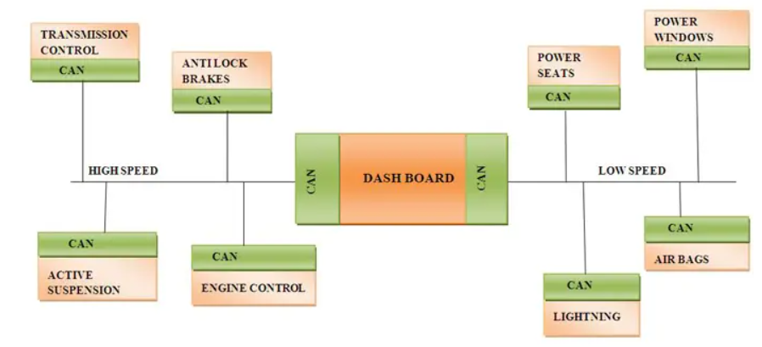
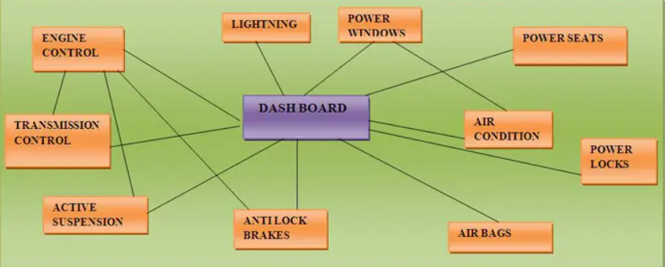

Slide 7
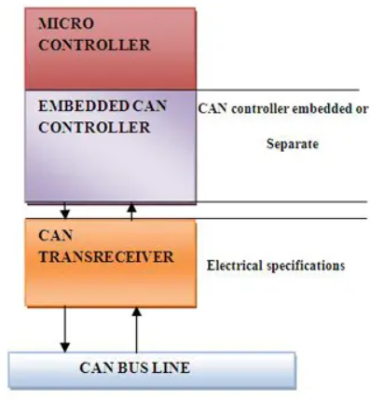

CAN – Controller Area Network
2 wire (twisted-pair) bidirectional serial bus -> allows electronic subsystems to be linked and interact in a network
Designed such that real time information can be exchanged ( transmission, ignition )
Reduced complexity
Symmetric
Massage based rather than address based usually
CSMA/CD
Bit stuffing
Identifier length : 11 to 29 bits
8 bytes of data
1+11+1+6+64+15+1+1+1+7+3 = 111 bits

Slide 8
More CAN
Differential signaling = two complementary signals Low and High wires
Each message or frame uses digital identifier that provides a message priority arbitration
Exchange rate 1Mbps ( up to 500kbps ) - not sufficient for active safety in modern vehicles
8 bytes of data per single CAN bus message

Slide 9

CAN-FD ( Flexible Data-Rate )
Broadcast sensor data
64bytes of DATA
Dynamically switch between data rates
Commands reach the output controller much faster

Slide 10
FelxRay
Successor of CAN
Higher data rates and bigger size
Diff signaling
Time triggered communications – eliminate prioritizing messages
High data rates : 10Mbps
Payload len : 256 bytes
Malfunction on one ECU doesn't impact the rest – they still communicate
High cost compared to CAN

Slide 11
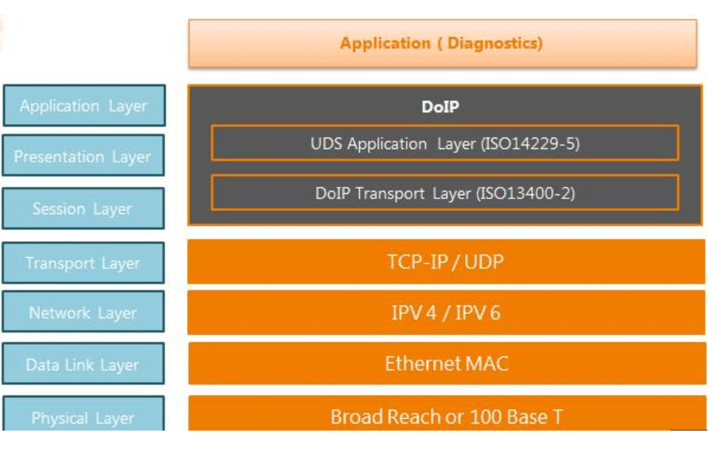
Automotive Ethernet
Physical layer adapted for automotive use cases
More complex communication -> increased software functionality in cars ( e.g : Autonomous driving ) -> scalability
High bandwidth + higher flexibility -> integration with cloud services
Alternatives to FlexRay and high baud rate versions of CAN
10Base-T1 / 100Base-T1 / 1000Base-T1S -> Mbps
CSMA/CD

