Slide 1
Embedded C
Microcontroller : I/O pins, ADC, PWM, Memories
Macro + Pragma
Compilation
Makefile, typedef, header files, typecasting,
Boot, interrupts, Interrupts handler
MISRA C

Slide 2
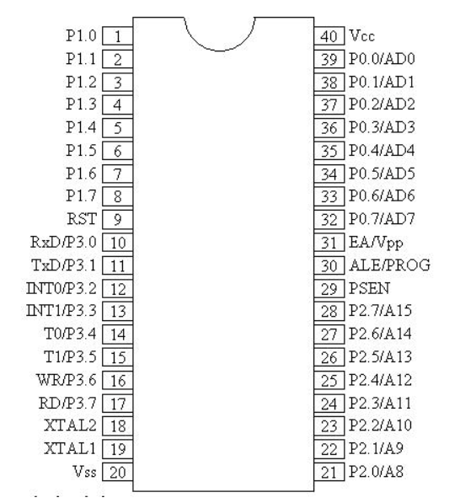
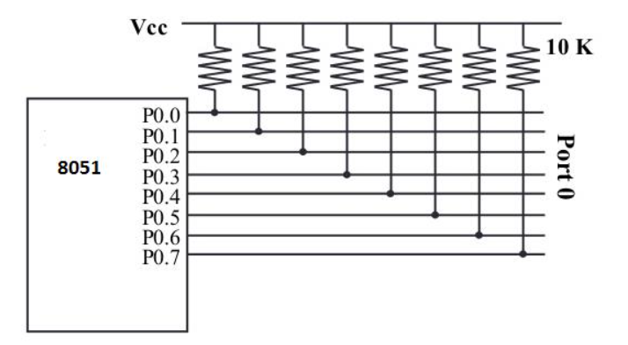
Microcontroller I/O pins
Communication with sensors / actuators / others
This representation has 40 pins
I/O reserves 32 pins – GPIO?
8pins / port ( P0->3)
Other 8 : Vcc, GND, XTAL1, .., RST
On RST -> all become input pins
Write 0 to port -> output port
P0 connect to 10K-ohm pull-up resistors – open drain, unlike other ports (they have internal R) and can work as well for both addressing and data

Slide 3

ADC – Analog to Digital Convertor
Necessary for interfacing with analog sensors ( voltage, temp )
Most microcontrollers have a built in ADC

Slide 4
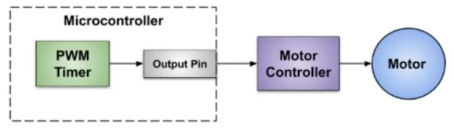
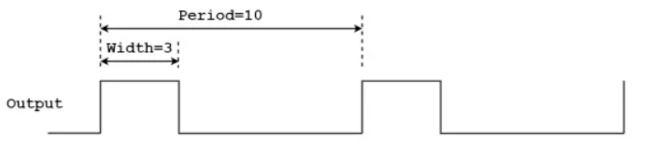

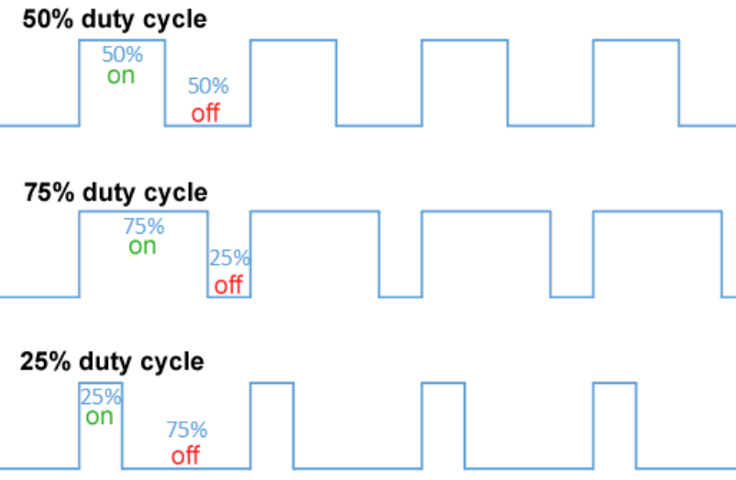
PWM – Pulse Width Modulation
It is a Timer in Microcontrollers
Used to generate analog signal for controlling actuators or LEDs that need varied amounts of power
Duty Cycle ( on active high )
Describes the proportion of 'on' time to the regular interval or 'period' of time
A low duty cycle corresponds to low power, because the power is off for most of the time

Slide 5
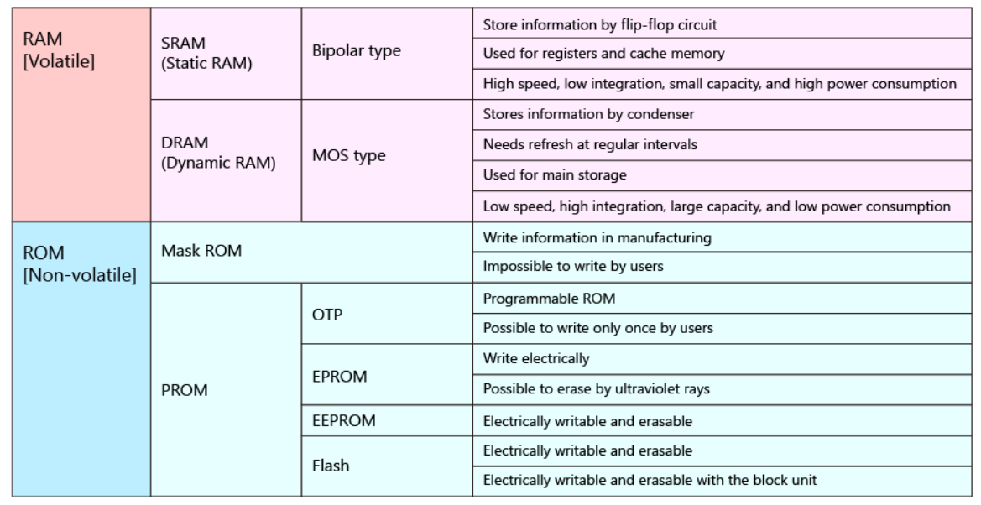
Memories

Slide 6
Embedded C
Normal C but what is different, is what it runs on. There-fore some libraries and functionalities will not work / are different. The architecture on which the application run on is different than for example the x86 from our computers. It is usually the ARM
These devices have limited resources as well, so it is important to keep that in mind while writing code.
Here are some examples of things to consider while programming on other architecture
const char *x = “…a thousand byte-long string constant” ;
…and you’ll be fine because the string constant is in flash memory where there is space for it. But you can’t say:
char x [ 1000 ] = “…a thousand byte-long string constant” ;
…because now that ‘x’ is a variable - it has to go into RAM - and there isn’t enough space for it

Slide 7
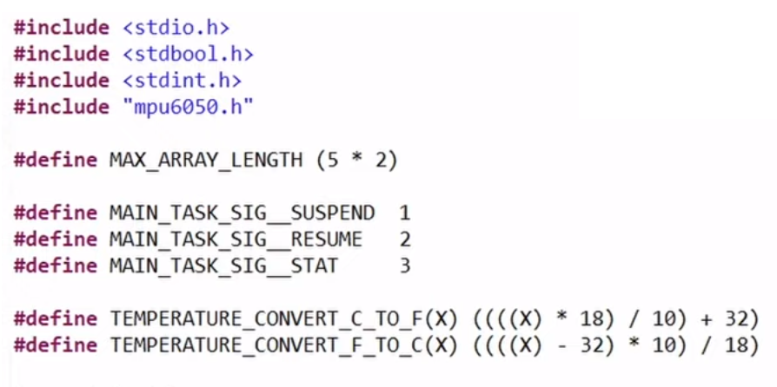
Macros

Slide 8
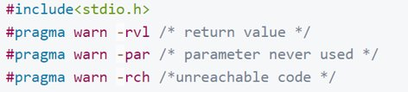
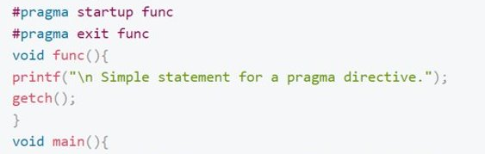
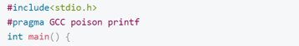
Pragma (pragmatic information)

Slide 9
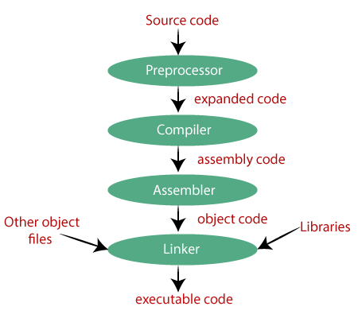
Compilation
Preprocessor: Where #include files will be resolved, as well as Macros | .c file => .i files
Parsing: parse .i files to check syntax -> if any error it's reported at this stage
Code generator : high level language converted to lower level (Assembly) | .i file => .s file
Assembler: converts mnemonics(abbreviations of commands) to machine code | .s file => .o file
Relocatable object ( .o ) - generated for every .c file
Linker: Multiple object files -> final executable
(Tool chain)

Slide 10
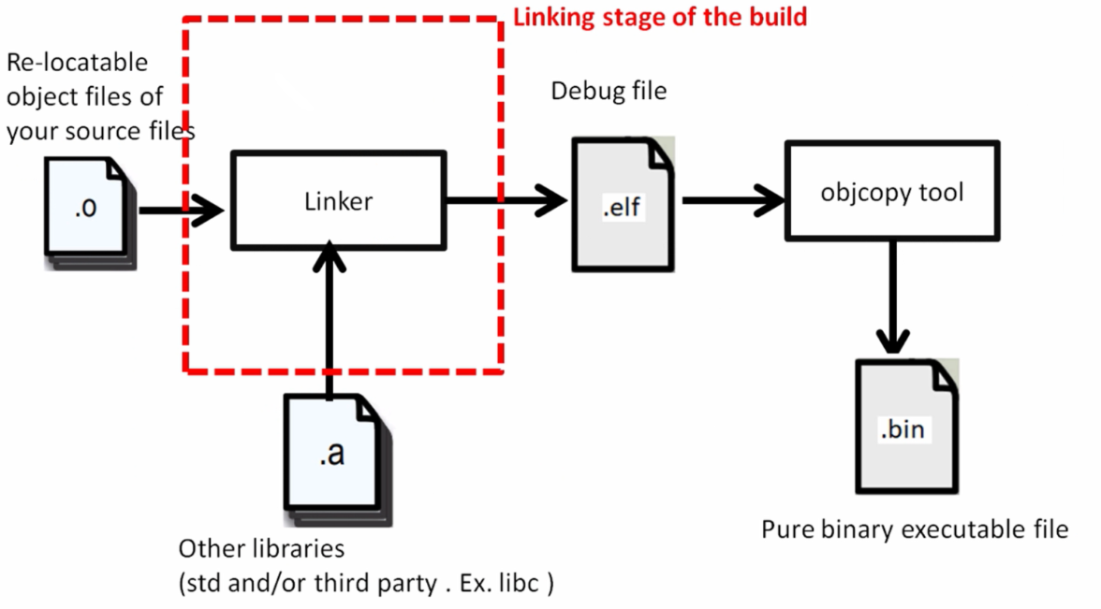



Slide 11

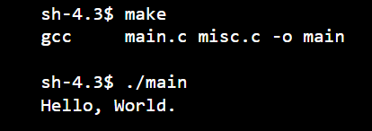
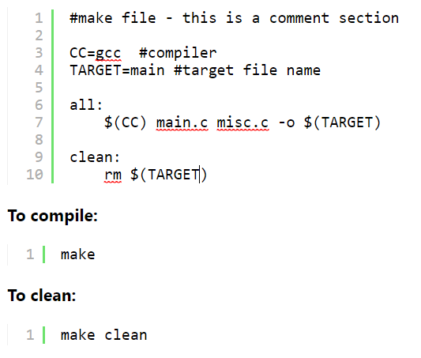
Makefile
Examples:
Automates software building procedure
Organize code for compilation
Contains:
Dependency
Rules
Macros
Suffix(or implicit) rules
Variables

Slide 12
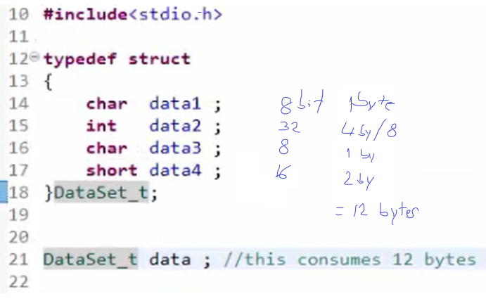
Typedef
Renames data types
The new type is named with _t at the end, for better visibility

Slide 13
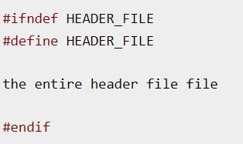
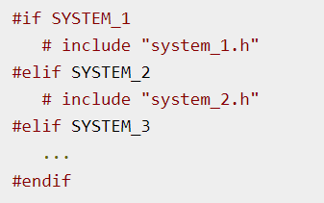
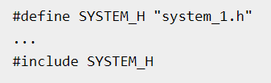
Header files
#include – preprocessing directive ( like pragma )
<file> -> searches system header files
"file" -> header files for own program. Searches in directory in which the current file is at
Or use –l option while compilation for both
Direct the C preprocessor to scan specified file ( like adding in the file where include is, the code from the header )
Once-Only Headers/wrapper
Computed includes
If the header is included again, conditional will be false, because HEADER_FILE is defined. -> preprocessor will skip over the contents so the compiler will not see it twice.
Select one of several headers ( for example config for different OSes)

Slide 14
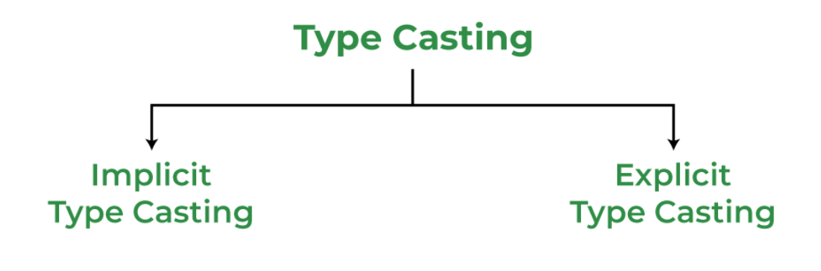

Slide 15
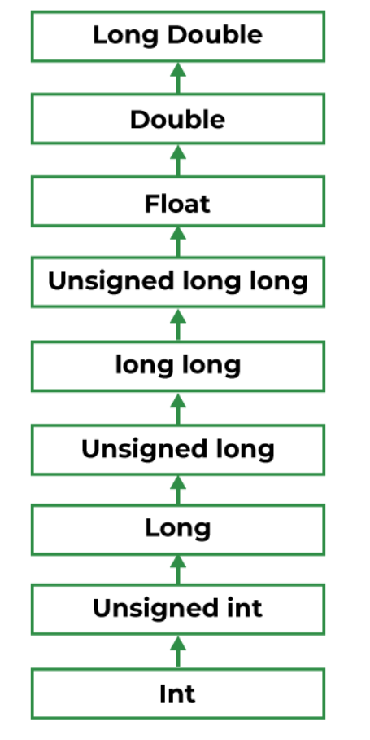
Implicit Type Casting
Without altering the value
Lower datatype to higher occurs automatically
Conversion would occur as in the hierarchy here if both have varied data types:

Slide 16
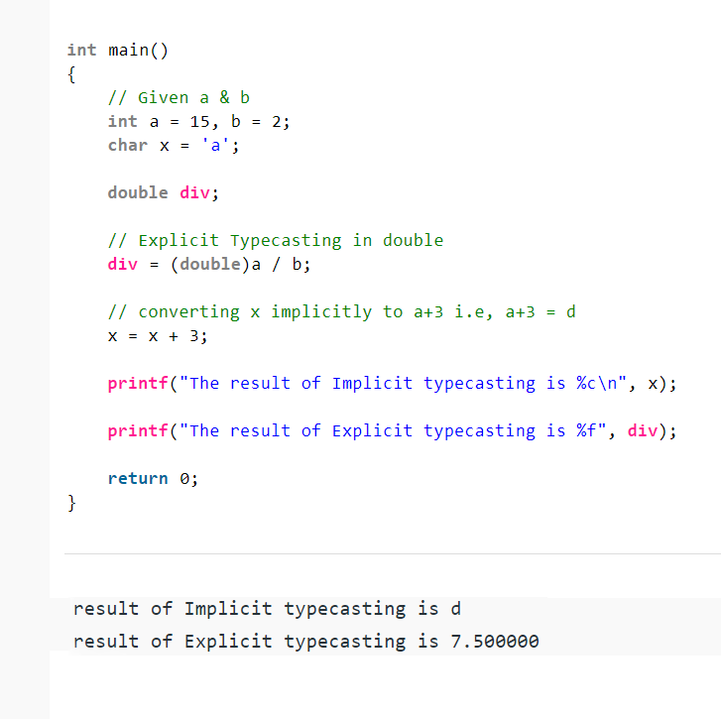
Explicit Type Casting
Forced conversion between datatypes
Explicitly defined within program
Built-in conversion functions:
atof(): This function is used for converting the string data type into a float data type.
atbol(): This function is used for converting the string data type into a long data type.
Itoa(): This function is used to convert the long data type into the string data type.
itoba(): This function is used to convert an int data type into a string data type.
atoi(): This data type is used to convert the string data type into an int data type.

Slide 17
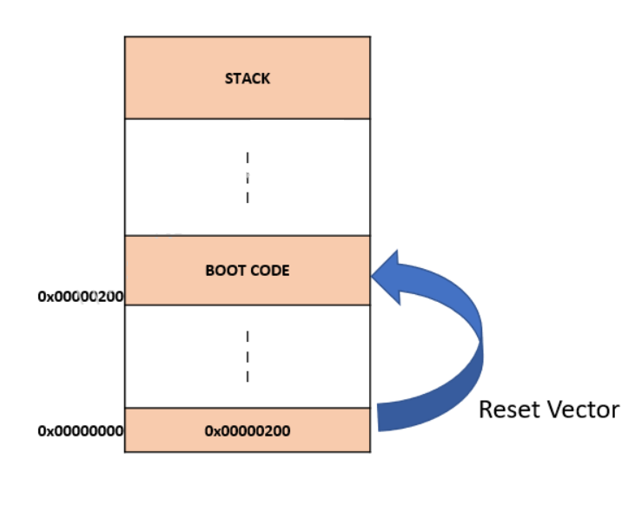
MIcrocontroller Boot Process
The startup is one of the most important process – ensures initial power, voltage sequencing, regulation, oscillator, boot loader etc.
During start up, the MC starts using the reset vector for the location of the bootloader in Flash memory
Boot code is a set of low level init functions which prepare the MC for operation before main app code is executed
Tasks :
Copy initialized variables from ROM to RAM,
set all bytes from Bss segment to 0
Set up stack pointer of processor
Setting up Heap
Call main function

Slide 18
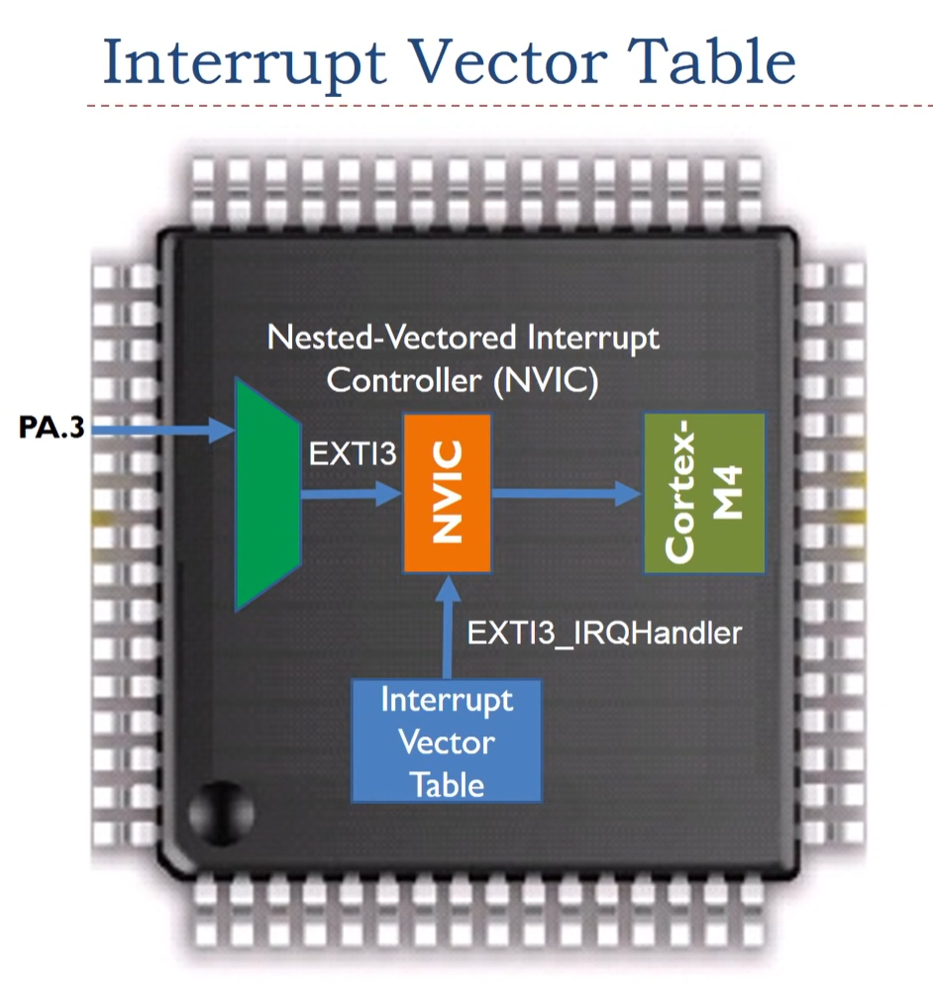
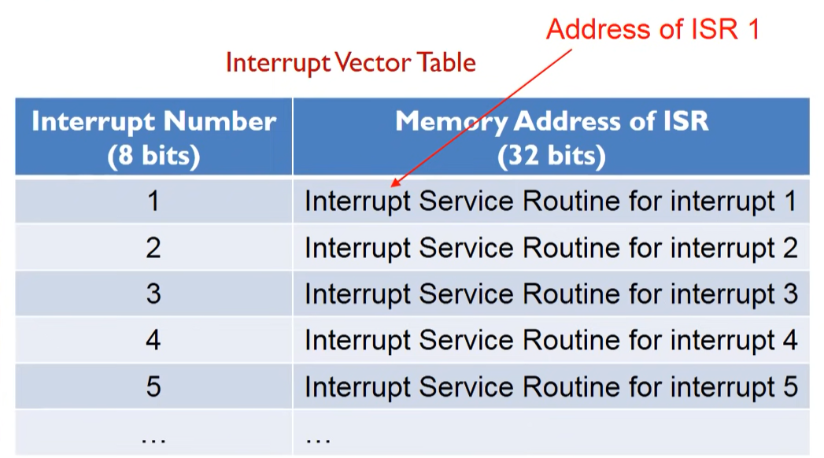
Interrupts
A clever alternative to polling
Events that alter the sequence of the processor instructions.
Dedicated hardware that checks the interrupt request signal, altering the sequence in which the processor executes instructions.

Slide 19
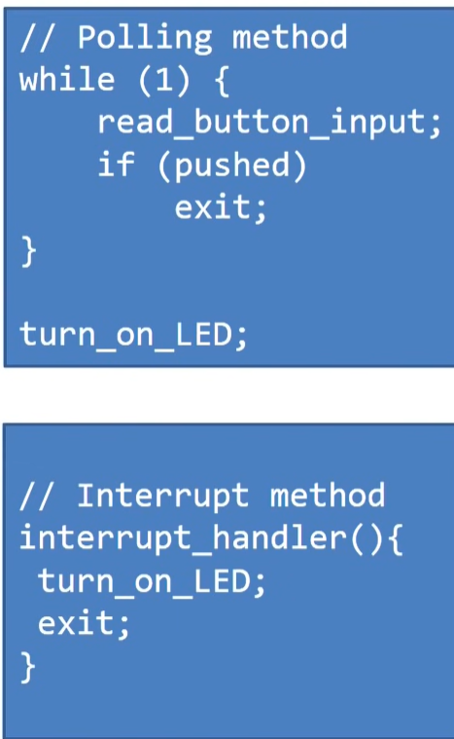
Interrupt handler / ISR
Block of code associated with a specific interrupt condition
Initiated by hardware/software interrupts or exceptions
Example : keyboard, mouse etc.
After the ISR finishes execution, the process is continued from where it left off

Slide 20
MISRA – C (The Motor Industry Software Reliability Association)
Set of development guidelines (127 / 1998 up to 200 /2012)
ISO 26262 and AUTOSAR approve MISRA C
Aims:
SAFETY
SECURITY
PORTABILITY
RELIABILITY
Classification:
Mandatory
Required
Advisory
Deviations must be documented in a file in order to be considered compliant – required and lower class
IS PAID?

Slide 21
Rules in different categories
Avoid possible compiler differences ( int for example -> int16_t will always be 16 bits )
Avoid using functions and constructs prone to failure = malloc
Produce maintainable and debuggable code
Best practices rules
Complexity limits

